Slide 1
EOSC EGI position and policy papers, EGI service portfolio
Sergio Andreozzi
Strategy and Policy Manager

Slide 2
Outline
Introduction
Description
Target groups
Analysis of result’s impact
Innovation level and capacity
Relevance of the key result
Exploitability level

Slide 3
EGI-Engage: Key Exploitable Results
Integrated Management System and Certification
Updated strategy, governance and procurement
Improved EGI Service portfolio
Policy papers on the EOSC
Improved EGI Service portfolio
Tools for federated service management
Security policies
Marketplace
Check-in
Federated Cloud Computing
Open Data
Platform
Integrated thematic services
Applications on Demand

Slide 4
EGI Position and Policy Papers: European Open Science Cloud for Research
OPEN
INTEROPERABLE
PUBLICLY FUNDED & GOVERNED
SOCIAL
RESEARCH-CENTRIC
SERVICE-ORIENTED
COMPREHENSIVE
DIVERSE & DISTRIBUTED
https://doi.org/10.5281/zenodo.32915 (Oct 2015)
Notes:
Bottom-up initiative
Just few months after the first announcement on the upcoming policy on the ECI/EOSC (see EC Communications on the “A Digital Single Market Strategy for Europe”), 5 key initiatives in the area of digital services for science came together to discuss the building principles for the EOSC:
Open: openness in design, in participation and in use
Publicly funded & governed: to guarantee persistence and sustainability, and ensure that outcomes are driven by scientific excellence and societal needs rather than profit
Research-centric: researchers engaged in the design
Comprehensive: all disciplines
Diverse & distributed: diversity of services & resources,
Interoperable
Service-oriented
Social

Slide 5
EGI Position and Policy Papers: European Open Science Cloud for Research
Dissemination activities
Press release:
The European Open Science Cloud for Research, October 2015, reprinted at CORDIS
Selected presentations at events:
Community Workshop on the Open Science Cloud: Shaping the Open Science Cloud of the Future, Bari (13 Nov 2015)
e-IRG workshop, Amsterdam (March 2016)
Demystifying science: Getting science out of the lab and into society, Brussels (June 2016)
RI sustainability workshop at EC, Brussels (November 2016)
e-Infrastructure Proposers' day, Amsterdam (January 2017)
EOSC Summit, Brussels (June 2017)

Slide 6
EGI Position and Policy Papers: Report on the governance and financial schemes for the European Open Science Cloud
Open Science Policy Platform
EC High-Level Advisory Group
Established in Sep 2016
Working group on EOSC
Activity period: Jan 2017 – May 2017
Report adopted in May 2017 and presented at the Competitiveness Council
Authors:
Sergio Andreozzi (Chair)
Kristiina Hormia-Poutanen (Co-chair)
John Wood
Paul Ayris
Steve Cotter
Natalia Manola
Eva Méndez
Karel Luyben
Christophe Rossel
Michela Vignoli

Slide 7
EGI Position and Policy Papers: Report on the governance and financial schemes for the European Open Science Cloud
Governance structure and principles
to identify the distribution of rights and responsibilities among the different entities in the EOSC ecosystem and rules for making decisions
Financial schemes
to shape the best financial mechanisms that can enable the EOSC ecosystem to flourish and deliver value in an efficient way
Others (3)
Governance (2)
Financial schemes (3)
https://ec.europa.eu/research/openscience/pdf/ospp_euro_open_science_cloud_report-.pdf
Notes:
Top-down initiative
First paper on high-level recommendations for governance structure/principles and financial schemes

Slide 8
Dissemination activities
OSPP EOSC paper on governance and financial scheme
Opinion article in the EGI newsletter:
Sergio Andreozzi joins the EC’s Open Science Policy Platform
(Nov 2016)
News:
New reports on European Open Science Cloud
and Open Access Publishing (July 2017)
Selected presentations:
Draft recommendations on EOSC governance
and financial schemes, 3rd Meeting of OSPP (March 2016)
Governance and financial schemes for the EOSC,
e-IRG workshop in Malta (June 2016)
EOSC Summit, Brussels (June 2017)
Social Media:
New reports on the European Open Science Cloud and
Open Access Publishing are available

Slide 9
Target groups, Innovation level and capacity
Target groups
Policymakers
Funding agencies
EOSC implementers (e.g. EOSCpilot project, HLEG on EOSC)
Innovation level
Benefits: provides expert advices on principles and recommendations to implement the EOSC
Who used it:
EC adopted the inputs to define the new EC Communications on ECI and future roadmap
EOSC implementers such as EOSCpilot project and HLEG on EOSC
Innovation Capacity
Support the policymakers (the EC in particular) in generating new policies and implementation roadmaps
Exploitation: the use of results in
Developing new policies and implementation roadmaps for the EOSC

Slide 10
EGI-Engage: Key Exploitable Results
Integrated Management System and Certification
Updated strategy, governance and procurement
Policy papers on the EOSC
Improved EGI Service portfolio
Tools for federated service management
Security policies
Marketplace
Check-in
Federated Cloud Computing
Open Data
Platform
Integrated thematic services
Applications on Demand

Slide 11
EGI Service Portfolio What it is
Structured information about all services from the EGI Federation
Captured from the customer/user viewpoint
To help them understanding functionalities, value, payment, models, contact points, ordering and request processes, etc.

Slide 12
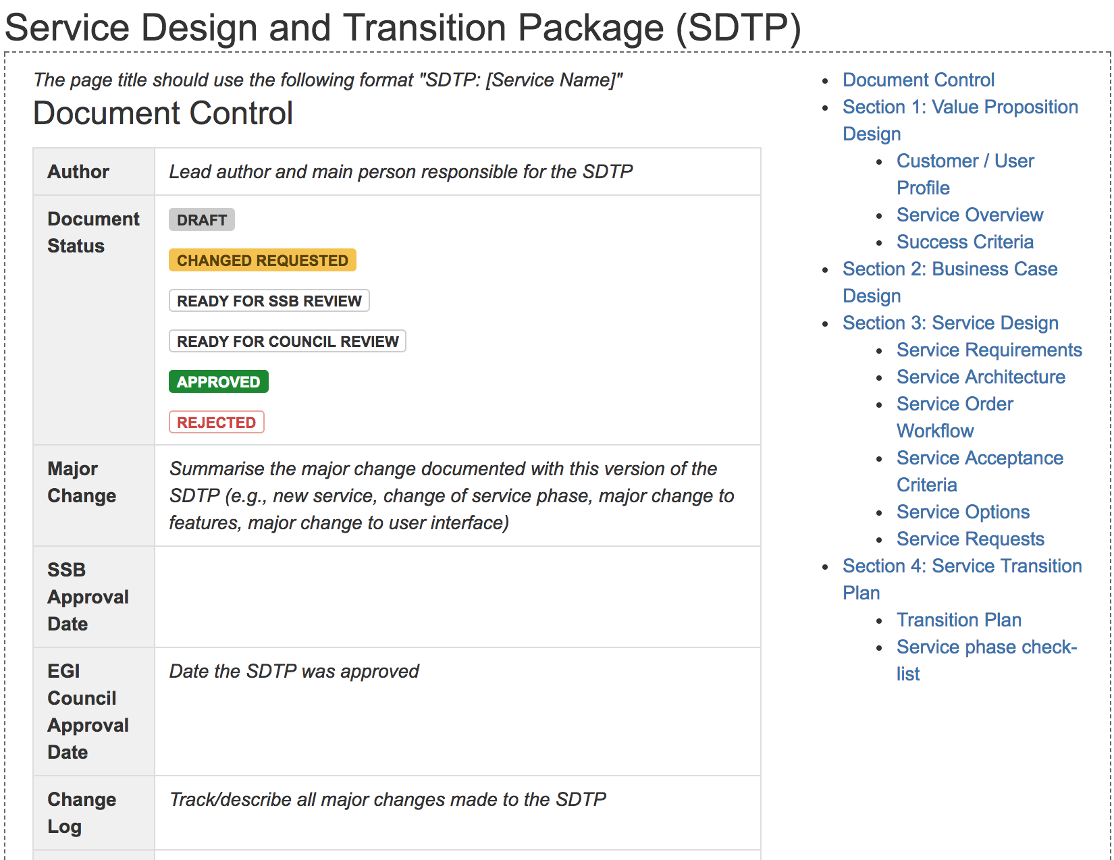
EGI Service Portfolio Templates

Slide 13
EGI Service Portfolio Process
EGI Council
EGI website
EGI marketplace
Service catalogue
requirements
Service catalogue
SPM
SLM
EGI service catalogue brochure
Other external representations
e.g. eInfraCentral Portal
Service portfolio
simplified view

Slide 14
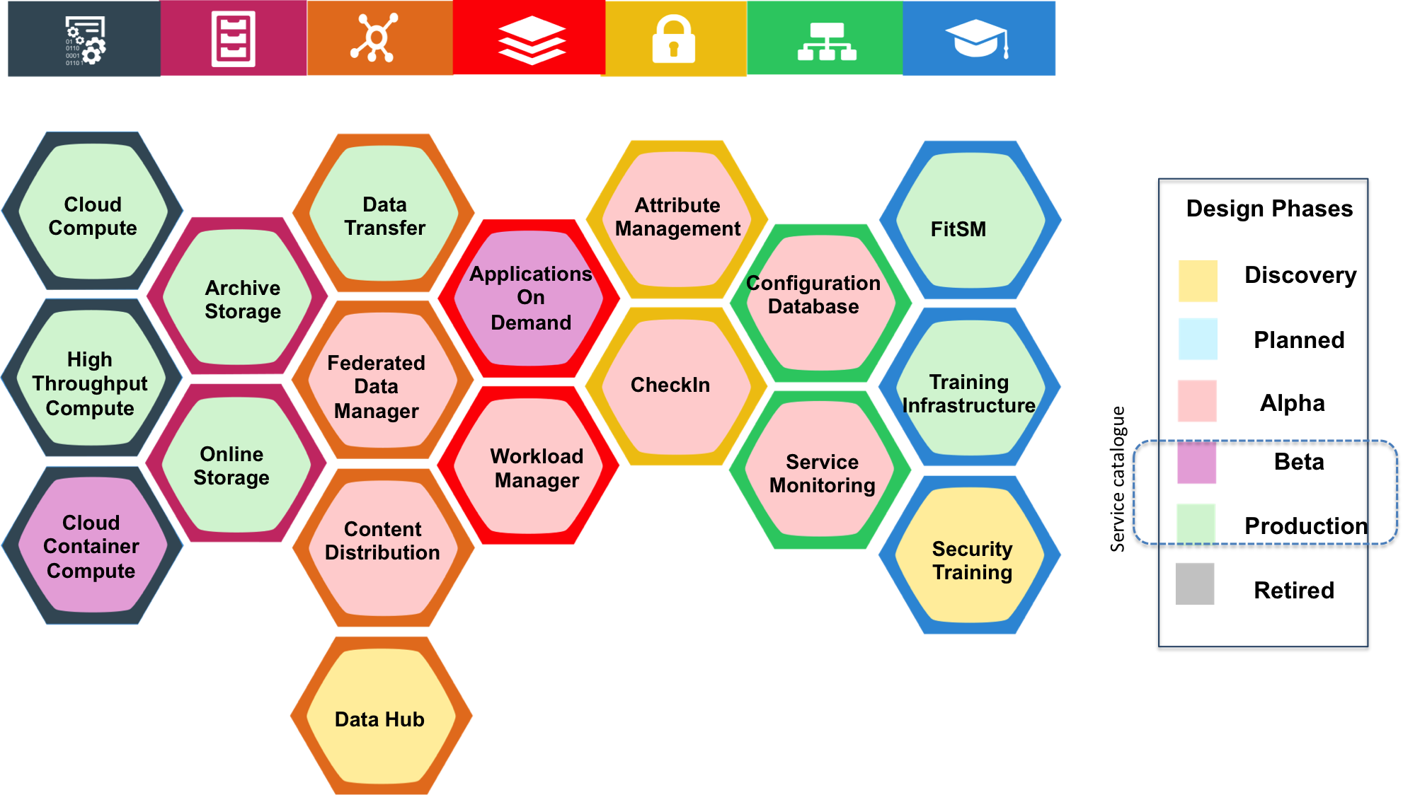
EGI Service Portfolio
The list of services that EGI as a federation offers for research & innovation
TO BE REPLACED

Slide 15
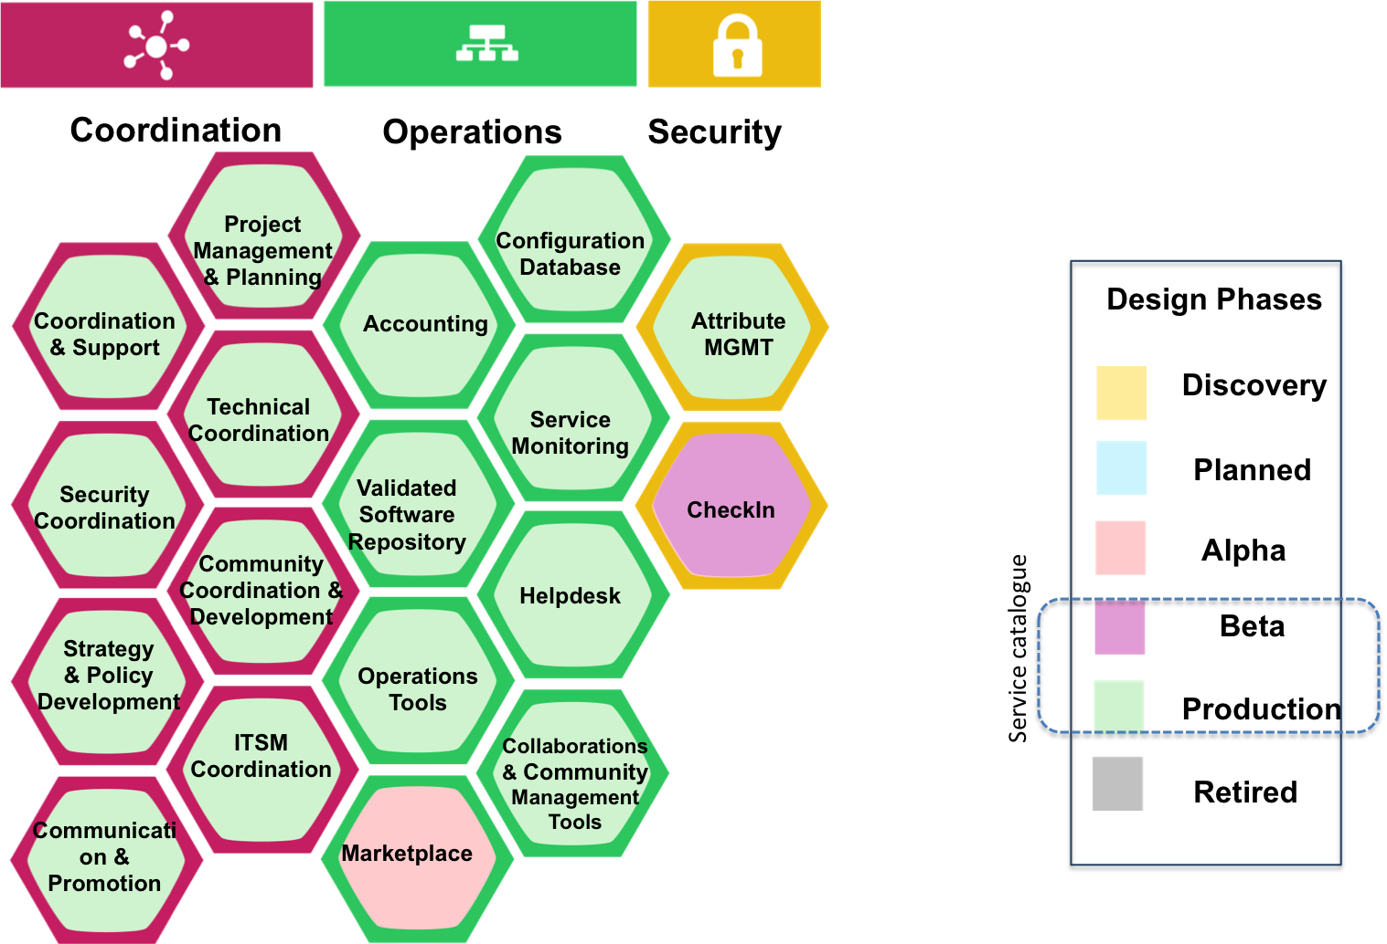
EGI Internal Service Portfolio
The list of services delivered internally to the EGI federation to enable the EGI resource providers to work together
TO BE REPLACED

Slide 16
Major changes to the service portfolio approved during EGI-Engage
Discovery
Beta
Planned
Alpha
Production
Retired
Application on Demand
DataHub
Federated Data Manager
Workload Manager
Check-in
external
internal
Check-in (int)
Marketplace

Slide 17
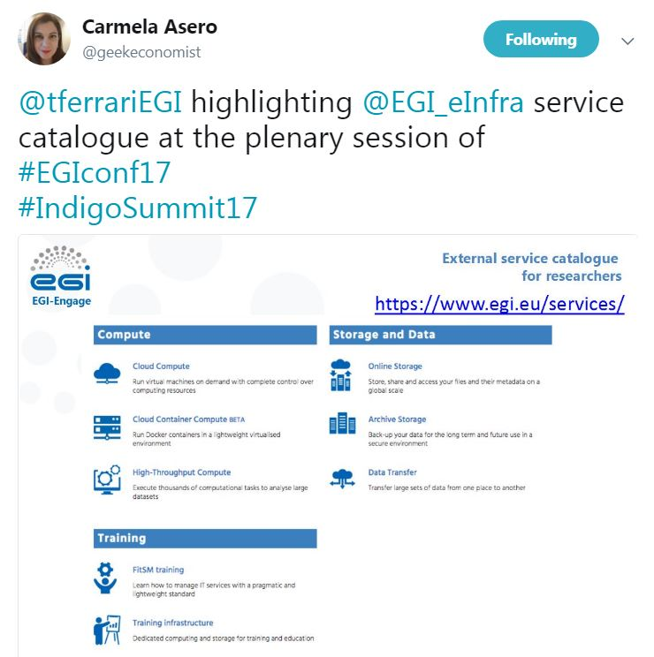
Dissemination activities
Improved Service Portfolio
EGI Website:
Dedicated areas: External catalogue and Internal catalogue
The services have two calls for action:
"Request the service“ and "Ask a question“
(contact forms that are forwarded to the UCST)
Selected presentations and contribution to panel discussions:
BDVA Summit 2016, meeting for policy makers (Valencia, November 2016)
Europe’s future: Open Innovation, Open Science, Open to the World
organised by the EC and the RISE high-level group
EGI service presentations: two “Design your e-Infrastructure Workshops”
Newsletter:
EGI Services for Open Science
(May 2017)
News item:
EGI computing services catalogue
for research and innovation

Slide 18
Target groups, Innovation level and capacity
Target groups
Customers/users, funding agencies, service providers
Innovation level
Benefits: clarity of offering, simplify management, improve communication
Who is using: EGI federation, eInfraCentral
Innovation Capacity
Reuse of best practices (template, process)
Reuse of service definitions
Exploitation
Marketing of EGI services
Internal processes to manage services
Reuse in future projects such as the EOSC-hub

Slide 19
Relevance of the key result
Relevance to Work Programme and societal Challenges
Scientific communities embrace storage and computing infrastructures as state-of-the-art services become available and the learning curve for their use becomes less steep
A well-defined service offering simplifies the understanding of the value proposition for the customers/users and encourage adoption
Relevance of Result for Policy domain of EOSC
Processes, templates and best practices support the creation of a joint service portfolio for the EOSC
The EGI service catalogue is already included in the eInfraCentral portal and in the EOSC-hub projcet proposal

