Slide 1
EGI and EGI-Engage PY2 Overview
Tiziana Ferrari
EGI-Engage Technical Coordinator

Slide 2
Outline
Introduction to EGI
Introduction to EGI-Engage
Answer to PY1 review recommendations
Key Exploitable Results and methodology

Slide 3
The needs of modern research
In research and society, ICT has become one key enabling factor for progress
Changing the modus operandi of research, new possibilities for geographically distributed collaboration and sharing
Data-driven science and more open access to data and scientific results transforming how science is made
All large-scale Research Infrastructures and the long tail of science depend on ICT resources
Need of collaboration to tackle generic ICT challenges
Effective and cost efficient services that can be of wide and general use

Slide 4
EGI: advanced computing for research
EGI delivers services to support scientists, multinational projects and research infrastructures
EGI is a federation of hundreds of data centres spread across 47 countries in Europe and worldwide
www.egi.eu
Notes:
EGI is a federation of over 300 computing and data centres spread across 50+ countries in Europe and worldwide
EGI delivers services to support scientists, multinational projects and research infrastructures from public and private sector.

Slide 5
EGI’s mission is to create and deliver
open solutions for science and research
by federating digital capabilities,
resources and expertise
between communities and
across national boundaries.
Notes:
EGI’s mission is to create and deliver open solutions for science and research by federating digital capabilities, resources and expertise between communities and
across national boundaries.

Slide 6
EGI Support to Science and Research
2000 peer reviewed scientific publications in 2015, 3000 in 2016
61,000 users (+30% in EGI-Engage)
Social Sciences
Medical and Health Sciences
Physical Sciences
Natural Sciences
https://www.egi.eu/use-cases/research-stories/

Slide 7
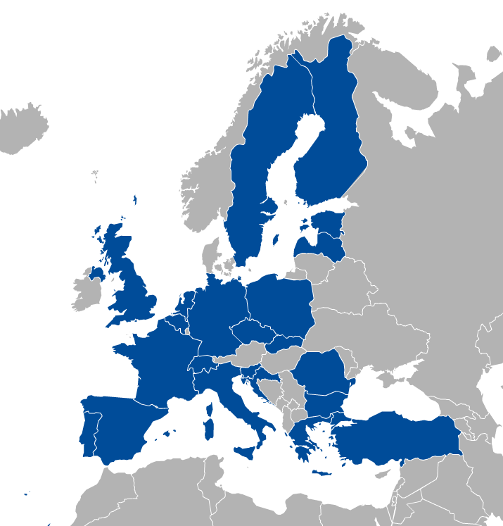
EGI Participants
Major National e-Infrastructures: 22 NGIs
EIRO: CERN
EGI Foundation
(ERICs)

Slide 8
A global system of e-Infrastructures
Africa-Arabia, Asia and Pacific region, Canada, China, Europe, India, USA
North and South America, Ukraine
China:
Institute of HEP,
Chinese Academy of Sciences
Europe (mainly)
Africa and Arabia:
Council for Scientific and
Industrial Research, South Africa
Latin America:
Universida de Federal do Rio de Janeiro
India:
Centre for Development of
Advanced Computing
Australia:
Nectar Research Cloud
USA
New in EGI-Engage
Canada

Slide 9
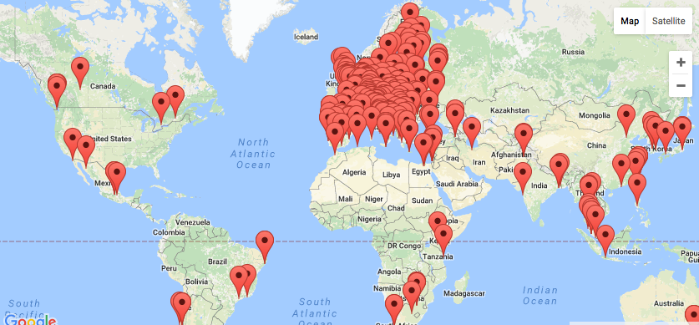
EGI Federation
260+ HTC providers
20 Cloud providers
730 k CPU cores
650 PB online and nearline storage
1.7 Million jobs/day
2.6 Billion CPU hours/year

Slide 10
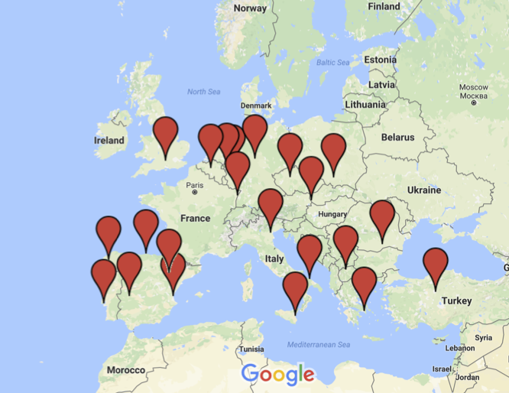
EGI Federated Cloud - Providers

Slide 11
Why a federation?
Leverage national e-Infrastructure investments
Open access to national infrastructures and services to support international user groups
Integrate private, community and public infrastructures into a scalable data/computing platform for research.
Ease of access via federated identity provisioning and single authentication and authorization framework
Interoperability of scientific applications and data across multiple providers bringing distributed computing to data.

Slide 12
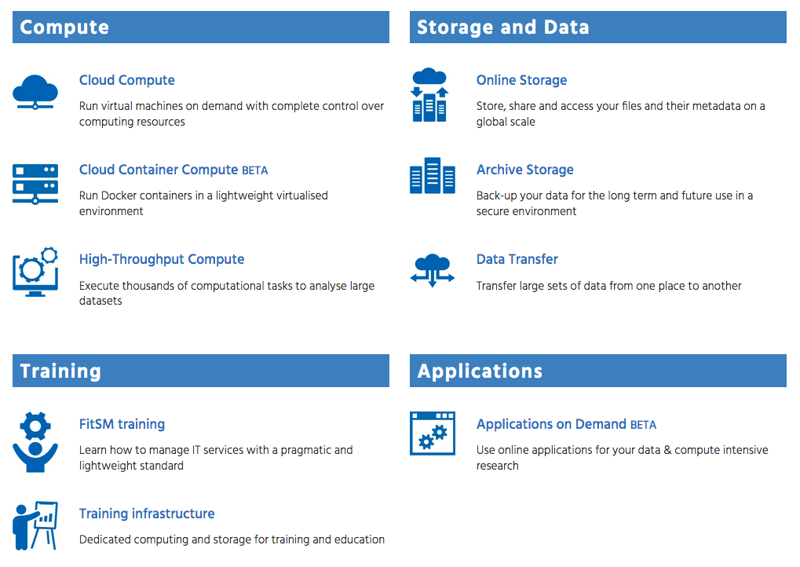
External service catalogue
New
https://www.egi.eu/services/

Slide 13
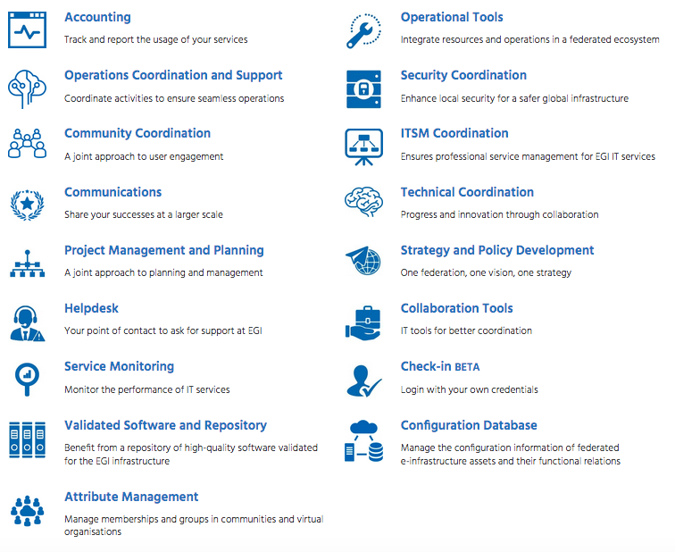
Internal service catalogue for providers of the EGI Federation
New
https://www.egi.eu/internal-services/

Slide 14
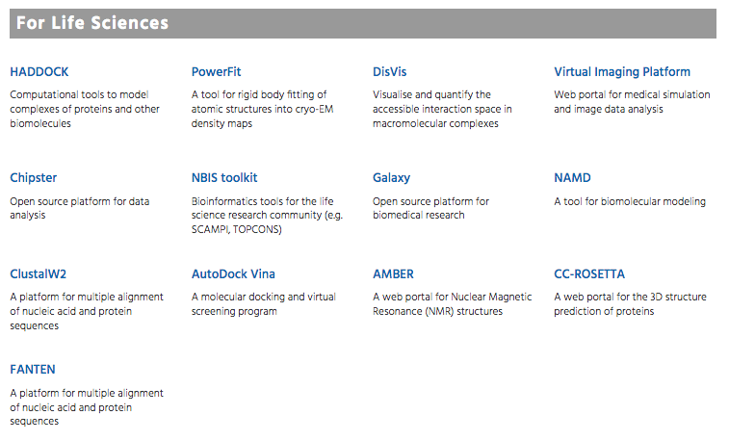
Scientific Applications and Tools from EGI Partners
Life Sciences
Arts and Humanities
Computer Science and Mathematics
Earth Sciences
Multi-disciplinary
https://www.egi.eu/use-cases/scientific-applications-tools/

Slide 15
EGI-Engage support to the service catalogues
Develop
Integrate, deliver and coordinate
SA2
Training Infrastructure
Community coordination
JRA1
Accounting
SA1
Operations Coordination and Support
NA2
Communications
Helpdesk
Service monitoring
Validated Software and Repository
Operational Tools
Security Coordination
NA1
Strategy and Policy
Configuration Database
Applications on demand
JRA2
Cloud Container Compute
GPU Compute
Online Storage
Service Portfolio Management
IT Service Management
Scientific applications/tools
Attribute Management
Cloud Compute
ITSM Coordination

Slide 16
Introduction EGI-Engage
A project built
on the Open Science Commons vision to advance its realization

Slide 17
Objective 1
Ensure the continued coordination of the EGI Community in
Strategy and policy development
Engagement
Technical user support and
Operations of the federated infrastructure in Europe and worldwide
EGI.eu
EIRO
ERIC
EGI
NGI
RP
RP
RP
EGI Federation
NGI
RP
RP
RP
RC
other
PP
TP
EGI Community

Slide 18
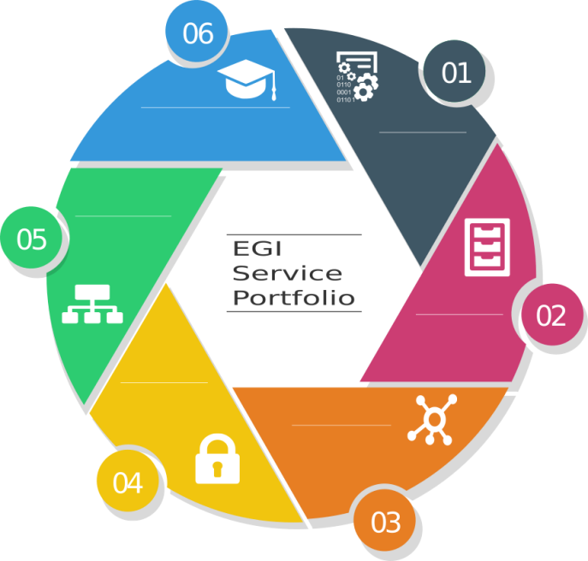
Objective 2
Evolve the EGI services
Capabilities
Business model
Access policies for different target groups
Provide services for
Large and medium size RIs,
Small distributed research projects and communities and single users
Higher education, industry/SMEs

Slide 19
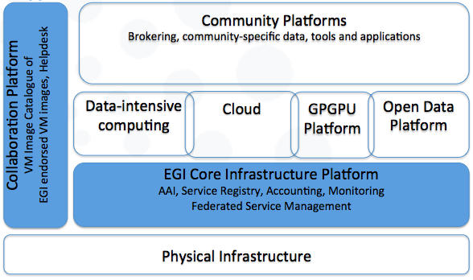
Objective 3
Digital services and applications
Knowledge & Expertise
Research Data
Instruments
Offer and expand an e-Infrastructure Commons solution
Develop existing and new federating services
Core infrastructure platform and Collaboration platform

Slide 20
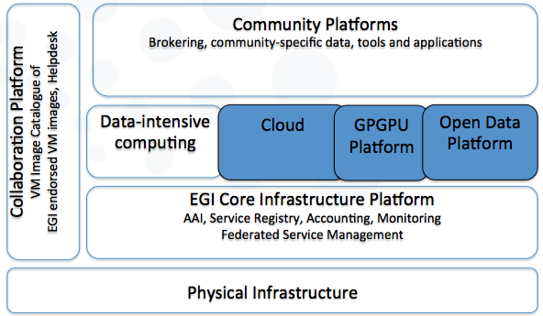
Objective 4
Digital services and applications
Knowledge & Expertise
Research Data
Instruments
Prototype an open data platform and contribute to the implementation of the European Big Data Value
Extend the capabilities of existing EGI platforms (cloud and HTC)
Develop new platforms
Open data platform
Accelerated computing platform

Slide 21
Objective 5 (1/2)
Promote the adoption of the current EGI services and extend them with new capabilities through user co-development
Requirement gathering, co-design, co-development and integration, training and technical user support
Provide new platforms compatible with the EGI Core Infrastructure Platform and drives its evolution → Applications on demand and thematic service
Co-design through a network of Competence Centres
Digital services and applications
Knowledge & Expertise
Research Data
Instruments

Slide 22
Objective 5 (2/2)
Distributed Competence Centre
BBMRI
ELIXIR
EPOS
MoBrain/ INSTRUCT
EISCAT-3D
DARIAH
LifeWatch
Environment (disaster mitigation)
EMSO (new)
ICOS (new)

Slide 23
Work Packages
NA2
Policy, Strategy and Communications
JRA2
Platforms for the Open Data Commons
SA2
Knowledge Commons
SA1
Operations
NA1
Project Management
JRA1
E-Infrastructure Commons

Slide 24
Answer to PY1 Recommendations

Slide 25
Maximize potential impact: New research communities are engaged
Long tail of science
Increased porting effort of applications for the long tail of science
Applications on Demand Service in EGI Service portfolio
Focused SME engagement plan
Remote Sensing Companies
Innovation Management
Projects Results Dissemination and Exploitation Plan
Key Exploitable Results
Food security, agro-climatic and economic modeling and food safety risk assessment
Marine fisheries
Revised KPIs
Communications plan to promote EGI service catelogues
Notes:
Agro-climatic & Economic modelling

Slide 26
Reinforced strategy development Address the unmet needs of diverse communities
Engagement Plan
Revised plan for engagement with Research Infrastructures and two additional competence centres
ESA
Research Collaborations or Tool/VRE providers
EGI Strategy 2020
Update of EGI Strategy
Definition of implementation actions
EOSC
Engagement with EOSC Science Demonstrators (EOSCpilot project)
Piloting of EGI services
Notes:
Agro-climatic & Economic modelling

Slide 27
Create a vision of the EGI Federation EGI Role in the EOSC
Open Science
Contribution to the Open Science Policy Platform (OSPP)
EOSC
Paper on EOSC Governance
Contribution of EOSC Stakeholders Forum
Input to EOSC Declaration
Definition of EGI contribution
EOSC vision implementation: EOSC-hub project proposal
Notes:
Agro-climatic & Economic modelling

Slide 28
Key Exploitable Results and Methdology

Slide 29
Identification of project results
Training on dissemination and exploitation
Regular interviews with WP personnel, Delierables
Definition of dissemination and exploitation plans
Selection of exploitable results

Slide 30
Identification of Key Exploitable Results
Analysis performed with WP leaders
Prioritisation and selection supported by a EC exploitation strategy seminar
Identification
Identify relevance for Project
Identify relevance for Policy domains as EOSC
Characterization
Aggregation of project results
Analysis of exploitation potential
Prioritization
Criteria:
Impact area
Exploitability
Impact level
Exploitation: the use of results in
Developing/creating/marketing product/services/processes
Internal use within the EGI federation or commercial
Further activities other than project
Standardisation

Slide 31
Identification of Project Results
Training WP/task leaders on dissemination and exploitation
Project results were collected periodically through:
Periodic reviews of project outcomes with Work-Package leaders
Analysis of plan for Dissemination and Exploitation of results requested in each deliverable of EGI-Engage
Selection of relevant results

Slide 32
Characterization: Registry of Project Results
Description of the result
Describes innovation compared to already existing products/services, and the unique selling point (competitive advantages)
Target audience
Who will use the results
Intellectual Property Rights status
Type of applicable IP protection
Exploitation strategy
Exploitation type (developing / creating /marketing products /services /processes, in standardisation activities, in other initiatives)
Dissemination strategy
Dissemination channels and set of actions that will be put in place to disseminate the output.
Actions to ensure that the results are exploited by the target groups for the intended use
The table of project results was periodically reviewed and updated each 3 months.

Slide 33
Prioritization
Analysis of impact area
Expected project project impacts
Classification of impact level based on:
Innovation potential (extent to which the result can bring benefit within three years after the end of the project)
Innovation capacity (extent to which the result can generate further innovation outside the project goals or to external parties within three years)
Classification of exploitability level, defined as the use of results in:
Developing/creating/marketing product/services/processes
Internal use within the EGI federation or for external use and commercial use
Relevance to the European Open Science Cloud EC initiative
Impact on science, economic growth and societal challenges
Notes:
Impact I1: Increased availability of scientific data for scientific communities independently of them having already embraced or not e-science; this will be measured by cross-border data traffic over the research networks in Europe as a proxy.
Impact I2: Better optimisation of the use of IT equipment for research.
Impact I3: Avoiding lock-in to particular hardware or software platforms in the development of science.
Impact I4: Scientific communities embrace storage and computing infrastructures as state-of-the-art services become available and the learning curve for their use becomes less steep; this will be measured by the storage capacity available for pan-European use as well as by the number of users of EGI and other production e-Infrastructures in this area.

Slide 34
Project results in numbers
86 results
12 Key Exploitable Results
35 different primary owners
58 technologies integrated

Slide 35
2 Areas
Policies Processes Procedures
Services and Software

Slide 36
12 Key Exploitable Results
Commercial
exploitation
Strategy, governance and procurement
Policy papers
on the EOSC
Improved EGI Service portfolio
IMS & Certification
Commercial
exploitation
Commercial
exploitation
Commercial
exploitation
Security policies
Tools for federated service management
Marketplace
Check-in
Commercial
exploitation
Commercial
exploitation
Commercial
exploitation
Commercial
exploitation
Federated Cloud Computing
Open Data
Platform
Integrated thematic
services
Applications on Demand

