Slide 1
Security policies
Peter Solagna

Slide 2
EGI-Engage: Key Exploitable Results
Strategy, governance and procurement
Policy papers
on the EOSC
Improved EGI Service portfolio
IMS & Certification
Security policies

Slide 3
Outline
Introduction
Description
Target groups
Analysis of result’s impact
Innovation level and capacity
Relevance of the key result
Exploitability level

Slide 4
Introduction

Slide 5
EGI security policies framework

Slide 6
Development of the EGI Security policies
EGI Infrastructure have always relied on a solid framework of security policies
An on-going effort since the EGEE projects
Policies developed for a distributed resource infrastructure
EGI security policies are developed by a group of experts including representatives from the EGI security experts, research infrastructures and peer e-Infrastructures
Coordination effort supported by SA1 (WP5)
Developing security policies requires effort and expertise, therefore set of documents that are already well integrated and proven to be effective in a distributed production infrastructure are a great added value to initiatives who are developing their security framework
Several EGI security policies have been re-used by EUDAT, PRACE and ELIXIR

Slide 7
Acceptable Usage Policy
Generic AUP for the users of any Infrastructure
What users can expect form the infrastructure
What users cannot expect from the infrastructure
What the infrastructure can expect from the users
The EGI AUP has been adopted, with few customisations, by the ELIXIR RI

Slide 8
Community management policies
The Community Operations Security Policy
It governs the relationship between Community and Infrastructure(s).
The Community Membership Management Policy
Community managing itself and its Users
Address the Snctfi (Scalable Negotiator for a Community Trust Framework in Federated Infrastructures) requirements
SNCTFI framework developed by the AARC project https://www.igtf.net/snctfi/
Can be implemented by the R-I and communities who need to establish a trust-relationship with the e-Infrastructure

Slide 9
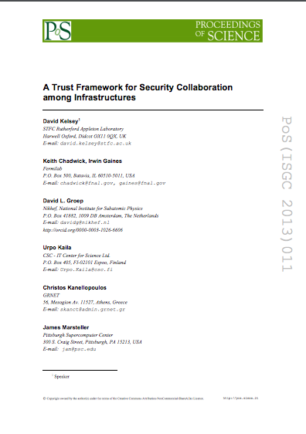
Security collaboration among Infrastructures
Stakeholders: EGI, HBP, PRACE, EUDAT, WLCG, OSG and XSEDE
Defined a policy trust framework
build trust and develop policy standards for collaboration on operational security
SCI was used as the basis for Sirtfi
A Security Incident Response Trust Framework for Federated Identity
to enable coordination of security incident response across federated organizations
Notes:
NON strictly EGI policy

Slide 10
Security procedures

Slide 11
Target group
Internal target groups:
Resource Centres and other service providers federated in EGI
Communities using EGI resources
Dissemination strategy:
Operations Management Board, EGI Wiki
External target groups
Other e-Infrastructures and RIs who can adopt the EGI policies adapting them to their needs
Policy bodies and initiatives who can use the security policies as an input for further
Dissemination strategy:
Security collaboration initiatives (WISE), EGI website, events and conferences

Slide 12
Analysis of result’s impact

Slide 13
Innovation level and capacity
Innovation level
Policies increase the security of the infrastructure. They can be used to demonstrate compliance with regulations and standard.
Innovation Capacity
EGI Security policies are already used by other activities external from EGI (ELIXIR, PRACE, for example).
This demonstrate that the work done by EGI in defining a policy framework for the operations is mature and ahead of what is done by other players in the e-Infrastructure ecosystem who can benefit from the existing work made available by EGI and EGI-Engage

Slide 14
Relevance of the key result
Relevance to Work Programme and societal Challenges
Better optimisation of the use of IT equipment for research
Relevance of Result for Policy domain of EOSC
The extent of the benefits derived from the
project result for EOSC
Notes:
Eosc-hub

Slide 15
Exploitability level
Exploitation: the use of results in
Average
From D2.14, KERs table, but I can’t remember very well the rationale behind it, since it was ranked high in the rest of the table.

