Slide 1
Check-in
Nicolas Liampotis
Authentication and Authorisation Infrastructure, GRNET
JRA1.1 Task Leader, EGI-Engage

Slide 2
EGI-Engage: Key Exploitable Results
Integrated Management System and Certification
Updated strategy, governance and procurement
Policy papers on the EOSC
Improved EGI Service portfolio
Tools for federated service management
Security policies
Marketplace
Check-in
Federated Cloud Computing
Open Data
Platform
Integrated thematic services
Applications on Demand

Slide 3
Outline
Introduction
Description
Target groups
Analysis of result’s impact
Innovation level and capacity
Relevance of the key result
Exploitability level

Slide 4
Introduction

Slide 5
EGI Check-in service: Secure and user-friendly federated authentication and authorisation
Enables single sign-on to services through eduGAIN and other identity providers
Users without institutional accounts can access services through social media or other external accounts
Services connected to Check-in can be made available to +2,000 universities and institutes with little or no administrative overhead
Secure - operates under the strict security policies of the EGI federation
Simple - hides the complexity of dealing with multiple authentication providers and sources of authorisation information
Low overhead - lowers the bureaucratic burden of integrating multiple identity providers and attribute authorities
Interoperable - implements the AARC blueprint architecture and is compliant with eduGAIN, REFEDS R&S and Sirtfi policies
Polyglot - translates SAML 2.0, OpenID Connect, OAuth 2.0 and X.509 credentials

Slide 6
Target groups
User communities with different needs:
operating their own AAI solution
operating their own group management service
in need of a ready-to-use group management solution
Service Providers
looking to leverage “AAI as a Service”

Slide 7
For communities operating their own AAI
Social IdPs
eduGAIN
Institutional IdP
Community operating its own AAI connected as an IdP Proxy to CheckIn to allow its users to access EGI services & resources
Access EGI services without changing your authentication workflow
AAI Proxy
EGI CheckIn
EGI Infrastructure
Service
Service
Notes:
This is the ELIXIR use case: ELIXIR has a full-fledged AAI solution, and it talks directly to checkin, in this way for the users there are no visible changes in the authentication process

Slide 8
For communities operating their own group management service
eduGAIN
Community managing authorisation information about the users (VO/group memberships and roles) via their own group management service, which is connected to Check-in as an external attribute authority
Check-in will handle the configuration of the IdPs and the aggregation of the attributes for the SPs
No need to migrate the group management functionality to an EGI-specific attribute authority
Institutional IdP
Social IdPs
Virtual Organization
Service
EGI CheckIn
EGI Infrastructure
Service
Service
Notes:
An established community may already have group management solutions, and may want to use it for authorization. CheckIN can aggregate these authorization information with the authentication information coming from the IdPs.

Slide 9
For communities in need of a ready-to-use group management solution
eduGAIN
Communities that do not operate their own group management service can leverage the group management capabilities of the Check-in platform
Ready-to-use solution
Avoid overhead of deploying a dedicated group management service
Support for multi-tenancy to allow authorised VO admins to manage the information about their users independently
Easy connect to both EGI and non-EGI services
Institutional IdP
Social IDPs
EGI CheckIn
Service
Virtual Organization
Service
EGI Infrastructure
Service
Supported technologies:
CΟmanage
Perun
Notes:
This option basically offers a full AAI solution as-a-service for the community (not only to access EGI services, but potentially any service relevant for the community).

Slide 10
For service providers: AAI as a service
Social IdPs
eduGAIN
Check-in as an authentication proxy
Enable login from institutional IdPs in eduGAIN and social media
Minimal overhead for the service development
All the other Check-in features are available for the SP: account linking, attribute aggregation, ..
Prerequisites:
Service provider must accept EGI policies on data protection
Institutional IdPs
EGI CheckIn
EGI Infrastructure
Service

Slide 11
Analysis of result’s impact

Slide 12
Innovation level and capacity
Innovation level
Main benefits
Only one account needed for federated access to multiple heterogeneous service providers
Identity linking enables access to EGI resources using different login credentials (institutional/social)
Aggregation and harmonisation of authorisation information from multiple sources
Who is using Check-in today
ELIXIR Research Infrastructure
LToS, Training, FedCloud VOs
EGI Services: Applications Database (AppDB), Configurations Database (GOCDB), Helpdesk (GGUS), Marketplace, Applications on Demand (AoD) service
Who is expected to use Check-in in the next three years
More e/R-infrarstructures, communities & services
Check-in acts as a proxy that allows ELIXIR users to use their ELIXIR IDs to interact with relevant EGI services (Cloud, Configurations database, Applications on Demand
Notes:
Innovation level
Describe which are the main benefits derived by using this result, who is using today and who is expected to use it in the next three years
Innovation Capacity
Describe briefly how the result can be used
-in other areas beyond the project objective
-for bringing benefits to others parties
within the next 3 years
The most significant uptake of the CheckIn service was reached with the ELIXIR Research Infrastructure. In the achieved setup ELIXIR users can interact with EGI services using ELIXIR IDs. The CheckIn service acts as a proxy that connects the ELIXIR Identity Provider to the EGI services that are relevant for the ELIXIR community (Cloud, Configurations database, Applications Database).

Slide 13
Innovation level and capacity
Innovation Capacity
Enables federated access to services
Enables multiple federated authentication sources using different technologies
Direct integration with the communities AAI services
User registration portal to allow accounts-linking
Enables the creation of other federated clouds re-using the same software stack
Notes:
Innovation level
Describe which are the main benefits derived by using this result, who is using today and who is expected to use it in the next three years
Innovation Capacity
Describe briefly how the result can be used
-in other areas beyond the project objective
-for bringing benefits to others parties
within the next 3 years
The most significant uptake of the CheckIn service was reached with the ELIXIR Research Infrastructure. In the achieved setup ELIXIR users can interact with EGI services using ELIXIR IDs. The CheckIn service acts as a proxy that connects the ELIXIR Identity Provider to the EGI services that are relevant for the ELIXIR community (Cloud, Configurations database, Applications Database).

Slide 14
Relevance of the key result
Relevance to Work Programme and societal Challenges
Impact 4: Scientific communities embrace storage and computing infrastructures as state-of-the-art services become available and the learning curve for their use becomes less steep
Relevance of result for the implementation roadmap of EOSC
Check-in is an enabling service of the EOSC-hub providing federated authentication and authorisation across multiple providers of EOSC
EGI Check-in is a contribution towards the development of Single Sign-On access to e-infrastructures for European researchers. It lowers the barriers to use of EGI resources today, and has been designed with an eye to integration with future developments
Notes:
Relevance to Work Programme and societal Challenges
Briefly describe how the result satisfies the expected impacts of the project and/or other relevant econmic or societal impacts, as:
• Strengthening the competitiveness and growth of companies by
developing innovations meeting the needs of European and
global markets; and, where relevant, by delivering such
innovations to the markets
• Any other environmental and socially important impacts
Relevance of Result for Policy domain of EOSC
The extent of the benefits derived from the
project result for EOSC

Slide 15
Exploitability level
Check-in was added to the EGI Internal Service Portfolio
Integrated with the EGI services to enable easy single sign-on capabilities for the users
Interoperable with existing AAI services operated by communities and RI so that their users can access and use EGI services in a uniform and easy way
Integrated with external service providers as an “AAI as a service” solution
Provided to user communities as a full-fledged user authentication and authorisation solution, including a fully managed group management service, and used with both EGI and non-EGI services
Notes:
Exploitation: the use of results in
-Developing/creating/marketing product/services/processes
-Internal use within the EGI federation or commercial
-Further activities other than project
-Standardisation

Slide 16
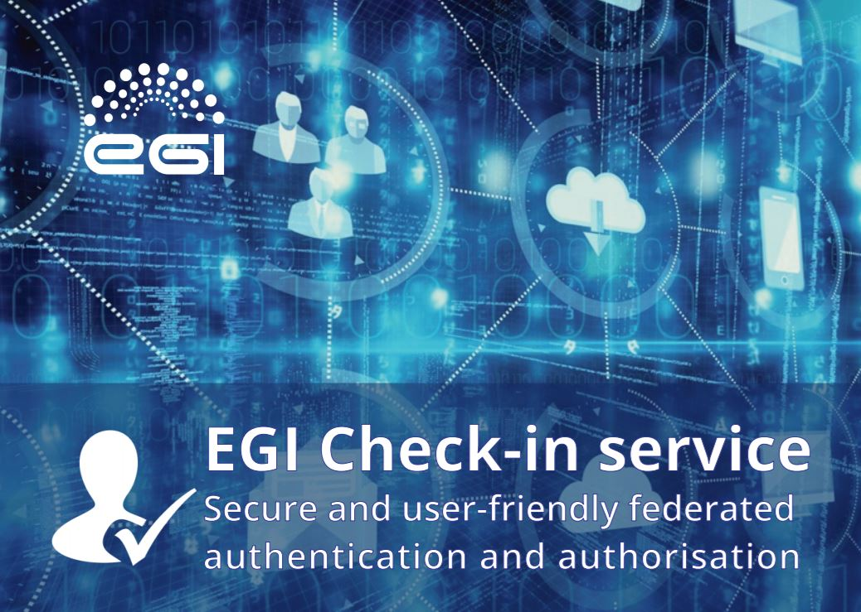
Dissemination activities
EGI website:
Check-in service webpage
Publications:
Check-in brochure
Newsletter
EGI: Services for open science
(May 2017)
Selected presentations at events:
“EGI AAI Demo”, First ASTERICS-OBELICS workshop
(December 2016)
“The EGI Check-in service”, 10th FIM4R workshop
(February 2017)
"EGI Check-in", meeting of the EOSCpilot project
(July 2017)

Slide 18
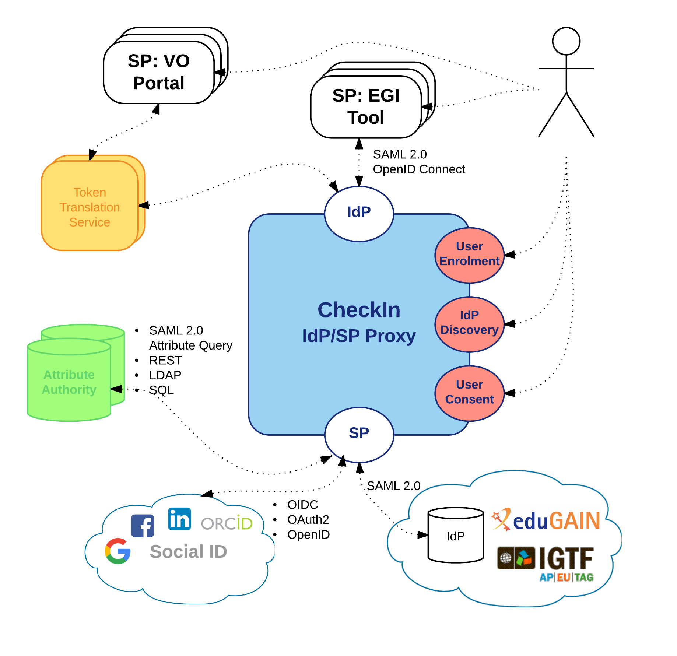
Check-in features
Identity Providers:
SAML2.0: eduGAIN
OIDC/OAuth2: Google, Facebook, LinkedIn, ORCID
X.509: IGTF
Service Providers:
SAML2.0 & OIDC
Attribute Authorities
SAML2.0 Attr. Query, REST, LDAP, SQL
Token Translation Services
SAML2.0-to-X.509: Master Portal to RCauth.eu Online CA
Support for Levels of Assurance
User enrolment & account linking
IdP Discovery
User Consent

Slide 19
Check-in consumes information from many diverse sources
Check-in
GOCDB
VOMS
COmanage
Perun
SAML IdP
OpenID Connect IdP
e/R-Infra AAI proxy (e.g. ELIXIR)
External VO Management (e.g. Unity IDM)
Notes:
Comanage, Perun: attribute authorities, group management services
e/R-infra: e-infrastructure, research-infrastructure

Slide 20
Reliable and secure AAI platform
EGI has always invested in improving and maintaining the reliability and security of the services
EGI has a mature and complete set of security policies and the processes to enforce them
Extended with Check-in specific policies:
Check-in acceptable usage policy
Check-in data protection policy
Agreement documents to integrate non-EGI and non-eduGAIN SPs and IdPs and maintain the compliance

Slide 21
Support for Levels of Assurance
CheckIn supports 3 different Levels of Assurance:
Use case
CheckIn conveys the LoA associated with the authenticated identity to SPs for authorisation purposes
Communicated through the eduPersonAssurance attribute in SAML or acr clain in OIDC
Translated into entitlements expressing the right of a user to access a particular resource (e.g. access Rcauth Onlince CA)
Key features/ Profiles | AARC-Assam | IGTF-DOGWOOD | IGTF-BIRCH | AARC-Darjeeling
Unique ID |  | ✔ | ✔ | ✔
Identity Vetting |  |  | ✔ | ✔
Multi Factor |  |  |  | ✔
Notes:
CheckIN will implement the Level of Assurance profiles as defined in the AARC project, as soon as they are final (there may be another presentation that talks about LOA)
Assam, (NOT SUPPORTED YET - open question whether we want it) can be used to specify a profile for the IDPs that do not have any Assurance feature guaranteed
DOGWOOD is what is required to access Rcauth online CA
BIRCH is similar to X.509 IGTF certificates.
Darjeeling is higher LOA since it adds multi-factor
If questions arise: Some of these profiles are very similar to the LOA REFEDS profiles, with some differences. They will be presented to REFEDS but EGI hopes for a quick adoption of these profiles (REFEDS may adopt them, but it would take time).

