Slide 1
Federated Cloud Computing
Enol Fernandez
Cloud Technologist, EGI Foundation

Slide 2
EGI-Engage: Key Exploitable Results
Improved EGI Service portfolio
Check-in
IMS & Certification
Security policies
Federated Cloud Computing

Slide 3
EGI Cloud Federation
Grid of clouds
Harmonised operational behaviour
Open Technology stack based on standards
Scalable computing platform supporting applications and services in research and science

Slide 4
A Federated IaaS Cloud for research
Enables application portability across resource providers
Single-Sign On via Check-in
Unified interfaces
Discovery of resources
Appliance library and secure distribution
User-friendly GUI
on a reliable infrastructure
operational and security processes
A/R Monitoring
accounting
technology agnostic

Slide 5
IaaS Federation Architecture
EGI
Check-in
Community Platforms
AppDB VMOps
IaaS Federated Access Tools
IaaS API
IaaS API
IaaS API
Cloud Management Framework
Cloud Management Framework
Cloud Management Framework
EGI Federation services:
Accounting, Monitoring, Conf. Database, Information Discovery, AppDB Marketplace

Slide 6
AppDB Cloud Marketplace
Open Library of Appliances
Use on clouds or on personal laptop
Re-use, share, associate contextualization
Automatic distribution to cloud providers
EGI endorsed VM images
securely configured and tested

Slide 7
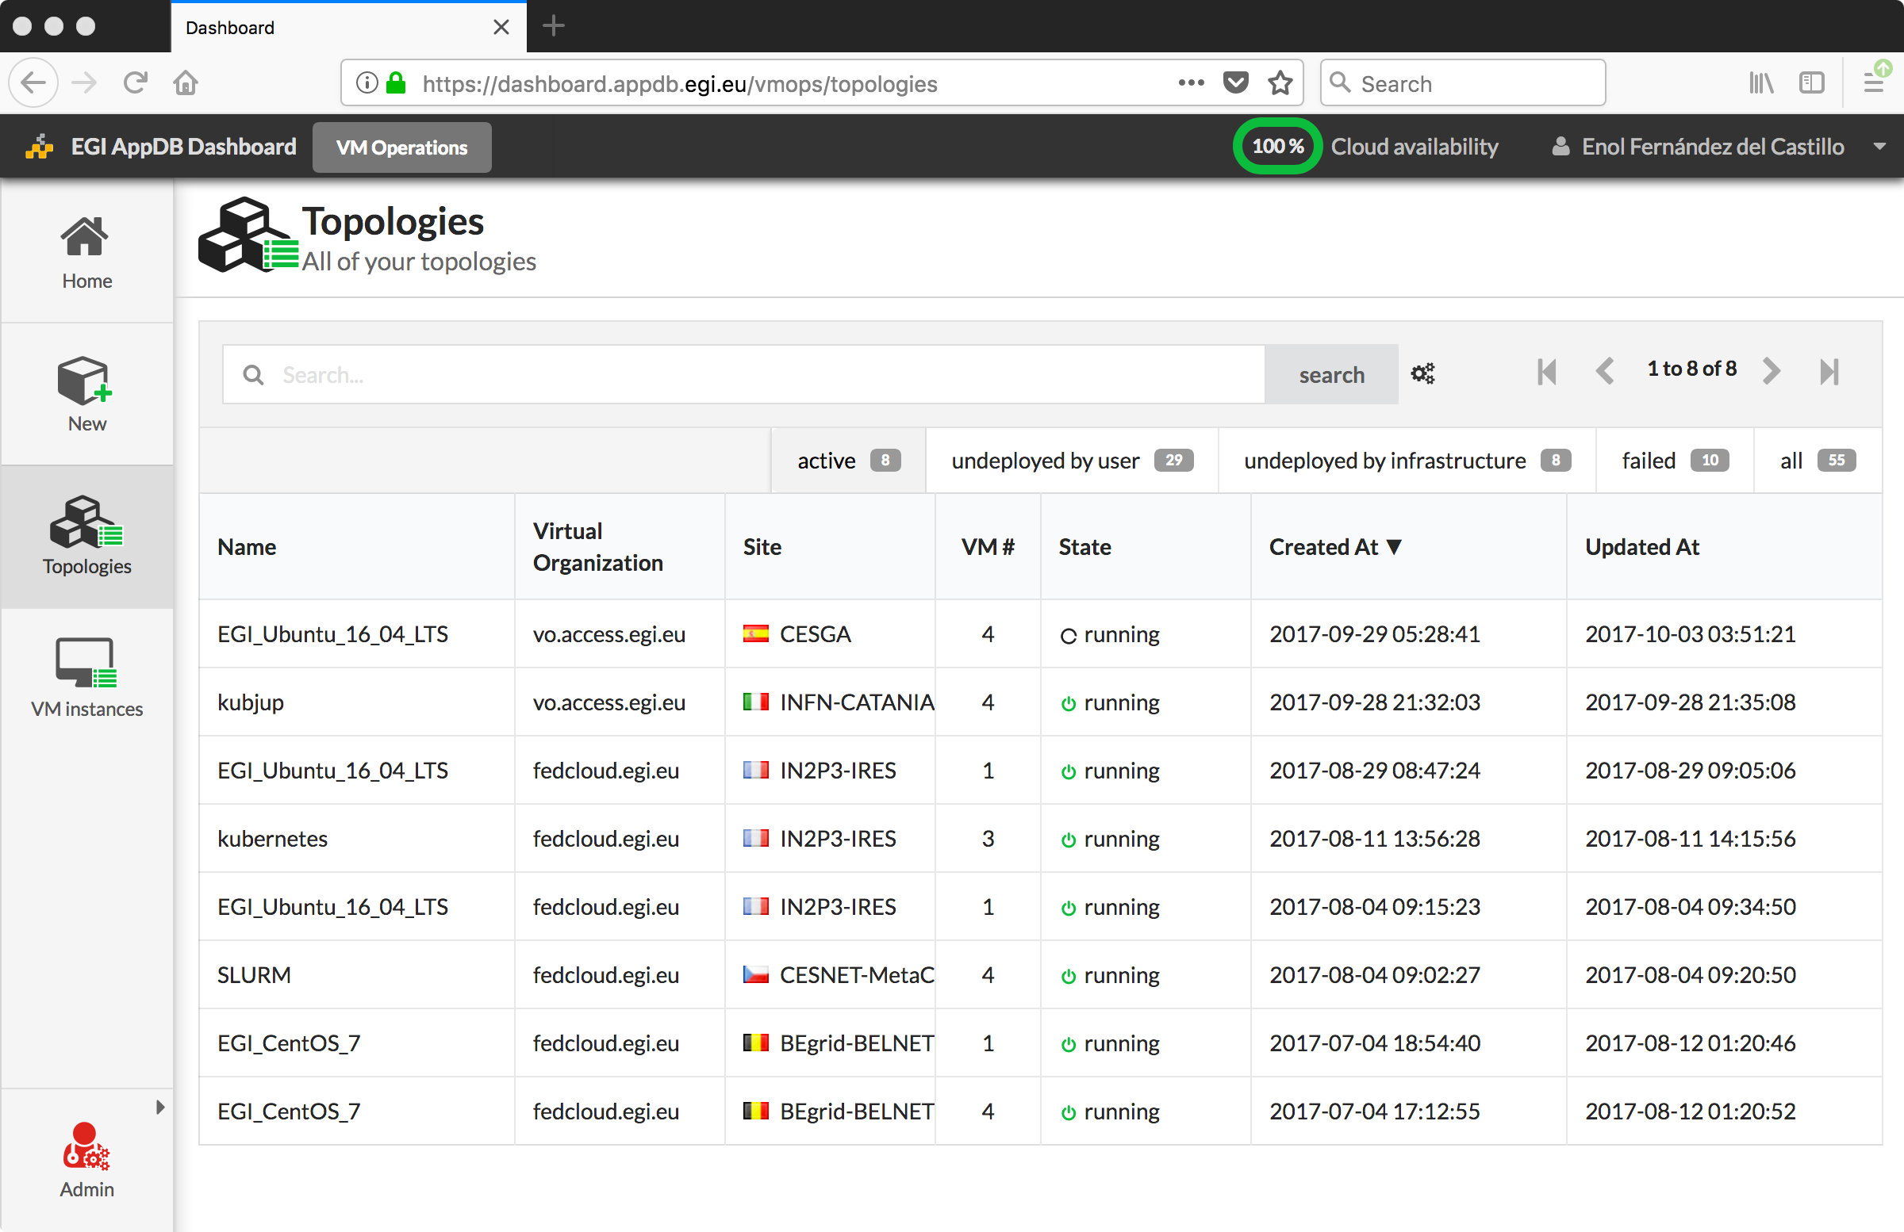
AppDB VMOps
Unified management of VM on the federation
Single dashboard for all providers
Complete EGI Check-in integration
Personalized - wizard-like- management of VMs

Slide 8
The infrastructure
20 resource centres
4 OpenNebula
15 OpenStack
1 Synnefo
11 VO SLAs
1 Incubator VO: +12K VMs, +5M CPUh

Slide 9
Innovation

Slide 10
Improvements and Benefits
Improvements:
AppDB VMOps GUI
IaaS Federated Access Tools layer
OCCI 1.2
Expose native APIs
Simplification of integration tools and minimize changes to the operations of the local provider
Benefits:
Increased usability and stability of the cloud resources, making them more suitable to a higher number of communities
Notes:
Improvements:
AppDB VMOps GUI, for user friendly access
OCCI 1.2 exposing new features and improved client support
Expose native APIs to federation as needed by communities
Rely on public APIs of cloud management frameworks
Minimise changes to the operations of the local provider
Benefits:
Increased usability and stability of the cloud resources, making them more suitable to a higher number of communities

Slide 11
Relevance of the key result
Relevance to Work Programme and societal Challenges:
Expected Impacts of EINFRA1 | Results
Increased availability of scientific data for scientific communities independently of them having already embraced or not e-science. | Enabler for building and operating thematic services
Avoiding lock-in to particular hardware or software platforms in the development of science. | Use of standards, promote application portability across providers
Scientific communities embrace storage and computing infrastructures as state-of-the-art services become available and the learning curve for their use becomes less steep | State of the art IaaS cloud federation with user-friendly GUI
Relevance of result the implementation roadmap of EOSC:
Unique hybrid cloud infrastructure for research in Europe

Slide 12
Exploitation

Slide 13
Who can exploit the result? For what?
EGI Cloud is a platform for:
RI/FET/VREs to operate their services and applications
Applications/Gateway developers to create and publish innovative applications and supporting environments
Expert users to run applications in a unconstrained environment
EGI Cloud Technology Stack:
Scientific communities wanting to establish a community specific cloud federation
Standardisation bodies

Slide 14
Exploitation cases
EGI Cloud Federation
20 resource providers with 3 different technology stacks
Foundation for EGI Services and Thematic Services
11 VO SLAs and 1 incubator VO
Applications on Demand
Training Infrastructure
Cloud Container Compute
Cloud Compute
Online Storage

Slide 15
Exploitation cases
EGI Cloud technology stack
ELIXIR Cloud Platform
Open Research Cloud
Component | EGI Technology | Standards
Single Sign On | EGI Check-in | OpenID Connect, X.509
EGI Accounting | cASO, oneacct-export, APEL | OGF UR (Cloud)
EGI Information Discovery | cloud-info-provider, BDII | OGF GlueSchema, LDAP
VMI replication | cloudkeeper | HEPiX image lists
VMI catalogue | AppDB | DMTF OVF, cloud-init
Unified GUI | VMOPs | OASIS TOSCA
IaaS standard interface | rOCCI, ooi | OGF OCCI 1.2

Slide 16
Dissemination & communication
EGI website:
Federated Cloud page
Selected presentations:
Cloudscape 2016, Brussels
(March 2016)
“The EGI Federated Cloud”, ELIXIR All Hands Meeting
(March 2017)
Open Research Cloud Summit, Boston
(May 2017)
Using the EGI Fed-Cloud for Data Analysis,
EUDAT summer school (July 2017)
Use cases:
How to predict social media trends?
(reprinted in ScienceNode)
The genetics of Salmonella infections
(results published in Nature, 2016)
Featured in the EGI Use Cases publication

Slide 17
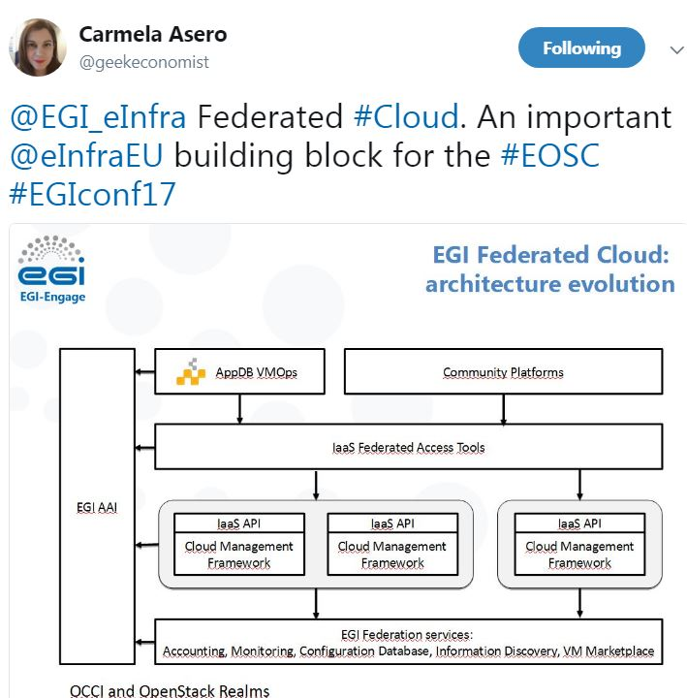
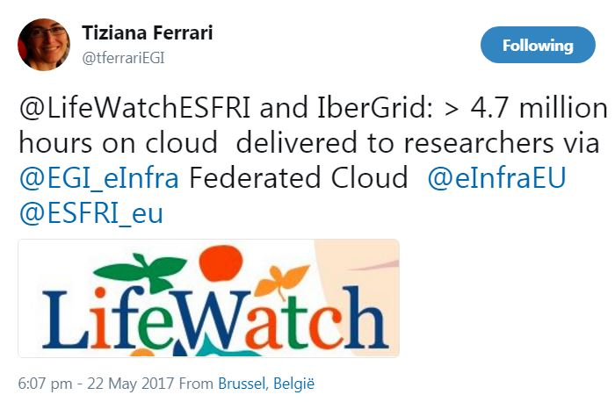
Dissemination & communication
Newsletter articles:
EMSODEV pilot running on
the EGI Federated Cloud
(July 2016)
EGI at the OpenStack Summit Barcelona 2016
(November 2016)
The EGI Federated Cloud architecture
(February 2017)
A new interface for the EGI Federated Cloud
(September 2017)
EGI-Engage: a list of key exploitable results
(September 2017)
Social Media:
@EGI_eInfra Federated #Cloud. An important
@eInfraEU building block for the #EOSC
@LifeWatchESFRI and IberGrid: > 4.7 million hours
on cloud delivered to researchers
via @EGI_eInfra Federated Cloud

