Slide 1
WP2 Strategy, Policy and Communications
Sergio Andreozzi
Strategy and Policy Manager, EGI Foundation
WP2 Activity Leader, EGI-Engage Project

Slide 2
Outline
WP Overview
Objectives, tasks, partners and effort
Achievements
Communications and events
Dissemination of project results
Service management and innovation
Procurement and business models
Engaging with the private sector
Use of resources, issues
Summary

Slide 3
WP Overview

Slide 4
NA2 (WP2) objectives
Task # | Task Objectives
NA2.1 Communication and Dissemination | Keep the EGI community informed of the project activities Disseminate the success stories
NA2.2 Strategy, Business Development and Exploitation | Disseminate the project’s outputs for exploitation Develop the EGI strategy and governance towards the Open Science Commons vision and assess progress Assess the EGI impact by defining/measuring key indicators Evolve the services and solutions portfolio and related business models Establish collaboration agreements with strategic partners
NA2.3 SME/Industry Engagement and Big Data Value Chain | Facilitate the engagement with SMEs Explore the creation of pilot projects, especially those based on Open Data in selected industry sectors

Slide 5
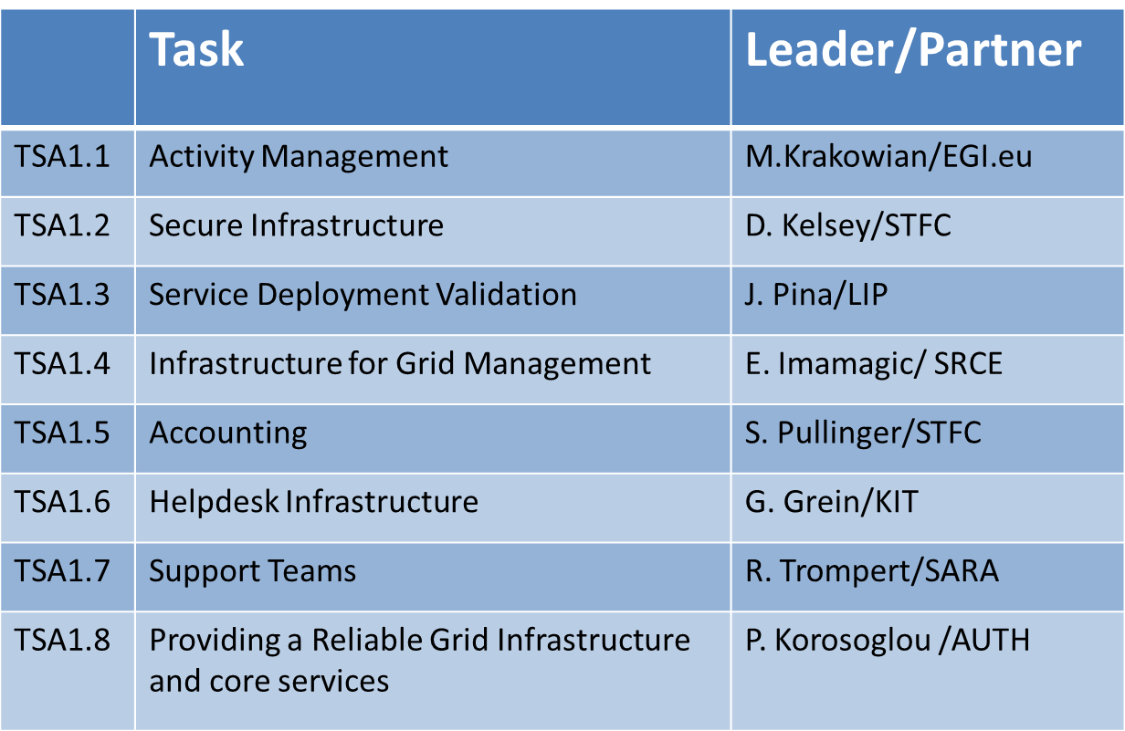
Partners and effort
57 Countries
58 Beneficiaries
PY4 effort (exc UNF)
1123 PMs
94 FTEs
Total effort (inc UNF)
4863 PMs
405 FTEs
Notes:
Provided by PO

Slide 6
Activities and Achievements
Notes:
Main achievements of the work package

Slide 7
Communications & Events
Communications
Website
Newsletter
Newsfeed
Blog
Publications
Social media
Events
EGI Conference 2016
DI4R 2016
EGI Conference 2017
DI4R 2017 (in prep)
Notes:
Main goals of NA2.1 were: 1) support the dissemination of the project results; 2) community building through events
For 1. the communication team developed and maintained 6 communication channels
This presentation will describe these channels and provide factual information;
The actual communication activities that were conducted with these channels were described in the KER presentation and in D2.14

Slide 8
Communications EGI website
Purpose: Shop window to the EGI services; give visibility to EGI's resource providers and users
Website redevelopment (M2.3)
Simpler, flatter structure
Focused on the service offer and service providers
New workflow to request access to services
Notes:
Realign the main shop window of the EGI website towards a strategy focused on the service offer
Simplified/streamlined content on two pillars: EGI services + resources providers
The old website was not optimised to promote the services and lacked a clear “call to action”; this website brought to as 40+ requests (add screenshot of call to action); to link in the future to the marketplace
(Check D2.14 related section)

Slide 9
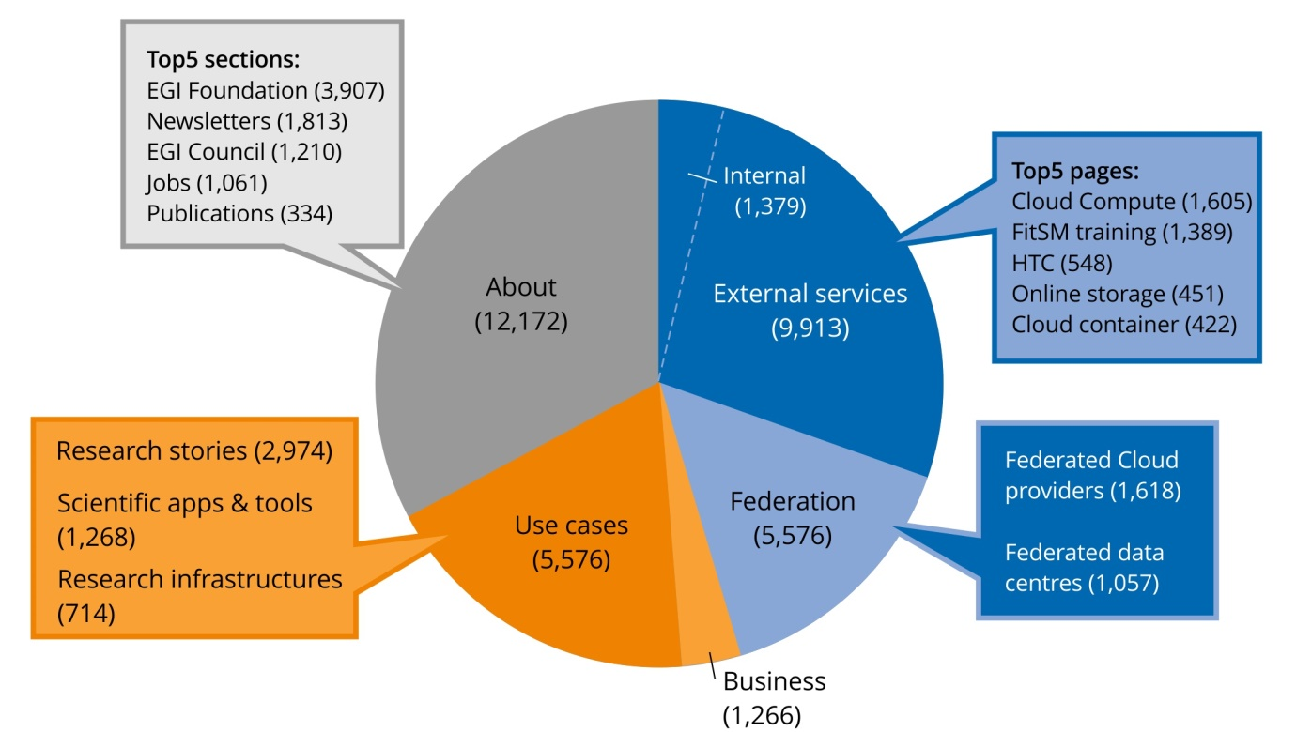
Communications EGI website
Unique website views per top menu section (Oct 2016 – July 2017)

Slide 10
Communications Newsletter
Purpose: For the EGI Community, with in depth stories, opinion, future trends, reflections
8 issues – 74 articles (2015-2017)
Sent via MailChimp to EGI SSO accounts + subscribers
Most popular articles:
About project milestones and technical developments

Slide 11
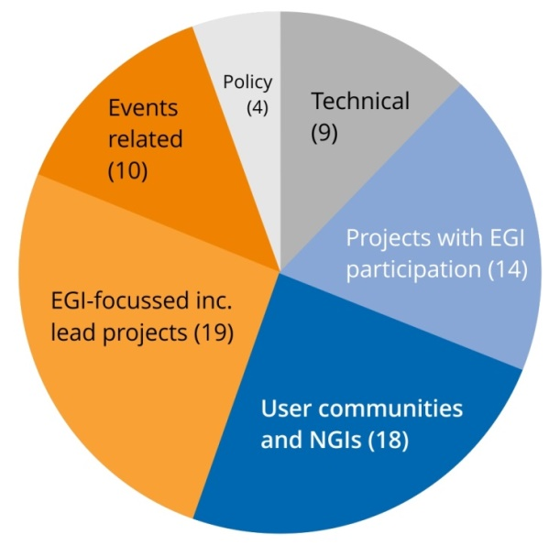
Communications Newsletter
Number of articles per category
Summary of readership stats
(details in D2.14):
On average, each issue:
Sent to about 4,000 subscribers
Reached 2,107 readers
Had 9 articles

Slide 12
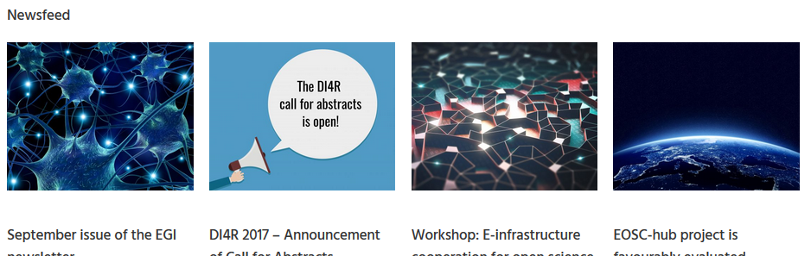
Communications Newsfeed
Purpose: For all audiences, to report updates, milestones, EGI+NGI announcements
103 news stories
Quoted by external sites at least 500 times
Syndicated by NGIs
Notes:
Conservative estimate: number of results of the Google search ["egi.eu/news" AND NOT site:egi.eu ]. Excludes all sites that do not publish 'naked' links, i.e. that embed links in text.

Slide 13
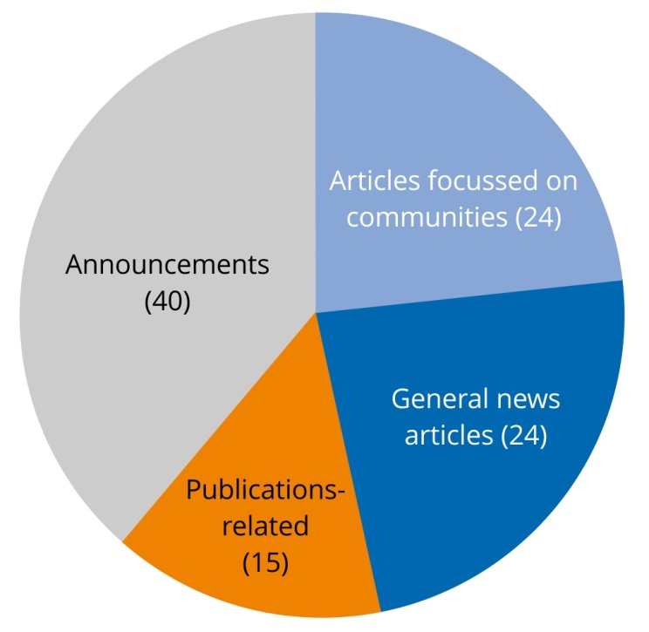
Communications Newsfeed
Number of articles per type
Articles
Stories about developments, results (including stories with a focus on communities)
Announcements
About EGI or NGI events
(conferences, webinars, training)
Publications
Announcements about EGI-related publications

Slide 14
Communications Blog
Purpose: For all audiences, event reports, announcements by other organisations, opinion
50 blog posts
Underrepresents EGI on purpose to broadcast the successes and announcements of partners.
Top 3 stories [unique views]:
Shaping the Open Science Cloud of the future [270]
Business track summary: outcomes and next steps [254]
Call for papers: workshop on Big Data Analytics 2016 [243]
Notes:
Used for events reports or announcements/news not directly centred on EGI

Slide 15
Communications Publications
Purpose: to convey the added value of or to stimulate interest in EGI services and key results
Keeping EGI Secure
Report about the EGI security team
go.egi.eu/csirt
EGI Check-in
Benefits and main features of the service
go.egi.eu/cin
Notes:
These are two examples on how publications support the dissemination of EGI services

Slide 16
Communications Publications
EGI Use Cases
Collection of the research use cases
Shows the scale & diversity of EGI-supported research
go.egi.eu/usec
EGI Service Catalogue
Overview of EGI’s services
Distributed at conferences and meetings with partners
go.egi.eu/SCpdf

Slide 17
Communications Social media
Purpose: to amplify EGI’s communication channels
EGI’s social media posts
Showcase EGI’s services in the community
Foster a good relationship with stakeholders and users and give them visibility
Strengthen the image of EGI
Support the EGI Directors to become social influencers

Slide 18
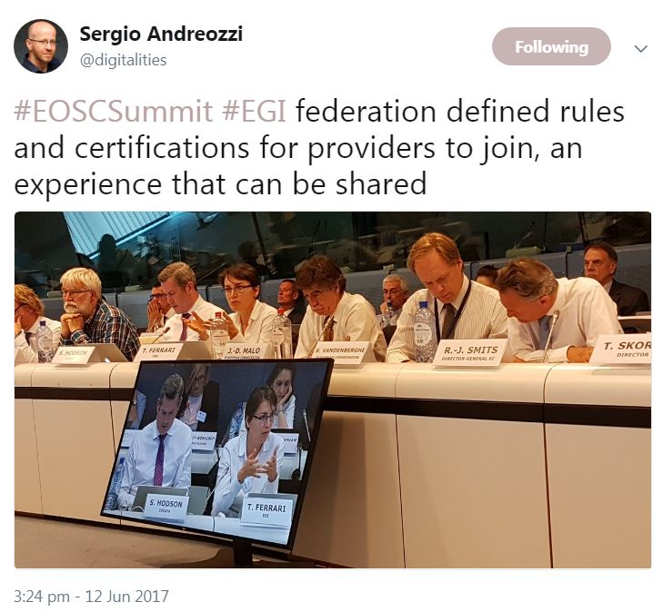
Communications Social media
Purpose: to amplify EGI’s communication channels
Twitter
@EGI_eInfra
2,201 followers
Facebook
/EGIeInfrastructure
452 followers
LinkedIn
group
570 members

Slide 19
Events
EGI Conference 2016
6-8 April, Amsterdam
188 participants
EGI-focused event
DI4R 2016
28-30 September, Krakow
407 participants
Jointly organised with EUDAT, GÉANT, OpenAIRE & RDA Europe
Notes:
EGI conference is focused on EGI community topics (e.g. procurement, operations, NGIs sharing experience on engagement)
Reflecting EGI strategy to work closely with other e-infrastructures, we replaced one of our yearly conferences with an event co-organised and co-developed with other e-infras;

Slide 20
Events
EGI Conference 2017
9-12 May, Catania
238 participants
In partnership with the INDIGO-DataCloud project
DI4R 2017
30 Nov-1 December, Brussels
In preparation
Jointly organised with EUDAT, GÉANT, OpenAIRE, PRACE & RDA Europe

Slide 21
Dissemination Dissemination of project outputs
Maintained catalogue of project results -> Identificaiton of KERs
Dissemination approach
Publication
Website
EGI conference
Software repository
Output category
Technical specifications
Policy & procedure
Software & service
Documents and reports
Business models
Know-how
Application of the output
In standardisation activities
Developing/creating/marketing product/service/ process
In further activities other than the project
IP protection approach
Open source license
Copyright
Confidential information
Target groups
Research infrastructures and collaborations
Long tail of science
Industry/SME
Funding agencies and policymakers
Standardisation bodies

Slide 22
Service Portfolio Management
Increased maturity of the process
Increased maturity of the IT governance
Established ”Services and Solutions Board”
Evolved the service portfolio
Held 31 meetings from the project start
Agreed Y major changes for EGI Council adoption
Part of the Key Exploitable Results (KERs)

Slide 23
Strategic Planning and Evaluation
Strategy for 2020 approved in May 2015
Strategy implementation evaluated at
M12 (D2.9) and M30 (D2.13)
Live document updated on a 6-month basis
Strategy for 2025 in advanced development
Discussion started in May 2017 with the EGI Council
Mature draft available as part of D2.13
Approval expected by the end of 2017
Part of the Key Exploitable Results (KERs)

Slide 24
Policy papers
Part of the Key Exploitable Results (KERs)

Slide 25
MoUs defined during EGI-Engage
MoU | EGI Partner | Counterpart | Status
GEANT | EGI Foundation | GEANT Association | Signed
CloudSME | EGI Foundation | CloudSME UG | Signed
Terradue | EGI Foundation | Terradue | Signed
PRACE-4IP | EGI-Engage | PRACE-4IP | Signed
UberCloud | EGI Foundation | UberCloud | Signed
ComputeCananda | EGI Foundation | Compute Cananda | Signed
TUW/EODC | EGI Foundation | Technische Universitat Wien | Agreed, ready to sign

Slide 26
Procurement and business models Main Model: Free at point of delivery
Funding Agency
Funding Agency
Resource Provider
Service provision:
a complex network of players interacting for providing products, services and solutions for excellent research
Funding Agency
Resource Provider
Funding Agency
Resource Provider
Funding Agency
EGI.eu
Service

Slide 27
Procurement and business models Pay-for-Use Motivations
Increase awareness of economic value for service delivered
Incentivize resource providers to serve users outside their own remit
Diversify revenue streams for support OPEX

Slide 28
Procurement and business models Additional Model: Pay-for-use
Funding Agency
Funding Agency
Resource Provider
Service provision:
a complex network of players interacting for providing products, services and solutions for excellent research
Funding Agency
Resource Provider
Funding Agency
Resource Provider
Funding Agency
EGI.eu
Service

Slide 29
Procurement and business models Pay-for-Use Proof of Concept: History
2013: Exploratory Document
2014: Kick-off of Proof of Concept
2015: Tool adaption (GOCDB, e-GRANT, Accounting Portal)
2016: Formalization
Services, pricing, processes
Letter of Intent (LoI)
Signed document confirming individual organization ability and willingness to offer services on a paid basis
Responding to tenders
e.g. ESA; Helix Nebula
2017:
Transition from e-GRANT as front-end to EGI Marketplace

Slide 30
Procurement and business models Pay-for-Use Proof of Concept: Results
Moved from alpha -> production
Public Page: https://wiki.egi.eu/wiki/Pay-for-use
Services; pricing; processes in place
Shift from e-GRANT to Marketplace
Focus on providing requirements for P4U functionality and processes
P4U Results – PY2
1st financial exchange: IBM->PSNC
New project funding model: NextGEOSS
4 New Letters of Intent
7 total: 100% IT; CESGA; CSC; IFCA; IISAS; INFN; PSNC)
Under discussion: Terradue, NUMECA, BlueBridge, FAO
Others at early stages through business engagement programme
Providers involved in P4U PoC: ~30
Actively working on enabling P4U: 8-10
Letters of Intent received: 7
Avg. price (HTC/cloud): €0.05/h
Knowledge of P4U capability is slowly increasing interest and demand
Notes:
IBM = PSNC
Terradue = INFN-Bari
NUMECA = CESNET and FZ Jülich
CloudSME = EGI Foundation (brokering several providers)
BlueBridge = EGI Foundation (idea is to serve as a broker – we are potentially their sustainability model)
ELIXIR = EGI Foundation (initial discussions for non-community users)

Slide 31
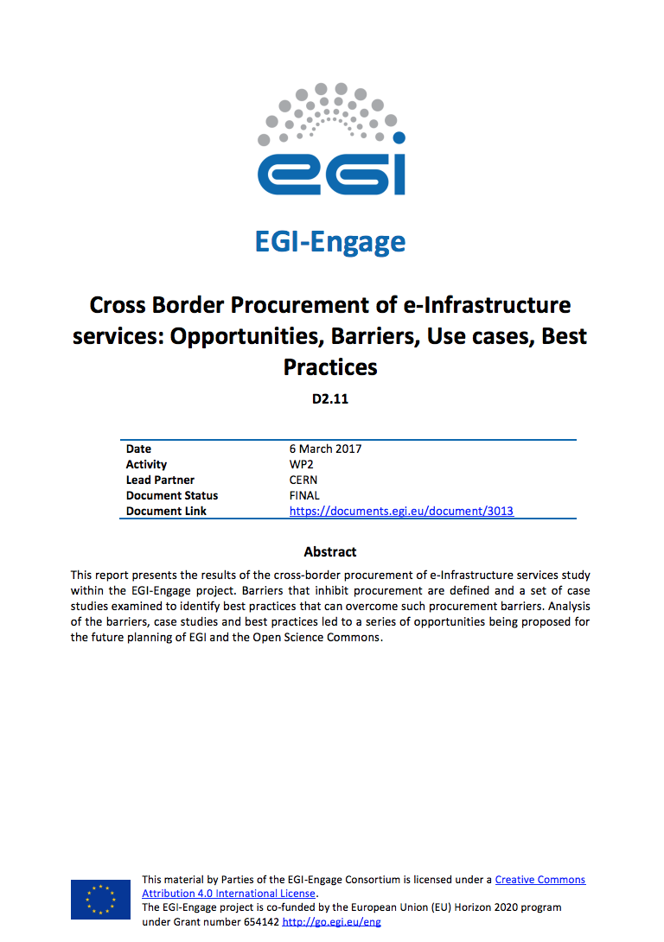
Procurement and business models Procurement study
Direct charging to users requires procurement for non-trivial capacity
Performed study on opportunities, barriers, use cases and best practices
Part of the Key Exploitable Results (KERs)
Exploitation as part of wider activity in the EOSC-hub project proposal

Slide 32
Procurement and business models Business & Service Delivery Model: Marine Fisheries
Early Adopters
Wider Outreach
BB SME 1
BB SME 2
BB SME 3
Marine Fisheries
CRM
SLA/
Contract
Paid
Free
SLA
CRM
TBD
(CNR, ENG)
Mediation
OLA
SUPM
UA/
Contract
SUPM
UA
SUPM
OLA/
Contract
EGI SP
EGI SP
EGI SP
OLA

Slide 33
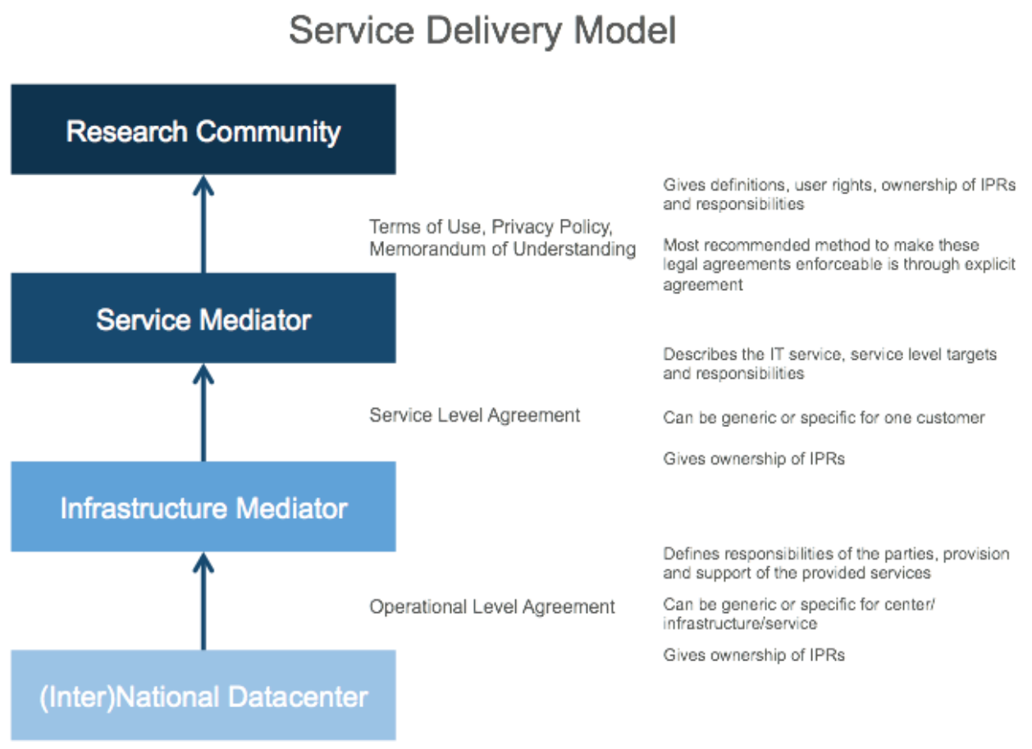
Procurement and business models Business & Service Delivery Model: FAO
Additional work (NA2.3) by FAO to define a concrete Service Delivery Model:
FAO as the end customer with need for legal interoperability
D4Science infrastructure as a mediator for data services (developed in the BlueBRIDGE)
EGI as infrastructure provider
FAO reviewed two agreements:
SLA between D4Science and the EGI Foundation
MoU between FAO and CNR
FAO provided a gap analysis in the legal framework
*SDM with each step in the ‘value chain’
Full report: https://documents.egi.eu/document/2875

Slide 34
Engaging with the private sector Established collaborations
Platform Integration
IaaS Consumers/Pilots
Business Development
Public/Private Partnerships
FitSM Training
EGI FedCloud Provider
Notes:
CloudSME = MoU
Terradue = MoU
UberCloud = MoU
TEISS + SixSq + (CloudEO as Pilot) = ESA Stimulus
AgroKnow, Engineering, FAO = EGI-Engage Partner
BDVA = EGI is a paying member
Helix Nebula = Partnership Agreement as members of the HNI
100%IT = OLA
ITEMO = Member
TUV = Registered Training Organisation
mITSM = Partnership Agreement
Ecohydros = Commercial contract with IFCA
CWA = ??
Singerise = ??

Slide 35
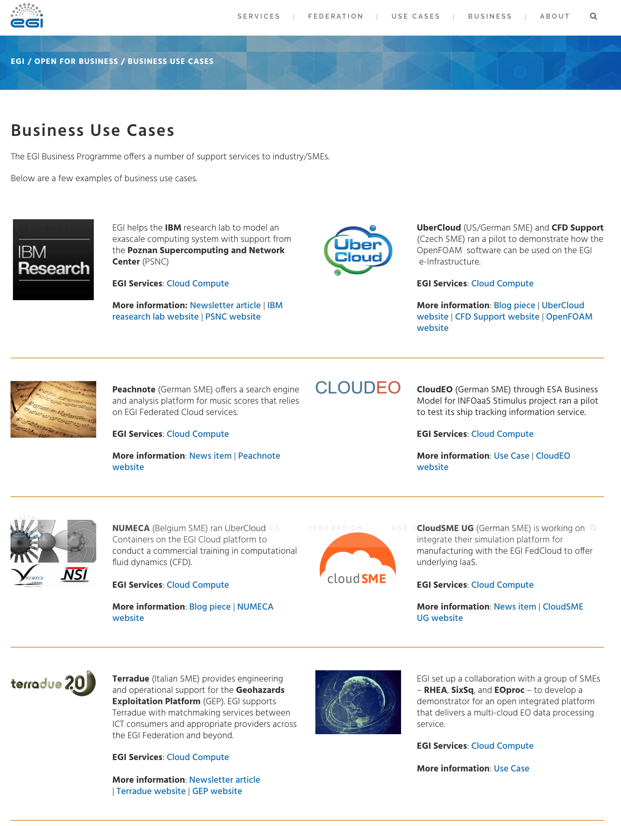
Engaging with the private sector Business Use Cases
8 Concrete business use cases
Main service used:
EGI FedCloud
Sectors:
Astrophysics
Computer-aided design
Computational fluid dynamics
Earth Observation
Manufacturing/Engineering
Music
Industry representatives
9 SMEs; 2 Large enterprises
9 Countries
Belgium; Czech Republic; France; Germany; Italy; Netherlands; Spain; Switzerland; UK
https://www.egi.eu/business/business-use-cases/
Notes:
CloudSME = MoU
Terradue = MoU
UberCloud = MoU
TEISS + SixSq + (CloudEO as Pilot) = ESA Stimulus
AgroKnow, Engineering, FAO = EGI-Engage Partner
BDVA = EGI is a paying member
Helix Nebula = Partnership Agreement as members of the HNI
100%IT = OLA
ITEMO = Member
TUV = Registered Training Organisation
mITSM = Partnership Agreement
Ecohydros = Commercial contract with IFCA
CWA = ??
Singerise = ??

Slide 36
Engaging with the private sector Success stories: Pay-for-Use
IBM research team in Zurich
Contact via business network
Developing a new exascale model to support Square Kilometre Array
Required access to systems with different network topologies
PSNC offered 1.4 PFlops computing power and a fat-tree network interconnect fabric
1st EGI facilitated commercial contract/agreement
Published article/linked business case
3-year EC H2020 project (2017-2020)
Developing the next generation hub for Earth Observation (EO)
10 formal pilots (6 scientific; 4 business)
New funding model used to ensure technical services
Allocated budget to EGI.eu to identify EGI service providers and distribute funds
Requires EGI service providers to understand costs and provide prices according to each pilot requirements
Excellent method to ensure researchers have access to services while providing cost recovery to providers

Slide 37
Engaging with the private sector Success stories
Earth Observation sector - Pilot
RHEA, SixSq, AWS, IPTPoland, EGI FedCloud, AdviceGEO
An open platform delivering a multi-cloud EO data processing service, with the objective to prevent cloud vendor lock-in situations while addressing end-to-end processing of EO data in multiple cloud environments.
Two use cases
Sentinel-1 data retrieved and processed to produce change detection maps of a glacier in Greenland and of shipping activity in the Panama canal.
Sentinel-2 data processor to generate true colour 10m resolution images.
Notes:
Our vision is to offer a generic and open service, intended to work with any EO data located anywhere and with any EO processor, that can be rapidly deployed with flexibility, scalability, at low cost, and which provides services accessed via public and standardised APIs.

Slide 38
Engaging with the private sector Success stories
Data Infrastructure for Food and agriculture research
Partnership facilitated by EGI-Engage leads to requested support in new 3-year initiative AGINFRA+ and 3 of its use cases
Project Objectives and EGI Support
Food security
Goal: Investigate link between crops such as wheat, maze and rice resistant to extreme weather conditions
How: Integrate plant phenotyping data with e-infrastructures, deploy a web service and new software to extract info from data to find most resistant types
Agro-climatic & Economic modelling
Goal: Generate a crop yield forecasting model
How: Scale up computing capabilities to improve forecasts of crop and soil types
Food safety risk assessment
Goal: Support risk assessment using mathematical models
How: Improve current software and existing tools to allow for repeatability such as for the prediction of microbes growth
Links to Industry
Market Analysis in the Agri-food sector
(EGI-Engage D2.10 https://documents.egi.eu/document/2843)

Slide 39
Engaging with the private sector Achievement Summary
150+ business related contacts (100+ of which are SMEs)
8 concrete use cases (https://www.egi.eu/business/business-use-cases/)
~20 actively ongoing (~90 added since the end of PY1); further details in D2.14
Initial questionnaire for private organisations was prepared during PY2
13 companies reached out via this form
Webinars
“How SMEs Can Use EGI’s Cloud for CAE – Intro & Demo Using OpenFOAM (Oct 2016) (https://www.egi.eu/blog/egi-and-ubercloud-webinar-for-smes-cae-openfoam-demo-20oct2016)
“How to engage SMEs for national e-Infrastructures” (May 2017) (https://www.egi.eu/news/egi-webinar-how-to-engage-smes-for-national-e-Infrastructure-providers)
Market Analysis
Marine Fisheries (D2.7 https://documents.egi.eu/document/2700)
Agri-food (D2.10 https://documents.egi.eu/document/2843)
Proposal for a service delivery model from data centre to community
Follow-up to D2.6 - Report on data sharing policies and legal framework in fishery and marine sciences data sector (https://documents.egi.eu/document/2699)
Uses EGI, CNR (D4Science) and FAO as a concrete test case
3 new MoUs with industry (Terradue; CloudSME and TUW/EODC (4 total including UberCloud from PY1)

Slide 40
Use of Resources and Issues
Notes:
Numbers will be provided by PO, work package leaders must provide explanation

Slide 41
CERN: requested 1PM + 1KE (travel) to support more dissemination actions
Pay-for-Use:
Shift from e-GRANT to Marketplace had a major impact on activity plans
Interest increasing, but slowly
Need to raise awareness as many seem unaware of opportunity
Need to educate as many are unsure/skeptical (demand, policies)

Slide 42
Summary
Notes:
Freedom on way to present

Slide 43
Summary
Objective 1 (O1): The continued coordination of the EGI Community
Consolidated the service portfolio management process
Four community conferences (two jointly organised with other e-Infrastructures)
Objective 2 (O2): EGI Solutions, related business models and access policies
Update to the EGI service portfolio
Pay for use in production
Procurement study identified opportunities that have been reused for follow-up activities (EINFRA12.a)
Objective 3 (O3): Offer and expand an e-Infrastructure Commons solution
Objective 4 (O4): Open data platform and the European Big Data Value
Developed pilot for supporting the exploitation of EO data using EGI services
Objective 5 (O5): Promotion of the adoption and extension of the current EGI services
New website launched
Research stories and news items to promote results
Notes:
Achievements grouped by objectives

Slide 44
Key exploitable results
KER name | Description
Policies, Processes and Procedures
Update of the Strategy, Governance evolution and Procurement | Developed the EGI strategy and governance towards the Open Science Commons vision. Analysis of opportunities and barriers for cross-border procurement of e-Infrastructure services
Policy papers on the EOSC | Co-authored papers providing a shared vision for the European Open Science Cloud for Research, input on its governance and financial schemes
Software and services
Improved EGI service Portfolio | Improved service definitions, creation of two portfolios and publication of service catalogues. Brochures and publication of EGI services in the EGI Website
Marketplace | Establishment of a marketplace where researchers can discover and exchange services relevant to their research, applying the one-stop-shop concept for data and services.

