Slide 1
Honeypots at CESNET/MU
Daniel Kouril

Slide 2
Honeypots
High-interaction honeypots
Real OS and applications, mostly virtual machines.
Custom data capture solution if any.
Hard to maintain, expensive and time consuming.
Threat to host or surrounding network when infected.
Low-interaction honeypots
Emulation of machines, services, etc.
Low level of interaction, limited data capture.
Cheap to deploy and maintain.
No threat to host or network.

Slide 3
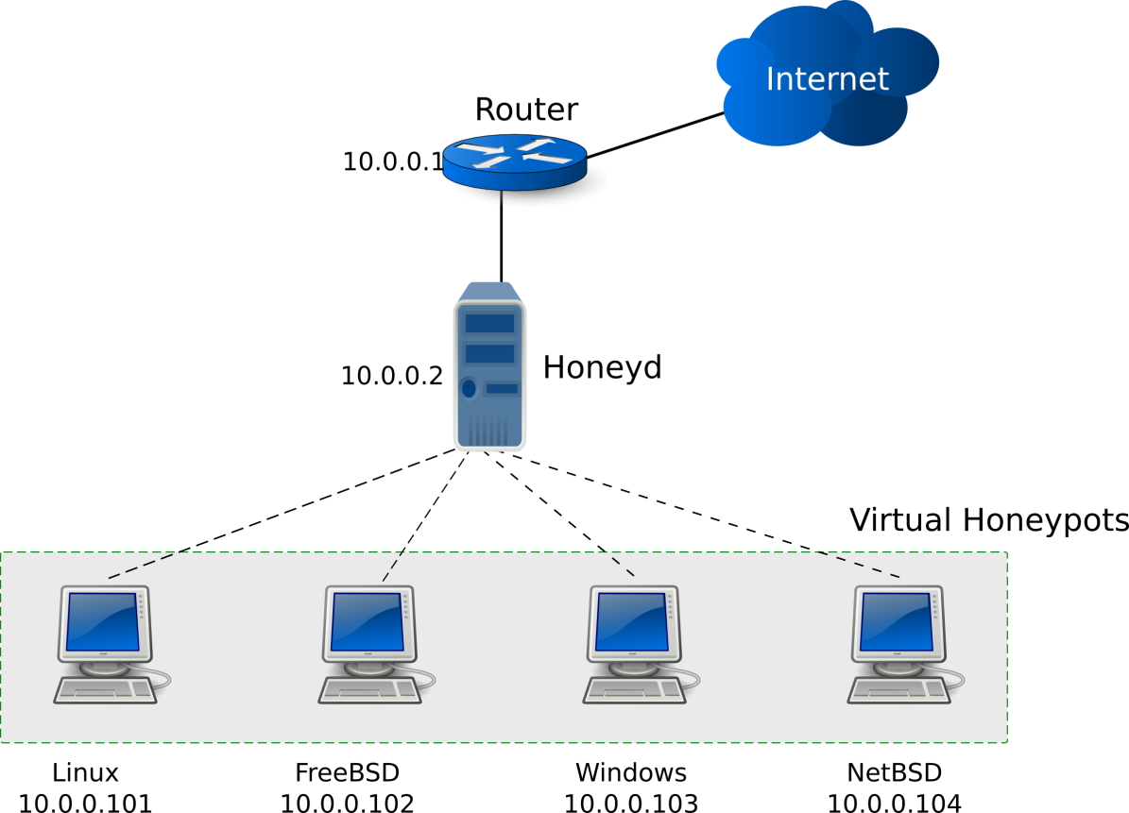
Low-interaction honeypots: Honeyd
Receive and responds to packets routed to unused IP address range.
Personalities and service scripts are assigned to unused addresses.
Personality defines traffic fingerprints, i.e., response appear to be from specific OS.
Service script emulate services running on these addresses.
Other honeypots available
Kippo, …

Slide 4
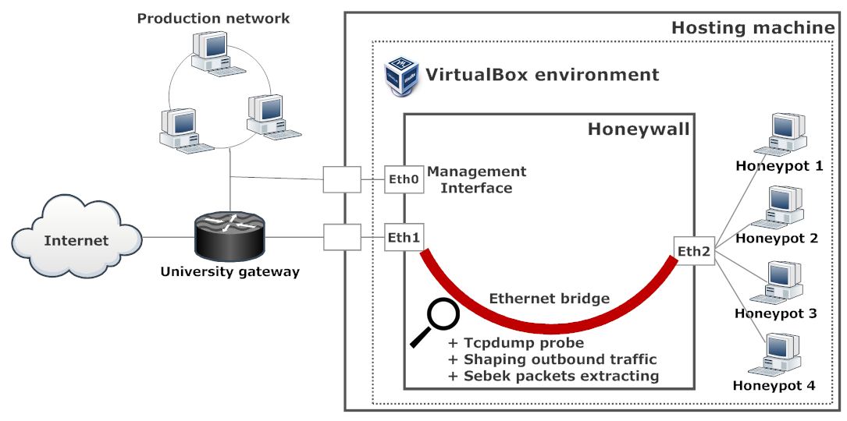
High-Interaction honeypots
A farm of honeypots
Easy to breach (PAM)
Kernel module (Sebek) monitors actiivites
With one exception only script kiddies, low-level ddos-ers, etc.

Slide 5
Honeypots in Fedcloud
Utilization of the environment
Distributed and/or floating “probe”
Detecting trends, common attacks
Detecting incentives, help attribute attacks
…..

