Slide 1
EGI Federated Cloud
Enol Fernández
Cloud Technologist @ EGI Foundation

Slide 2
EGI: Advanced Computing for Research
Notes:
A globally distributed ICT infrastructure that federates the digital capabilities, resources and expertise of national and international research communities in Europe and worldwide.
EGI has delivered unprecedented data analysis capabilities to more than 48,000 researchers from many disciplines and is now committed to bring innovation to the private sector.

Slide 3
EGI Service Catalogue
Compute
High-Throughput Compute
Execute thousands of computational tasks to analyse large datasets
→ aka ‘Grid computing’
Cloud Compute
Run virtual machines on demand with complete control over computing resources
Cloud Container Compute
Run Docker containers in a lightweight virtualised environment
Storage and Data
Online Storage
Store, share and access your files and their metadata on a global scale
Archive Storage
Back-up your data for the long term and future use in a secure environment
Data Transfer
Transfer large sets of data from one place to another
Training
FitSM training
Learn how to manage IT services with a pragmatic and lightweight standard
Training infrastructure
Dedicated computing and storage for training and education

Slide 4
EGI Federated Cloud
Grid of clouds
Harmonised operational behaviour
Clouds and their interconnections are based on open standards, open technologies
EGI Service → Access online AND Technology → Build your own federation

Slide 5
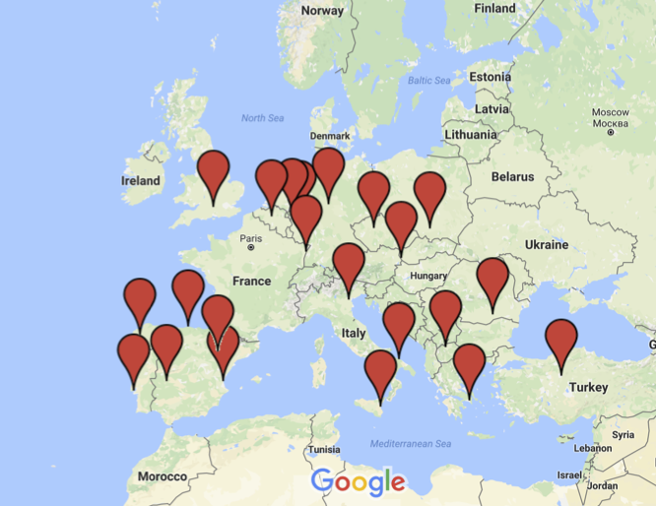
EGI Federated Cloud Infrastructure

Slide 6
Architecture: IaaS Federation
EGI AAI
Community Platforms
AppDB VMOps
IaaS Federated Access Tools
IaaS API
IaaS API
IaaS API
Cloud Management Framework
Cloud Management Framework
Cloud Management Framework
EGI Federation services:
Accounting, Monitoring, Configuration Database, Information Discovery, VM Marketplace
Notes:
Provide access to the heterogeneous IaaS frameworks:
IaaS provisioning systems that allow to define infrastructure as code and manage and combine resources from different providers, thus enabling the portability of application deployments between them
Smart brokers providing matchmaking for workloads to available providers
Cloud Management Software that provides a unified console for accessing resources and deploy workloads following a set of user-defined established policies (e.g. Scalr or RightScale)

Slide 7
IaaS Cloud User
or Gateway
Browse
VAs
EGI AppDB
Registers
VAs
Cloud Developer
Manage IaaS resources
IaaS API
IaaS API
VM
VM
Automatic distribution of VAs
VM
EGI Cloud Providers
Platform/Service User

Slide 8
AppDB: VM Image Marketplace
Open Library of Virtual Appliances
Use on providers or for personal download
EGI VM images, securely configured and tested
Community curated sets of images
Automatic distribution to cloud providers

Slide 9
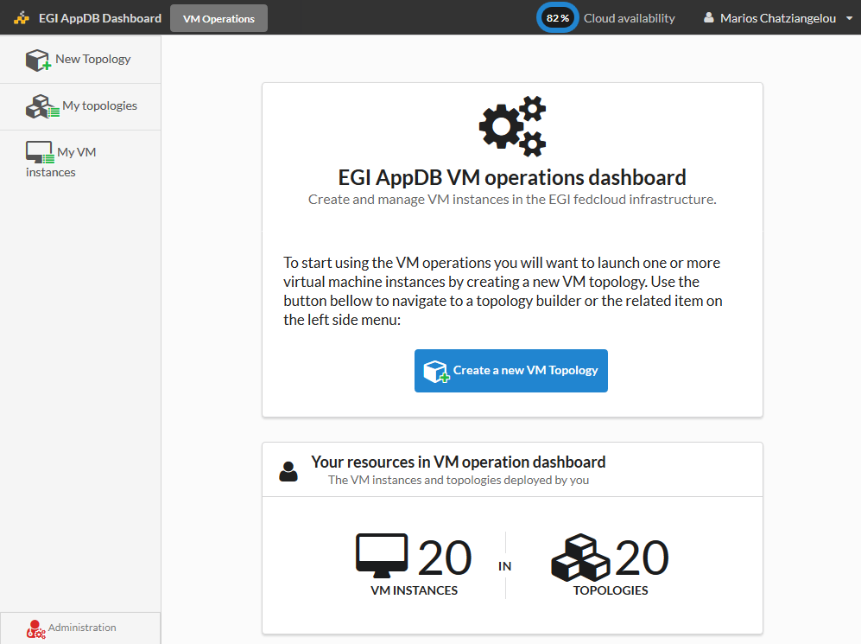
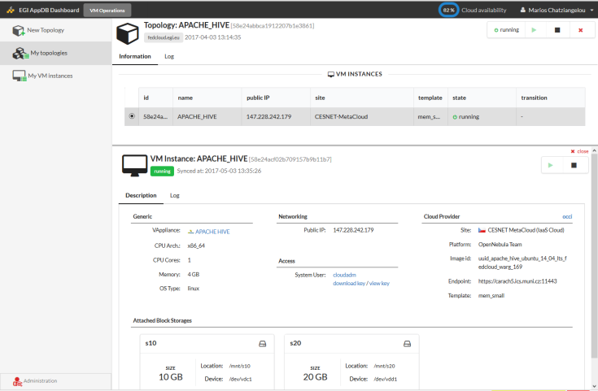
AppDB: VMOps Dashboard
https://dashboard.appdb.egi.eu/vmops
Unified GUI for resource management on the Federated Cloud
Complete EGI CheckIn integration
Personalized, wizard-like, topology builder:
Manage multiple-VM topologies with associated storage and contextualization
Fine grained control of VMs within topologies
Notes:
Feature list from Marios original slide:
Create a new topology with one (or more) instances of a specific VM
Attach additional storage to the VM instances
Deploy/Un-deploy a topology
Start/Stop a topology (= all the VM instances of a topology)
Start/Stop a single VM instance
Execute bash script on deployment time

Slide 10
Platforms on top of fedcloud
PeachNote | NBIS | GeoHazards TP | AoD | D4Science
7K registered users +64M page views | 8 different services 8K users from 73 countrues | +500 registered users 50% resources on EGI | Beta open for NILs Easy to access applications | VREs on a Hybrid Data Infrastructure Entering production this month
104 vCPUs 162 GB RAM 8TiB Storage | 172 vCPUs 400 GB RAM 9TiB Storage | 360 vCPUs 800 GB RAM 10TiB Storage | 167 vCPUs 244 GB RAM 4TiB Storage | 210 vCPUs 584 GB RAM 12,5 TiB
CESNET, FZJ | RECAS-BARI, IN2P3, ULAKBIM | RECAS-BARI, 100IT, GRNET, GWDG, CYFRONET, BELSPO, CESGA | CESGA, BIFI, RECAS-BARI, INFN-CATANIA | IISAS, CESGA, UPV-GRYCAP, RECAS-BARI, GWDG

Slide 11
User Support
https://wiki.egi.eu/wiki/Federated_Cloud_user_support

Slide 12
Support flow
Initial use case assessment
Prototyping under fedcloud VO
Migration to production
Identify suitable setup
Allocate Technical experts
2x6 months periods
Limited allocation at most sites
Identifying committed providers
Setup of VO, SLA and OLAs
Notes:
EGI’s federated support model
National support teams (NGIs)
Topic/discipline-specific support teams
EGI.eu UCST – primarily coordination & support for supporters (support@egi.eu)
DOCS:
Step by step guides
Tutorials
Examples
EGI Endorsed images
Main OS versions
Secure, up-to-date
Contextualisation

Slide 13
Getting access credentials
AppDB Dashboard does not require user certificates
EGI SSO account (http://www.egi.eu/sso)
Can be opened to selected users of EGI CheckIn
Simple ’point-and-click’ interface
User certificates
Need to be obtained from recognized CA
Allow complete access to the APIs of sites
OpenStack / OCCI
Use solutions like IM from Indigo
Terena TCS:
ESA/ESFRIN IdP is recognised

Slide 14
Documentation
Federated Cloud User Support
https://wiki.egi.eu/wiki/Federated_Cloud_user_support
APIs, SDKs, CLIs:
https://wiki.egi.eu/wiki/Federated_Cloud_APIs_and_SDKs
OCCI Developer guide:
https://wiki.egi.eu/wiki/EGI_Federated_Cloud_jOCCI_APIs
AppDB Cloud Marketplace FAQ:
https://wiki.appdb.egi.eu/main:faq#cloud_marketplace
FedCloud FAQ:
https://wiki.egi.eu/wiki/FAQ10

Slide 15
Resource allocation to Virtual Organisations (VOs)
Type, number, size, cost, availability, etc.
Applic. provider
Service requirements
Conditions
Storage provider
Cloud provider
Project/Community representing the VO
Negotiator
Grid provider
Service Level Agreement
Operation Level Agreement
Training
Support
Satisfaction review (every 3/6/12 months)
Performance reports
Notes:
SLA is an agreement on intentions to collaborate and support research.
OLA captures conditions, such as: What type of service? How much capacity? Location of service? Free or pay-for-use? How much availability and reliability? Response time for user/operational requests? ‘Human services’, such as consultancy and training? Etc.

