Slide 1
The Copernicus Collaborative Ground Segment and the ESA Earth Observation Ground Segment
G. Buscemi - ESA
B. Angelucci - RHEA
25 May 2017

Slide 2



ESA EO Core Ground Segments
Dissemination
Dissemination (Mix of Virtual and Physical resources):
Virtual Central Dissemination (DissHarm)
Copernicus Dissemination Platform (Pick-Up Point)
Local DMZ on remote sites
Multi-Mission Central Services
Copernicus Central Services
Internet
Pick-Up Point
Data Hub Portals
DissHarm
ELVIS
Dissemination Center
Processing Center
KSAT
e-GEOS
INTA
DLR
Airbus
UK
ESAC
Multi-Mission
MPLS Backbone
Copernicus
MPLS Over DWDM
EUMETSAT
SSC
CLS - B
Cloud Services
CNES
CNMCA
CLS - T
DAS
ESRIN
ACRI
Indra

Slide 3
ESA EO Core Ground Segments
Processing
Processing (Mix of Virtual and Physical resources):
Virtual Central Processing (ELVIS)
Mixed local physical servers and local virtual solutions
Private PaaS high performing infrastructure (Insourced ESA)
Interconnected Public Cloud
Multi-Mission Central Services
Copernicus Central Services
Internet
Pick-Up Point
Data Hub Portals
DissHarm
ELVIS
Dissemination Center
Processing Center
KSAT
e-GEOS
INTA
DLR
Airbus
UK
ESAC
Multi-Mission
MPLS Backbone
Copernicus
MPLS Over DWDM
EUMETSAT
SSC
CLS - B
Cloud Services
CNES
CNMCA
CLS - T
DAS
ESRIN
ACRI
Indra

Slide 4
ESA EO Core Ground Segments
Archiving
Archiving:
Local LTA at PACs
Data Archival Center (DAS)
Cold Backup
Multi-Mission Central Services
Copernicus Central Services
Internet
Pick-Up Point
Data Hub Portals
DissHarm
ELVIS
Dissemination Center
Processing Center
KSAT
e-GEOS
INTA
DLR
Airbus
UK
ESAC
Multi-Mission
MPLS Backbone
Copernicus
MPLS Over DWDM
EUMETSAT
SSC
CLS - B
Cloud Services
CNES
CNMCA
CLS - T
DAS
ESRIN
ACRI
Indra

Slide 5
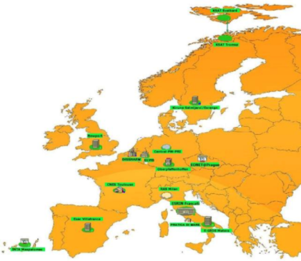
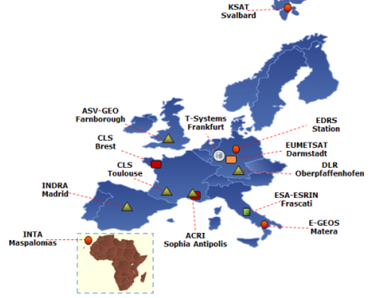
ESA EO Core Ground Segments
Network
Network
Two networks based on MPLS/DWDM up to 10 Gbps
Central Internet break-outs
LAN at remote sites with heterogeneous technologies and ownership
Multi-Mission Central Services
Copernicus Central Services
Internet
Pick-Up Point
Data Hub Portals
DissHarm
ELVIS
Dissemination Center
Processing Center
KSAT
e-GEOS
INTA
DLR
Airbus
UK
ESAC
Multi-Mission
MPLS Backbone
Copernicus
MPLS Over DWDM
EUMETSAT
SSC
CLS - B
Cloud Services
CNES
CNMCA
CLS - T
DAS
ESRIN
ACRI
Indra

Slide 6
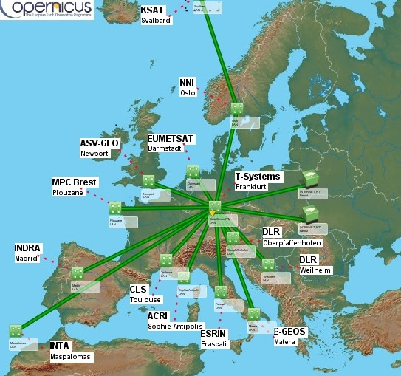
Copernicus Core Ground Segment
WAN Details
The Ground Segment
3 Core Ground Stations (CGS)
7 Processing and Archiving Centres (PAC)
3 Mission Performance Centres (MPC)
3 Payload Data Monitoring Centres (PDMC )
1 Marine Centres (Eumetsat)
1 Coordinated Data Access Service (CDS)
EDRS Receiving Station

Slide 7
EO Core facilities
Site | ACRI @ Luxemburg | ACRI @ S. Antipolis | Airbus @ Newport | Airbus @ Weilheim | CLS @ Brest | CLS @ Toulouse | CNES @ Toulouse | DLR @ Oberpfaffenhofen | E-GEOS @ Matera | ESAC | ESRIN | EUMETSAT @ Darmstadt | Indra @ Madrid | INTA @ Maspalomas | KSAT @ Svalbard | KSAT @ Tromsoe | SSC @ Kiruna
MM | 1 |  | 0,3 |  |  |  | 0,1 | 0,15 | 1 | 0,3 | 2 |  |  |  | 0,4 | 0,3 | 0,3
Copernicus |  | 1 | 10 | 1 | 1 | 1 |  | 10 | 10 |  | 1 | 1 | 10 | 1 | 2.5
Gb/s
Intranet combined capacity: 100 Gb/s
Internet access combined capacity: 45 Gb/s
Mission | Globe Coverage | Orbit # | BW
S 1A/B | 6 days | 175 | 2 x 280 Mb/s
S 2A/B | 5 days | 143 | 1 x 280 Mb/s
S 3A | 27 days | 385 | 2 x 280 Mb/s

Slide 8
EO Data Volume
Site | Host | pCPU | pCore | RAM | VM | Storage
Copernicus PuP | 16 ESXi | 64 | 672 | 8 TB | 70 | 8 PB
DISSHARM | 4 ESXi | 8 | 48 | 768 GB | 33 | 2.75 PB
ELVIS | 5 ESXi (INT) 3 ESXi (DMZ) | 16 | 176 | 2048 GB | 81 | 2.25 PB INT 250 TB DMZ
ESRIN | 2 ESXi (INT) 2 ESXi (DMZ) | 66 | 924 | 4,5 TB | 350 | 300 TB x2 960 TB
Data volume | Data/Day
S1A+B | 16 TB
S2A | 800 GB
S3A | 420 GB
Swarm | 5 GB
Cryosat | 33 GB
Traffic | Volume/month
Copernicus Circulation | 1.25 PB
MM Circulation | 170 TB
Dissemination from DataHub | 1.98 PB
Dissemination from DISSHARM + Centres | 130 TB

Slide 9











ESA-EO Operated Data Hubs
Open Access
Data Hub
Collaborative
Data Hub
International
Access Hub
Copernicus Services
Data Hub
Self Registration
13 Collaborative Users
5 Data Hub Relay Users
4 Users
166 Users
> 53,660 Users
No Rolling
Policy Applied
Node 1: 30 days
No Rolling Policy Applied
Node 2: 9 days
30 Days
Sentinel-1 NTC
Sentinel-1 NRT & NTC
Sentinel-1 NTC
Sentinel-1 NRT¹ & NTC
Sentinel-2 L1C
Sentinel-2 L1C
Sentinel-2 L1C
Sentinel-2 L1C
Sentinel-3 pre-ops
Max 2 Concurrent Downloads
Node 1: Max 10 downloads
No limits
Max 10 concurrent downloads
Node 2: No limits
NRT¹ via dedicated ftp

Slide 10








ESA-EO Collaborative Hub
Use of Collaborative Hub and International Hub requires a technical arrangement with ESA or an international arrangement with the EC
The Collaborative Hub was initially setup for ESA Member states participating in the GMES program and later expanded to all GMES/Copernicus participating states.
Partners retrieving data from the Collaborative Hub and the International Hub will redistribute the products from their own platforms and data access points.
Node 2
Node 1
STFC
Member States mirror sites
Member States mirror sites
Member States mirror sites

Slide 11
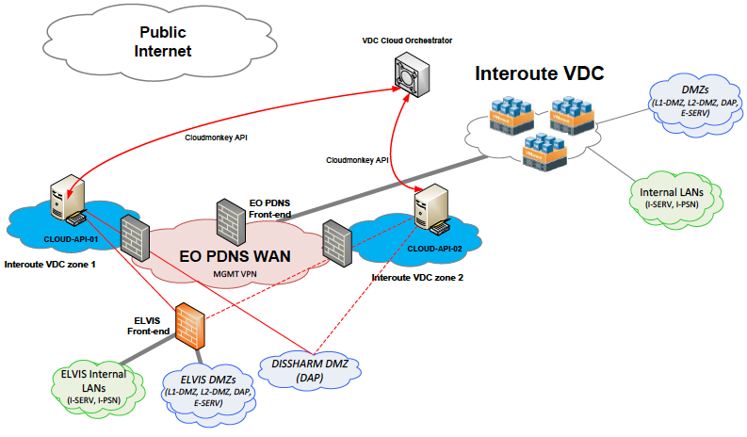
EO Cloud API proxy service
Commercial Cloud service
Aimed to support processing or dissemination peaks
Private PaaS high performing infrastructure
Cloud API proxy: 2 virtual servers in two Interoute VDC
CloudMonkey software installed
“pay per use” cost model
VM allocation capabilities: 3 minutes
Notes:
In case of dissemination and/or processing peaks, the platforms can (automatically or manually) request additional resources to the Cloud services (Interoute VDC). VDC Cloud resources can be released after completion of the extra processing.
A Cloud API proxy service is installed for EO PDNS VPNs/VRFs, composed of 2 virtual servers in Interoute VDC in Amsterdam and Frankfurt (for redundancy) with CloudMonkey software installed.
CloudMonkey is a command line interface (CLI) tool for CloudStack written in Python. CloudMonkey can be use both as an interactive shell and as a command line tool which simplifies CS configuration and management.
The proxy cloud API will allow to activate the Infrastructure as a Service “pay per use” cost model, capable of allocating bulks of VMs (up to 200 VMs) within 5 mins.
The Cloud service accessed via Cloud API follows a self-service model. Therefore, in an end-to-end perspective, two independent services are combined: a self-service VDC for VMs activated via Cloud API and a standard management network connectivity and security service independently activated via change process.
Templates for VM to be instantiated are provided by ESA.
Mechanisms for automatic activation/decommissioning of resources via API for both DMZ and I-PSN, import/export of VM templates are made possible by CloudMonkey API.
The VDC API is a standard 'REST-like' API which can be programmed using any modern programming language (JAVA, JavaScript, Ruby, PHP, etc, etc.).

Slide 12
EOP possible roadmap & use cases
EOP Private Cloud in line with EOSC and integration with commercial cloud
Possible federation with EGI
EOP applications running on the scientific cloud
EOP federated clouds
Data acquisition, storage & processing
Cloud bursting: on-demand computation capacity for processing for peak requests
Dissemination & federation
Improved Security

