Slide 1
Engagement meeting
2017. June 9.
Gergely Sipos Customer and Technical Outreach Manager on behalf of EGI Foundation

Slide 2
From opportunities to operational setups
Opportunity
Customer support case
Operation
User story (business case)
Community national footprint
Potential EGI services
NGI support
Cost-value-support analysis
Engagement wg- NEW
Detailed technical requirements
Sw. devel. &integration
SLA – OLAs
Service satisfaction review interviews (3/6/12 months)
Improvement suggestions
Publications, users
Capacity plan updates
Helpdesk; Complaints
Customer relationship management
Business development
Service Level Management
Notes:
NGIs support is critical in all the three stages:
Willingness to support Opportunities
Contribute with technologies and effort
High quality operations (IT and staff)

Slide 3
NILs
National/institutional/regional representatives
An inclusive ‘club’ (even for non-full member NGIs)
Linking national ‘non-operational’ activities with EGI and with other NGIs
Proactive outreach to new communities
Marketing and communication
Training
Support for new users/communities
Service orders?
Materials, information to make You successful in this role:
https://wiki.egi.eu/wiki/NGI_International_Liaison
Check current membership, ask for update/signup if needed!

Slide 4
In the pipeline
Opportunities | Customer support cases | Operation (SLA!)
DANUBIUS ANAEE Virgo/LIGO EMPHASIS KM3Net EBMRC SKA (AENEAS) EOSCpilot demonstr. (16) EOSC-hub CC&TS (2018) ACTRIS (2018) HBP (2018) | EGI-Engage CCs (8) ELI (ELItrans) ICOS-D4Science ICOS Carbon portal Euro-Argo EOSCpilot demonstrators (4) ENES (Ophidia) ENES (Climate4Impact) Eur. Research Initiative in CLL | MoBrain (WeNMR) DARIAH EMSO-EMSODEV
OpenDreamKit VRE Multiscale Genomics VRE AGINFRA+ use cases MSO4SC project | PhenoMeNal project EuroBioImaging-ES DISCCo-Scratchpads Nanotechnology-SK BigDataEurope project ESA-Geohazards Platforms Earth Observation PoC | Apps. On-Demand Service DRIHM VRE EXTraS project Life Science Grid Community NBIS (bioinformatics-SE) PeachNote Terradue SME D4Science communities
Research Infrastructures
Mid & long-tail
Notes:
Next 6 months is critical for arranging SLAs and serious links with RIs (EGI-Engage CCs)
Note that national/regional catch-all VOs don’t have SLAs – see issues raised later

Slide 5
Support recently improved for…
Opportunities:
Service portfolio on Website → Request; Questions;
19 requests in 2 months
To come: User manuals; Training materials (for every service where this is relevant)
→ https://www.egi.eu/services/
Community support cases:
Requirement interview and description forms
→https://confluence.egi.eu/display/Support/Community+Requirements+Database
Operation:
Applications on demand service
To come: Jupyter aaS; Galaxy aaS; GPGPUs
→ http://access.egi.eu

Slide 6
EGI-INDIGO Conference
https://indico.egi.eu/indico/event/3249/timetable
CC updates:
8 EGI-Engage, 2 unfunded (ICOS, EMSOdev)
Technology roadmaps (Later today)
Marketplace (Later today)
NGI session:
INCD (PT), CRO-GRID (HR), France-Grilles (FR), DNI (NL), Taiwan, UK, Ukraine, OSG (US)

Slide 7
Summary update talks
Diego, Giuseppe

Slide 8
Events
Recent:
MSO4SC workshop, Budapest, May 22-24
Event: http://mso4sc.elmerex.hu/?page_id=894
EGI overview presentation: https://documents.egi.eu/document/3119
Nordic e-Infrastructure Conference, Umea, May-June
http://neic2017.nordforsk.org/schedule
EGI Engagement presentation: http://neic2017.nordforsk.org/workshops/poco/
Next:
Webinar: Applications on Demand Service, June 13: https://indico.egi.eu/indico/event/3378/
User Community Board meeting: June 14 (closed)
International Workshop on Science Gateways, Poznan, June 19-21
AODS paper: https://documents.egi.eu/document/3132
EGI Federated Cloud tutorial and demo @ EUDAT Summer School, July 6, GR
EGI Federated Cloud tutorial @ CODATA-RDA Summer School, July 21, IT

Slide 9
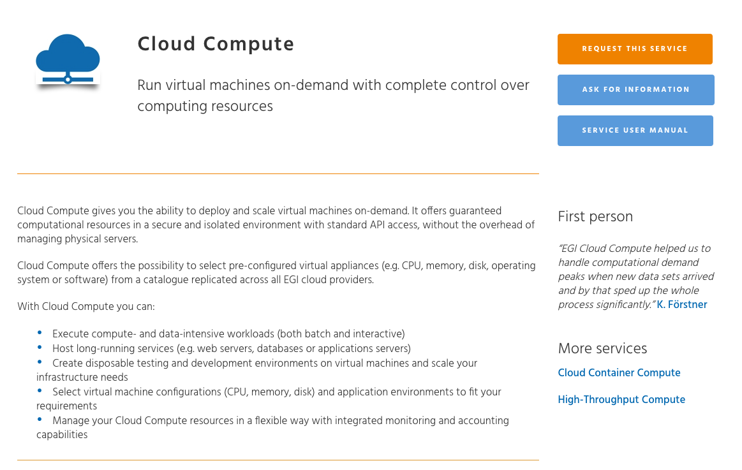
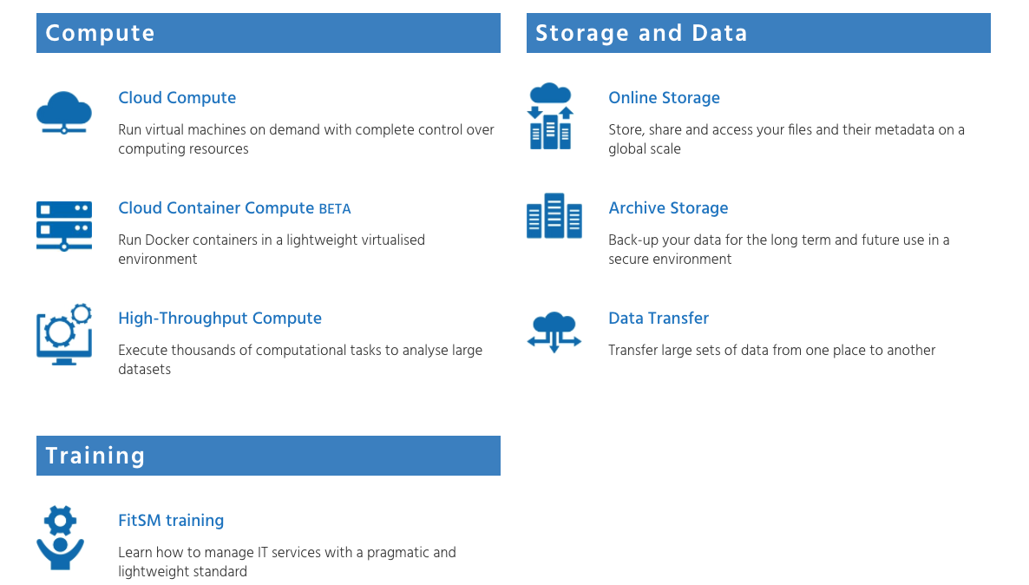
Discussion point 1: Service orders
Responses received by UCST.
But who should we involve from national level? NILs? USTs?

Slide 10
Discussion point 2: Engagement
NGI engagement status – Plans:
Updating NIL and UST contact points
Running a survey (roadmaps, priority communities, likes and dislikes in NIL structure)
Engagement meetings
Frequency?
Next meeting?

