Slide 1
EGI Marketplace Status of the design & Next Steps
Diego Scardaci
Technical Outreach Expert

Slide 2
Outline
Marketplace design
Data Model
Worflow
Marketplace prototypes
PrestaShop
Open IRIS
Outcome of the assessment
Next Steps
EGI-Engage
EOSC-hub

Slide 3
Marketplace Design

Slide 4
Marketplace design
Marketplace prototypes implemented adopting and customising technologies developed by third parties
PrestaShop: https://www.prestashop.com/en/documentation
Open IRIS: https://wiki.systemsx.ch/display/openiris/Open+IRIS
Focused on defining:
Data model
Workflows

Slide 5
Data Model

Slide 6
Data Model
Representing services in the EGI service catalogue
Work in progress:
extension to include thematic and external services
Three-level hierarchy:
First level: EGI service areas (categories in the marketplace)
Second level: maps to the EGI services (sub-categories in the marketplace)
Third level: defines the EGI service option
What user can order
Complete data model available in EGI-Engage D3.13

Slide 7
EGI Service Catalogue - First and Second levels
Service area | Services
Compute | Cloud Compute, Cloud Container Compute and High-Throughput Compute
Storage | Online Storage, Archive Storage
Data | Data transfer
Training | Training Infrastructure, FitSM

Slide 8
Service Areas
Attribute | Definition | Notes
Name | Name of the category | The first level category maps to the EGI service area: Compute Storage Data Operations Security Training
Description | Description of the category | Inspired by the description of the EGI service areas in the service catalogue: short, punchy and expressing the value

Slide 9
Services
Attributes
Name | Category
Unique ID | Service Condition
Short description | Payment model
Description | Term of use
Webpage | SLA
Service Phase

Slide 10
Third level – service options An example – Cloud Compute (1/2)
Service options | Descriptions | Options
General purpose instance type | Base performance instance type suitable for web services, micro-services, development environments, building server, small database and tests. | Number of Cores: [1,2,4] Amount of RAM (GB): [2,4,8] Local disk (GB): [10,20,40]
HPC instance type | High performance CPU and low latency network | Number of Cores: [8,12,16,20,24,28,32,64] Amount of RAM (GB): [2,4,8] Local disk (GB): [10,20,40]

Slide 11
Third level – service options An example – Cloud Compute (2/2)
Service options | Descriptions | Options
High-Memory instance type | Instances for tasks that require more memory relative to virtual CPUs, ideal for running in-memory stores (e.g. redis, memcached) or in-memory big data processing engines (e.g. Apache Spark). | Number of Cores: [2,4,8,12,16,20,24,28,32,64] Amount of RAM (GB): [8,16,32,48,64,80,96,112,128,256] Local disk (GB): [10,20,40]
GPU instance type | GPU-enabled instances for graphics and general purpose GPU compute applications. | Number of GPUs: [1,2] Number of CPUs: [8,16] Amount of RAM (GB): [24,50] Local disk (GB): [280]

Slide 12
Workflows

Slide 13
Workflows
Authentication & Registration
Customer logs in the EGI marketplace through the CheckIn service.
Customer fill in an additional form
Information not provided by CheckIn
Customer profile
Discover and request services
Customer navigates on the EGI service catalogue and requests access to one or more services.
Check-out
Service order profiling

Slide 14
Authentication & Registration
Overview:
Customer logs in the EGI marketplace through the CheckIn service.
Trigger:
Customer decides to log in while he/she is visiting the marketplace.
Customer starts the checkout process
Entities involved in the process
Customer
Marketplace
CheckIn service

Slide 15
Authentication & Registration
Input
No input
Output
Personal customer information including the unique EGI identifier.
CheckIn: mail, name, surname, display name, EGI identifier
Additional information: country, institution, department, departmental web page, linkedin profile, …
Customer’s VO membership list
Currently not available in CheckIn

Slide 16
Discover and request services
Overview:
Customer navigates on the EGI service catalogue and requests access to one or more services.
The marketplace exposes services following the service catalogue structure:
First level: service categories
Second level: services
Third level: service options
Trigger:
Customer accesses the marketplace
Directly or through the EGI web site.

Slide 17
Discover and request services
Entities involved in the process
Marketplace & customer
Input
No input
Output
List of services including service options.

Slide 18
Check-out
Overview:
Profiling the service access request:
Customer type: single users, research community, private company.
Reason to access EGI resources
User group/VO name
Information on the project
Trigger:
Customer starts the check-out process after have requested access to one or more services
Entities involved in the process
Customer, Marketplace, CheckIn service, Operations Portal

Slide 19
Check-out
Input
Personal customer information including the unique EGI identifier.
Customer’s VO membership list (not available yet).
Service list including options selected by the customers
Output
Personal customer information including the unique EGI identifier
Customer typology: community or single user
Reason to request access to the EGI services
Only for customers representing a community:
Information on the project (to be expanded)
VO information; new or existing, VO name

Slide 20
Marketplace prototypes

Slide 21
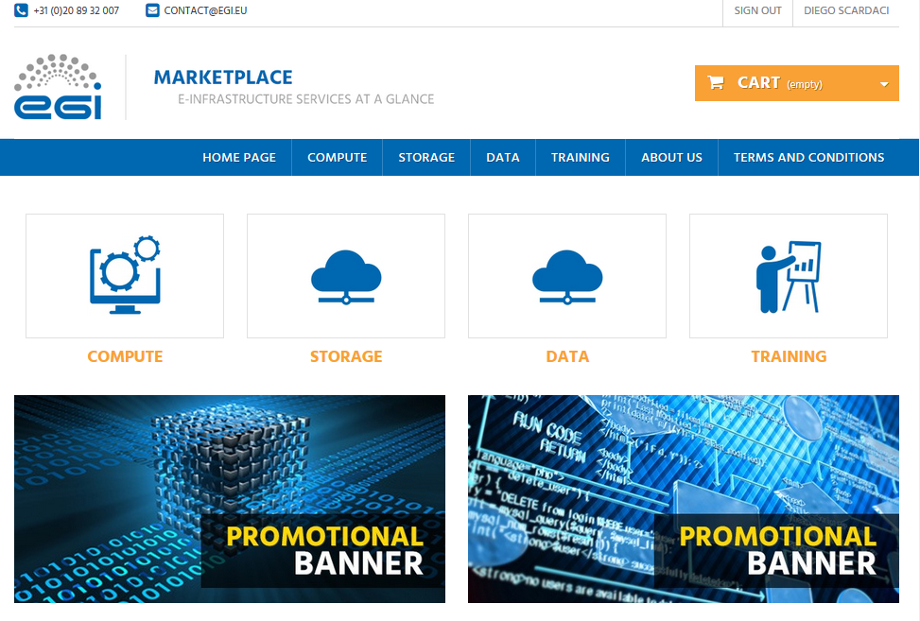
PrestaShop prototype http://marketplace.egi.eu

Slide 22
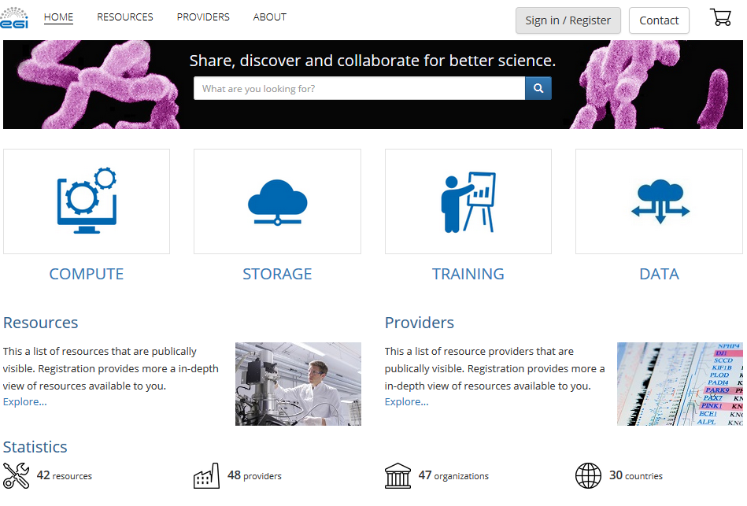
Open IRIS prototype http://egi.science-it.ch

Slide 23
Open IRIS Status
2017 Award for “Laboratory Effectiveness” from S-Lab and UKSPA (UK Science Park Association) presented by JISC.
Current discussions/testing/pilots with UCL UK, Newcastle UK, PSI Switzerland, UPMC Paris, ICM Paris, BIC France, MDC Berlin, BIH Berlin, France-BioImaging, HiLIFE Helsinki.
Productively used by ETHZ, Unibas, College de France, ENS France, FMI, Institut Curie.
Partnership with ThermoFisher.

Slide 24
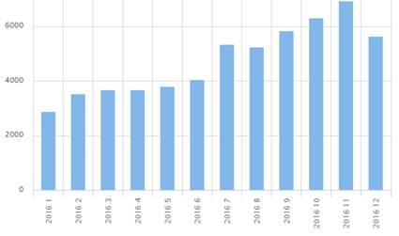
Open IRIS Metrics
Doubling of users in 2015 and 2016, over 4200 users currently on the platform.
Doubling of resource usage requests in 2016, over 6000 per month at the end of 2016.
85 organizations in 12 countries with hundreds of logins per day.
It has approximately 150 resource providers registered with a total of over 1000 resources in the system.
Usage spans universities, institutes, hospitals, and commercial entities.
Resource Usage Requests 2016

Slide 25
Outcome of the marketplace assessment
PrestaShop technology chosen
Widely used by other Internet web stores
Easy to maintain as it has a wide community of developers
Expertise within the EGI collaboration
Ready-to-use feature to implement the pay-for-use support
Clear open-source license

Slide 26
Work in progress in EGI-Engage

Slide 27
Ticketing system Register/Manage the service requests
Registry of the service requests
Ticket attributes defined according to the needs of the processes
flags to trigger BDS, CRM or SLM processes (EGI IMS)
attributes to fill in databases: business opportunities, customer, SLA
Notification system
Trigger the different processes
Trigger workload for enabling services (e.g. notify ops)

Slide 28
Pay for use – Analysis (1/2)
Add the pay-for-use attributes directly in the service options (product in the marketplace)
EGI acts as a broker
Flag “for pay” to be added in the service options
Under service level differentiate each option according to the access mode: for free or for pay.
“General purpose instance” and “General purpose instance for pay”, etc.
EGI acts as a broker / or individual provider offers listed separate, but aggregated on the service level

Slide 29
Pay for use – Analysis (2/2)
Add an additional category related to the pay-for-use providers.
Direct contracts between customers and providers
Under this category all the providers will be listed
Under each provider, all its products will be listed.

Slide 30
Integration with the Applications on demand platfom
User registration done through the marketplace
Markplace will forward service order to App on demand platform
Redirection to the current e-GRANT to be removed
amount of requested resources assigned to the customer
total amount of resources < of a threshold

Slide 31
Cart and customer dashboard
Cart:
Improving the information to profile service orders
Customer dashboard:
Allowing customer to know the status of their orders

Slide 32
Marketplace in EOSC-Hub

Slide 33
Planned Marketplace activities in EOSC-hub
Support thematic and external services
Publish the whole EOSC-hub service catalogue
Dynamic Marketplace
Gather service information from a service portfolio management tool
Satellite Marketplace
Per NGI/resource provider
Service order management
SLA/OLA
Reporting
Automatic service activaction

