Slide 1
The EGI Applications on Demand (AoDs) service
Giuseppe La Rocca giuseppe.larocca@egi.eu Technical Outreach Expert

Slide 2
Problem statement
Fragmented landscape of ‘catch-all’ services (35 VOs)
Barrier for reuse
Abandoned services in some NGIs
Barrier for use
‘Reinventing the wheel’ (same applications, frameworks)
Waste of effort
Complicated access (X509)
Barrier for usability

Slide 3
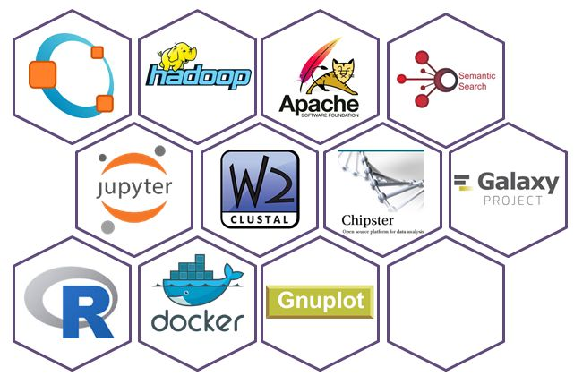
Applications on Demand service
Usability, Openness, Transparency, Quality
Open for users: http://access.egi.eu
Open for providers:
Add new applications
Add science gateways
Add cloud providers
Join the support team
User Registration Portal (URP)
2. Approval
User
1. Request
User DB
User support team
3. Generate user account
4. Application use
8. Scientific papers
Applications hosted in VRE gateways
5. Obtain proxy
Infra. certificate
6. Access cloud/HTC/storage
Support team monitors user activity
EGI Accounting system
7. Accounting records
access.egi.eu resource pool

Slide 4
Applications on Demand: value propositions
For Researchers/Scientists
> Use applications from provided library
For NGIs & cloud providers
> Offer applications to your own user groups by plugging own compute/storage in the backend
1. Request
User Registration Portal (URP)
2. Approval
User
User DB
User support team
3. Generate user account
4. Application use
8. Scientific papers
Applications hosted in VRE gateways
5. Obtain proxy
Infra. certificate
For Application Developers/Integrators:
> Add application to Science Gateway/hosting framework and share with other users
6. Access cloud/HTC/storage
Support team monitors user activity
EGI Accounting system
7. Accounting records
access.egi.eu resource pool

Slide 5
User requests so far
28 requests from 16 NGIs
Last updates June 08, 2017
NIL contact: Macedonia, Croatia, Czech Republic.

Slide 6
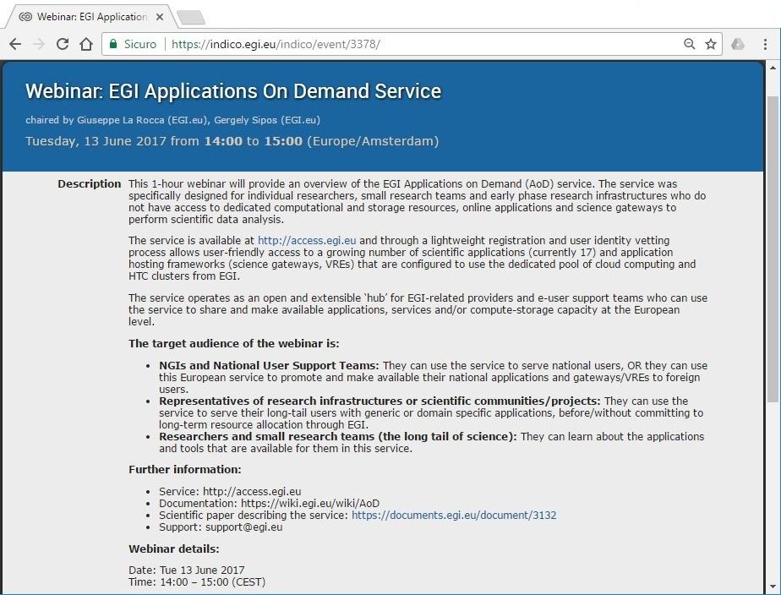
Webinar next week: save date!
Agenda: https://indico.egi.eu/indico/event/3378/

