Slide 1
Climate Data Analytics in a Big Data world
Christian Pagé
Research Engineer
Xavier Pivan
Research Engineer
Centre Européen de Recherche et de Formation Avancée en Calcul Scientifique (CERFACS), Toulouse, France

Slide 2
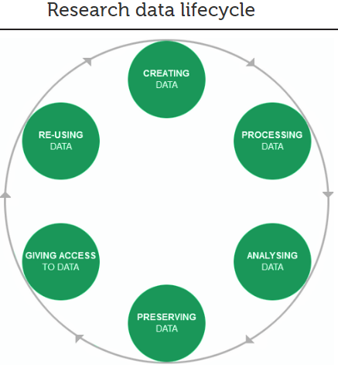
Motivations
Scientific
  Perform efficient Data Analysis
    Large number of realizations (ensemble of scenarios)
    Uncertainties range estimation
    Process Higher spatial and temporal resolution
    Easily share intermediate results with collaborators
  Achieve a more robust and flexible Data Life Cycle
    More robust experiments setup
      Explore several experiment configurations to answer scientific questions
    Reproducible experiments

Slide 3
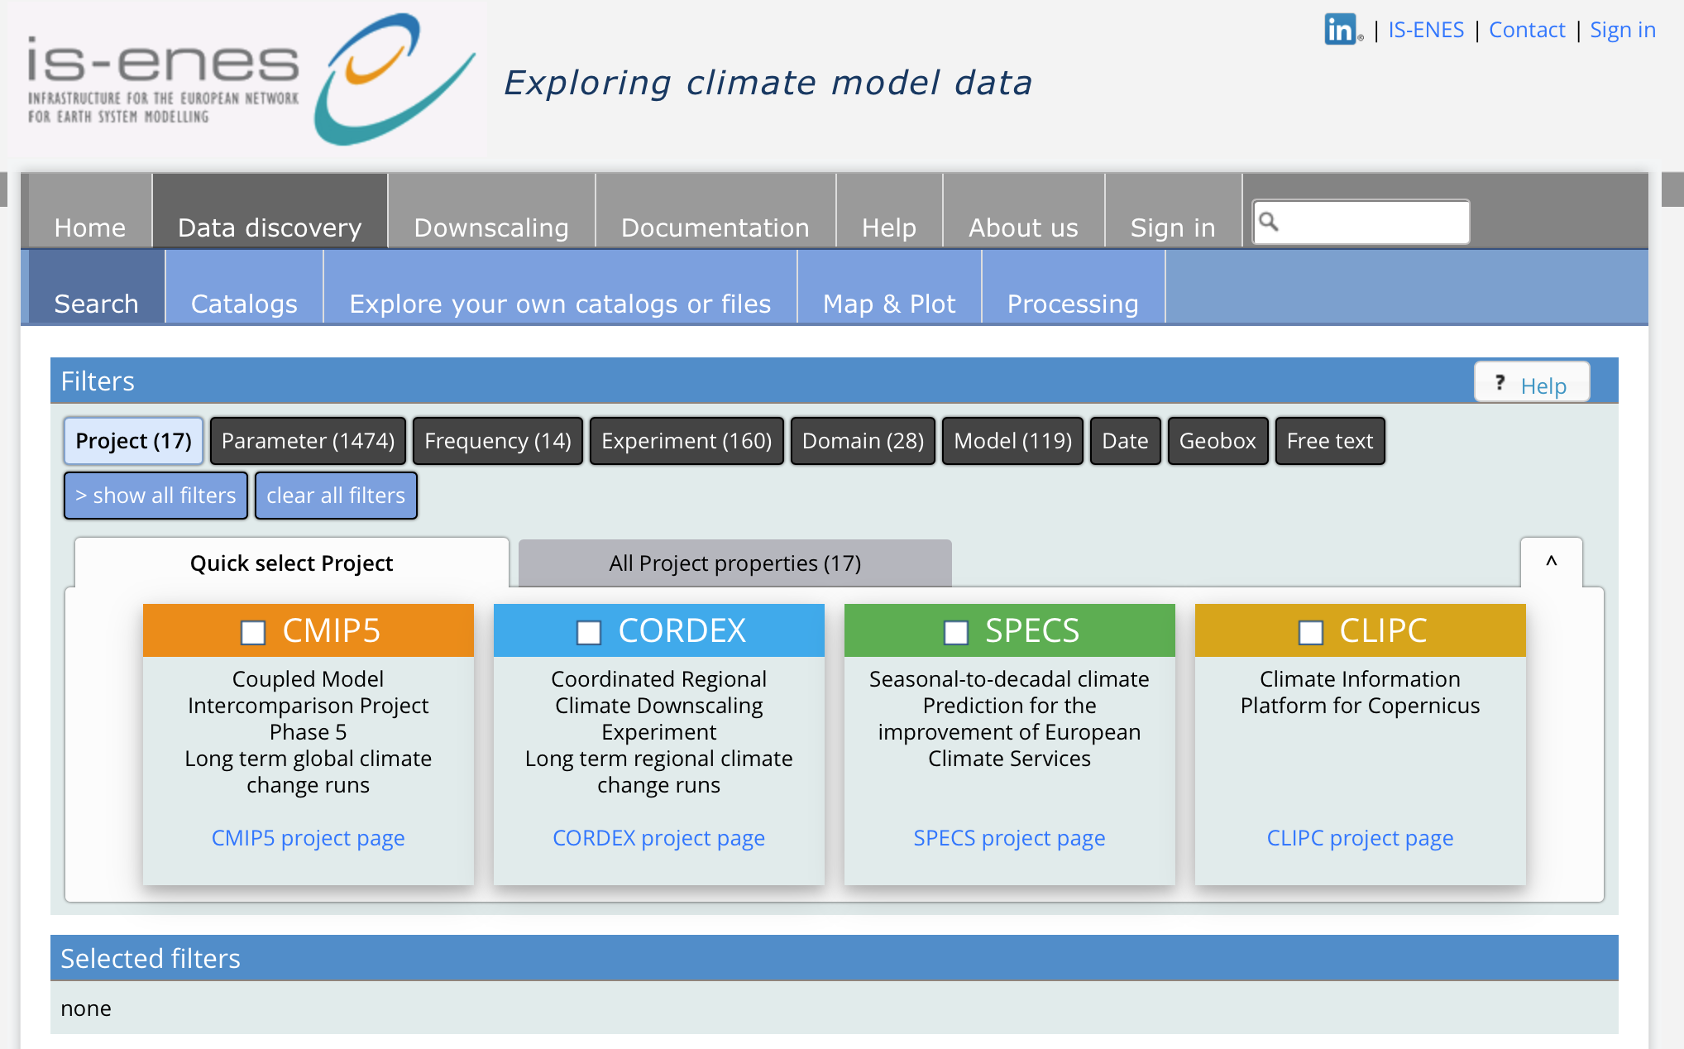
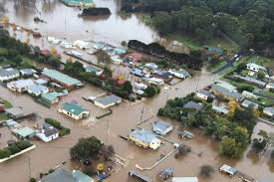
Motivations
Societal
  Provide climate projections data to climate change impact researchers, facilitators, practitioners
    Ease access with better intuitive interfaces
    Provide more common data formats
    Generate tailored products from data processing workflows
http://climate4impact.eu

Slide 4
Current situation
Climate Research Community
Data available for scientific analysis: a very large trend
  Limitations in data access means limitations in data analytics and scientific results
Download locally then Analyze: a workflow that cannot be sustained
  Climate researchers
  Impact researchers

Slide 5
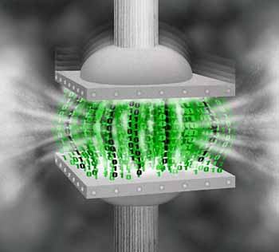
Current situation
Practical Example: Climate Community
Temperature at 850 hPa field (Aggregated files 30 levels)
10 climate models
1960-1990 & 2040-2070 = 60 years = 21 915 days
Daily fields = 1 field per day
Global spatial scale 100 km resolution
TOTAL: 6 754 500 fields to download
~100 Kb per 2D field = 626 Gb
After the analysis post-processing
Anomaly of the average of the two periods over a specific country for each climate model
Result: 10 times 2D fields over a small domain
  Estimated datasize after post-processing: 1 Mb
Federation Service
Data reduction...

Slide 6





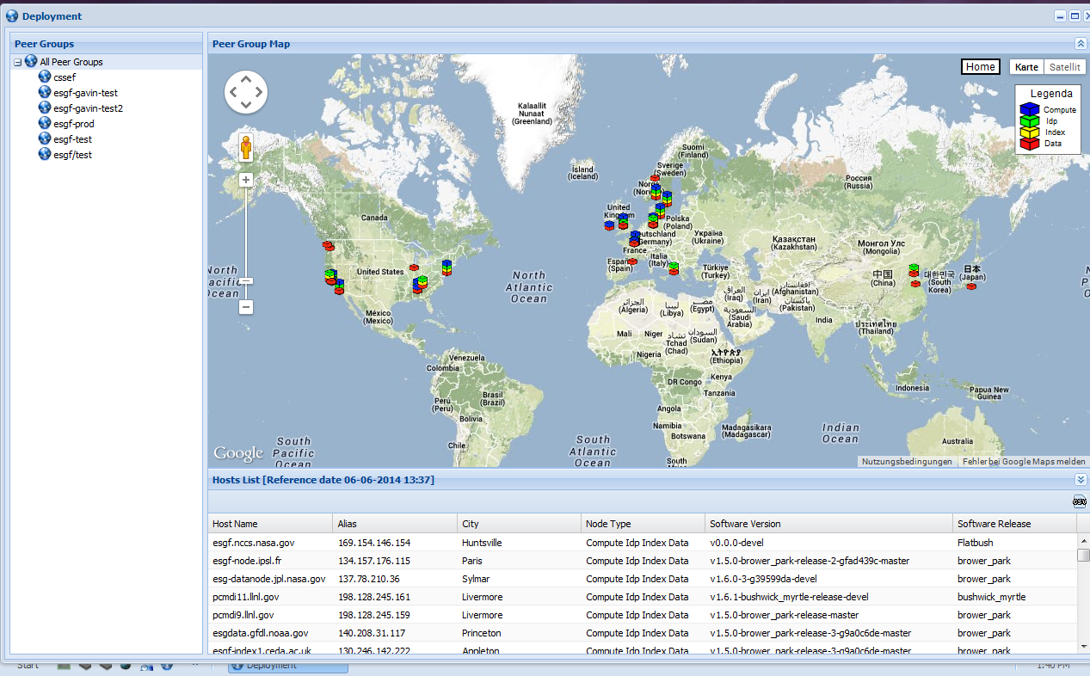







Climate Data Distribution: ESGF
ESGF Data Nodes 2015:
40 worldwide
18 in Europe
(coordinated in IS-ENES)
IS-ENES ESGF Portals
BADC (UK)
DKRZ (Germany)
IPSL (France)
SMHI (Sweden)
CMCC (Italy)
DMI (Denmark)
IS-ENES climate4impact Portal
KNMI (Netherlands)
Interlinked with Uni. Cantabria downscaling portal (Spain)
CLIPC Portal
Climate Information Portal for Copernicus
Ack: Michael Lautenschlager, DKRZ

Slide 7
Current situation
Status CMIP5 data archive:
1.8 PB for 59000 data sets stored in 4.3 Mio Files in 23 ESGF data nodes CMIP5 data is about 50 times CMIP3
Extrapolation to CMIP6:
CMIP6 has a more complex experiment structure than CMIP5.
Expectations: more models, finer spatial resolution and larger ensembles
Factor of 20: 36 PB in 86 Mio Files
Factor of 50: 90 PB in 215 Mio Files

Slide 8
Simplified Prototype ENES Use Case
Researcher finds data in B2SHARE using B2FIND, or provides PIDs/URLs
2. Researcher performs Data Analytics of selected data using GEF deployed on EGI FedCloud. Output is stored into EGI DataHub.
3. Results are sent back to B2SHARE/B2DROP for researcher to download, or execute another GEF for further calculations or to generate a figure. Resulting figure could be put into B2DROP.

Slide 9
Solutions: Putting it all together
Bridge EUDAT / EGI / ESGF / IS-ENES
  EUDAT Workflow API (GEF) ⬄
    EGI Federated Cloud
    EUDAT B2SAFE/B2STAGE/B2SHARE & B2DROP Services
    ESGF Computing API WPS
    IS-ENES Data Analytics Services => climate4impact.eu platform
Detailed technical prototype schema follows.... along with needs wrt resources

Slide 10
Prototype overview
B2SAFE
B2STAGE
LOCALHOST
B2SHARE/B2DROP
GEF – User Interface
Send request / calculation order
Data URL or PID
Transfer with globus
Virtual Machine
New data
GEF backend deploy docker container
Execute calculation command
Docker Volume
EGI Volume
Data
New data
Data transfer
New data
In progress
Calculation
Input
Output
EGI Federated cloud
EUDAT service

Slide 11



Infrastructure in progress
EGI infrastructure
IAAS: Virtual Machine – CPU / RAM
Storage - Docker engine – GEF backend

Slide 12
EUDAT – EGI interoperability
We have:
  IAAS structure
  VM: CPU – RAM – Storage
  Docker engine
We want to use / set up:
  Globus
  Interoperability B2SAFE-B2STAGE / EGI

