Slide 1
Applications on Demand (AoD) service
Giuseppe La Rocca
Technical Outreach Expert

Slide 2
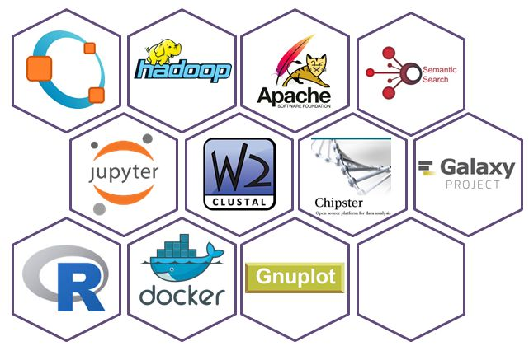
Applications on Demand (AoD) service
Usability, Openness, Transparency, Quality
Open for users: http://access.egi.eu Webinar: https://indico.egi.eu/indico/event/3378/
Open for providers:
Add new applications
Add science gateways
Add cloud providers
Join the support team
User Registration Portal (URP)
2. Approval
User
1. Request
User DB
User support team
3. Generate user account
4. Application use
8. Scientific papers
Applications hosted in VRE gateways
5. Obtain proxy
Infra. certificate
6. Access cloud/HTC/storage
Support team monitors user activity
EGI Accounting system
7. Accounting records
access.egi.eu resource pool

Slide 3
Applications on Demand: on-going and planned developments
Engage with NGIs and scientific communities to extend the portfolio of offered applications and VREs
JupyterHub aaS and Galaxy aaS in the pipeline
Preparing a prioritised list of future applications
Engage with resource providers to expand the available capacity (cloud, HTC, storage)
Harmonize the access with the EGI Marketplace
Replace UNITY with the EGI AAI CheckIn service
Notes:
COntinuous DElivery of Research Applications in a Distributed Environment (CODE-RADE) approach:
http://www.africa-grid.org/CODE-RADE/overview/
https://github.com/SouthAfricaDigitalScience
https://www.digitalinfrastructures.eu/content/code-rade-community-infrastructure-automated-cross-platform-application-delivery

