Slide 1
EOSCpilot WP5.4 “Service Pilots”
13 June 2017

Slide 2
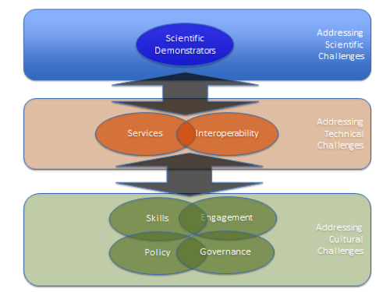
Project overview
WP5.4 Service pilots
Implementation and testing in a pilot environment of federated services that meet research challenges identified in WP4 (Scientific Demonstrators)
D5.6 Evaluation report of service pilots (M24)

Slide 3
Subtasks
Subtask 5.4.1 Definition of service pilots: Provides (in working closely with WP4 and WP6, specifically the RIs) the necessary expertise on existing services and solutions, to analyse science demonstrator requirements, and to translate them into a set of service capabilities and workflows, underpinning technical solutions and gaps, and service providers.
Subtask 5.4.2 Execution of service pilots: Develops the technical bridges identified in subtask 5.4.1 and provides as a result of this, a technical infrastructure on which the selected Science Demonstrators (WP4) can be exercised, as a series of concrete user-driven cross-infrastructure service pilots involving services/capabilities from different providers: data providers, e-infrastructures, Research Infrastructures, VRE operators.

Slide 4
WP4 – WP5
PHASE 1 (WP4)
Science demonstrator objectives, specifications, requirements
PHASE 2 (WP5.4)
Analysis of requirements, gap analysis
Service pilot design
→ both assisted by WP4 shepherd
Development of technical bridges
Testbed implementation
Access
Coordinated service provisioning
Support
(WP6.3: provisioning of generic e-Infrastructure components, validation of functional/non functional requirements, test suites)
PHASE 3 (WP4)
Validation reports

Slide 5
WP5 partner effort distribution overview
 | STFC | CSC | EMBL | SURFsara | EGI | ARC | CNR | DESY | INGV | GEANT | INAF | ESS | PIN | CINECA | Future Science Demos | TOTAL
5.1 EOSC Service Architecture |  | 2 | 2 | 2 | 2 | 2 | 8 |  | 2 | 2 | 2 | 2 | 2 |  |  | 28
5.2 EOSC Service portfolio |  | 2 | 2 | 8 | 2 | 2 | 2 |  | 2 | 2 | 2 | 2 | 2 |  |  | 28
5.3 EOSC Service Management Framework |  | 8 | 2 | 2 | 2 | 2 | 2 |  | 2 | 2 | 2 | 2 | 2 |  |  | 28
5.4 EOSC Service pilots | 2 | 4 | 6 | 8 | 14 | 8 | 8 | 6 | 12 | 8 |  |  | 3 | 4 | 31 | 114
TOTAL | 2 | 16 | 12 | 20 | 20 | 14 | 20 | 6 | 18 | 14 | 6 | 6 | 9 | 4 | 31 | 198

Slide 6
Communication involving T5.4
Regular status updates from demonstrators (via WP4 shepherds)
Identification of technical gaps with demonstrators
Input from Resource Providers (WP5, external)
Problems
New services, giving expertise to shepherds
Liaison with WP6 T6.3 Interoperability Pilots
same testbeds/RPs?
issues from demonstrators may be interoperability
Avoiding content duplication across meetings, surplus reporting, irrelevant content…

Slide 7
Communication involving T5.4
WP5 Service Pilots
WP6 Interoperability
WP4 Demonstrators

Slide 8
Proposal for T5.4 meeting
Monthly cross WP (5,4,6) meeting involving:
Shepherds of current demonstrators
Resource Providers of current demonstrators
WP6.3 representative
Agenda
Status updates from Service Pilots and current demonstrators
Issues/reports from resource providers
Interoperability
Focus on services (special agenda item)
Keeping it high-level, spin-off meetings/communication can happen
https://eoscpilot.eu/groups/wp5-services/wikipage/t54-regular-meeting

Slide 9
Other monthly WP5 meetings
T5.1 EOSC Architecture (Donatella Castelli) 20 Jun
T5.2 EOSC Service Portfolio (Jan Bot) 4 Jul
T5.3 EOSC Federated Service Management Framework (Damien Lecarpentier) after summer
T5.4 Service Pilots (Matthew Viljoen)
All on Tuesdays between 14-15h CEST

