Slide 1
The OpenAIRE infrastructure

Slide 2
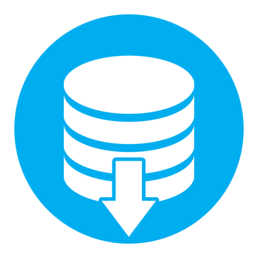
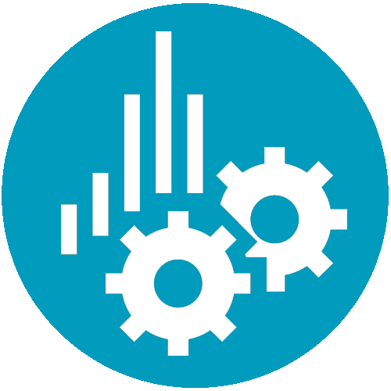
Service infrastructure for Open Science
Foster and facilitate the shift of scholarly communication towards making science Open and Reproducible (OpenAIRE-Connect)
Collaborative and participatory approach at European and Global level
Research admins
Researchers
Neworking &
e-Infrastructure
Research communities
Funders
SMEs
Content providers in scholarly communication
Notes:
Content providers in scholarly communication: publications, datasets, processes, projects, organizations, researchers

Slide 3
OpenAIRE’s e-infrastructure Commons
End-User Services
TERMS
OF USE
Funders, research admins, research communities
Research impact (evaluation)
Research trends (analysis)
Open Access trends
Info Space Services
Funding
Funder
Cleaning
De-duplication
Organization
Project
initiative
Validation
Enrichment
By inference
Result
Content providers
Repository validation
Repository notification broker
Repository analytics and usage stats
Publication
Data
Software
GUIDE
LINES
Content Providers
Researchers
Claim publications, datasets, software
Deposit publications, datasets, software
Search & browse: interlinked publications, datasets, projects
Open Access & DMP Helpdesk
End-User feedback
Publications repositories
Research Data repositories
CRIS
systems
Registries
(e.g. projects)
OA
Journals
Software
Repositories

Slide 4
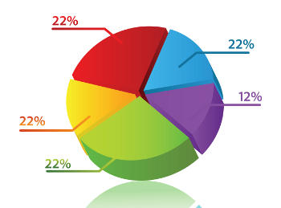
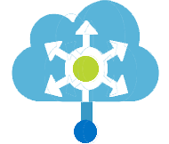
Open Science as-a-Service (OSaaS) Jan 2017- June 2019
Researchers
OSaaS
Deposit-Search-Browse-Monitor-Research Impact
Research Community Dashboard
Catch-All-Notification Broker
Methods
Articles
Subscribe & Receive Notification
Projects
Packages
Methods
Data
Packages
OpenAIRE as a mediation gateway between research communities and the scientific communication landscape
Articles
Data
Aggregation
Content Providers
Packages
Methods
Articles
Projects
Data

Slide 5
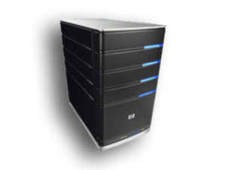
Technical infrastructure numbers
Public
system
8srv
48CPU
120GB
5TB
Mining
System
21srv
406CPU
2TB
385TB
Data provision
System
23srv
154CPU
430GB
23TB
RAM
RAM
RAM
Disk
Disk
Disk

Slide 6
Aggregation Activities and Results
Regular bibliographic metadata harvesting, validation and normalization
18M+ publications (de-duplicated)
~5 M full-texts
300,000+ links publication-project from 6 funders
40,000+ datasets linked to publications or projects
60,000+ organizations (de-duplicated)
Collected from:
800+ “direct” data providers
Key-regional aggregators: CORE-RIOXX, JAIRO (Japan), LA Referencia
6,000+ “indirect” data providers (inherited from aggregators)

