Slide 1
Lightning talk:
ELIXIR Competence Center
Kimmo Mattila – CSC – IT Center for Science
Coordinator of the ELIXIR CC

Slide 2
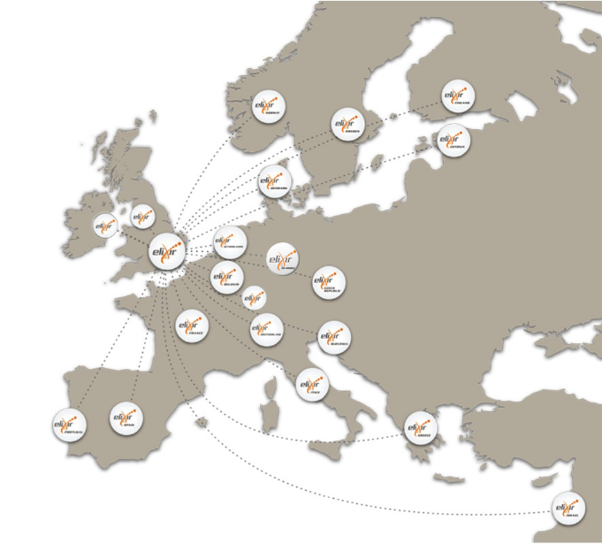
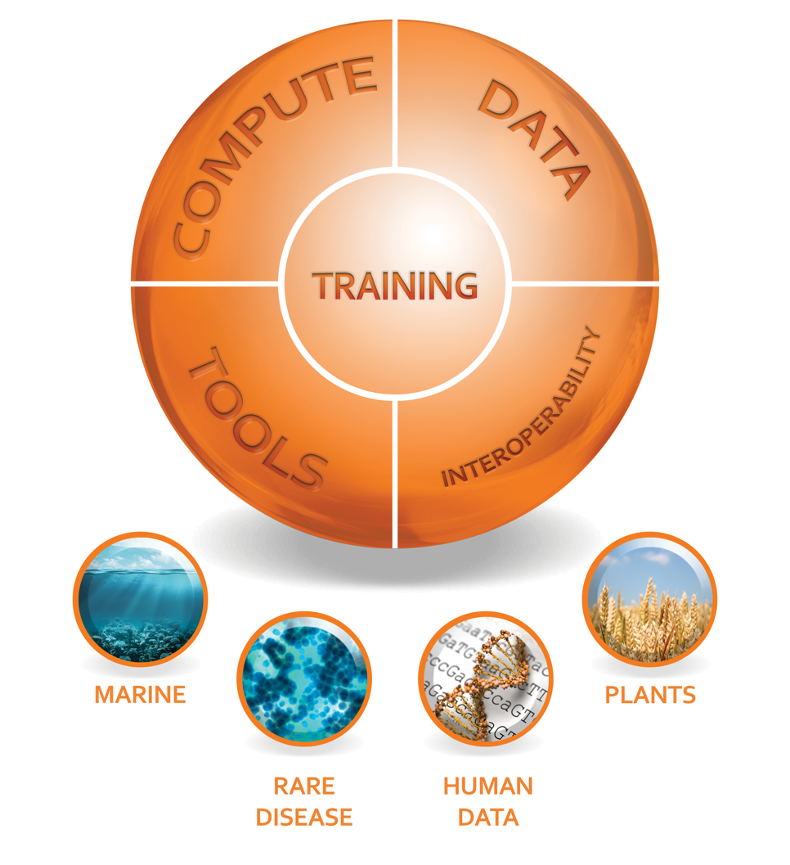
ELIXIR
ELIXIR connects national bioinformatics centers and EMBL-EBI into a sustainable European infrastructure including databases, software, training, storage and computing.
20 Members
1 Observer
ELIXIR Hub based
alongside EMBL-EBI
in Hinxton
EGI-Engage Final Review: Lightning talk Elixir
Notes:
Introduce the ELIXIR RI (not the CC!)
1 slide
2

Slide 3
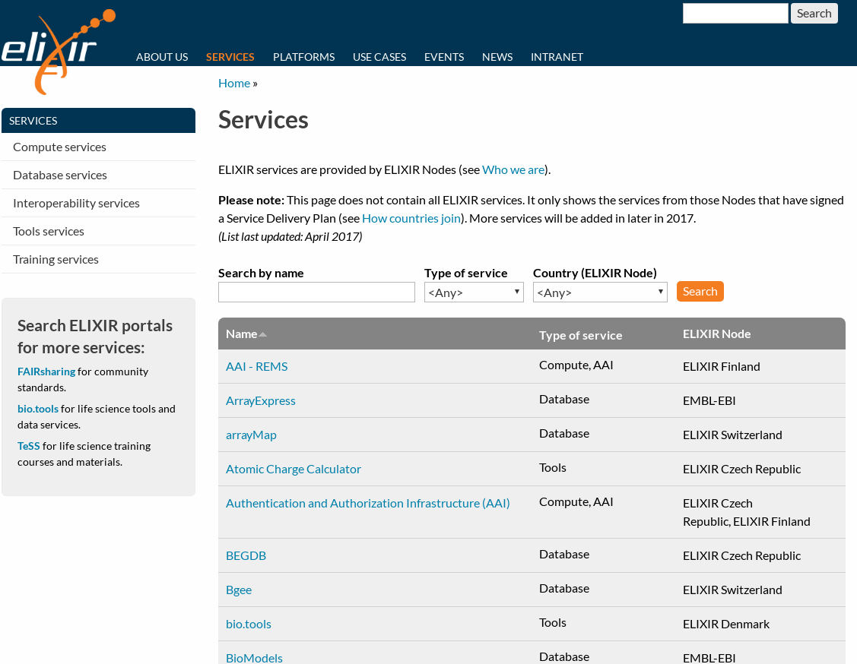
ELIXIR Competence Center
ELIXIR resources today:
Computing
Authentication and authorization
Applications and tools
Challenge: Services provided by ELIXIR are mostly site specific.
Goal: Using EGI technologies to federate ELIXIR services.
Development in collaboration with the ELIXIR Compute Platform project.
EGI-Engage Final Review: Lightning talk Elixir
Notes:
Introduce the ELIXIR RI (not the CC!)
1 slide
3

Slide 4
ELIXIR Competence center:
Time-line
1. Establishing an ELIXIR federated cloud (9/2015 – 6/2016)
Applying EGI Federated Could in ELIXIR related clouds.
Customizing EGI Federated Cloud to match ELIXIR technologies (AAI) and policies (OLAs)
collaboration
best-practices and experiences reported
2. Scientific use cases (12/2015 – 8/2017)
selection of five use cases representing different usage scenarios
development, implementation and testing
reporting the results
EGI-Engage Final Review: Lightning talk Elixir
Notes:
Introduce the CC, including why ELIXIR needed it (how it intends to help ELIXIR), why now, why the chosen membership, and how was their work organized (expertise, monthly calls, etc.)
1 slide
4

Slide 5
ELIXIR Competence center members
CESNET – Use case and cloud provider
CNRS IFB-core – Use case provider
CSC - Use case provider
EMBL-EBI - Use case and cloud provider
GRNET - Cloud provider
JetStream - Use case provider
SurfSara - Cloud provider
Other collaborators representing users and service developers. (Open Science Grid, other ELIXIR nodes)
EGI-Engage Final Review: Lightning talk Elixir
Notes:
Introduce the CC, including why ELIXIR needed it (how it intends to help ELIXIR), why now, why the chosen membership, and how was their work organized (expertise, monthly calls, etc.)
1 slide
5

Slide 6
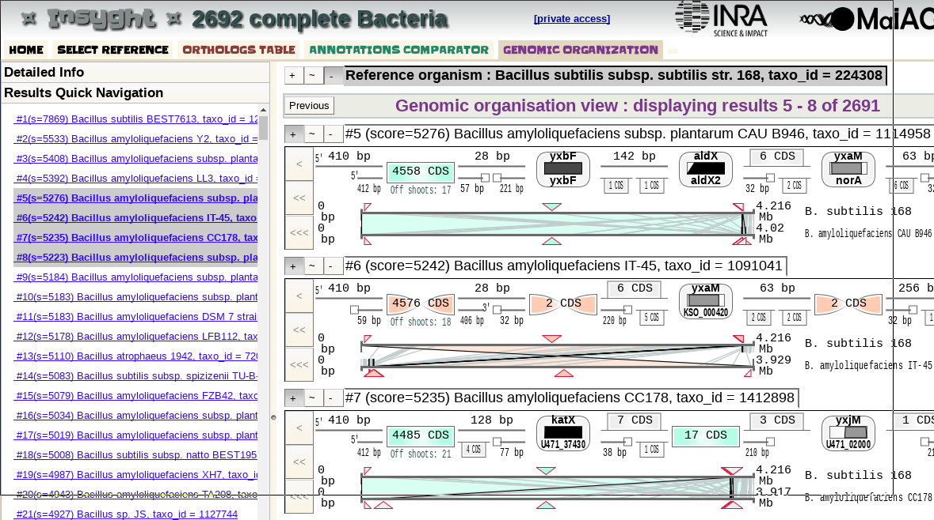
Results of Scientific use cases
1. Supporting life-scientist to instantiate their own data analysis environment in the cloud
Insyght Comparative Genomics/CNRS- IFB
Launching a user specific bacterial genome comparison environment in the EGI Federated Cloud as a cluster of VMs
PhenoMeNal (EMBL-EBI).
Tools for (Human) phenotyping based on metabolomics data
Testing the portability of PhenoMeNal VRE
to various cloud platforms, including the EGI Federated Cloud
EGI-Engage Final Review: Lightning talk Elixir
Notes:
This is the main part of the talk – What was achieved
6

Slide 7
Results of Scientific use cases
2. Burst out the compute-intensive part of analysis services to federated cloud resources (thematic service)
Metagenomics
analysis server
Offloading computationally heavy parts of two environmental microbiome analyzing workflows from a central server to an external cloud
META-Pipe metagenomics/CSC
Marine metagenomics/ EMBL-EBI
WWW
interface
ELIXIR
Federated cloud
Analysis
step 1
Virtual cluster
Analysis
step 2
Analysis
step 3
EGI-Engage Final Review: Lightning talk Elixir
Notes:
This is the main part of the talk – What was achieved
7

Slide 8
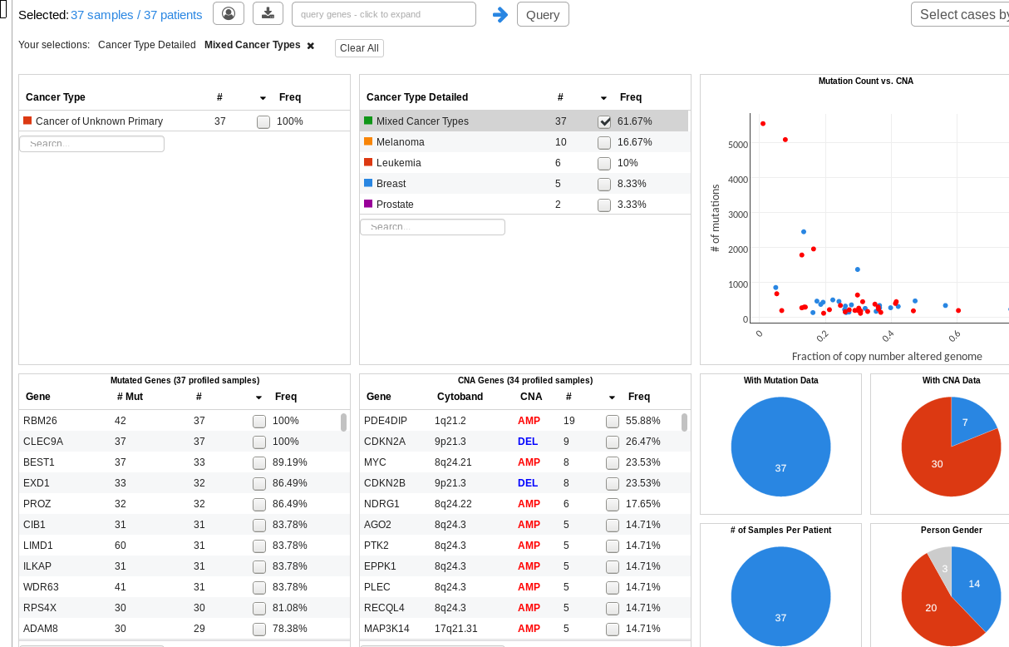
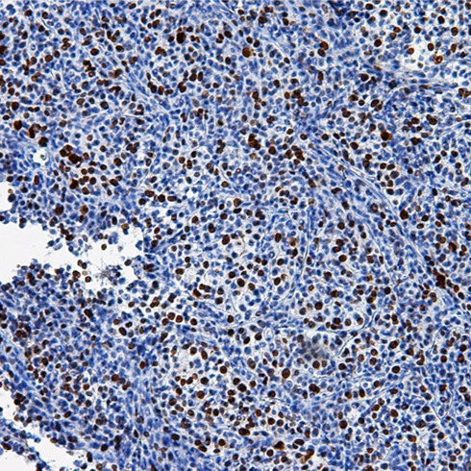
Results of Scientific use cases
3. Hosting long-running service (a portal) on the EGI Federated Cloud
hosting a cBioPortal Cancer Genomics platform for the EuroPDX cancer research consortium.
EGI-Engage Final Review: Lightning talk Elixir
Notes:
This is the main part of the talk – What was achieved
8

Slide 9
Results of Scientific use cases
4. Sharing applications between cloud federations
Sharing Visualized applications between the JetStream cloud and the ELIXIR federated cloud was tested.
EGI-Engage Final Review: Lightning talk Elixir
Notes:
This is the main part of the talk – What was achieved
9

Slide 10
Summary of results
Federated community cloud for ELIXIR was established
blending together EGI and ELIXIR services, technologies and policies
Cloud service providers have a tested process for EGI Federated Cloud integration.
Tools available to manage the user community of the federated resources (ELIXIR VO and ELIXIR compatible authentication).
Virtual appliances can be distributed through a common interface (AppDB).
Interoperability problems between already adopted tools were tackled which led to a ready-to-use toolkit for operating and using community clouds (rOCCI, jOCCI, OpenStack Cli, Terraform RCAuth portal).
Demonstration level thematic service available for ELIXIR
EGI-Engage Final Review: Lightning talk Elixir
Notes:
10

Slide 11
Lesson learned and doors opened
ELIXIR perspective
The effort of setting up and managing Federated Clouds is better understood
Experience gained in managing service and tools in a Federated Clouds.
ELIXIR can now start to create business models and OLAs that bring together resource providers to the user communities
ELIXIR can list priorities for adding new features to its federated Cloud.
EGI-Engage Final Review: Lightning talk Elixir
Notes:
11

Slide 12
Lesson learned and doors opened
EGI perspective
New role when supporting research infrastructure collaborations: technology provider, consultant (to build community cloud federation)
Evolved the EGI Federated Cloud technologies based on community requirements from ELIXIR (authentication, environment orchestration, user interfaces and repositories)
EGI-Engage Final Review: Lightning talk Elixir
Notes:
12

Slide 13
ELIXIR Competence Center:
Future Plans
All the scientific use cases will continue to evolve.
EOSC-hub project (EGI, ELIXIR and EUDAT) will continue to build federated services including:
Expanding to data federation: E.g. staging reference datasets from EBI to partner clouds.
Business models
Policy work to create cloud certification scheme for clouds for sensitive data (BBMRI)
Final results of the CC will be demonstrated in the ELIXIR all-hands meeting (June 7th 2018, Berlin)
EGI-Engage Final Review: Lightning talk Elixir
Notes:
Here you can mention how the results will be picked up in the Comp Platform, in EXCELERATE, in the follow-up CC, and/or maybe in a new cluster project for biomedical RIs
13

