Slide 1

Lightning talk: ICOS
Ute Karstens
ICOS Carbon Portal at Lund University, Sweden

Slide 2
Outline
ICOS Research Infrastructure
ICOS use case: ‘Footprint tool for Atmospheric stations’
EGI-Engage and ICOS
Status of the application
Lessons learned
Future plans

Slide 3
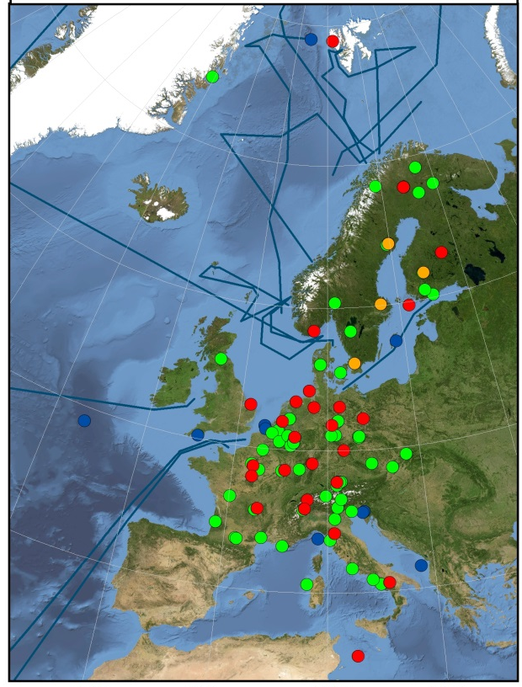
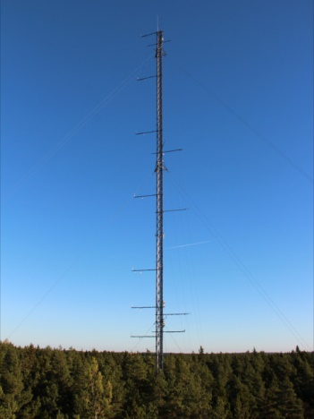
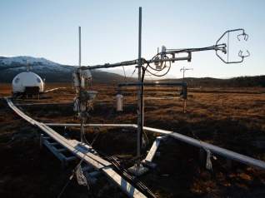
ICOS: Introduction
Integrated Carbon Observation System
“A pan-European research infrastructure for quantifying and understanding the greenhouse gas balance of the European continent”
Mission:
Collect high-quality observational data on the greenhouse gas (GHG) budget of Europe
Promote the use of ICOS data
Support modelling activities of GHG fluxes
Support verification of GHG emission data
Members:
12 European countries
> 120 measurement stations
Target Groups:
Scientific community
Governments, policy makers
Citizen scientists
Notes:
Introduce the ICOS RI, and it’s envisioned e-infrastructure
Approx 1-2 slides.

Slide 4
ICOS: Introduction
ICOS Research Infrastructure
Notes:
Introduce the ICOS RI, and it’s envisioned e-infrastructure
This decribes the whole ICOS infrastructure but highlights the information/datta flow in the use case – the diagram can be further simplified…
Approx 1-2 slides.

Slide 5
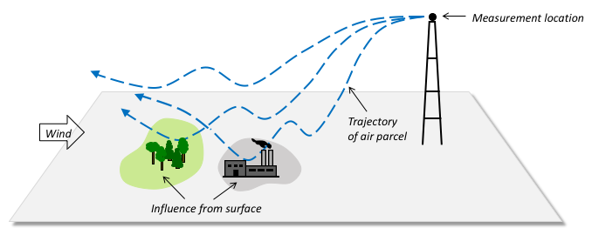
ICOS: Introduction
ICOS use case: ‘Footprint tool for atmospheric stations’
A web-based tool to help users explore the sensitivity of atmospheric GHG concentrations at ICOS atmospheric sites to European GHG emissions and ecosystem fluxes
Notes:
Introduce the ICOS RI, and it’s envisioned e-infrastructure
Approx 1-2 slides.

Slide 6
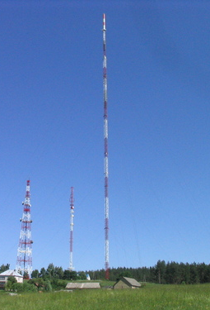
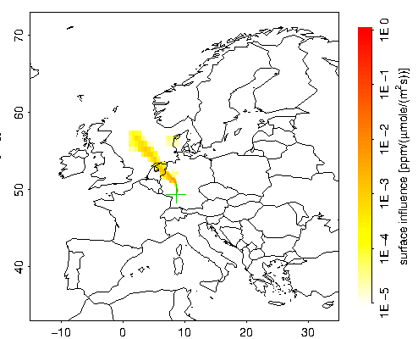
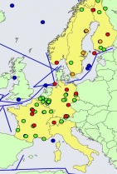
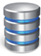

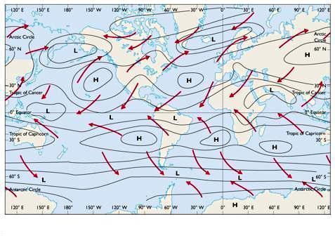
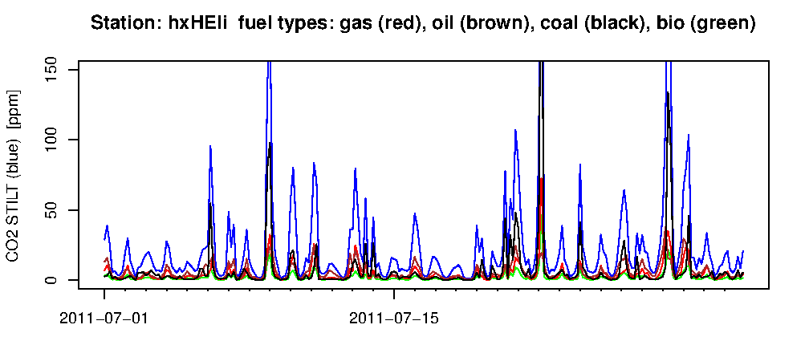

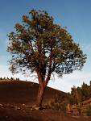

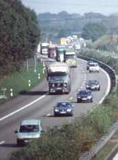

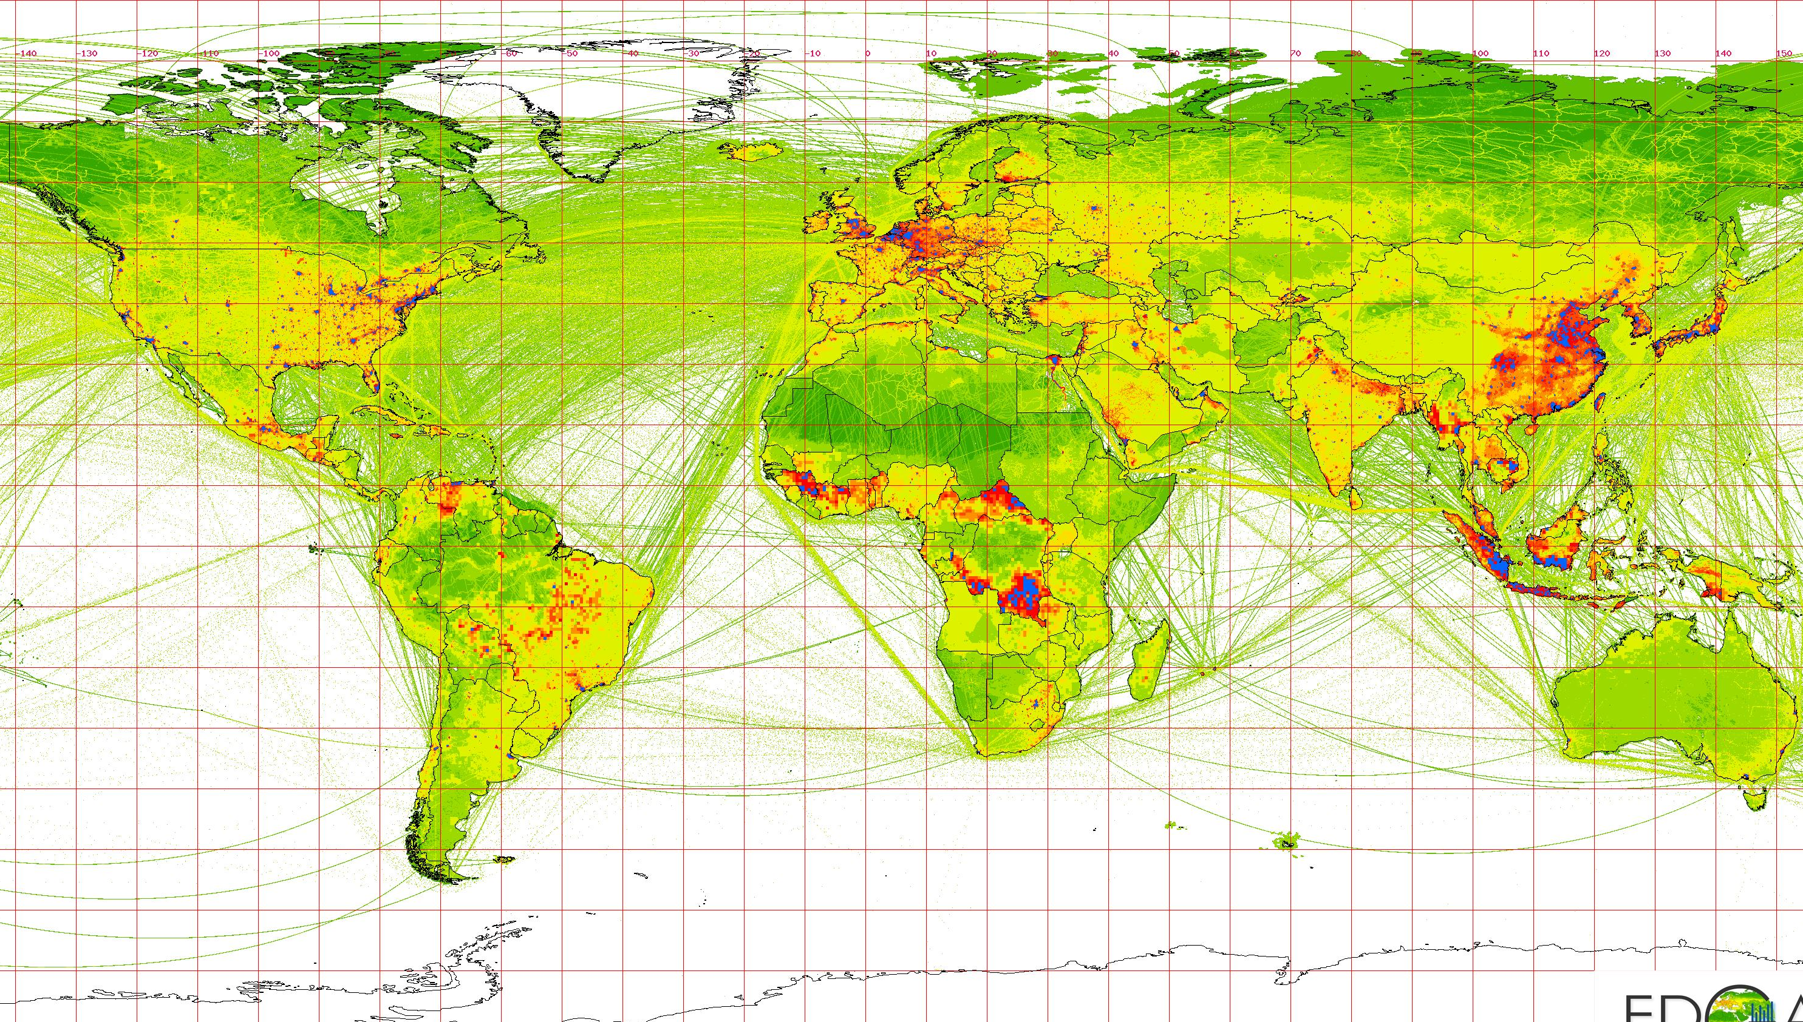



ICOS: Introduction
ICOS use case: ‘Footprint tool for atmospheric stations’
Atmospheric observations
Station Footprints
ICOS
Carbon Portal
≈ 1 GB
Meteorological driver fields
STILT
Lagrangian transport model
GHG concentrations
≈ 2-3 TB
Container Compute
Emissions
≈ 300 CPUs per footprint
=> 750 CPUh/station/year
≈ 1-2 TB
per year
≈ 0.5-1 TB
Cloud Compute
Online Storage
Federated Cloud
Notes:
Introduce the ICOS RI, and it’s envisioned e-infrastructure
Approx 1-2 slides.

Slide 7
EGI and ICOS
  ICOS use case aiming to be an EGI Thematic Services
ICOS use case was initiated in the EUDAT2020 project to apply and test interoperability of EGI and EUDAT services
ICOS was invited to participate in the 1st EGI ‘Design your e-infrastructure’ Workshop in 2016
ICOS was able to set up the use case with support from EGI experts
  ICOS use case is supported through the incubator VO fedcloud.egi.eu in the testing phase

Slide 8
EGI-Engage and ICOS: Achievements
Status of the ‘Footprint Tool for Atmospheric Stations’
Web-based service available at ICOS Carbon Portal https://icos-cp.eu
  Visualization of all existing footprints and GHG concentrations is available and open to all users
  On-demand computation using EGI resources
    is available in Alpha mode for early adopter test users
    requires registration at ICOS Carbon Portal
Exploitation examples:
  Support for interpretation of GHG measurements
  Evaluation of measurement strategies, eg. in EU project RINGO
  Network design studies
Notes:
This is the main part of the presentation

Slide 9
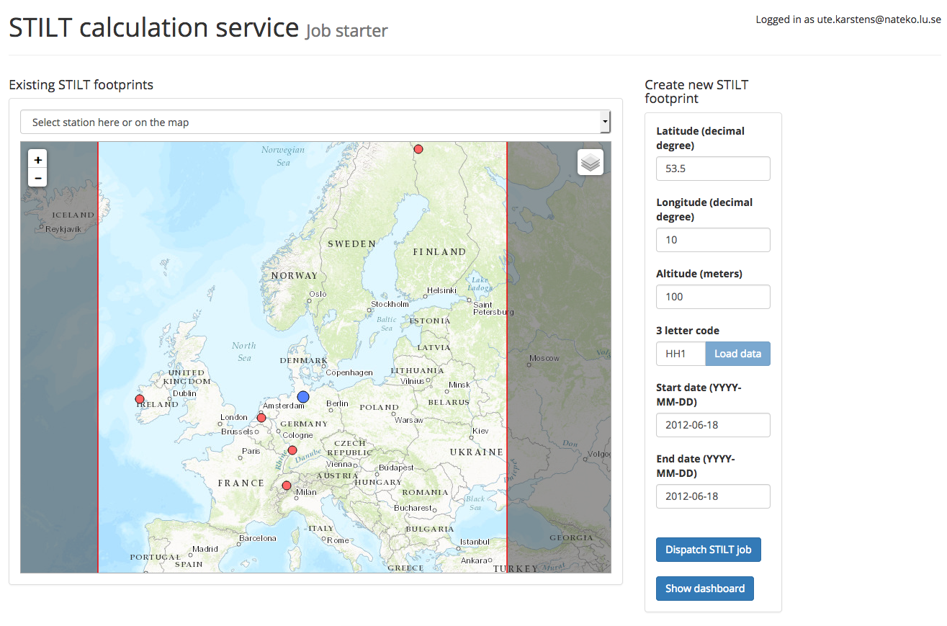
EGI-Engage and ICOS: Achievements
Notes:
This is the main part of the presentation
Screen shots of the next steps will be included. Updated version of footprint tool will be deployed in the next days.

Slide 10
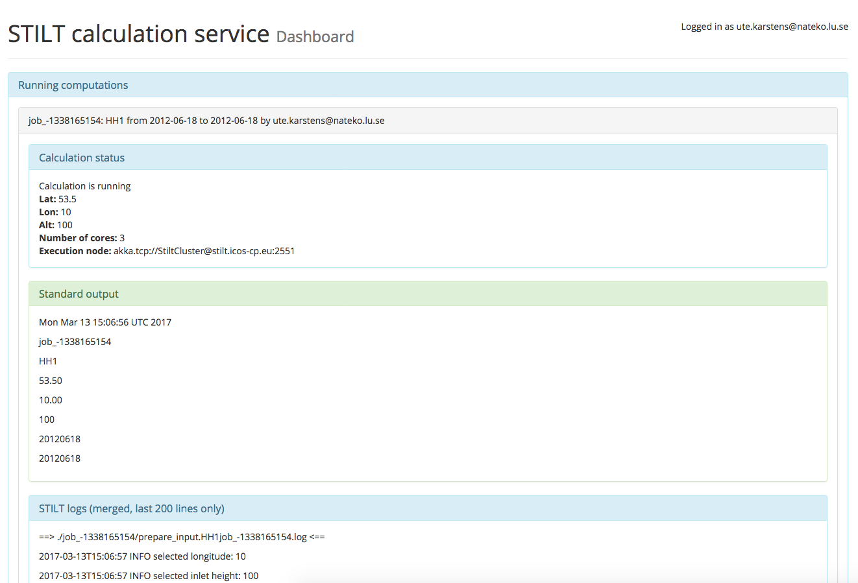
EGI-Engage and ICOS: Achievements
Notes:
This is the main part of the presentation
Screen shots of the next steps will be included. Updated version of footprint tool will be deployed in the next days.

Slide 11
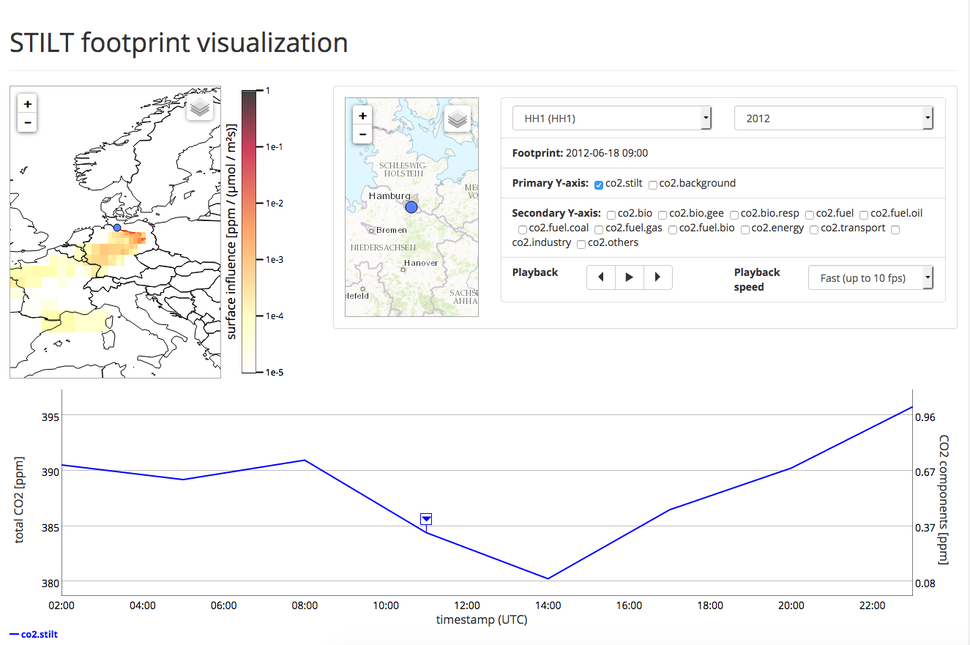
EGI-Engage and ICOS: Achievements
Notes:
This is the main part of the presentation
Screen shots of the next steps will be included. Updated version of footprint tool will be deployed in the next days.

Slide 12
EGI-Engage and ICOS: Lessons learned
Essential steps to set up the use case:
  Initial workshop to develop roadmap in direct discussion with EGI
  Definition of contact persons at EGI and ICOS
  Regular web-meetings to monitor progress, identify problems, and develop new strategies
  Documentation for users on different expert-levels
Testing by ICOS of software/infrastructure tools helped to identify deficiencies and stimulate improvements, e.g. EGI DataHub

Slide 13
Plans
Bring footprint tool to production quality and fully embed the application in the ICOS Carbon Portal
Add more applications to ICOS Carbon Portal:
  Establish operational data processing services
  Extend on-demand model simulation services
  Enhance interoperability between observations and modelling
  Improve data integration services based on metadata ontologies
Extend cooperation between environmental research infrastructures and e-infrastructure providers
EOSCpilot: ENVRI Radiative Forcing Integration
EOSC-hub: ICOS + eLTER Competence Centre

