Slide 1
Impact Report
Tiziana Ferrari
EGI-Engage Technical Coordinator
EGI-Engage Final Review
23-24 October 2017

Slide 2
Outline
Science
Individual researchers
Community innovators
Digital innovation for science
Adoption of storage and computing infrastructures
Increased availability of scientific data
More efficient use of IT equipment for research
No lock-in to hardware and software solutions
Contribution to Digital Innovation Megatrends
Implementation of the ERA
Society and Economy
European Open Science Cloud

Slide 3
Impact on Science
With more 5,000 scientific papers* published, EGI-Engage supported science at all scales
* Source: OpenAIRE

Slide 4
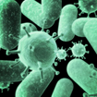
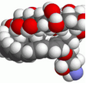
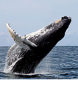
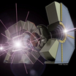
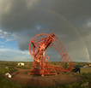
Excellence at all Scales
2,000
papers
2015
3,000
papers
2016
23,000
papers
since 2008
Applications on Demand
Integrated thematic
services
Federated Cloud Computing
Improved EGI Service portfolio

Slide 5
Individual researchers Case 1
When human cell meets Salmonella
Konrad Förstner (U Würzburg) used EGI Cloud Compute to run READemption - a pipeline for the analysis of sequencing data.
Cloud Compute helped the team to handle demand peaks and that sped up the whole process significantly.
Published in Nature
(doi:10.1038/nature16547)
http://go.egi.eu/salm
Federated Cloud Computing
Notes:
Summary: Salmonella infections end up with many unpleasant symptoms and a likely trip to the hospital. Konrad Förstner, a bioinformatician working at the University of Würzburg (Germany), investigated the invisible genetic battle going on inside the cells.
Förstner and his team took a groundbreaking approach and analysed the combined genetic material from the Salmonella bacteria and the host. They analysed the genetic sequences with READemption, a pipeline designed to process the computational tasks using EGI Cloud Compute.
They found that a piece of Salmonella RNA has a strong influence on what happens inside the host cells. This result is key for a better understanding of the infection processes and immune responses and was published in Nature and Bioinformatics.

Slide 6
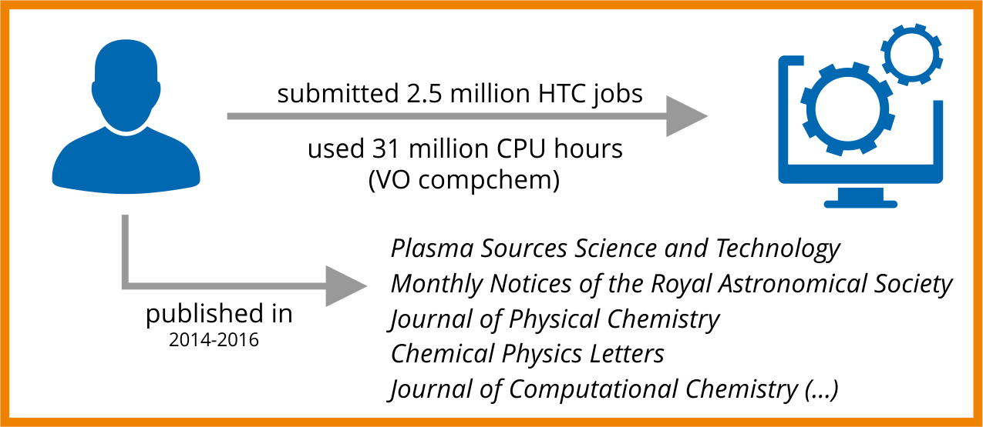
Individual researchers Case 2
Theoretical chemistry
Ernesto García (Uni. Basque Country) is a leading expert on chemical reactions and their dynamics.
+23.4%
HTC CPU
hours
2015
+20.5%
2016
→ More than 3 Billion CPU hours in 2017 expected with the current trend
Notes:
Chemical reactions are at the core of everything that happens in the Universe. From the thermonuclear fusion that powers the Sun, to how antibiotics help to fight pneumonia, everything depends on what happens when molecules collide and interact to form new compounds.
Ernesto García, based at the University of the Basque Country in Spain creates computational models to describe chemical reactions. In the last two years, García worked in projects ranging from astronomy, to applied chemistry and atmospheric science. He has submitted about 2.5 million High-Throughput Compute jobs for a total of 31 million of CPU hours and published eight papers in peer-reviewed journals, including high-impact MNRAS and Chemical Physics Letters.

Slide 7
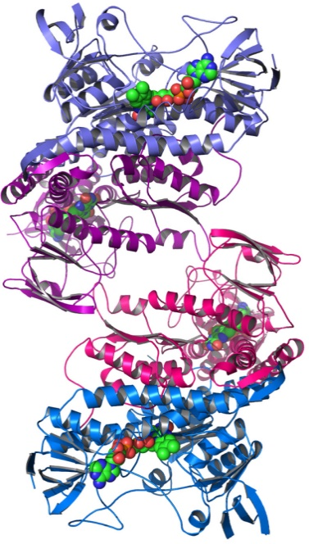
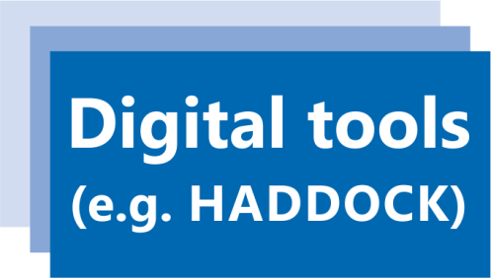
Community innovators with communities of practice Case 3
Digital tools for structural biology
Forefront of innovation in medicine and health sciences
Relies on computational resources for (e.g.):
storing databases of molecular structures
processing power required to run complex simulations
develop & operate
powered by
Notes:
Structural biology: Studies the structure of proteins, aminoacids and all the biomolecules essential to life; how they interact
MoBrain portals: AMBER, FANTEN, DisVis, CS-Rosetta, HADDOCK, etc

Slide 8
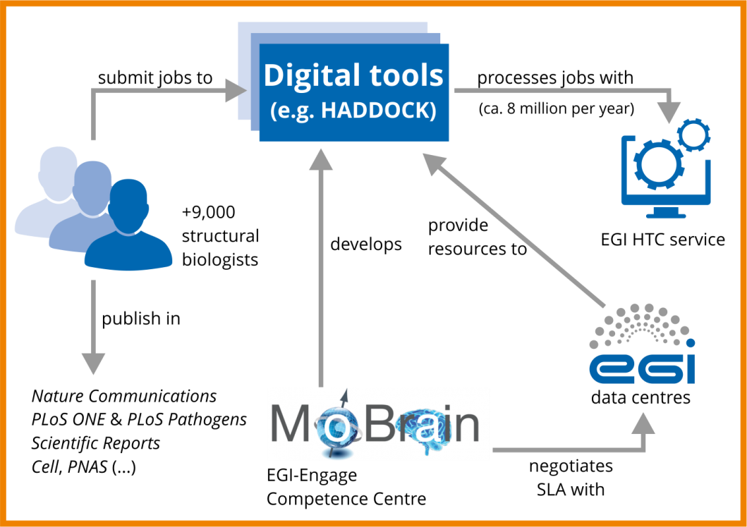
MoBrain 1/2

Slide 9
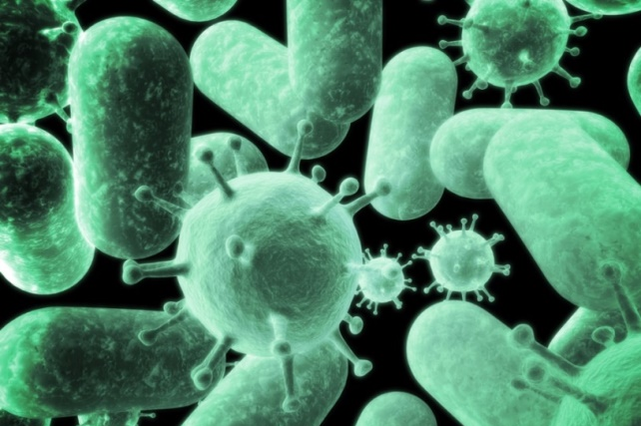
MoBrain 2/2
HADDOCK
9,000 users, ~8 million computing jobs/year
HADDOCK at work
Rhys Grinter (Monash Univ.) used the HADDOCK portal to understand the structure of FusA, a receptor in cells designed to grab and steal iron from plant proteins
Published in
Nature Communications
(doi:10.1038/ncomms13308)
Workload Manager
BETA New
http://haddock.science.uu.nl/
Integrated thematic
services
Improved EGI Service portfolio
Notes:
HADDOCK consistently ranks at the top of protein prediction experiments and is one of the best programs available for molecular docking.

Slide 10
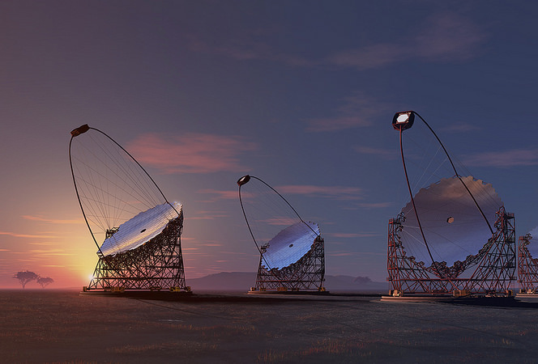
Large research collaborations/CTA Case 4
Cherenkov Telescope Array
the world’s leading gamma-ray observatory
1350 scientists from 32 countries
Credit: Akihiro Ikeshita Mero-TSK
With EGI’s HTC and Online Storage
CTA preformed Monte Carlo simulations to determine the best geometrical configurations for the array
High-Throughput
Compute
Online Storage
Notes:
The CTA collaboration brings together 1350 scientists and engineers from 32 countries with the goal of building the world’s largest and most sensitive very high-energy gamma-ray observatory. The CTA facility will be used to understand the role of high-energy particles in the most violent phenomena of the Universe and to search for annihilating dark matter particles.
During the EGI-Engage period, the team consumed +360 million core hours in High-Throughput Compute jobs made available by six EGI data centres. With these resources, the collaboration preformed Monte Carlo simulations to decide the best locations and the best geometrical configuration for the telescope arrays. This led to the selection of La Palma in Spain and Paranal in Chile. Construction is expected to start soon.

Slide 11
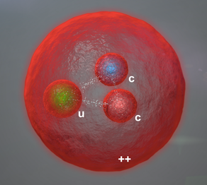
Large research collaborations/ALICE & LHCb Case 5
Strange and charming particles
ALICE reported enhanced production of strange hadrons
LHCb announced the first ever observation of a doubly-charmed baryon
With EGI’s HTC and Data Transfer
ALICE and LHCb rely on the EGI Federation to distribute and analyse the data collected by their LHC detectors
High-Throughput
Compute
Tools for federated service management
Improved EGI Service portfolio
Data Transfer

Slide 12
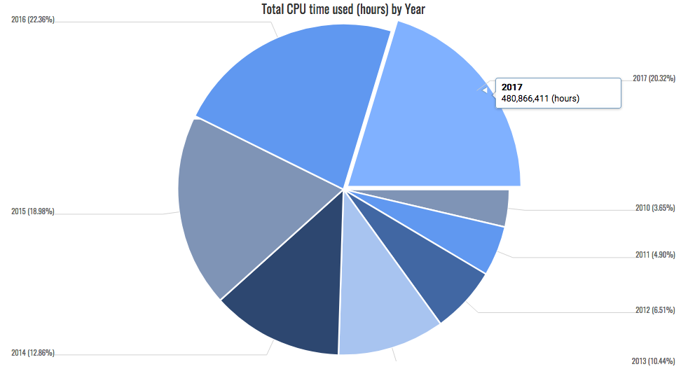
ALICE’s increased demand for HTC

Slide 13
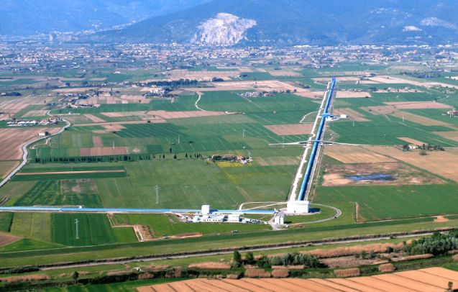
Large research collaborations/LIGO and Virgo Case 6
Gravitational waves
1,250 scientists worldwide
Detected various instances of gravitational waves in 2016 and 2017
Virgo Virtual Organistion (VO):
Manages thousands of HTC computations submitted to resource centres of the EGI federation.
VO consumed collectively 40 million CPU hours in 2015 and 2016.

Slide 14
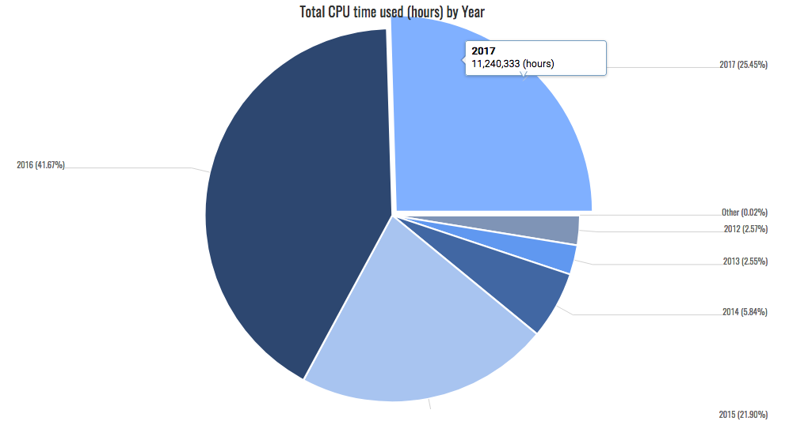
Virgo’s increased demand for HTC

Slide 15
… and the Nobel Prize for Physics 2017
The observation of gravitational waves confirmed a 1915 prediction of Albert Einstein’s theory of relativity and opens an unprecedented new window onto the cosmos.
In recognition of the achievement, the Nobel Committee awarded the 2017 Physics prize to members of the LIGO/Virgo collaboration.

Slide 16
KPIs, targets and Performance

Slide 17
Digital innovation
EGI-Engage contributed to megatrends in digital innovation for science with developments on Cloud, Grid, and Big Data Analytics

Slide 18
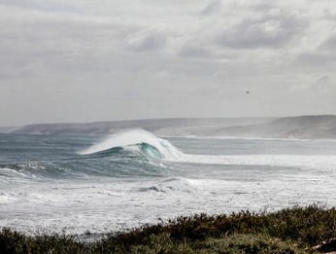
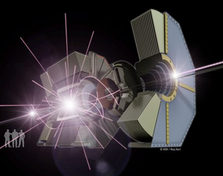
Increased availability of scientific data
EGI federates a total of 650 PB of stored data
EGI-Engage extended by +48% the availability of research data for processing and analysis
Online storage
+12% 2015
+5% 2016
Tape storage
+42% 2015
+23% 2016
OpenCoasts portal
2 TB per year
Belle experiment
10s PB per year
LHC
+ 200 PB archived data,
+ 45 PB in 2016

Slide 19
Increased availability of scientific data
EGI services for ESFRI
To date, EGI compute services are being tested and/or used for production-level data analysis by eight ESFRI projects
BBMRI, DARIAH, ELI, ELIXIR, EMSO, HL-LHC, INSTRUCT and LifeWatch
With three others in discovery phase
CTA, EPOS and KM3NeT 2.0
Among the 31 large-scale research initiatives currently supported, those which reached full adoption in 2015, largely increased usage in 2016 and 2017
KPI.2.SA1.Integration: 31 (Target: 15) → +52%

Slide 20
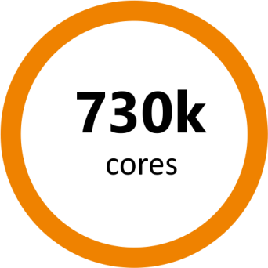
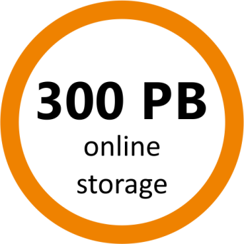
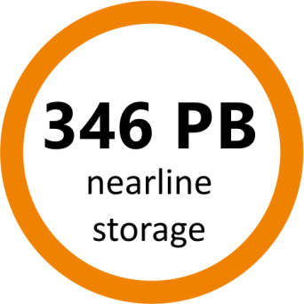
Efficient use of IT for research
The EGI Federation is the largest international digital infrastructure for scientific computing in the world
EGI enables the sharing of applications and access to distributed data and compute facilities
+ 23% *
+ 12% #
+ 12% *
+ 5% #
+ 42% *
+ 23% #
* PY1 / # PY2

Slide 21
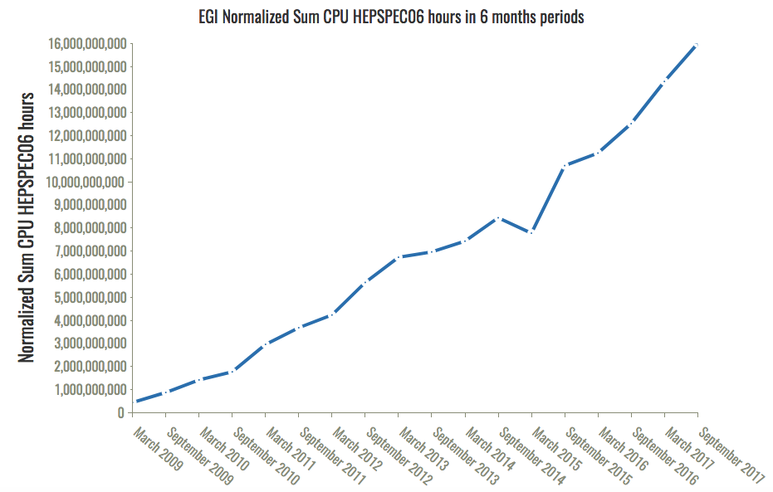
Efficient use of IT for research 2008-2017
EGI-Engage

Slide 22
No lock-in to particular hardware and software platforms
EGI federates heterogeneous e-Infrastructures worldwide
Community-defined standards roadmap
https://wiki.egi.eu/wiki/Standards
Contribution to the development and implementation of the OCCI cloud standard
Research data federation
21 Thematic services and Applications on Demand for sharing of scientific software
EGI Federated Cloud architecture blueprint
https://wiki.egi.eu/wiki/Federated_Cloud_Architecture
Federated Cloud Computing
Open Data
Platform
Integrated thematic
services

Slide 23
Adoption of federated cloud compute
+67.5%
Cloud
CPU hours
2016
+40%
Cloud CPU hours
Jan-Aug
2017
KPI.4.SA1.Cloud : 22 (Target: 28) → -21%. Reluctance of providers in being part of the federation

Slide 24
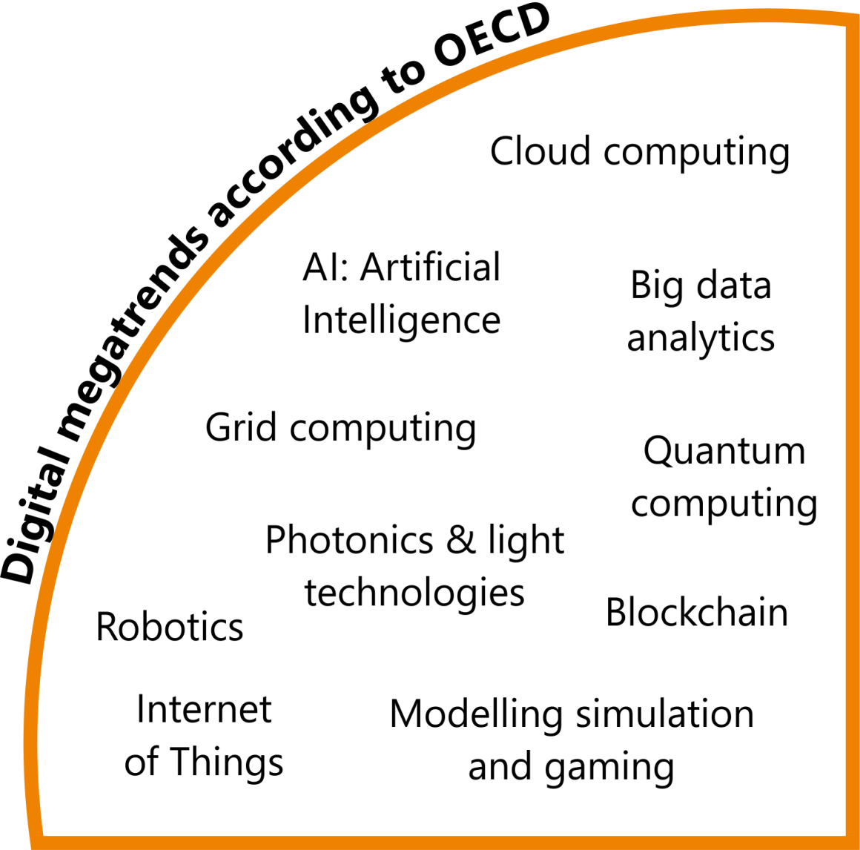
Contribution to megatrends in digital innovation for science
Large-scale changes that are slow to form but, when rooted, have a profound lasting influence
→ Organisation for Economic Co-operation and Development: Science, Technology and Innovation Outlook 2016

Slide 25
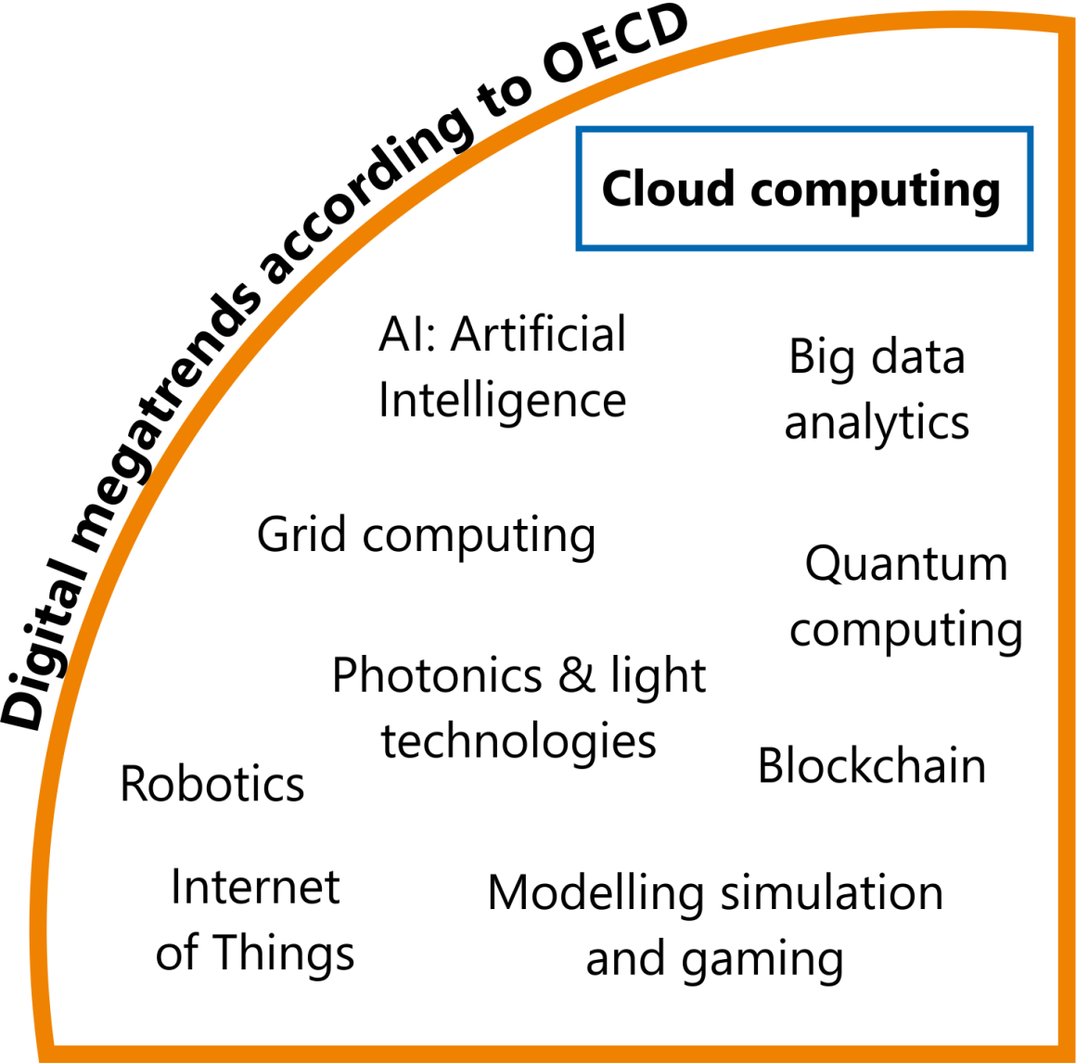
Contribution to megatrends/Cloud
EGI Federated Cloud
IaaS-type cloud
only existing publicly-funded distributed research cloud in Europe
Offers ca. 10 million CPU hours per year to researchers from all disciplines.
Cloud Compute

Slide 26
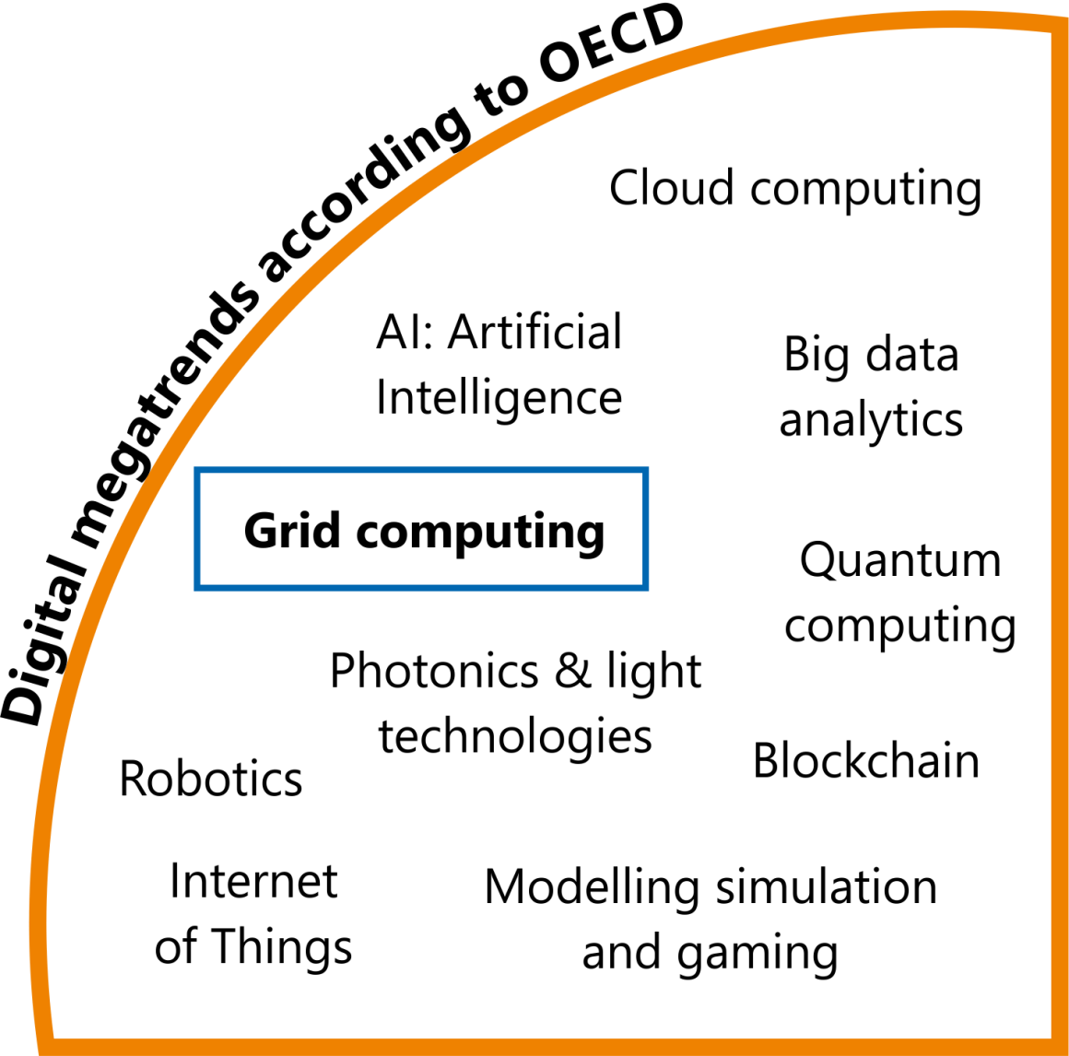
Contribution to megatrends/Grid
Grid computing (HTC)
EGI Federation is largest HTC distributed computing infrastructure in the world
Offers ca. 730k cores
Processes 1.7 million jobs per day
High-Throughput
Compute

Slide 27
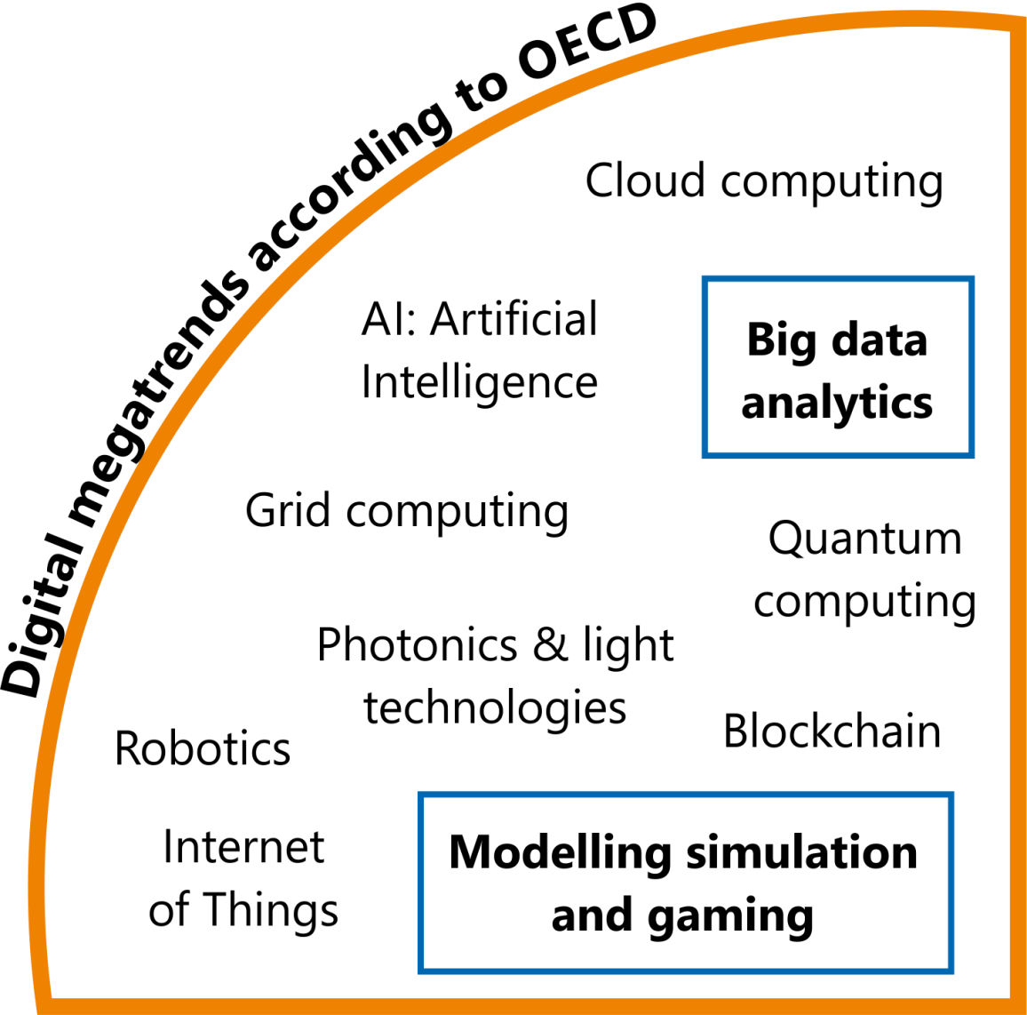
Contribution to megatrends/Applications
Simulations and big data analytics
19 Thematic Services
Applications on Demand
Integrated thematic
services
Applications on Demand

Slide 28
KPIs, targets and Performance

Slide 29
Implementation of the ERA
An European Research Area open to the world, in which scientific knowledge, technology and researchers circulate freely*.
* http://ec.europa.eu/research/era/index_en.htm

Slide 30
EGI-Engage contribution to ERA
Strengthens national e-Infrastructures (NGIs)
Optimises transnational scientific cooperation thanks to federated services
Allows knowledge circulation and sharing
Enables international cooperation through new agreements involving Compute Canada, GÉANT and PRACE
Addresses societal challenges by:
Promoting research data exploitation in the agrifood and marine health sectors
Co-developing a Data Management Platform with and for EMSO - an ESFRI dedicated to a better understanding of marine ecosystems
Many other contributions in the area of biodiversity preservation, climate and environment, health (ELIXIR, BBMRI, WeNMR)

Slide 31
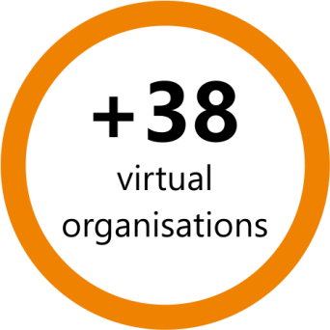
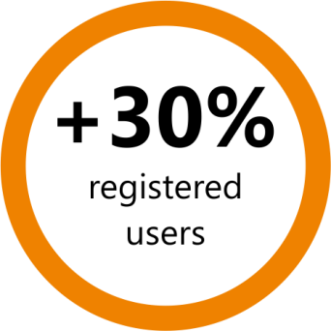
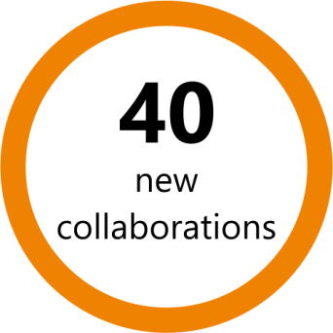
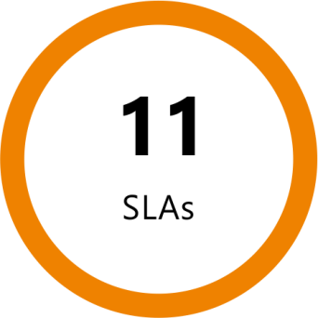
Transnational Scientific Cooperation
Research communities
Increase driven by:
Physics, RIs
SaaS operated on top of the EGI Federated Cloud
KPI.5.SA2.Users: 61,000
In response to outreach activities and the Competence Centre programme
Including:
19 Research Infrastructures
31 RIs and e-Infrastructures integrated
Examples:
Peachnote (platform)
EMSOdev (ESFRI)
EXTraS (H2020 project)

Slide 32
KPIs, targets and Performance

Slide 33
Society & Economy
Long term impacts and active collaborations
with Industry and SMEs

Slide 34
Long term impacts: the life sciences example
Many projects enabled by the use of an e-Infrastructure – for example those in structural biology – contribute to our knowledge
In this knowledge lays the foundation to improved crops, new drugs or personalized medicine in the long term
Example: the pathway from the initial research to the marketing of a new drug typically takes 10-15 years, with many projects abandoned along the way.
Researchers using EGI resources, contribute to the initial stage of this long process.
The evaluation of the societal impact of a project like EGI-Engage requires decades.

Slide 35
Support to Economic Growth https://www.egi.eu/business
Business programme
EGI partnered with industry and SMEs to co-develop support solutions for their computing needs
Use cases:

150 recorded
20 in progress
✓
11 completed, 4 MoUs
KPI.18.NA2.Industry: 11

Slide 36
KPIs, targets and Performance

Slide 37
European Open Science Cloud
A vision for a federated, globally accessible, multidisciplinary environment for
Researchers, innovators, companies and citizens

Slide 38
Vision
EOSC is a vision for a federated, globally accessible, multidisciplinary environment where researchers, innovators, companies and citizens can publish, find, use and reuse each other's data, tools, publications and other outputs for research, innovation and educational purposes.
The EOSC is one of five broad policy action lines of the European open science agenda endorsed also by the EC Communications on the Digital Single Market (DSM) strategy.
Open Science Policy Platform, May 2017

Slide 39
EGI-Engage inputs to the vision
Governance and funding
Support to the Open Science Policy Platforms on EOSC
Policies, processes and tools for federating resources and services from hundreds of providers worldwide
Community-defined EOSC “rules of engagement”
Multiple actors (e.g. end-users, customers and providers)
Lightweight federation of services capabilities
Interoperability among multiple suppliers at worldwide scale
Strategy, governance and procurement
Policy papers
on the EOSC
IMS & Certification
Security policies

Slide 40
Inputs to Data culture and FAIR
Implementation guidelines for FAIR services in the area of advanced compute, federated identity provisioning, authentication and authorization
EOSC minimum set of reference standards and interoperation agreements and service accreditation models

Slide 41
Input to research data services and architecture
Operate the EOSC Hub, the Service Integration and Management system (SIAM)
Operate an open hybrid e-infrastructure offering data-driven advanced compute (Cloud and HTC) and data services
Operate a federated identity provisioning, authentication and authorization services for the EOSC users and service providers.
Improved EGI Service portfolio
IMS & Certification
Tools for federated service management
Check-in

Slide 42
EOSC Hub
EGI-Engage has shaped the concept of the EOSC Hub
The Hub acts as a European-level contact point for researchers and innovators to discover, access, use and reuse a broad spectrum of resources for advanced data-driven research.

Slide 43
Input to EOSC Service Catalogue
Thematic Services
Baseline compute/storage services
Collaborative Services
Federation Services
Tools for federated service management
Improved EGI Service portfolio
Check-in
Marketplace
IMS & Certification
Integrated thematic
services
Applications on Demand

Slide 44
Summary
EGI-Engage’s impact is observable on all scales the European Research Area, from individual research, to large collaborations and business, promoting digital innovation and the implementation of the EOSC vision and the FAIR principles

