Slide 1
EGI contribution to the European Open Science Cloud initiative and next steps
Tiziana Ferrari
EGI-Engage Technical Coordinator
EGI-Engage Final Review, 23-24 October 2017

Slide 2
Outline
EOSC vision, EGI-Engage contribution and next steps
EOSC-hub project

Slide 3
EGI-Engage and EOSC

Slide 4
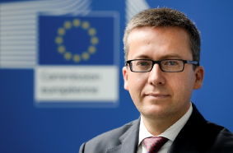
Vision
"Europe's final transition must be one from fragmented data sets to an integrated European Open Science Cloud”
"By 2020, we want all European researchers to be able to deposit, access and analyse European scientific data through a European Open Science Cloud"
.

Slide 5
Challenges
No widespread awareness of the value of data and of incentives for data sharing
Lack of common standards to ensure inter-operability of data.
Insufficient hardware capacity for scientific computing, storage, connectivity
Fragmentation and lack of coordination over different scientific communities and countries
Need to translate recent changes in privacy, data protection and copyright rules to the research data domain

Slide 6
EOSC Value Proposition
European Open Science Cloud (EOSC) will
Integrate and consolidate e-infrastructures
Federate existing research infrastructures and scientific clouds
Develop cloud-based services for Open Science
Connect ESFRIs to the EOSC

Slide 7
EGI-Engage Value Proposition 1/2
EOSC Declaration | EGI-Engage | Future Steps
[Architecture] User-driven federation of existing resources and services | Operation of an international federation of compute, data and thematic services | - Federation of EGI and EUDAT facilities - 18 research community services
[Implementation] Federation of pan-European service providers | - EGI as a component of internationally federated e-Infrastructures - IMS, including processes, policies and best practices | Virtual access to national services
[Legacy] Reuse of existing building blocks [Thematic areas] Coordination and federation of open data infrastructures | - Integration of Thematic Services Competence Centres (CCs) - DataHub for the federation of public core data resources | - Federation of core data resources - Continuation and extension of the CC programme

Slide 8
EGI-Engage Value Proposition 2/2
EOSC Declaration | EGI-Engage | Future Steps
[Service Provision] Customer-centric approach Quality assurance | IMS customer facing processes and procures, e.g. Service Level Management, Customer Relationship management | - Definition of IMS by EOSC Hub service providers - Aggregation of demand and supply
[Service Deployment] High Technology Readiness Levels Commercial providers | IMS, including processes, policies and best practices | - Quality verification procedures for EOSC Hub - Federation of commercial cloud providers and DIAS
[User needs] One-stop-shop for users | Marketplace Co-design with the CCs | EOSC Hub Marketplace
[Ris] Stewards of community-defined standards | Standards roadmap Service Portfolio Management | Community-defined standards roadmap
[Innovation] level playing field for business | Business engagement programme | Joint Digital Innovation Hub

Slide 9
EGI Role

Slide 10
EGI Endorsement
Endorsement of the principles of the EOSC Declaration
EOSC should be the initiative addressing the needs of open access, sharing within and across research communities, ensuring sustained funding to digital research infrastructures

Slide 11
EGI Role
Operate the EOSC Hub as service integrator accountable for ensuring that all EOSC service providers provide a seamless service compliant to contractual obligations made with customers
Communicate/manage alignment of services to defined policies and standards
Define/maintain/review service level agreements
Conduct service audits and quality assurance reviews
Manage end-to-end service level management performance retaining overall accountability
Provide the tools for aggregating demand and supply
Make services and research artifacts discoverable and accessible at European level

Slide 12
EOSC-hub
From vision to implementation

Slide 13
Mission 1/2
EOSC-hub mobilises providers from the EGI Federation, EUDAT CDI, INDIGO-DataCloud and 20 major research e-infrastructures offering services, software and data for advanced data-driven research and innovation.

Slide 14
Mission 2/2
The project will create the Hub the integration and management system of the future EOSC
Process
Policies
Federation tools
Service
Catalogue
Data
Software
EOSC-hub in numbers
Duration: 36 months
Start date: 1 Jan 2018
End date: 31 Dec 2020
Tot. funding: 33.4 Million (30 M from EC)
# partners: 74
Countries involved: 23

Slide 15
EOSC Architecture Roadmap and EOSC-hub contribution
Stage 1 by 2020
Supporting EOSC components (geographical and thematic)
Core data ad services through an EOSC Hub
Advanced services by certified actors
Catalogues of data and Catalogues of services
Rules of participation
EOSC portal as a universal entry point
FAIR data / FAIR Action Plan

Slide 16
The Hub
The Hub acts as a European-level contact point for researchers and innovators to discover, access, use and reuse a broad spectrum of resources for advanced data-driven research.
Through the virtual access mechanism, more scientific communities and users have access to services supporting their scientific discovery and collaboration across disciplinary and geographical boundaries.
The project will support the integration additional thematic services from other communities and disciplines.

Slide 17
Objectives
Simplify access
Remove fragmentation
Standards for interoperability of compute, storage, data and software platforms
Broad portfolio of products, resources and service through an open and integrated service catalogue
Open access
Recovery of virtual access costs for international research collaborations
Innovation
Increase innovation capacity through a knowledge hub

Slide 18
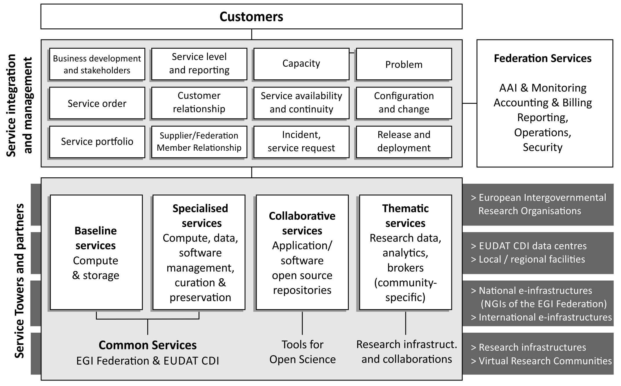
Service Integration and Access Management

Slide 19
Service Architecture
Community Support services
Thematic
Service
Thematic
Service
Thematic
Service
Thematic
Service
Thematic
Service
Thematic
Service
Federation Services
AAI,
Accounting,
Monitoring,
Operations, Security Coord.
Added Value Services
Orchestration of Compute, Data, Software
Curation and Preservation
Open
Collaboration
Platforms
Application Repository,
Configuration Management,
Marketplace
Baseline services
Compute and Storage
Common services

Slide 20
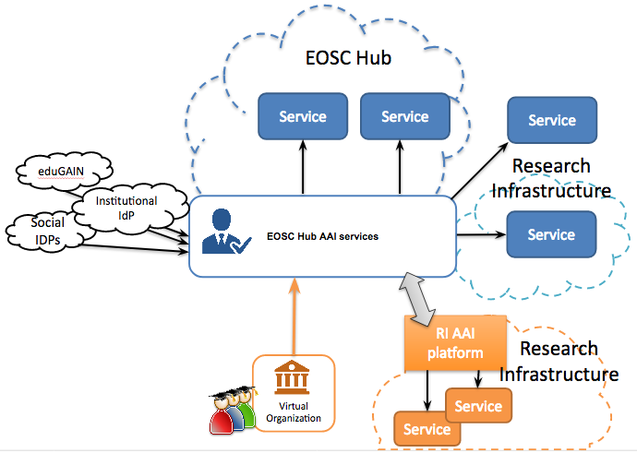
Hub services: Federated Identity, Authentication and Authorization

Slide 21
Service Providers 1/2
e-Infra
EGI Federation
EUDAT CDI
Humanities
Language and literature (CLARIN)
Arts (DARIAH)
Engineering
Environmental engineering (sea vessels, LNEC)
Civil Engineering (Disaster Mitigation)
Medical and Health Sciences
Biological Sciences (ELIXIR)
Structural biology (WeNMR)

Slide 22
Service Providers 2/2
Natural Sciences
Physical Sciences
Earth Science
Astronomy (LOFAR)
Fusion (ITER)
High Energy Physics (CMS and VIRGO)
Space Science (EISCAT-3D)
EO Pillar
GEO
Climate Research (ENES)
Seismology (ORFEUS, EPOS)
Biological Sciences
Marine and freshwater biology (IFREMER)
Biodiversity conservation (LifeWatch)
Ecology (ICOS)

Slide 23
EOSC Domains and the Hub
Hub
EOSC Domain
EOSC Domain
EOSC Domain
EOSC Domain
19/10/17

Slide 24
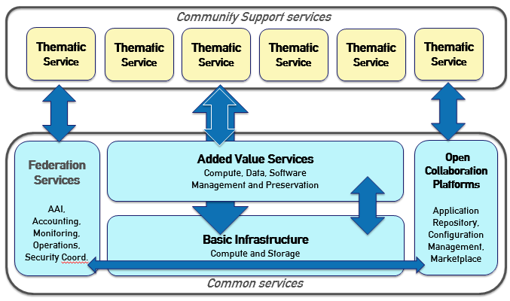
Research Communities
Thematic Service Providers
Providers of community-specific services for the project service catalogue.
Role: SERVICE PROVIDER
Activities: Integrate in catalogue, Train, Exploit
(B) Early Adopters
Research Community as consumer of common e-Infrastructure services
Role: USER
Activities: technical support,
co-design, pilot use
(C) Customers
Research Community as
existing/prospective consumers
of the service in the catalogue
Role: CUSTOMER
Activities: credit allocation,
technical support, exploit

Slide 25
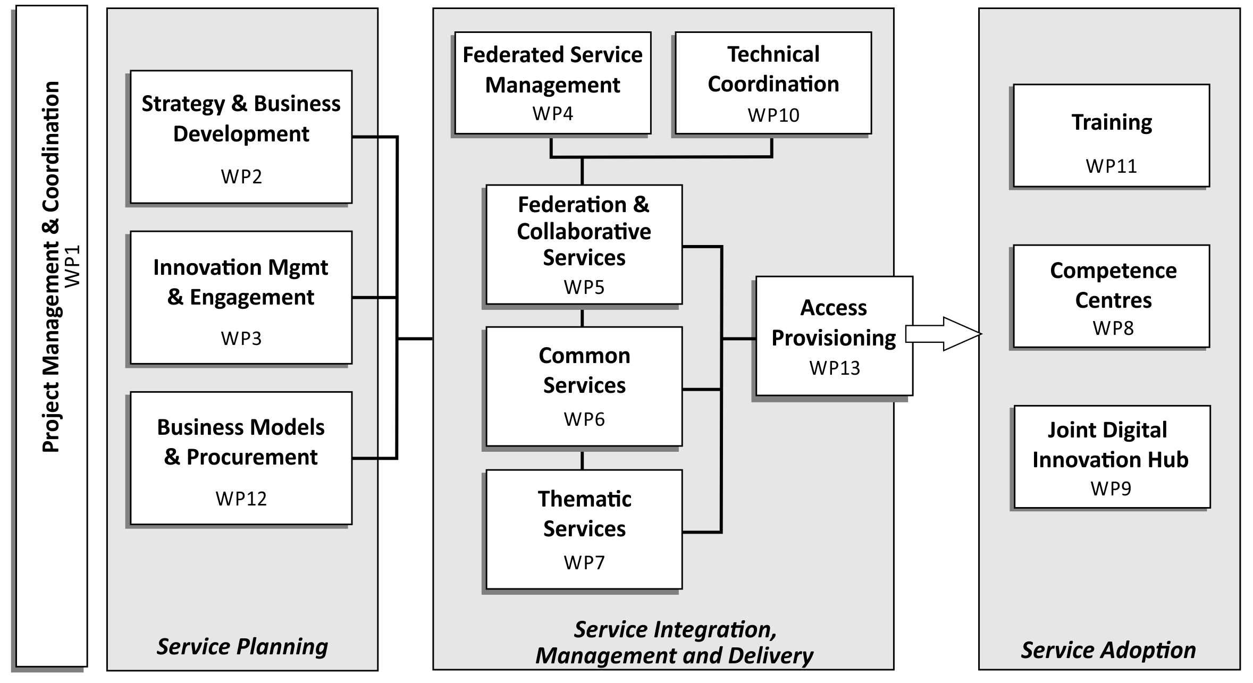
Service Lifecycle
19/10/17
25

Slide 26
EOSC Governance and Funding
Be an EOSC service integrator and federator
Develop the know-how and the prototype procurement and purchasing framework that interested organisations can use to acquire digital services from either publicly funded infrastructures or commercial providers.

Slide 27
Data Culture and FAIR
Provide production-quality FAIR data and services
Ensure data can be used as widely as possible across scientific disciplines and between the private and public sector by:
Providing third-party public/private data as a service
Making core data resources discoverable and accessible
Interconnecting existing data infrastructures across Europe

Slide 28
Research Data Services and Architecture
Realize a system of EOSC domains
Deliver the Hub as a contact point for researchers and innovators to easily discover, access, use and reuse a broad spectrum of resources for advanced data-driven research.
Improve skills and knowledge among researchers and service operators by delivering specialised trainings and by establishing competence centres to co-create solutions

Slide 29
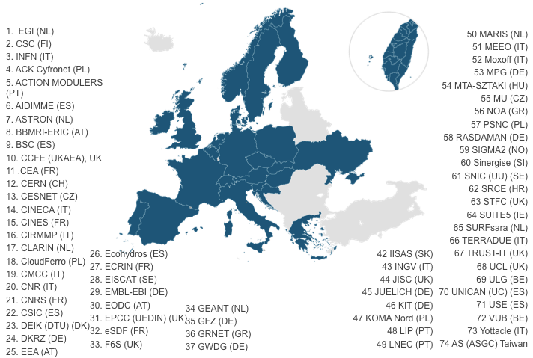
Consortium

