Slide 1

Lightning talk: WLCG
Ian Collier
Distributed Computing Infrastructure Group, STFC
Chair of WLCG Grid Deployment Board

Slide 2
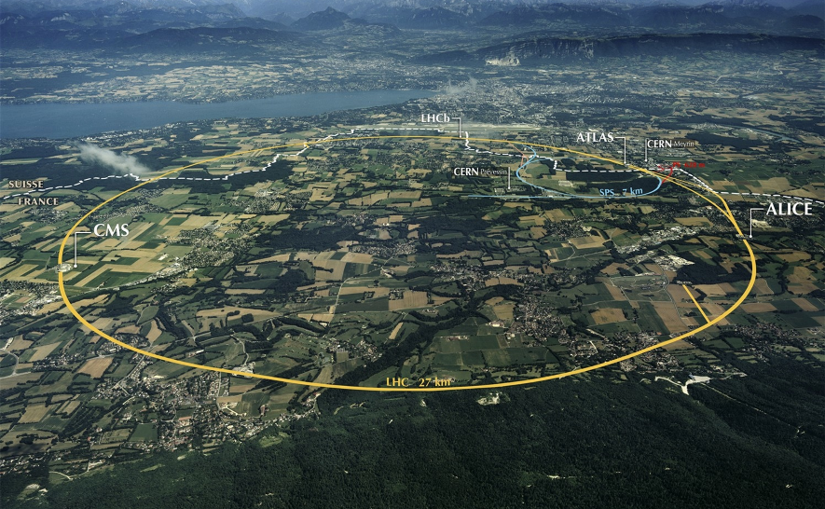
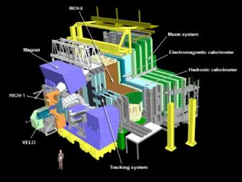
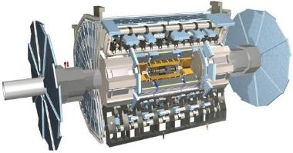
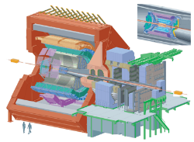
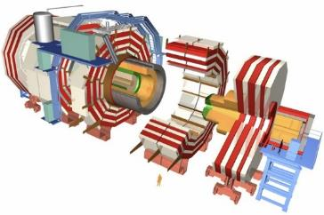
The Large Hadron Collider (LHC)
>1 GB/s
~700 MB/s
A new frontier in Energy & Data:
LHC experiments generate 50 PB/year
~10 GB/s
>1 GB/s
Notes:
Largest scientific apparatus ever build
27km around
2 general purpose detectors: Huge microscopes – to explore the very small – using a long lever arm
2 specialized detectors

Slide 3
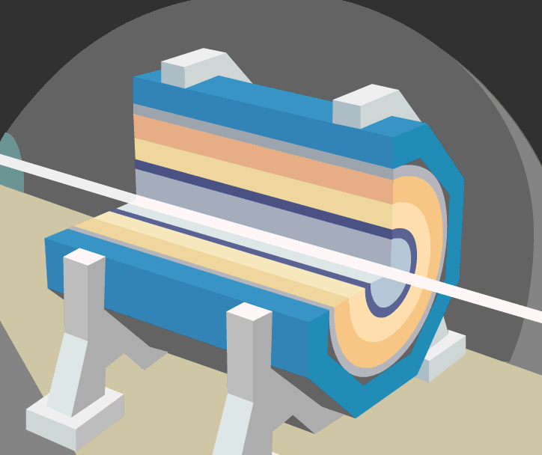
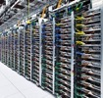

Data Analysis at the LHC
The process to transform raw data into useful physics datasets
This is a complicated series of steps at the LHC (Run2)
After HardwareTrigger (TB/s)
From Detector (1PB/s)
Derived Data (2 GB/s)
Derived Data (2 GB/s)
Analysis Selection
(100MB/s)
Data
Volume
Selected RAW (1 GB/s)
20k
cores
Reconstruction
Reprocessing
Organized Analysis
Final Selection
Processing and people
HLT
40k
cores
30k
cores
DAQ and Trigger (less than 200)
Operations
(less than100)
Analysis Users
(lMore than 1000)
Operations
(less than 100)
60k cores
Analysis Users
(lMore than 1000)
Notes:
Takes weeks and involves a big central operation team and large user community. Data is touched several times and by different sets of teams

Slide 4
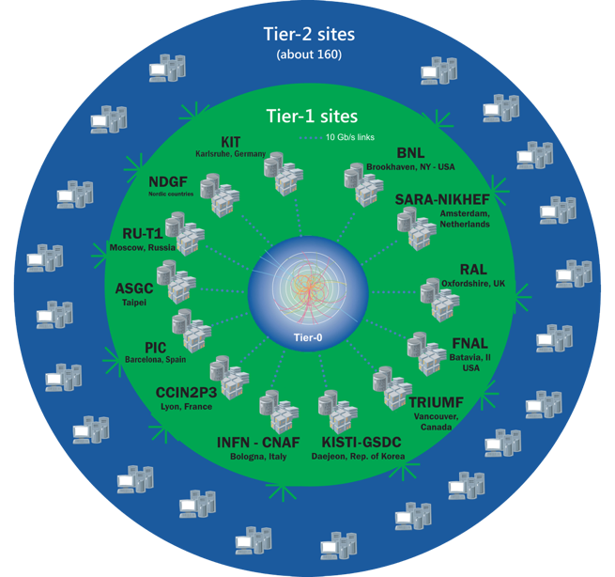
The Worldwide LHC Computing Grid
Tier-0
(CERN and Hungary):
data recording, reconstruction and distribution
167 sites,
42 countries
~750k CPU cores
Tier-1: permanent storage, re-processing,
analysis
~1 EB of storage
> 2 million jobs/day
Tier-2: Simulation,
end-user analysis
10-100 Gb links
WLCG:
An International collaboration to distribute and analyse LHC data
Integrates computer centres worldwide that provide computing and storage resource into a single infrastructure accessible by all LHC physicists

Slide 5
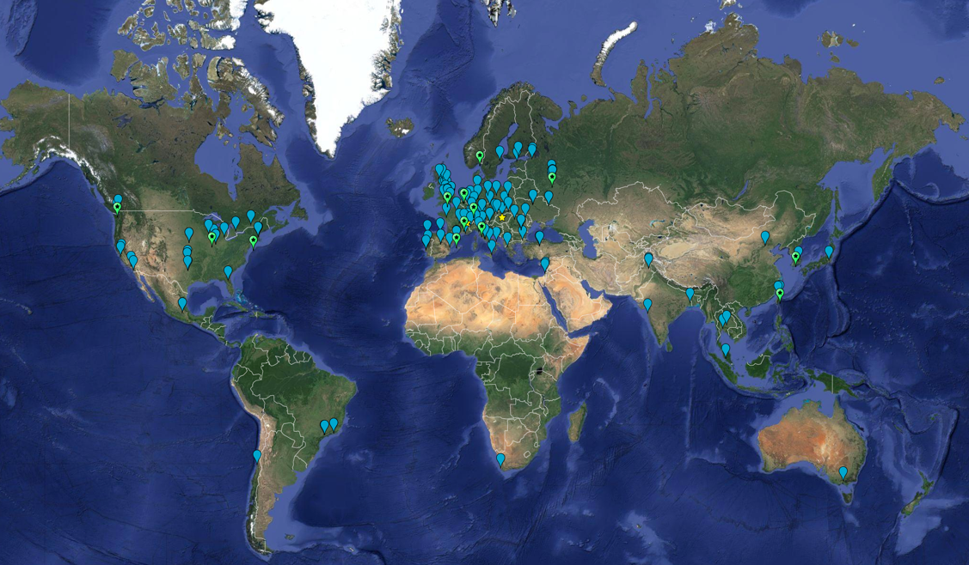
WLCG MoU Signatures
2017:
63 MoU’s
167 sites; 42 countries

Slide 6
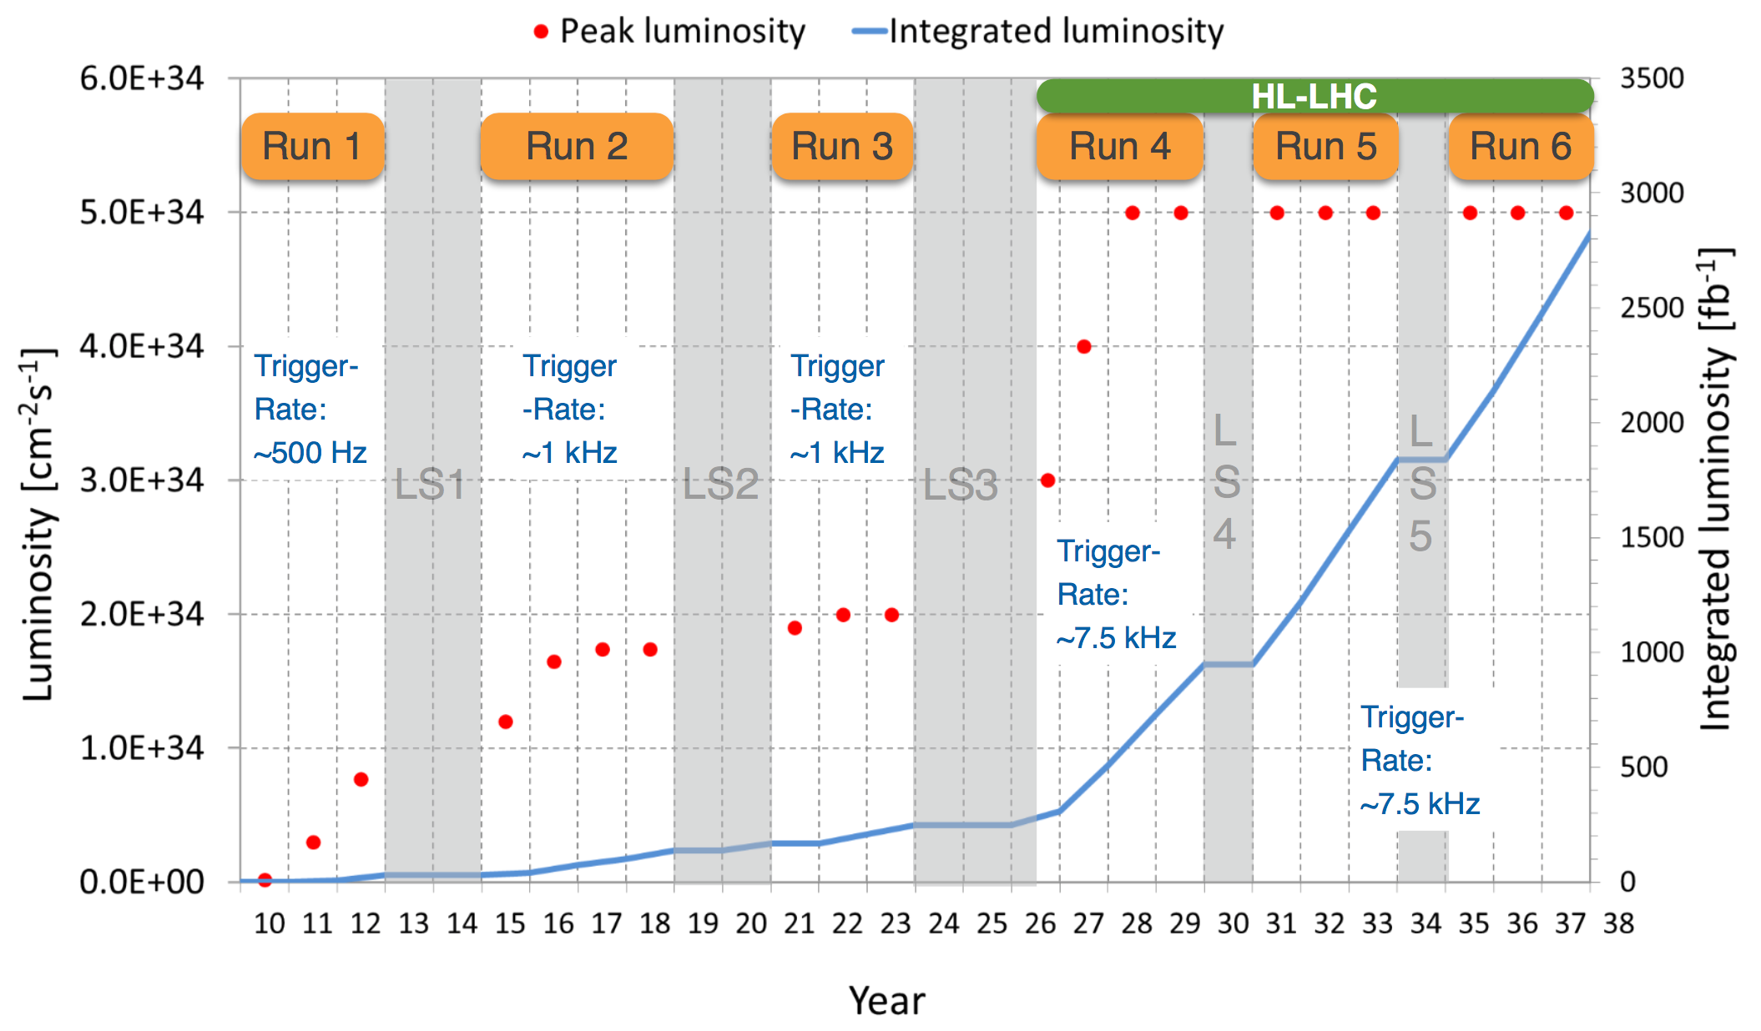
LHC Schedule
Run 3
Alice, LHCb upgrades
Run 4
ATLAS, CMS upgrades

Slide 7
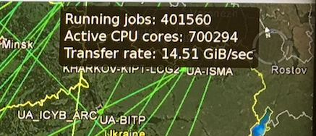
WLCG: Introduction

Slide 8
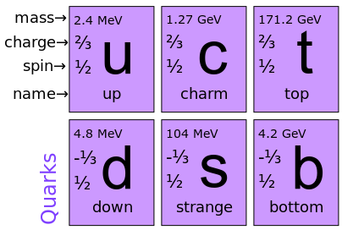
Some elementary particle physics
Hadrons : Particles made of quarks
  Meson
    Particle made up of a
    quark – anti-quark pair
  Baryon
    Particle made up of 3 (anti)quarks
Until now, all known Baryons have
  ≤ 1 of “heavy” (c, t, b) quarks
  Mesons have been seen with multiple heavy quarks
Quarks

Slide 9
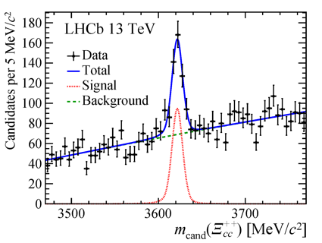
LHCb in July 2017
Observation of first baryon with two “heavy” (charm) quarks
Measured mass of 3621 MeV/c²
  Has to exist in the Standard Model
  First of a family of such particles waiting to be seen
Will allow precision tests of QCD
As with the Higgs discovery this is confirming our model of how the universe works

Slide 10
EGI and WLCG
WLCG has been directly involved with the development of distributed e-infrastructure in Europe (and around the world) for 15 years
DataGrid (2002-2004)
EGEE-I, -II and -III (2004-2010)
EGI-InSPIRE (2010-2014)
EGI-Engage (2014-2017)

Slide 11
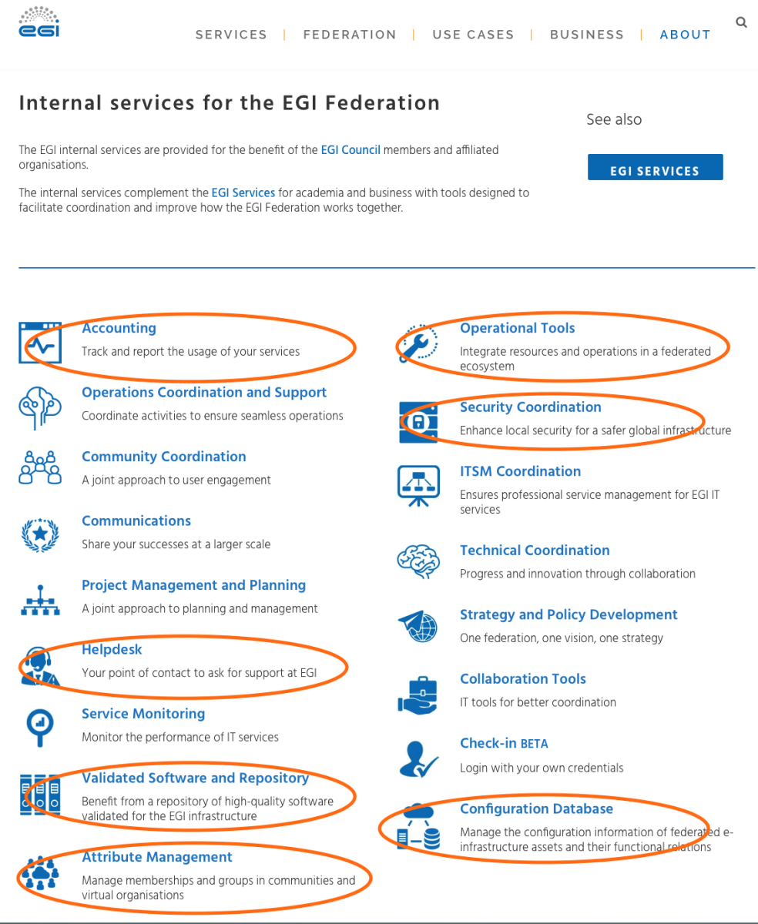
EGI and WLCG
WLCG uses a number of the internal services for the EGI federation:
  service registry
  resource accounting
  help desk platform and issue handling
  security policy and incident handling
These services are essential in the running a global exascale, federated computing infrastructure such as WLCG

Slide 12
EGI-Engage and WLCG: Achievements
Supported by these services WLCG is able to routinely run:
~700 million jobs per year (~5 billion CPU hours)
Regular data transfers of >80PB/month
The computing is in itself an achievement, but the resulting scientific results also endorse the approach.
Led to Higg’s discovery in 2012
confirming standard model
LHCb discovery of ‘charmonium particles’ this year

Slide 13
EGI-Engage and WLCG: Future
WLCG computing infrastructure and the services that enable it are not static.
Those services will continue to evolve to meet new challenges & requirements:
  e.g. as the WLCG information system evolves it requires a write API for service registry which will play a more significant role
  Security policy & the incident response framework has to develop to support new technologies (containers, hybrid clouds) that are central to WLCG meeting its goals and future challenges.

Slide 14
EGI-Engage and WLCG: Future
Run 3 and then the much greater challenges of HL-LHC
  Order of magnitude greater demands on computing infrastructure
  Will continue to depend heavily on the essential federating services provided by EGI
Increasing focus on interoperation with other emerging communities (SKA is just one example)
The future holds fruitful opportunities for continued collaboration

