Slide 1
Check-in
Nicolas Liampotis
Authentication and Authorisation Infrastructure
GRNET

Slide 2
EGI-Engage: Key Exploitable Results
Improved EGI Service portfolio
IMS & Certification
Security policies
Marketplace
Check-in
Tools for federated service management

Slide 3
Description of the KER
Check-in is a service that enables single sign-on to services (web and non-web) through eduGAIN and other identity providers
Users without institutional accounts can access services through social media or other external accounts
Services connected to Check-in can be made available to +2,000 universities and institutes with little or no administrative overhead

Slide 4
Innovation

Slide 5
What is new or improved?
Secure - operates under the strict security policies of the EGI federation
Simple - hides the complexity of dealing with multiple authentication providers and sources of authorisation information
Low overhead - lowers the burden of integrating multiple identity providers and attribute authorities
Interoperable - implements the AARC blueprint architecture and is compliant with eduGAIN, REFEDS R&S and Sirtfi policies
Polyglot - translates SAML 2.0, OpenID Connect, OAuth 2.0 and X.509 credentials

Slide 6
What benefits does it bring?
Only one account needed for federated access to multiple heterogeneous (web and non-web) service providers using different technologies (SAML, OpenID Connect, OAuth 2.0, X509)
Identity linking enables access to resources using different login credentials (institutional/social)
Aggregation and harmonisation of authorisation information from multiple sources

Slide 7
Exploitation

Slide 8
Who can exploit the result? For what?
Check-in can provide secure and user-friendly federated authentication and authorisation for:
User communities with different needs:
operating their own AAI solution
operating their own group management service
in need of a ready-to-use group management solution
Service Providers
looking to leverage “AAI as a Service”

Slide 9
For communities operating their own AAI
Social IdPs
eduGAIN
Institutional IdP
Community’s AAI connected to Check-in as an IdP Proxy to allow its users to access EGI services & resources
Access EGI services without changing your authentication workflow
AAI IdP Proxy
EGI Check-in
EGI Infrastructure
Examples: ELIXIR Research Infrastructure - Check-in allows ELIXIR users to use their ELIXIR IDs to interact with relevant EGI services (Cloud, Configurations database, Applications on Demand
Service
Service
Notes:
This is the ELIXIR use case: ELIXIR has a full-fledged AAI solution, and it talks directly to checkin, in this way for the users there are no visible changes in the authentication process

Slide 10
For communities operating their own group management service
eduGAIN
Community managing authorisation information about the users (VO/group memberships and roles) via their own group management service, which is connected to Check-in as an external attribute authority
Check-in will handle the configuration of the IdPs and the aggregation of the attributes for the SPs
No need to migrate the group management functionality to an EGI-specific attribute authority
Institutional IdP
Social IdPs
Virtual Organization
Service
EGI Check-in
EGI Infrastructure
Service
Service
Examples: VOMS-managed VOs such as FedCloud
Notes:
An established community may already have group management solutions, and may want to use it for authorization. CheckIN can aggregate these authorization information with the authentication information coming from the IdPs.

Slide 11
For communities in need of a ready-to-use group management solution
eduGAIN
Communities that do not operate their own group management service can leverage the group management capabilities of the Check-in platform
Ready-to-use solution
Avoid overhead of deploying a dedicated group management service
Support for multi-tenancy to allow authorised VO admins to manage the information about their users independently
Easy connect to both EGI and non-EGI services
Institutional IdP
Social IDPs
Service
EGI Check-in
Virtual Organization
Service
EGI Infrastructure
Service
Supported technologies:
CΟmanage
Perun
Examples: Training and Long Tail of Science communities
Notes:
This option basically offers a full AAI solution as-a-service for the community (not only to access EGI services, but potentially any service relevant for the community).

Slide 12
For service providers: AAI as a service
Social IdPs
eduGAIN
Check-in as an authentication proxy
Enable login from institutional IdPs in eduGAIN and social media
Minimal overhead for the service development
All the other Check-in features are available for the SP: account linking, attribute aggregation, ..
Prerequisites:
Service provider must accept EGI policies on data protection
Institutional IdPs
EGI Check-in
EGI Infrastructure
Service
Examples: EDISON Community Portal

Slide 13
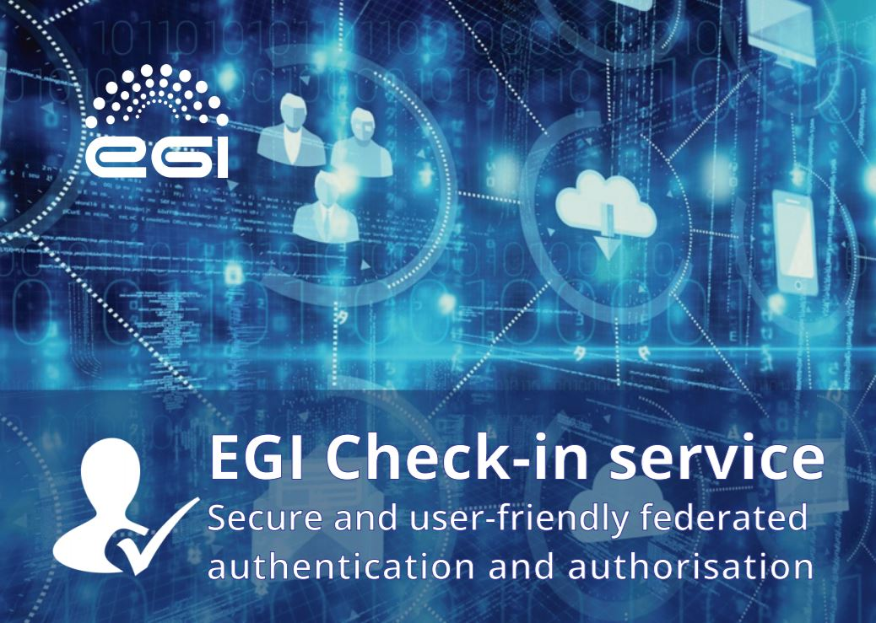
Dissemination & Communication
EGI website:
Check-in service webpage
Publications:
Check-in brochure
Newsletter
EGI: Services for open science
(May 2017)
Selected presentations at events:
“EGI AAI Demo”, First ASTERICS-OBELICS workshop (December 2016)
“The EGI Check-in service”, 10th FIM4R workshop (February 2017)
"EGI Check-in", meeting of the EOSCpilot project (July 2017)

