Slide 1
Marketplace & Tools for federated service management
Diego Scardaci
Senior User Community Support and Outreach Officer EGI Foundation

Slide 2
EGI-Engage: Key Exploitable Results
Marketplace
Improved EGI Service portfolio
IMS & Certification
Security policies
Tools for federated management

Slide 3
Marketplace

Slide 4
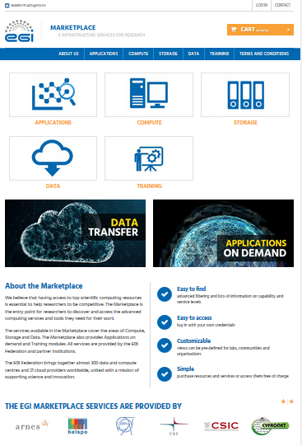
The EGI Marketplace
Platform where an ecosystem of EGI-related services can be
Promoted
Discovered
Shared
Ordered
Accessed

Slide 5
Marketplace Data Model
Three-level hierarchy:
EGI service areas: categories in the marketplace
EGI services: sub-categories in the marketplace
EGI service options: what a customer can order
Customers can personalise their order with service options and related attributed
Defined for each service of the EGI service catalogue

Slide 6
Marketplace EGI Service Catalogue – Areas and Services
Service area | Services
Applications | Applications on demand
Compute | Cloud Compute, Cloud Container Compute and High-Throughput Compute
Storage | Online Storage, Archive Storage
Data | Data transfer
Training | Training Infrastructure, FitSM

Slide 7
Marketplace Workflows
Three workflows defined
Authentication & Registration
Discover and request services
Check-out

Slide 8
Marketplace Workflow: Authentication & Registration
Customer logs in the EGI marketplace through Check-in
Integration with the Check-in service
Credentials of their home organization or social
Basic set of customer data retrieved
Profiling
Mandatory registration
Additional set of user’s data collected to profile the order

Slide 9
Marketplace Workflow: Discover and request services
Customer navigates on the EGI service catalogue and adds one or more services to the cart
Browsing
Services exposed according to the three levels hierarchy
Customisation
A customer can select a specific option for a service
Attributes allow a further customisation
Selection
Selected services are added to the cart

Slide 10
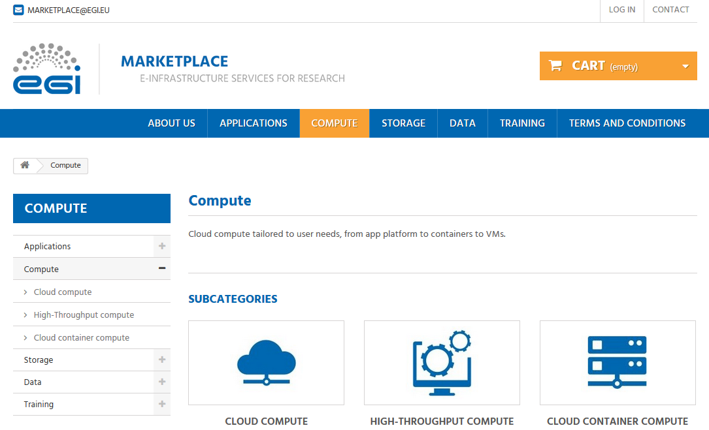
Marketplace Workflow: Discover and request services
1. Compute service area selected
2. Services available in the Compute service area

Slide 11
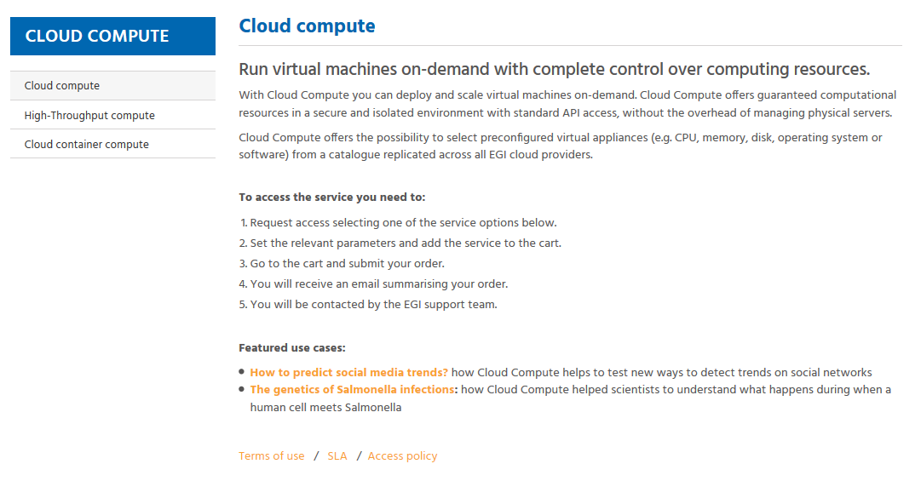
Marketplace Workflow: Discover and request services
3. Description of the Cloud compute service
4. Steps to access the service
5. Term of use, SLA and access policy

Slide 12
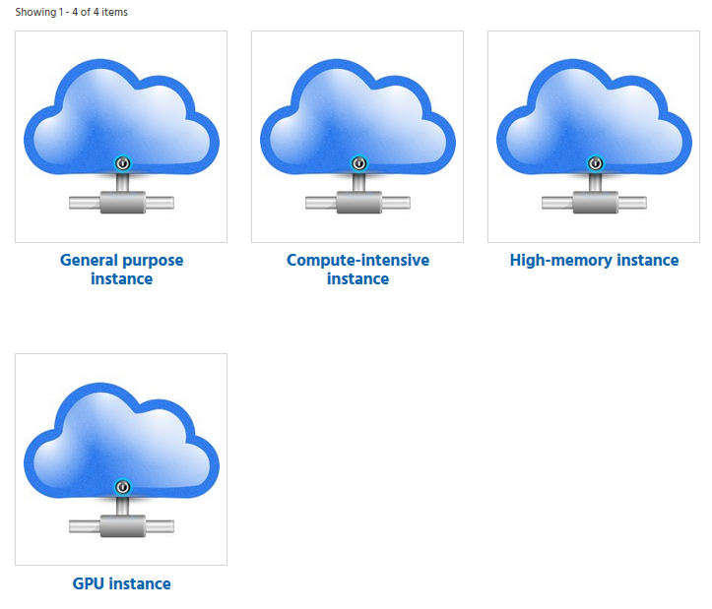
Marketplace Workflow: Discover and request services
6. Cloud Compute service options

Slide 13
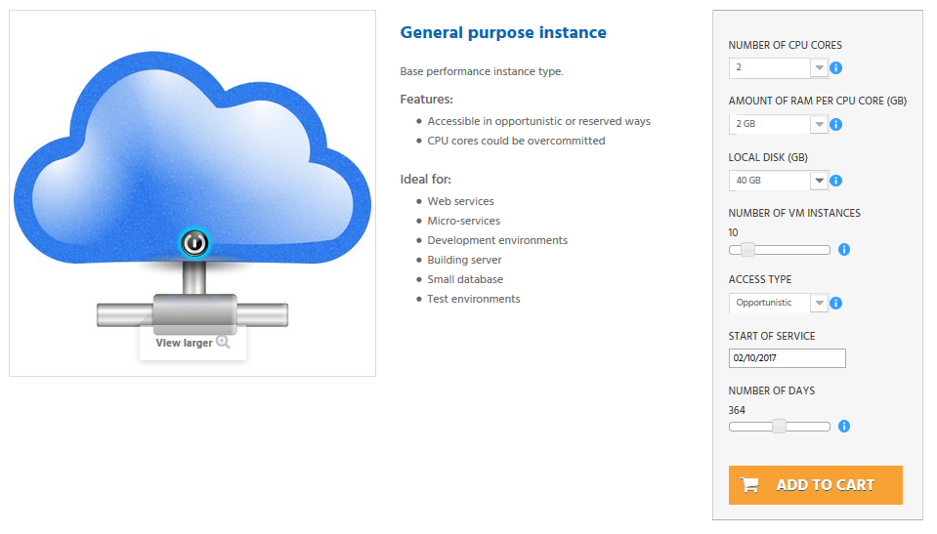
Marketplace Workflow: Discover and request services
8. Attributes for customisation
7. Service option description
9. Add to the cart to order later

Slide 14
Marketplace Workflow: Discover and request services
10. List of service providers offering the service (available for each option)

Slide 15
Marketplace Workflow: Check-out
Customer submits service orders with profile information complemented
Summary of the selected services
The customer shows a summary of the services in the cart specifying options and attributes
Service order profiling
Further information is collected to profile the service orders allowing the appropriate service order management, according to the EGI IMS processes and procedures.

Slide 16
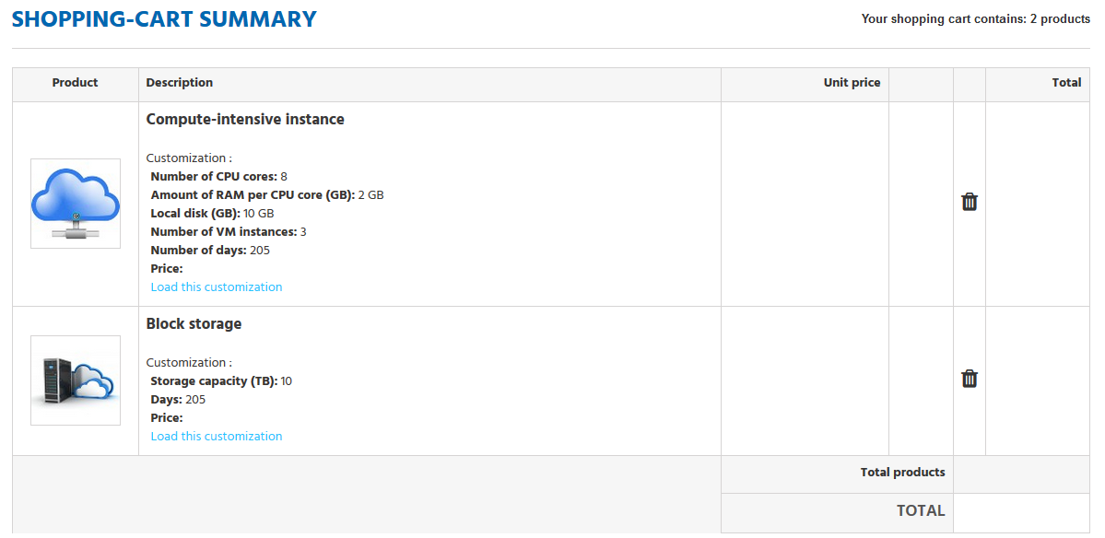
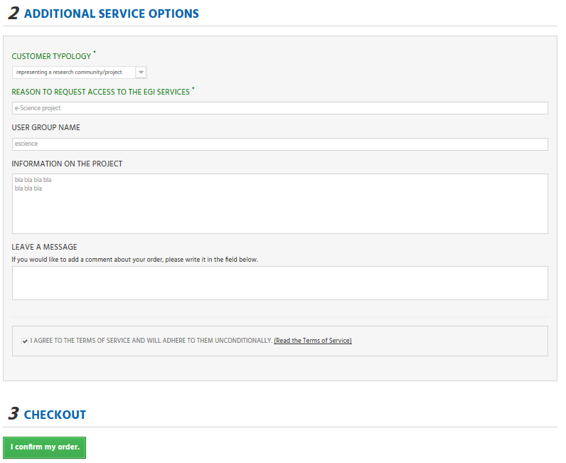
Marketplace Workflow: Check-out
1. Summary of the services being ordered
2. Service order profiling

Slide 17
Marketplace Dashboard
Users can monitor status of their order through ad dashboard
Status and details
SLA when an order is accepted
Contact the EGI user support team

Slide 18
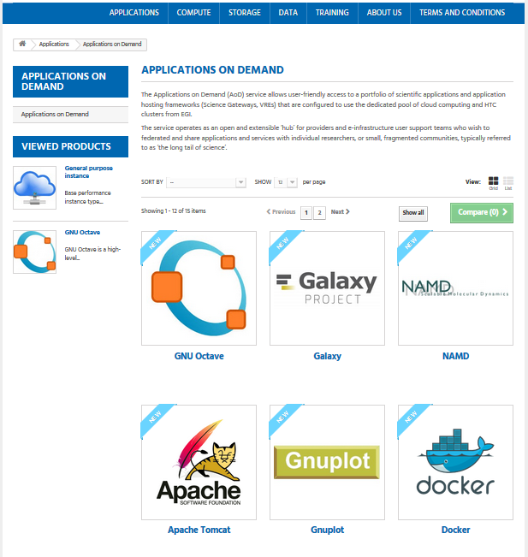
Marketplace Marketplace as Frontend for the Applications on Demand
Users eligible for the AoDs automatically detected
Access provided in an semi-automatic way

Slide 19
What benefits does it bring?
Efficient sharing of resources and provision or e-Infrastructure services to researchers
Easy discoverability and access to the services
Increased competitiveness through a low cost of entry to expensive technologies for small academic institutions and businesses
Facilitates inter-disciplinary research by providing access to technologies typically considered outside of a particular field
Collaborative improvement of services and resources
Allows researchers and institutions to focus on value creation as opposed to maintaining redundant resources

Slide 20
Exploitation

Slide 21
Who can exploit the result? For what?
Publish services
EGI and EGI Federation participants, Research Infrastructures, Research and Technology Organisations (RTOs) and universities, Research communities, SME/Industry
Order services
Research Infrastructures, research groups, individual researchers, academic organizations, SME/Industry especially those doing computer-aided studies

Slide 22
Use cases
Current:
The Marketplace exposes services of the EGI Service Catalogue
Planned:
Publish services from the whole EGI Federation including discipline and community-specific tools and services enabled by EGI
Publish services from third-party
Re-use the technology to create marketplaces for research infrastructures, EGI service providers, etc.

Slide 23
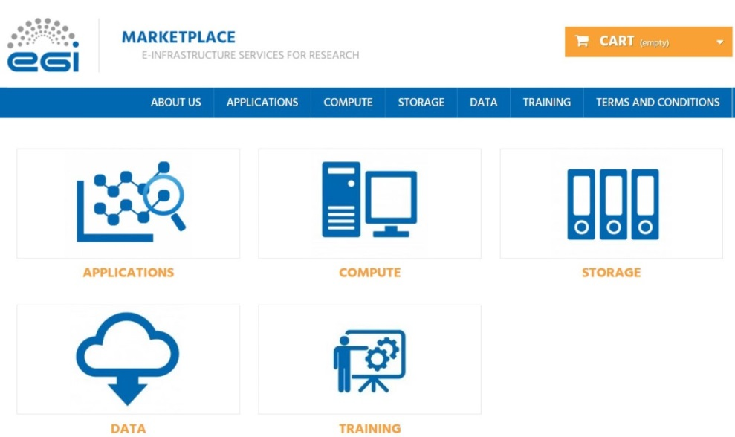
Dissemination & Communication
Dedicated website:
EGI Marketplace
Newsletter:
EGI: Services for open science (May 2017)
The EGI Marketplace (September 2017)
EGI-Engage: a list of key exploitable results (September 2017)
Social Media:
The brand-new EGI Marketplace will be launched!
The EGI Marketplace aims at becoming an online platform for discovering, accessing & sharing EGI services

Slide 24
Tools for federated service management

Slide 25
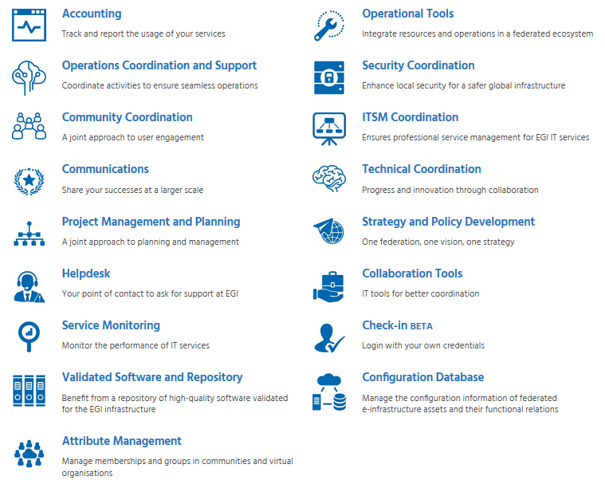
Tools for Federated Service Management Description of the KER
Ecosystem of services that constitute the foundation layer of any distributed e-Infrastructures.
EGI Internal Service Catalogue
Operations portal, Messaging infrastructure, Secant

Slide 26
Innovation

Slide 27
Tools for Federated Service Management What is new or improved?
Operations Portal
Portal for operations: broadcast tool, VO management facilities, operation and security dashboards, metrics, etc.
Supported IMS processes
Incident and service response mgmt
Capacity mgmt
Configuration mgmt
Customer relationship mgmt
Operational Tools
Configuration Management DB (GOCDB)
Catalogue to record information about resource providers, services, service-endpoint of a digital infrastructure
Supported IMS processes
Configuration mgmt
Supplier, Federation Member Relationship Management
Operational Tools

Slide 28
Tools for Federated Service Management What is new or improved?
The EGI Monitoring System - ARGO
Availability & Reliability monitoring:
Hierarchical distributed architecture
Rack a vast number of monitoring metrics
Provide real-time notifications and status reports
Monitor SLAs/OLAs
Relies on Nagios for status monitoring
Supported IMS processes
Service Level mgmt
Supplier, Federation Member Relationship Management
Service Availability & Continuity Management
Operational Tools
Messaging Service
Enables reliable asynchronous messaging for the EGI infrastructure
HTTP Rest Interface

Slide 29
Tools for Federated Service Management What is new or improved?
Supported IMS processes
Service Level mgmt
Customer relationship mgmt
Capacity mgmt
Supplier, Federation Member Relationship Management
Accounting System
Gather and publish usage data from al the resource providers of the EGI infrastructure
CPU, Cloud, Storage and Data measurements
Accounting
Secant
Framework to detect security vulnerabilities in images of virtual machines
Perform security assessment of new images available in the Cloud Marketplace
Operational Tools

Slide 30
What benefits does it bring?
Operational tools solve common problems with federated operations.
Every distributed infrastructure can benefit from some or all the tools operated by EGI.
Accounting/Monitoring can be sold as a service or used as an added value to market the EGI federation to new members

Slide 31
Exploitation

Slide 32
Who can exploit the result? For what?
Users, Resource centres, Research Infrastructures, Service providers, NGIs, Operations and Security teams, Funding agencies and decision/policy makers
Examples:
EGI users can retrieve information about their usage of the infrastructure via the accounting portal
NGIs can manage their operation and resource centres
Research infrastructures can adopt tools to setup their IT infrastructure (e.g. ELIXIR)

Slide 33
Use cases
Current:
The tools for federated service management are used daily in the EGI infrastructure
Planned:
Research infrastructures (e.g. ELIXIR) and e-infrastructures (e.g. EUDAT) adopt tools to setup their IT infrastructure
Interconnect EGI with other e-/R infrastructures through standard interfaces

Slide 34
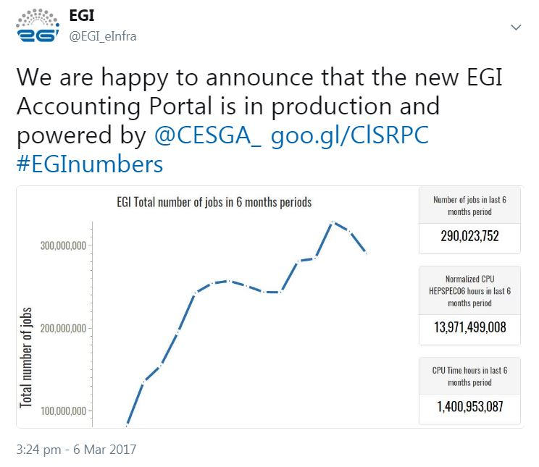
Dissemination & Communication
Accounting Portal
EGI website:
Accounting Portal service webpage
Presentations:
EGI accounting system, ELIXIR Meeting, for RIs (Amsterdam, March 2015)
Delegate of the EGI accounting system, GridPP34 meeting, for the UK WLCG community (London, April 2015)
Accounting system - presentation, WLCG Workshop, for the WLCG community (Lisbon, February 2017)
News item:
New EGI Accounting Portal is ready for use (March 2017)

Slide 35
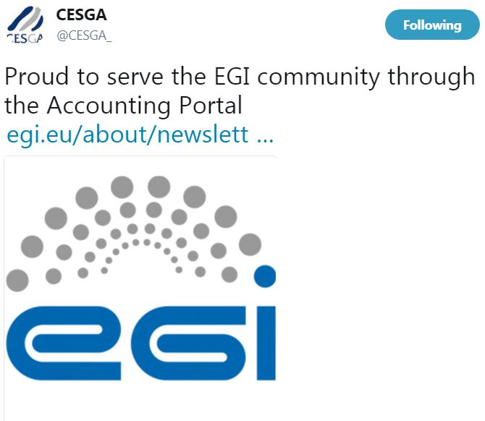
Dissemination & Communication
Newsletter:
The new accounting portal (May 2017)
Social Media:
We are happy to announce that the new EGI Accounting Portal is in production and powered by @CESGA
GOCDB
Presentation:
ELIXIR Meeting, for Research Infrastructures (Amsterdam, March 2015)
ARGO
Presentation:
EGI monitoring system, ELIXIR Meeting, for RIs (Amsterdam, March 2015)

