Slide 1
Federated Cloud Computing
Enol Fernandez
Cloud Technologist, EGI Foundation

Slide 2
EGI-Engage: Key Exploitable Results
Improved EGI Service portfolio
IMS & Certification
Security policies
Marketplace
Federated Cloud Computing
Tools for federated service management
Check-in

Slide 3
EGI Cloud Federation
Grid of clouds
Harmonised operational behaviour
Open Technology stack based on standards
Scalable computing platform supporting applications and services in research and science

Slide 4
A Federated IaaS Cloud for research
Users achieve application portability
Single-Sign On via Check-in
Unified interfaces
Discovery of resources
Appliance library and secure distribution
User-friendly Graphic User Interface
Providers join a reliable infrastructure
Support international communities
Operational and security processes
A/R Monitoring
Accounting
Technology agnostic
Notes:
benefit from standardiation, network with like-minded providers

Slide 5
IaaS Federation Architecture
EGI
Check-in
Thematic Services
AppDB VMOps
IaaS Federated Access Tools
IaaS API
IaaS API
IaaS API
Cloud Management Framework
Cloud Management Framework
Cloud Management Framework
EGI Federation services:
Accounting, Monitoring, Conf. Database, Information Discovery, AppDB Marketplace

Slide 6
AppDB Cloud Marketplace
Open Library of Appliances
Use on clouds or on personal laptop
Re-use, share, associate contextualization
Automatic distribution to cloud providers
EGI-endorsed VM images
securely configured and tested

Slide 7
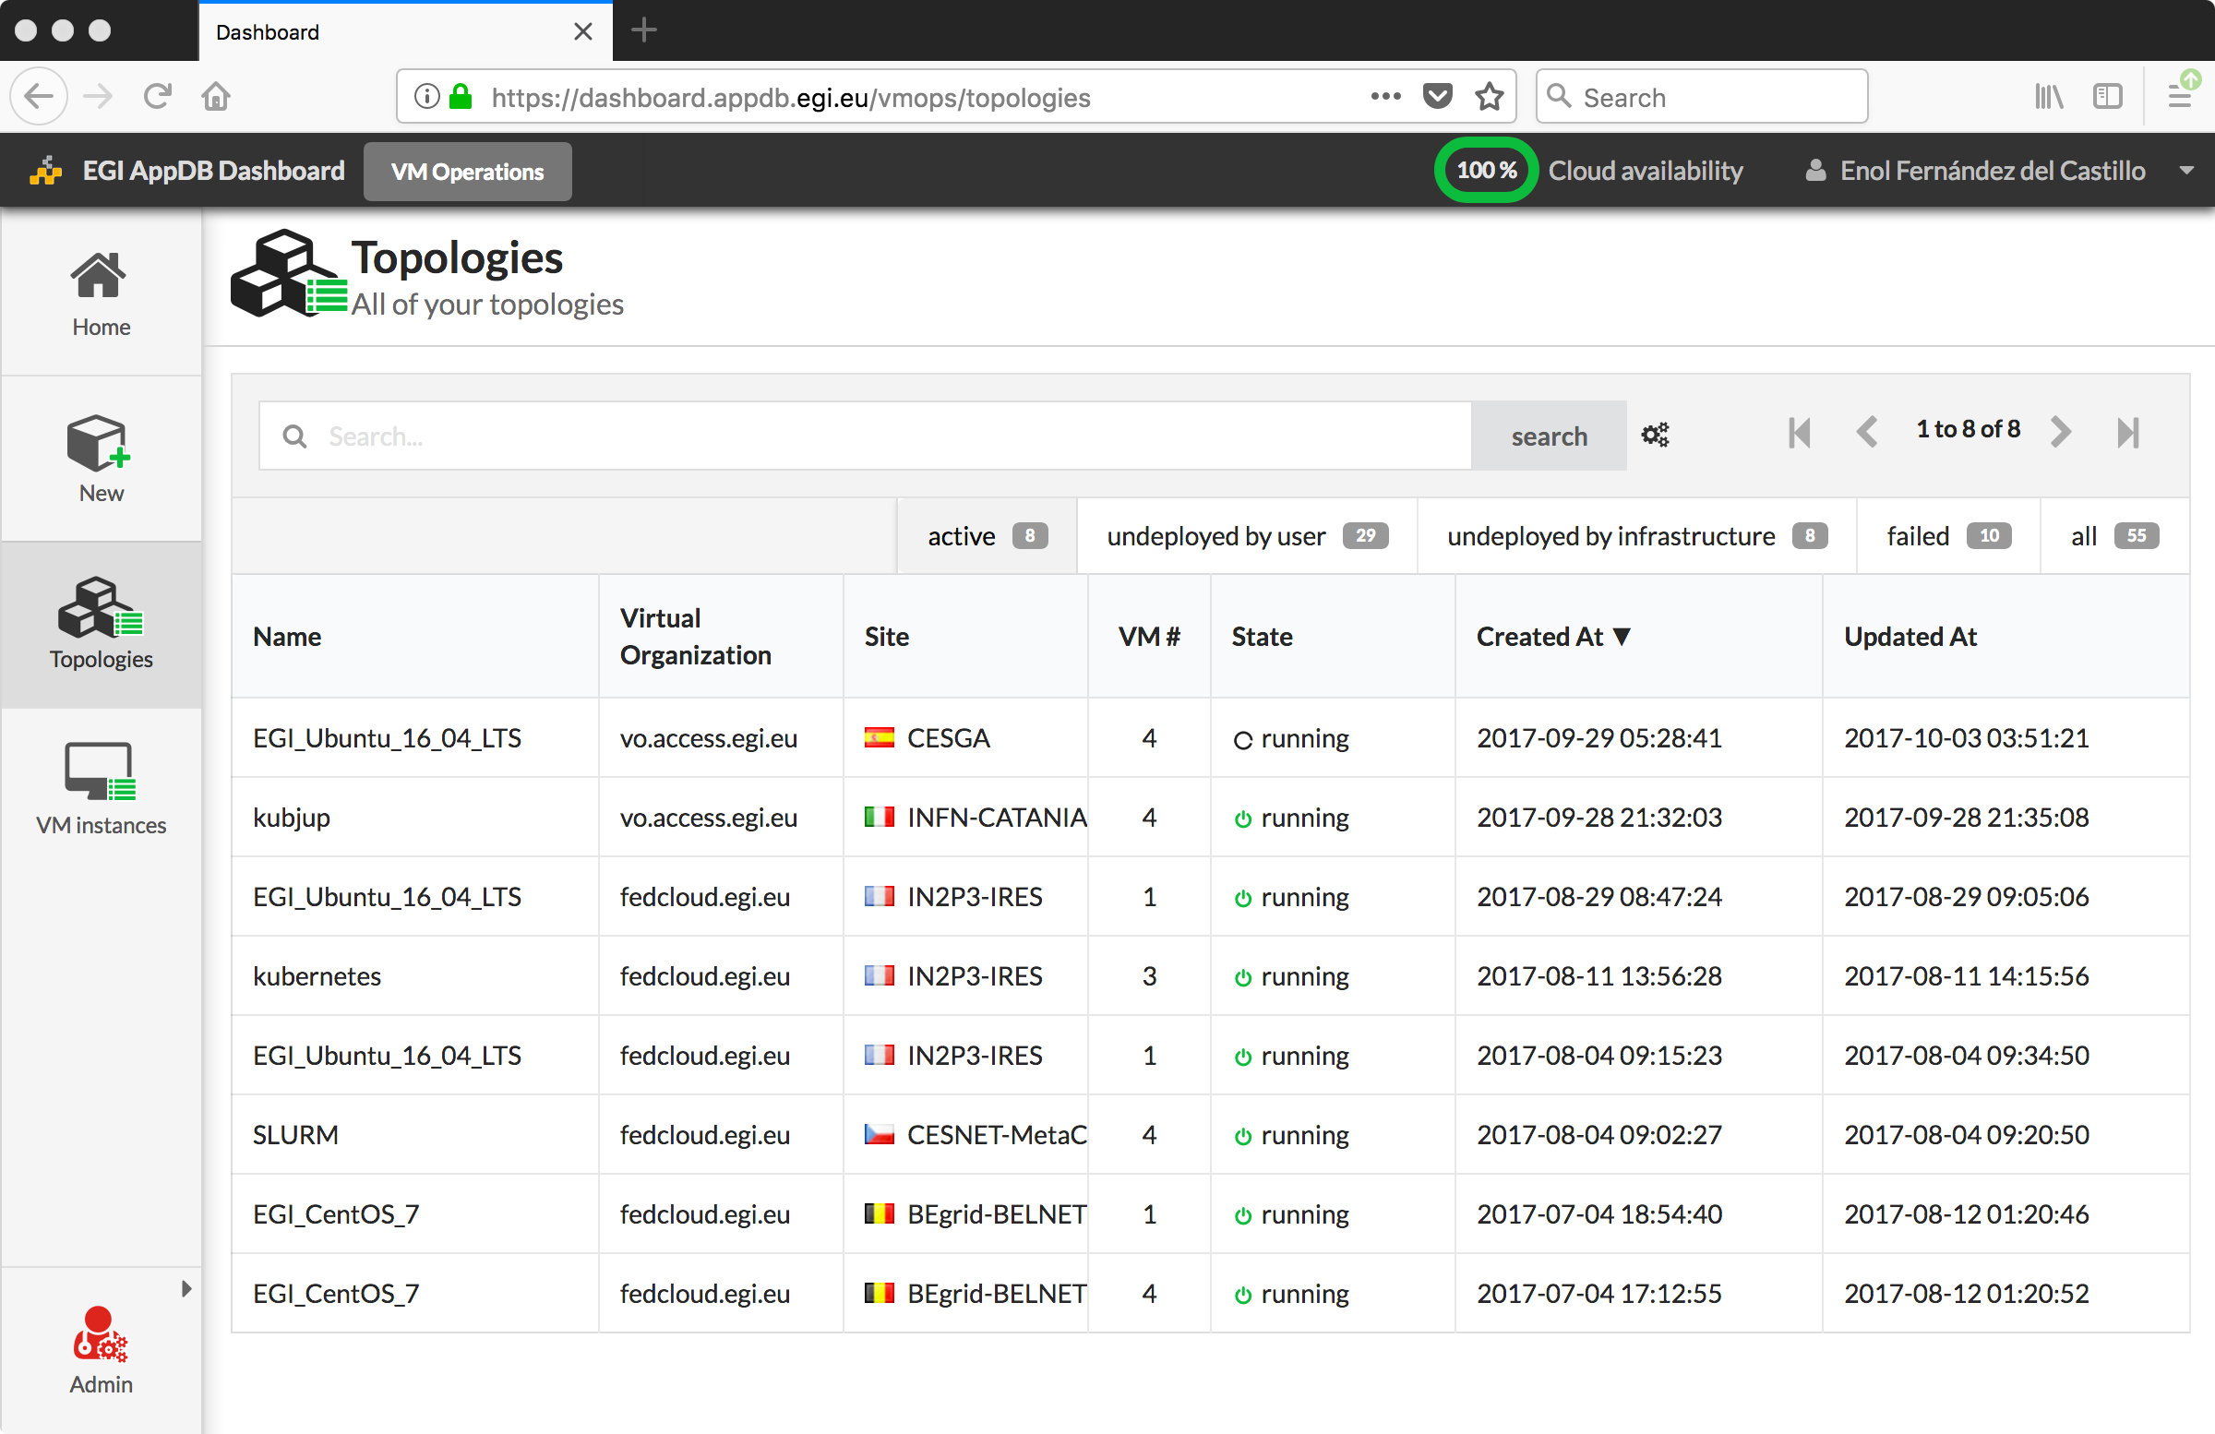
AppDB VMOps
Unified management of VM on the federation
Single dashboard for all providers
Complete EGI Check-in integration
Personalized - wizard-like- management of VMs

Slide 8
Innovation

Slide 9
What is new or improved?
EGI
Check-in
EGI
Check-in
Thematic Services
AppDB VMOps
AppDB VMOps
IaaS Federated Access Tools
IaaS Federated Access Tools
IaaS API
IaaS API
IaaS API
Cloud Management Framework
Cloud Management Framework
Cloud Management Framework
OCCI 1.2
Native API access
EGI Federation services:
Accounting, Monitoring, Conf. Database, Information Discovery, AppDB Marketplace
EGI Federation services:
Accounting, Monitoring, Conf. Database, Information Discovery, AppDB Marketplace
Notes:
- The introduction of the VMOps, a user friendly graphical user interface that makes the federation services more accessible to the users
- The support of the IaaS Federated Access Tools layer that provide better portability across providers and technology stacks
- The definition and implementation for the OCCI 1.2 standard that exposes new features demanded by users and facilitates the implementation of new clients
- Support for exposing native APIs to the federation users so they can leverage existing legacy environments and toolsets
- A simplification of all the components that build the federation that remove the need of modifying the local resource centres for integration by relying on public APIs as much as possible.

Slide 10
What is new or improved? Technology Stack and Standards
Federation Component | EGI Technology | Standards
Single Sign On | EGI Check-in | OpenID Connect, X.509
EGI Accounting | cASO, oneacct-export, APEL | OGF UR (Cloud)
EGI Information Discovery | cloud-info-provider, BDII | OGF GlueSchema, LDAP
VMI replication | cloudkeeper | HEPiX image lists
VMI catalogue | AppDB | DMTF OVF, cloud-init
Unified GUI | VMOPs | OASIS TOSCA
IaaS standard interface | rOCCI, ooi | OGF OCCI 1.2

Slide 11
Benefits
Federation of cloud resources is a recognized value for research communities
EGI Federated Cloud as a reference model
EGI Federated Cloud enables high-demanding use cases to be deployed on distributed computing centres.
Reducing vendor lock-in risks
Increasing usability and stability of the cloud resources
Notes:
Allows Connecting researchers to resources

Slide 12
Exploitation

Slide 13
Who can exploit the result? For what? EGI Cloud Infrastructure and Services
Online IaaS service provided by EGI federation
Target Users:
RIs to operate their services and applications
Applications/Gateway developers to create and publish innovative applications and supporting environments
Expert users to run applications in a unconstrained environment
Notes:
I also phrase this: Talk about three exploitation areas: Online cloud service: 21 sites, X VOs, … Technology to build cloud federation for RIs (and EOSC thematic clouds?): ELIXIR example Contribute to global standardisation/harmonisation initiatives (Open Cloud Conference series you organised recently)
Technology to build cloud federation for RIs
ELIXIR Compute Platform
EOSC thematic clouds
Blueprint

Slide 14
Who can exploit the result? For what? EGI Cloud Technology Stack
Open Source software components for building community-specific clouds
Target Users:
Scientific communities wanting to establish a community specific cloud federation (e.g. ELIXIR)
EOSC Thematic Clouds

Slide 15
Who can exploit the result? For what? EGI Federated Cloud Blueprint
Unique hybrid research cloud in Europe
Open technology
Open standards
Target Users:
Global standardisation & harmonisation initiatives
Pathfinder for the Open Research Cloud
Notes:
Pathfinder for the Open Research Cloud global initiative
Aim to produce a high level set of principles on the value for federating a distributed open cloud for researchers and scientists internationally

Slide 16
Use cases: the infrastructure
20 resource centres
15 OpenStack
4 OpenNebula
1 Synnefo
5 centres under integration
2 centres expressed interest on joining

Slide 17
Use cases: usage
1.6M users
+500 users
2 VREs
Piloting / testingVO
+80 users

Slide 18
Dissemination & communication
EGI website:
Federated Cloud page
Selected presentations:
Cloudscape 2016, Brussels (March 2016)
“The EGI Federated Cloud”, ELIXIR All Hands Meeting (March 2017)
Open Research Cloud Summit, Boston (May 2017)
Using the EGI Fed-Cloud for Data Analysis, EUDAT summer school (July 2017)
Use cases:
How to predict social media trends?
(reprinted in ScienceNode)
The genetics of Salmonella infections
(results published in Nature, 2016)
Featured in the EGI Use Cases publication

Slide 19
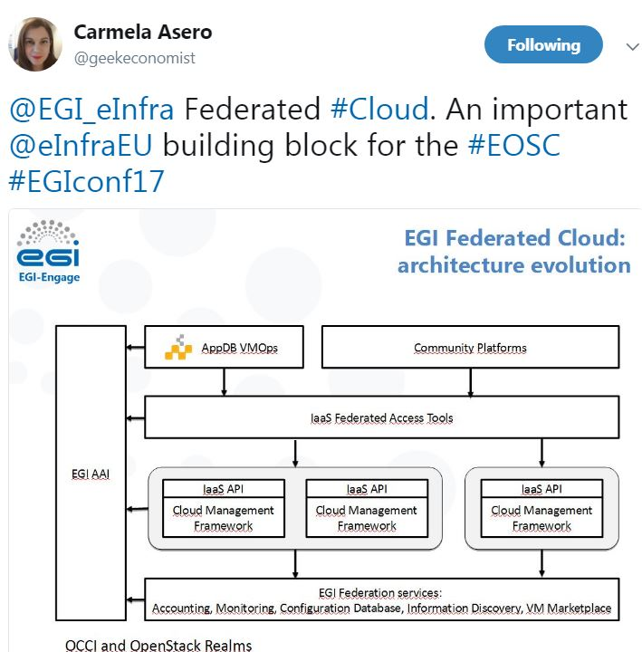
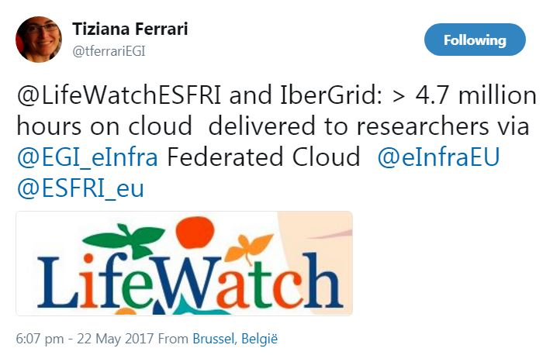
Dissemination & communication
Newsletter articles:
EMSODEV pilot running on the EGI Federated Cloud (July 2016)
EGI at the OpenStack Summit Barcelona 2016 (November 2016)
The EGI Federated Cloud architecture (February 2017)
A new interface for the EGI Federated Cloud (September 2017)
EGI-Engage: a list of key exploitable results (September 2017)
Social Media:
@EGI_eInfra Federated #Cloud. An important
@eInfraEU building block for the #EOSC
@LifeWatchESFRI and IberGrid: > 4.7 million hours on cloud delivered to researchers via @EGI_eInfra Federated Cloud

