Slide 1
Open Data Platform
Matthew Viljoen
WP4 Leader

Slide 2
EGI-Engage: Key Exploitable Results
Improved EGI Service portfolio
IMS & Certification
Security policies
Marketplace
Open Data Platform
Tools for federated service management
Check-in
Federated Cloud Computing

Slide 3
Description
EGI Open Data Platform
=
Enabling Open Data access and exploitation
Fundamental to the successful competitiveness of European science and industry
Notes:
open data, research data & big data
Relevance to Work Programme and societal Challenges
Briefly describe how the result satisfies the expected impacts of the project and/or other relevant economic or societal impacts, as:
• Strengthening the competitiveness and growth of companies by
developing innovations meeting the needs of European and
global markets; and, where relevant, by delivering such
innovations to the markets
• Any other environmental and socially important impacts
Relevance of Result for Policy domain of EOSC
The extent of the benefits derived from the
project result for EOSC

Slide 4
Description
A solution to enable the easy discovery, access and usage of reference open data and user data
The first open source means to:
Federating existing data sources and data storage providers
Bringing data to the multiple hybrid clouds
Discovery and publish data

Slide 5
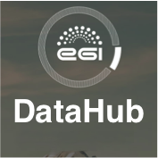
Introducing the EGI DataHub
New Data as a Service offering from EGI based on Onedata
Cross-domain federation of existing storage providers
Central means for accessing open data
Domain level open data repository
Storage provider
Generic open data repository (e.g. AWS)
EGI FedCloud
VM
User browsing data
User analyzing data
Notes:
Based on OneData – developed by Cyfronet as part of EGI-Engage project and the INDIGO DataCloud
and the EGI DataHub which is the prototype installation of it being made available to all members of EGI.
Data here could mean datasets ­ a collection of data/files/filesets at a level of granularity considered useful to user communities.

Slide 6
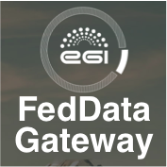
And the EGI Federated Data Gateway
Same technology as the EGI DataHub
Brings user data to the clouds
Enables storage providers to easily expose their storage
Domain level open data repository
Storage provider 2
Storage provider
Generic open data repository (e.g. AWS)
Storage provider 3
EGI FedCloud
VM
User browsing data
User analyzing data
Notes:
Based on OneData – developed by Cyfronet as part of EGI-Engage project and the INDIGO DataCloud
and the EGI DataHub which is the prototype installation of it being made available to all members of EGI.
Data here could mean datasets ­ a collection of data/files/filesets at a level of granularity considered useful to user communities.

Slide 7
Bringing data to computing
Private cloud 1
Institutional cloud 2
Public cloud
VM
VM
VM
VM
VM
VM
VM
VM
POSIX/S3
POSIX/S3
POSIX/S3
Shared storage
Notes:
Brings the possibility of scalable, data intensive computing to communities regardless of their domain.
Seemless access to multiple clouds – private, institutional, public.
Multiple VMs accessing the same data via shared storage SPANNING these clouds.
Accessible via the EGI DataHub
Possibility of publishing data via a DOI and depositing it into a long term archive such as B2SAFE from EUDAT

Slide 8
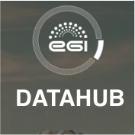
Publishing, discovery and using open data
From isolated domain level data repository with its users to:
open discovery by new users via EGI DataHub
exploitation of data on EGI FedCloud
integrated EGI Check-in (OpenID Connect, social media, Token Translation Service)
publishing and long term data archiving
Domain level
open data repository
EGI FedCloud
VM
VM
VM
POSIX/S3
Shared storage
Notes:
From the point of view of a domain level data repository. Many store data, very few bring the data to computing – an issue with big datasets.

Slide 9
Innovation

Slide 10
What is new or improved?
EGI Open Data Platform and services did not exist before EGI-Engage
Requirements gathering and enhancements of Onedata
Provision of EGI DataHub and the EGI Federated Data Gateway

Slide 11
What benefits does it bring?
Increased accessibility of data to users
Bringing data to computing
Integrated services (federation of data providers, multiple data access, publishing/DOIs and AAI)
Scalability

Slide 12
Exploitation

Slide 13
Who can exploit the result? For what?
Who can benefit?
End users (inc. scientists, researchers, end users)
accessing/using data
Industry and SMEs
services based on data exploitation
Society and citizens
increased data reuse = more research
Service and resource providers
easier use of cloud and data

Slide 14
Use cases
Earth Observation Proof of Concept (EGI-Engage)
ICOS (EGI-Engage)
PanCancer (EGI + EOSCpilot)
Molecular Dynamics/INSTRUCT/LHC-CMS ... (INDIGO-DataCloud)
Industry e.g. T-Systems (INDIGO-DataCloud)
Notes:
Innovation level
Describe which are the main benefits derived by using this result, who is using today and who is expected to use it in the next three years
Innovation Capacity
Describe briefly how the result can be used
-in other areas beyond the project objective
-for bringing benefits to others parties
within the next 3 years

Slide 15
Use case: Earth Observation Proof of Concept
Greenland Glacier (15 scenes) & Shipping in Panama Canal (24 scenes)
Sentinel scenes processed in parallel on up to 4 clouds
15 VMs (one per scene) for Greenland Glacier Up to 15x faster than sequential processing
24 VMs (one per scene) for Panama Canal
~24x faster than sequential processing
15

Slide 16
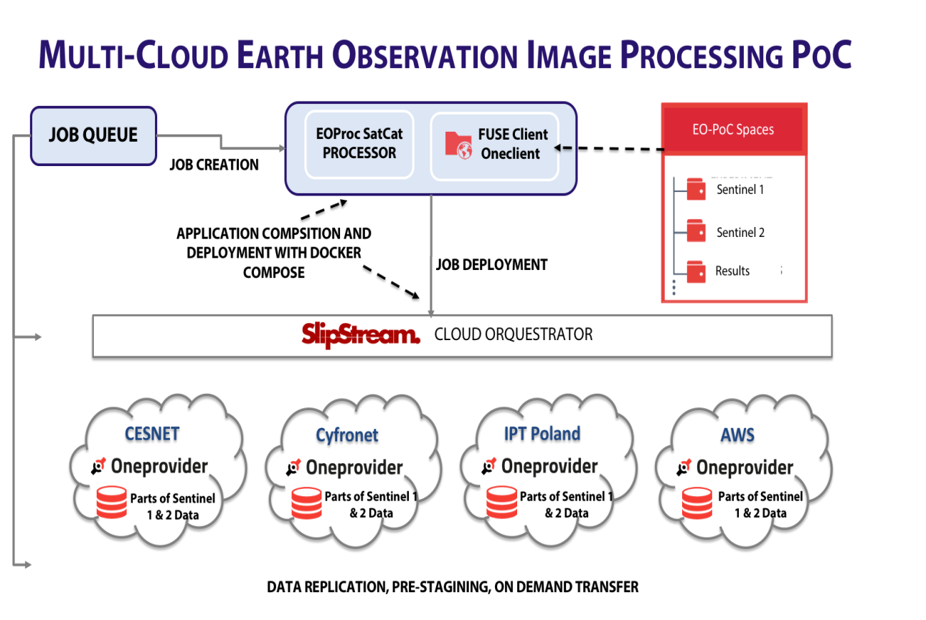
Use case: Earth Observation Proof of Concept
Fast parallel processing of Sentinel data
Transparent data access
Easy processing of data across multiple clouds

Slide 17
Dissemination and Communication
Webinar:
The EGI Open Data Platform (May 2016)
Publication:
Towards European Open Science Commons:
The EGI Open Data Platform and the EGI DataHub
Newsletter:
Introducing the EGI DataHub prototype (issue 25)
EGI: Services for open science (issue 27)
EGI-Engage: a list of key exploitable results (issue 28)
Social Media:
Towards European Open Science Commons:
The EGI Open Data Platform and the EGI DataHub
Join EGI's webinar on Tuesday 17 May at 15:00 to learn about the newly launched Open Data Platform

