Slide 1
Key Exploitable Results (KERs): Benefits, Dissemination and Exploitation Introduction and Methodology
Sergio Andreozzi
Strategy and Policy Manager, EGI Foundation
WP2 Activity Leader, EGI-Engage Project

Slide 2
Outline
Project results
Characterisation
Process to collect and analyse
Supporting templates
Catalogue of project results
KERs selection
KER presentations

Slide 3
Characterization of Project Results
Description of the result
Describes innovation compared to already existing products/services, and the unique selling point (competitive advantages)
Dissemination strategy
Dissemination channels and set of actions that will be put in place to disseminate the output.
Benefits
Who will use the result? For what?
Target audience
Exploitation strategy
Exploitation type (developing / creating /marketing products /services /processes, in standardisation activities, in other initiatives)
Intellectual Property Rights status
Type of applicable IP protection

Slide 4
Identification and management of project results
Review with Activity Management Board
Characterization & update of catalogue
Aggregation & prioritization
KER
& supporting results
Catalogue of Project Results
Deliverables
Review with WP leaders

Slide 5
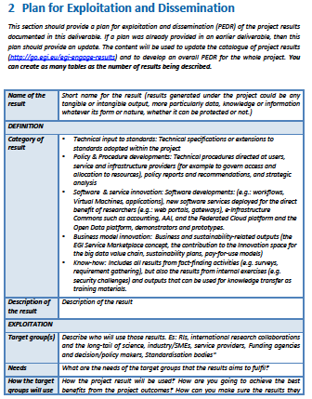
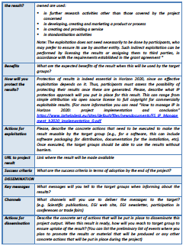
Draft Plan for Exploitation and Dissemination as part of Deliverables
https://documents.egi.eu/document/2501

Slide 6
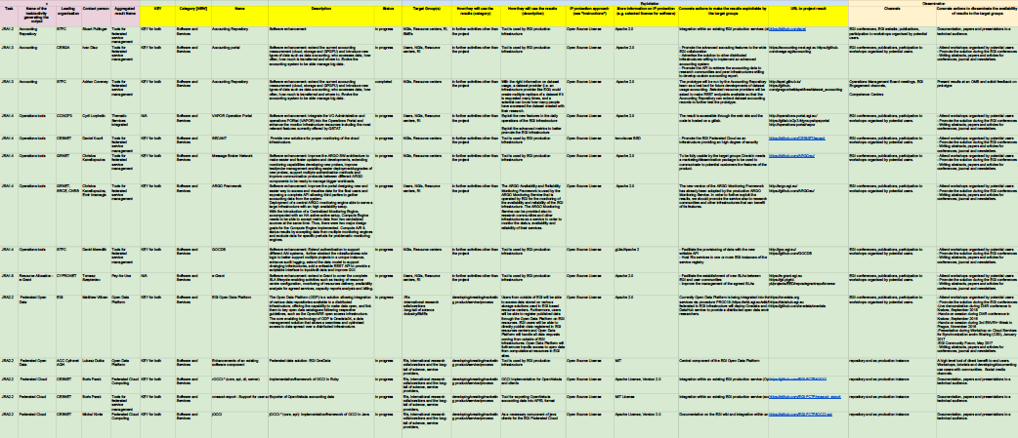
Catalogue of project results – live version
Final version included in D2.14: https://documents.egi.eu/document/3036

Slide 7
Prioritization
Analysis of impact area
Expected project impacts
Classification of impact level based on:
Innovation potential (extent to which the result can bring benefit)
Innovation capacity (extent to which the result can generate further innovation outside the project goals or to external parties)
Classification of exploitability level
Developing/creating/marketing product/services/processes
Internal use within the EGI federation or for external use and commercial use
Relevance to the European Open Science Cloud EC initiative
Impact on science, economic growth and societal challenges
Notes:
Impact I1: Increased availability of scientific data for scientific communities independently of them having already embraced or not e-science; this will be measured by cross-border data traffic over the research networks in Europe as a proxy.
Impact I2: Better optimisation of the use of IT equipment for research.
Impact I3: Avoiding lock-in to particular hardware or software platforms in the development of science.
Impact I4: Scientific communities embrace storage and computing infrastructures as state-of-the-art services become available and the learning curve for their use becomes less steep; this will be measured by the storage capacity available for pan-European use as well as by the number of users of EGI and other production e-Infrastructures in this area.

Slide 8
Project results in numbers
86 results
35 different primary owners
58 technologies integrated

Slide 9
12 Key Exploitable Results
Improved EGI Service portfolio
IMS & Certification
Security policies
Marketplace
Tools for federated service management
Check-in
Federated Cloud Computing
Open Data
Platform
Strategy, governance, procurement
Integrated thematic services
Applications on Demand
Policy papers
on the EOSC

Slide 10
KER Presentations
Description
Innovation
What is new or improved
Benefits
Exploitation
Who will exploit the result? For What?
Use Cases
Dissemination & Communication
General description of Key Exploitable Result

