Slide 1
EGI Service Portfolio
Sy Holsinger
Senior Strategy and Policy Officer, EGI Foundation
WP2 Activity, EGI-Engage Project
Notes:
Good morning, my name is Sy Holsinger.
I am a Senior Strategy and Policy Officer at the EGI Foundation.
Within EGI-Engage, work specifically in the WP2 activity leading federated service management in Task 2.2, which is my connection to this presentation of the EGI Service Portfolio as a Key Exploitable Result.
I also lead the pay-for-use activities as well as I am the task leader of NA2.3, which covers SME engagement.
All of which you will hear later in the day through the dedicated NA2 presentation from WP manager, Sergio Andreozzi.

Slide 2
EGI-Engage: Key Exploitable Results
Improved EGI service portfolio
Notes:
As mentioned in the introduction, the majority of today will be dedicated to presenting a number of Key Exploitable Results.
I guess I have the honor if giving the first key exploitable result presentation that starts with how we have improved the EGI Service Portfolio.

Slide 3
EGI Service Portfolio
The list of services that EGI as a federation offers for research & innovation
Compute
Storage and Data
Training
Applications
Cloud Compute
Archive Storage
FitSM Training New
Applications on Demand BETA New
Cloud Container Compute BETA New
Data Transfer
Training Infrastructure New
High-Throughput
Compute
Online Storage
Platforms
Security
Workload Manager BETA New
Check-in BETA New
Planned
Alpha
Security Training
Auditing Management Systems
Attribute Management
Configuration Database
Content Distribution
Data Hub
Federated Data Manager
Service Monitoring
Notes:
Actually, EGI has 2 service portfolios. The first covers the services that we offer externally, as a Federation to support research and innovation.
Services such as cloud compute and storage, as well as a data management services.
Here you can see that we have introduced a number of new services, some of which are in Beta. As well as a number which are in the pipeline at various stages.
I will go into more detail into how we manage these services as I go through the presentation.

Slide 4
EGI Internal Service Portfolio
The list of services delivered internally to the EGI federation to enable the EGI providers to work together
Coordination
Operations
Security
Communications
Accounting
Attribute Management New
Project Management
and Planning
Collaboration Tools
Check-in New
Strategy and Policy Development
Configuration Database
Community
Helpdesk
Operations and Support
Operational Tools
IT Service Management
Service Monitoring
Security
Validated Software and Repository
Technology
Marketplace BETA New
Notes:
The other Service Portfolio is our Internal Service Portfolio, which are all of the services delivered internally to the EGI Federation that enables the EGI providers to work together.
These services are broken down into areas such as:
Coordination, both technical like security, technology and operations and support as well as non-technical such as around strategy, planning and communications
Operations, which are the federation services, such as central accounting, monitoring and helpdesk as well as a new service such as the EGI marketplace, which you will hear more details from Diego Scardaci after the coffee break.
And finally security, which are both new services added during EGI-Engage, attribute management and check-in which is the new EGI AAI service.

Slide 5
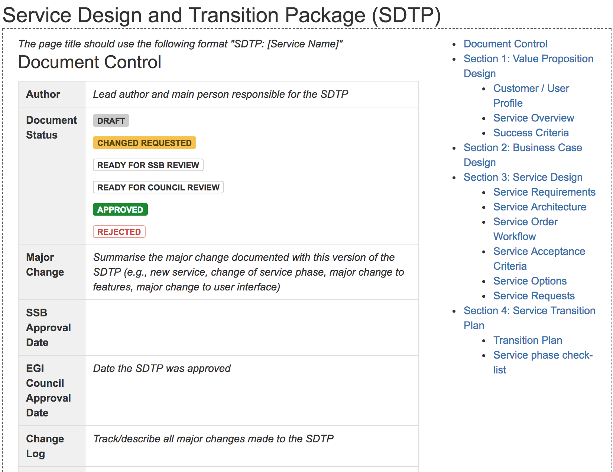
EGI Service Portfolio Templates
Notes:
The majority of information is captured through the use of templates.
What this allows for is to not only harmonize and structure the basic set of required information, but also to facilitate discussions and decision making.
A couple examples are:
Having a service portfolio entry, outlining key information such as the service name, description, service phase (from initial concept to design to beta to production or if retired), who the service is for, the value, etc. a lot that is reused for publication in the catalogue, but it also includes things like service management information such as service owner, agreements, ordering workflow, and costs.
We have definitions for each service phase and how we move from one phase to the next and the resulting actions.
As well as what is called a service design and transition package, which is how we manage any new service or major changes to services, like running an internal project, covers aspects from defining customer profiles, building the business case, designing the technical architecture to transitioning the service to a live environment. Around 15 such packages have been created during the life of EGI-Engage.

Slide 6
EGI Service Portfolio Process
EGI Council
EGI website
Services and Solutions Board
EGI marketplace
Requirements
Service catalogue
Service Portfolio Mgmt.
Service Level Mgmt.
EGI service catalogue brochure
Other external representations
e.g. eInfraCentral
Service portfolio
*Simplified view
Notes:
So the way we manage such activities is by following a process-oriented approach, which is mainly taken from our implementation of the FitSM lightweight service management standard, which was an output of an EC project a couple years ago, but has since matured not only through our move towards ISO 9000 and ISO 20000 certifications, but through improving through experience over the last couple years.
This approach starts from the need of a mechanism to feed requirements that are collected into services, whether new or improved
This is handled by the Service Portfolio Management process, one a several processes that will be detailed by Malgorzata later in this session.
The management team behind this process is called the Service and Solutions board that comprises a number of process owners, service owners and policy group representatives, who evaluation new service ideas, ensure information and ideas are articulated, make decisions regarding service phase changes and interface with the EGI Council, who approve new services (which is a verification of resources are being invested and links to strategy ensured).
This results in a formalized service portfolio.
From there, this process interfaces with Service Level Management, which ensures that agreements are in place (such as SLAs and OLAs) as well as coordinates the Service Catalogue, which is the public rendering of all services that can be requested.
This results in a cleaner, clearer communication of services, whether through the EGI website, the EGI Marketplace, through promotion material as well as other external catalogues such as the eInfraCentral project.
This is just a high-level view of how some of pieces fit together.

Slide 7
Innovation
Notes:
As I just mentioned, this approach to managing a service portfolio is ultimately a mechanism to better translate requirements into concrete innovation.

Slide 8
What is new or improved?
Discovery
Beta
Planned
Alpha
Production
Applications on Demand
Check-in
Cloud Container Compute
EGI Service Portfolio
Workload Manager
Data Hub
Federated Data Manager
Auditing Mgmt. Systems
Security Training
EGI Internal Service Portfolio
Check-in
Marketplace
Notes:
Here you can see some of the services that have through the various designed services phases during EGI-Engage.
Read the services and phases

Slide 9
What is new or improved?
Increased maturity of the process
Validated through ISO certifications
Increased maturity of the IT governance
Established ”Services and Solutions Board”
Included EGI Council in final approval of major changes
Evolved the service portfolio
Managed 10+ major improvements
Ensured alignment with EGI Strategy
Notes:
In addition to service improvements, over the last couple years we’ve:
Increased maturity of the process, which was validated through ISO certifications
Increased maturity of the IT governance through both establishing the ”Services and Solutions Board” and included EGI Council in final approval of major changes
Evolved the service portfolio by managed more than 10 major improvements and ensured alignment with EGI Strategy

Slide 10
What benefits does it bring?
Clarity of offering
Reuse of best practices (template, process)
Reuse of service definitions
Simplify management
Improve communication
Notes:
The ultimate benefits of this has been:
Clarity of our service offerings
Improving communication
Simplifying management, of course after some initial investment is has been the end result
Reuse of best practices through defined processes and use of templates
And reuse of service definitions

Slide 11
Exploitation
Notes:
So then how can we exploit this result

Slide 12
Who is using the result? For what?
Target groups
Customers/users
Research Communities and Infrastructures, Long tail of science, Industry
Funding agencies
European, National
Service providers
Technology, Resources
Exploitation
Marketing of EGI services
Understanding value
Reuse of processes to manage services
Notes:
Well, there are a number of groups that either will use the result or benefit from it. The first is our main target group:
The customers/users of the various services: Research Communities and Infrastructures, Long tail of science, Industry
But also funding agencies both at the European and National levels
As well as service providers, such as technology developers and resource providers
So from an exploitation perspective, this allows for:
Better marketing of EGI services
Understanding value
Reuse of processes to manage services

Slide 13
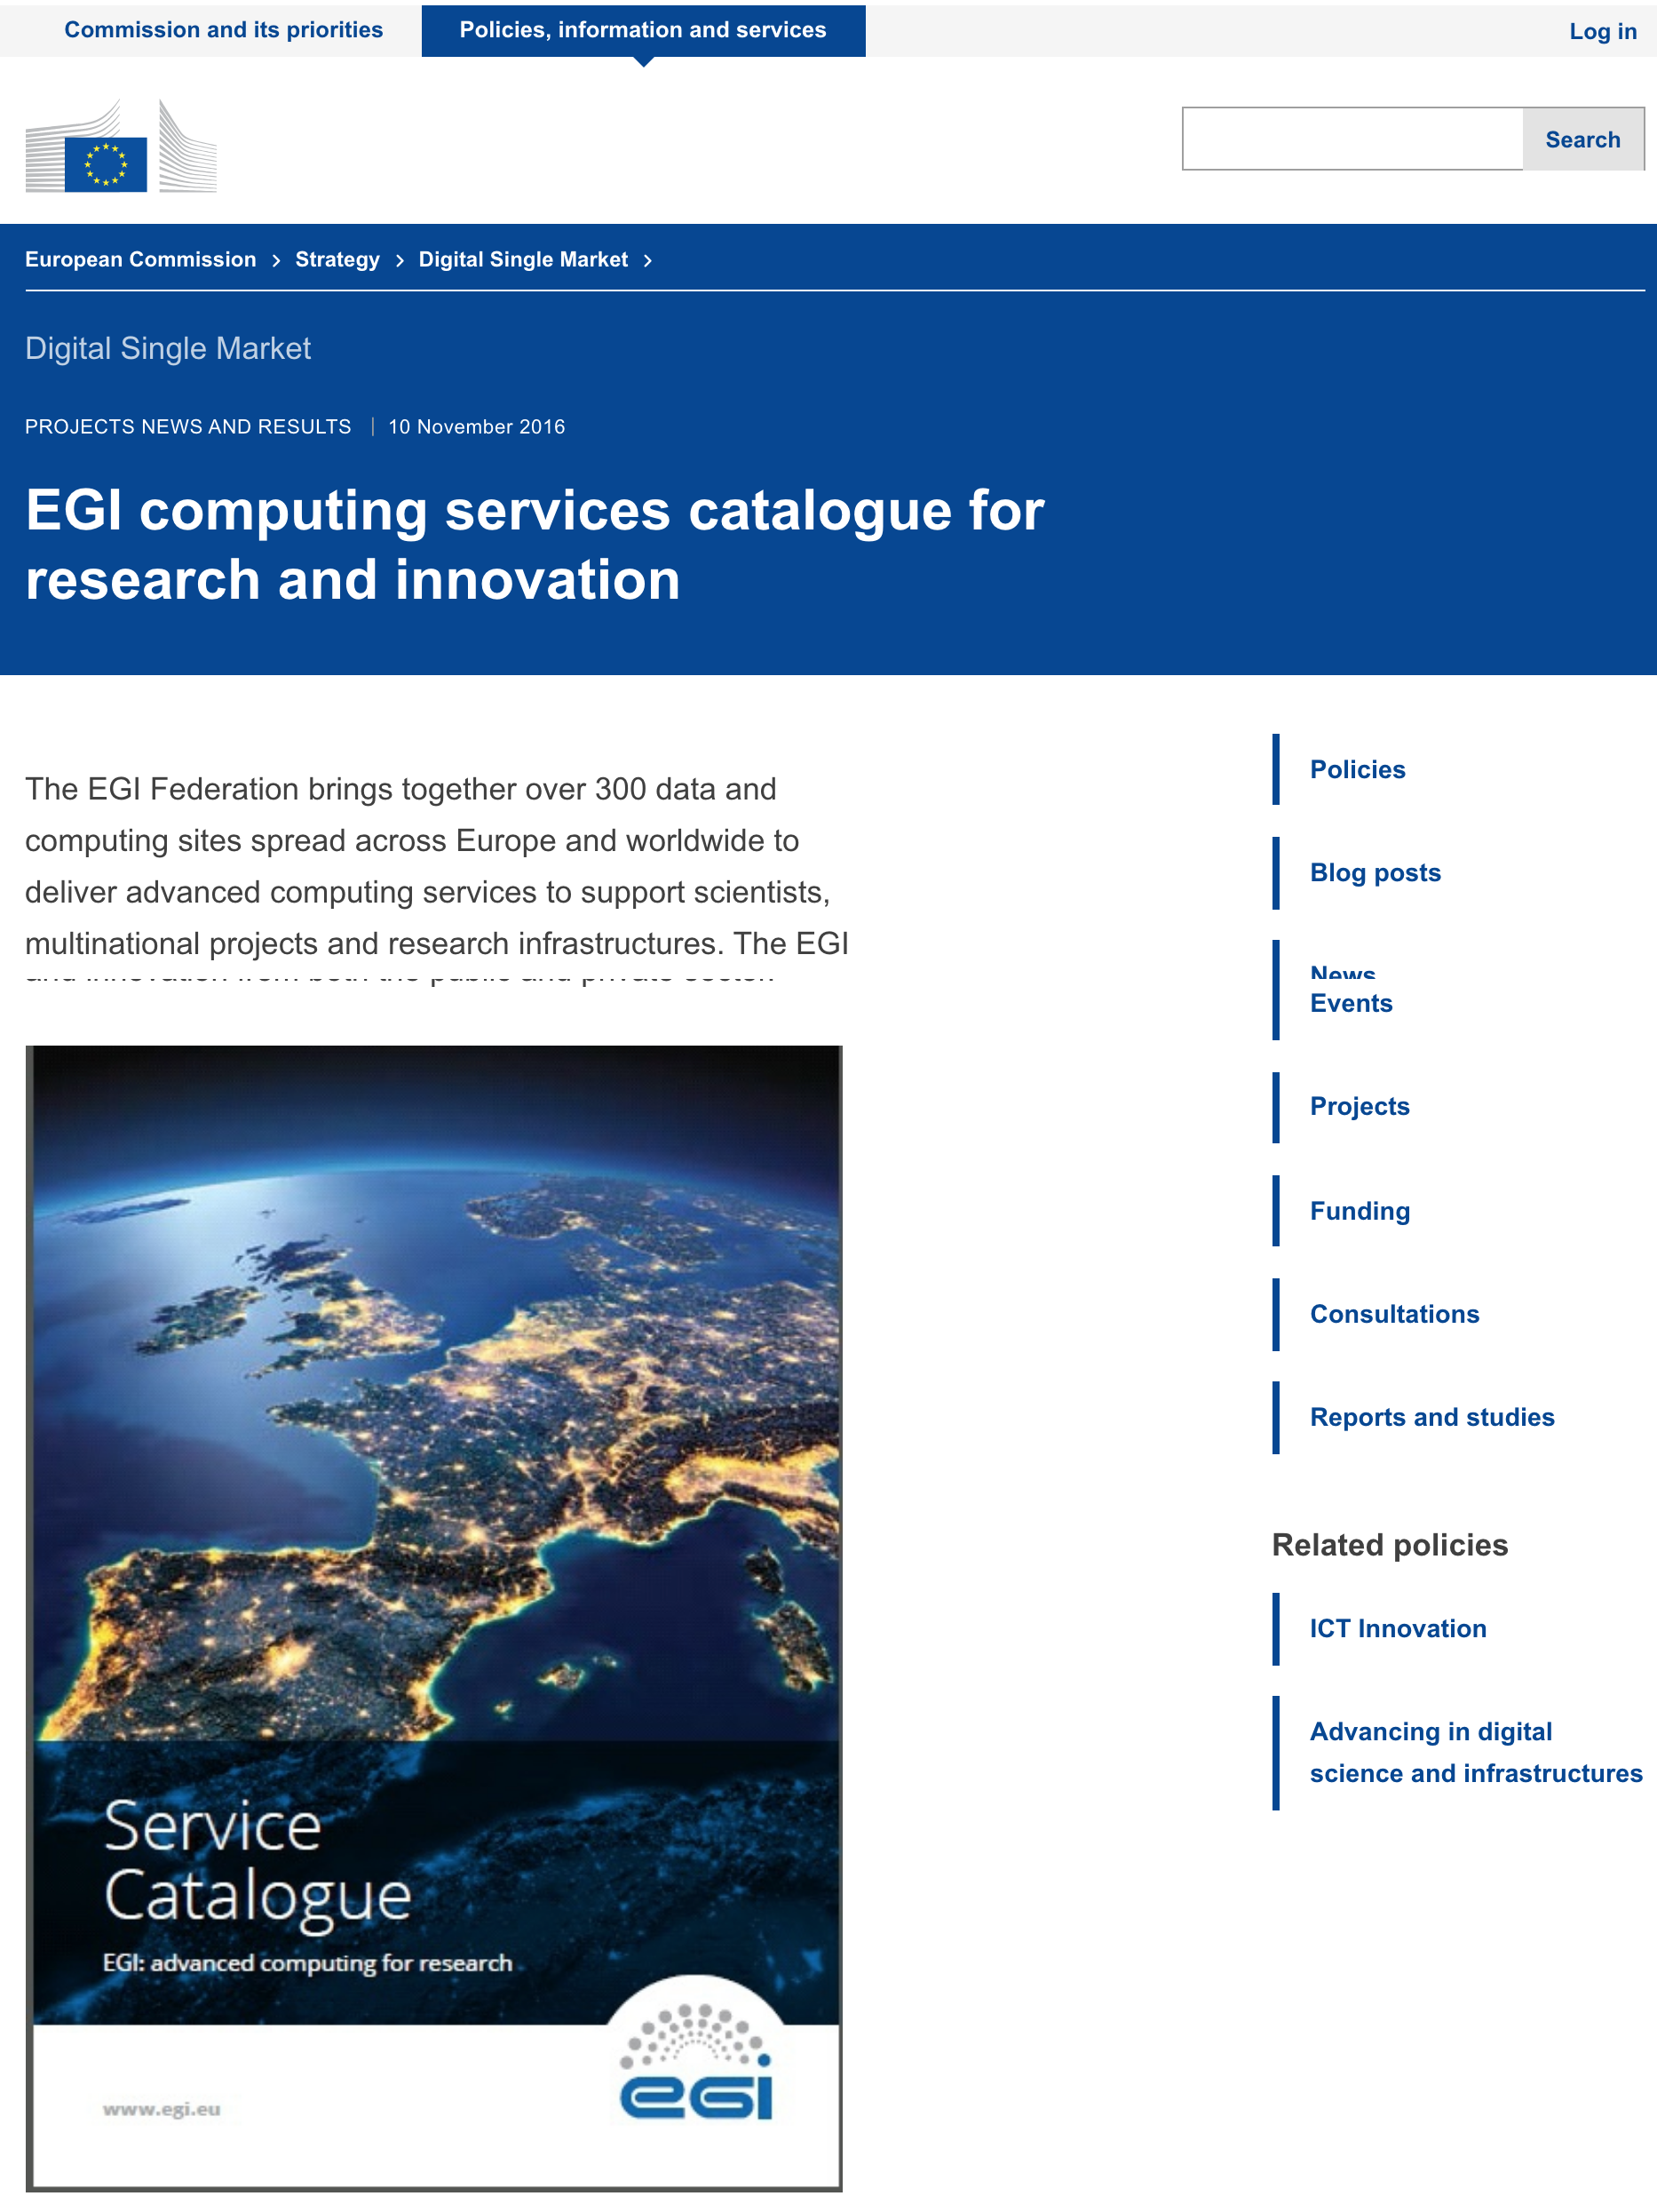
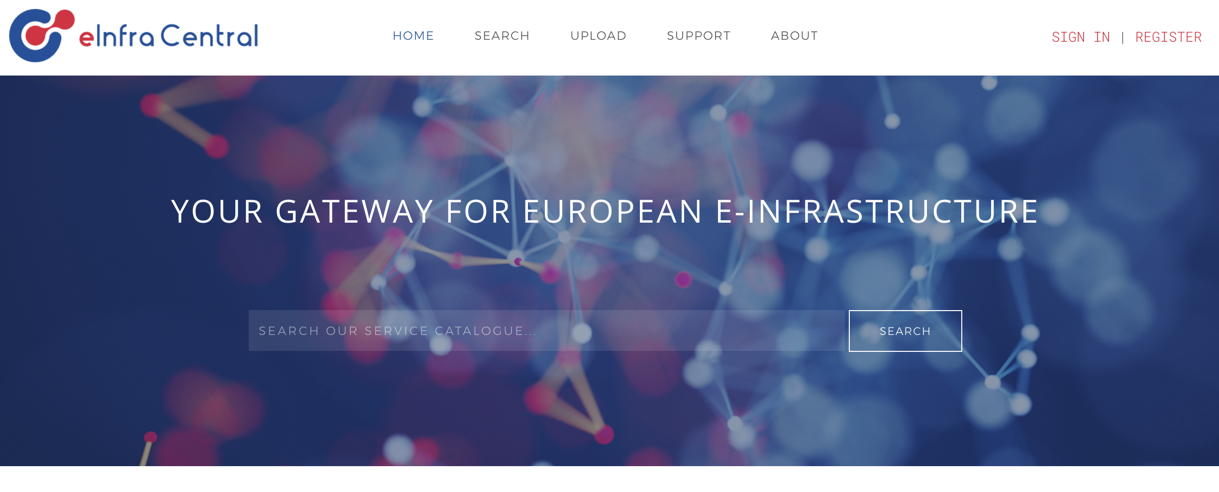
Use cases
Marketing of EGI services
Re-developed the EGI website around a well-defined service offering
Published promotional material
Understanding value
Demonstrated investment results to funding agencies
Reuse of portfolio and processes to manage services
EOSC-hub
Contributed to the project design and the process-oriented approach to manage a joint service portfolio
e-InfraCentral
Supported the project definition and approach to service portfolios and catalogues
Publication of the EGI service portfolio within it project’s service catalogue (beta)
Notes:
So for some concrete use cases of those benefits:
Starting with better marketing of EGI services, this demonstrated through the re-developed EGI website around a well-defined service offering and published promotional material. Again, which you will hear more detail in the WP2 presentation by Sergio towards the end of today.
We’ve started to see evidence that funding agencies are seeing the results of their investment, screen shot of a recent publication of the EGI service catalogue on the European Commission website
Reuse of portfolio and processes to manage services as fed into project such as:
EOSC-hub, where the approach to service portfolio management, and really service management as a whole, contributed to the project design and the process-oriented approach to manage a joint service portfolio; as well as
The e-InfraCentral project, where EGI’s experience supported the project definition and approach to service portfolios and catalogues and the reuse of the services published within it project’s service catalogue (currently in beta).

Slide 14
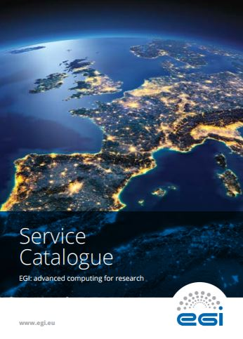
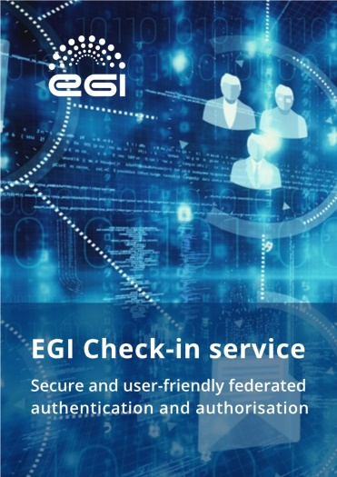
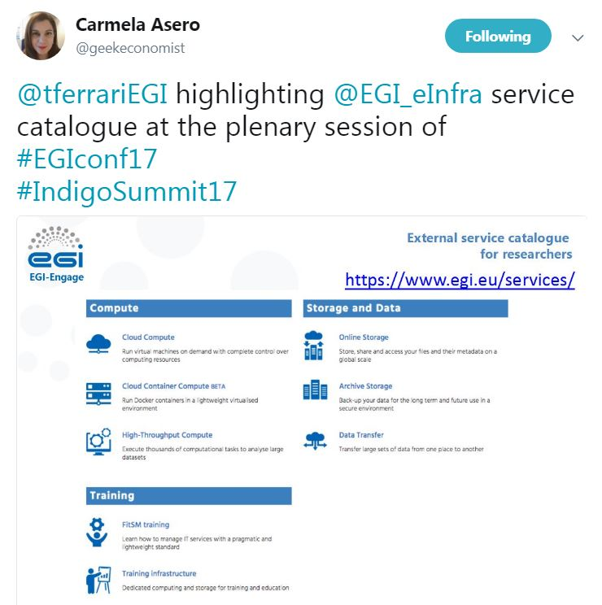
Dissemination activities
EGI Website
Dedicated areas: EGI Service Catalogue and Internal Catalogue
The services have two calls for action:
“Request the service“
"Ask a question“
*contact forms forwarded to the EGI User Community Support Team (UCST)
Selected presentations and contribution to panel discussions
“BDVA Summit 2016”
Meeting for policy makers (Valencia, Nov 2016)
“Europe’s future: Open Innovation, Open Science, Open to the World”
Organised by the EC and RISE high-level group (Brussels, May 2017)
“Design your e-Infrastructure Workshops” (x2)
EGI service presentations (Amsterdam, Apr 2017; Krakow, Sept 2017)
Newsletter
EGI Services for Open Science (May 2017)
EGI computing services catalogue for research and innovation
Notes:
Just to conclude this presentation with a few examples of how these results were disseminated:
We have dedicated areas of the EGI Website hosting information of both the EGI service catalogue and internal service catalogue, with a functionality to request the service itself or more information about it. This will be further facilitated by the EGI Marketplace
We’ve giving a number of presentations and contributed to panel discussions, such as at:
“BDVA Summit 2016”
“Europe’s future: Open Innovation, Open Science, Open to the World”, organised by the EC and RISE high-level group
Organised 2 design your e-infrastructure workshops.
At each event,
Other areas beyond material include articles in Newsletters such as EGI’s own newsletter, as well the European Commission’s.

Slide 15
Notes:
With that, I am happy to take any questions you may have.

