Slide 1
Position and policy papers on EOSC
Sergio Andreozzi
Strategy and Policy Manager, EGI Foundation
WP2 Activity Leader, EGI-Engage Project

Slide 2
EGI-Engage: Key Exploitable Results
Improved EGI Service portfolio
Check-in
IMS & Certification
Security policies
Federated Cloud Computing
Integrated thematic services
Applications on Demand
Marketplace
Policy papers on the EOSC
Tools for federated service management
Open Data
Platform

Slide 3
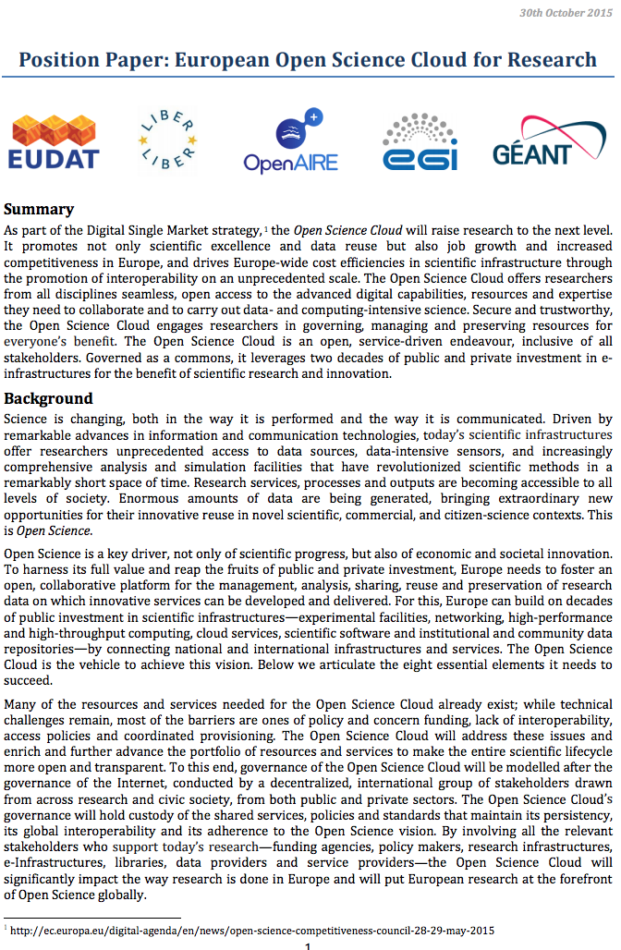
EGI Position and Policy Papers: European Open Science Cloud for Research
OPEN
INTEROPERABLE
PUBLICLY FUNDED & GOVERNED
SOCIAL
RESEARCH-CENTRIC
SERVICE-ORIENTED
COMPREHENSIVE
DIVERSE & DISTRIBUTED
https://doi.org/10.5281/zenodo.32915 (Oct 2015)
Notes:
Bottom-up initiative
Just few months after the first announcement on the upcoming policy on the ECI/EOSC (see EC Communications on the “A Digital Single Market Strategy for Europe”), 5 key initiatives in the area of digital services for science came together to discuss the building principles for the EOSC:
Open: openness in design, in participation and in use
Publicly funded & governed: to guarantee persistence and sustainability, and ensure that outcomes are driven by scientific excellence and societal needs rather than profit
Research-centric: researchers engaged in the design
Comprehensive: all disciplines
Diverse & distributed: diversity of services & resources,
Interoperable
Service-oriented
Social

Slide 4
EGI Position and Policy Papers: Report on the governance and financial schemes for the European Open Science Cloud
Open Science Policy Platform
EC High-Level Advisory Group
Established in Sep 2016
Working group on EOSC
Activity period: Jan 2017 – May 2017
Report adopted in May 2017 and presented at the Competitiveness Council
Authors:
Sergio Andreozzi (Chair)
Kristiina Hormia-Poutanen (Co-chair)
John Wood
Paul Ayris
Steve Cotter
Natalia Manola
Eva Méndez
Karel Luyben
Christophe Rossel
Michela Vignoli

Slide 5
EGI Position and Policy Papers: Report on the governance and financial schemes for the European Open Science Cloud
Governance structure and principles
to identify the distribution of rights and responsibilities among the different entities in the EOSC ecosystem and rules for making decisions
Financial schemes
to shape the best financial mechanisms that can enable the EOSC ecosystem to flourish and deliver value in an efficient way
https://ec.europa.eu/research/openscience/pdf/ospp_euro_open_science_cloud_report-.pdf
Notes:
Top-down initiative
First paper on high-level recommendations for governance structure/principles and financial schemes

Slide 6
Innovation

Slide 7
What is new or improved? What are the benefits?
EOSC first announced in April 2015 by the EC
What is new with the papers?
Leading e-infrastructures joining forces together Agreed principles for designing the EOSC
Recommendations for designing the EOSC governance and financial schemes
What are the benefits?
Expert advices to develop new policies and implementation for the EOSC

Slide 8
Exploitation

Slide 9
Who can exploit the result? For what?
Who can exploit the results?
Policymakers
Funding agencies
EOSC implementers (e.g. EOSCpilot project, HLEG on EOSC)
For what?
Developing new policies or design documents
Defining implementation roadmaps for the EOSC

Slide 10
Use cases
European Open Science Cloud for Research
Report on the governance and financial schemes for the European Open Science Cloud
Paper adopted by the OSPP, 20.03.2017
https://ec.europa.eu/research/openscience/index.cfm?pg=open-science-policy-platform
Outcome of the Competitiveness Council, 29-30 May 2017
http://www.consilium.europa.eu/en/meetings/compet/2017/05/st09716_en17_pdf/

Slide 11
Dissemination & Communication European Open Science Cloud for Research
Press release:
The European Open Science Cloud for Research, October 2015, reprinted at CORDIS
Selected presentations at events:
Community Workshop: Shaping the Open Science Cloud of the Future, Bari (13 Nov 2015)
e-IRG workshop, Amsterdam (March 2016)
Demystifying science: Getting science out of the lab and into society, Brussels (June 2016)
RI sustainability workshop at EC, Brussels (November 2016)
e-Infrastructure Proposers' day, Amsterdam (January 2017)
EOSC Summit, Brussels (June 2017)

Slide 12
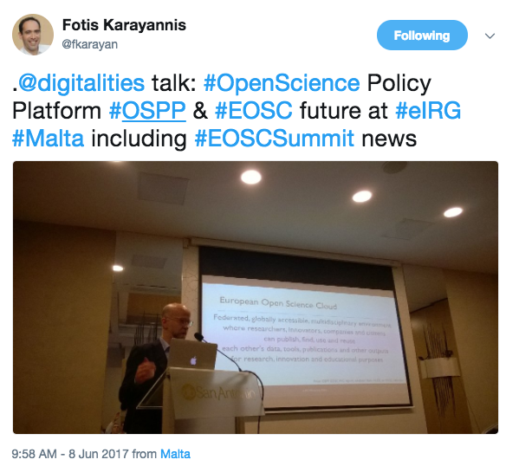
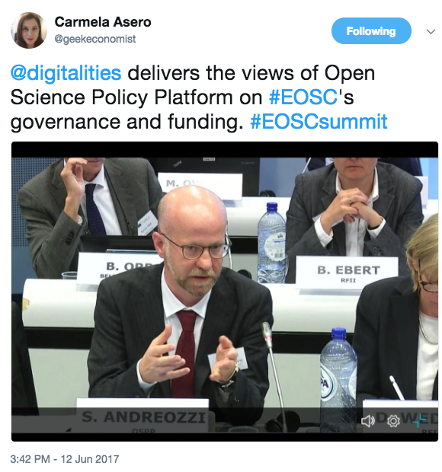
Dissemination & Communication Report on the governance and financial schemes for the European Open Science Cloud
Opinion article in the EGI newsletter:
Sergio Andreozzi joins the EC’s Open Science Policy Platform (Nov 2016)
News:
New reports on European Open Science Cloud
and Open Access Publishing (July 2017)
Selected presentations:
EOSC governance and financial schemes, 3rd Meeting of OSPP (March 2016)
Governance and financial schemes for the EOSC, e-IRG workshop in Malta (June 2016)
EOSC Summit, Brussels (June 2017)
Social Media:
New reports on the European Open Science Cloud and Open Access Publishing are available

