Slide 1
Thematic services, Applications on demand
Gergely Sipos
Customer and Technical Outreach Manager, EGI Foundation
SA2 Activity Manager, EGI-Engage

Slide 2
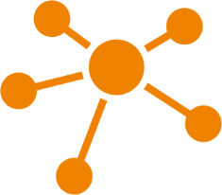
EGI-Engage: Key Exploitable Results
Improved EGI Service portfolio
IMS & Certification
Security policies
Marketplace
Tools for federated service management
Check-in
Federated Cloud Computing
Open Data
Platform
Integrated thematic services
Applications on Demand

Slide 3
Outline
Description and innovation – Thematic Services
Introduction and benefits
What is new or improved
Description and innovation – Applications on Demand
Introduction and benefits
What is new or improved
Communication and exploitation
Dissemination & Communication
Use of results

Slide 4
Description and innovation Thematic Services

Slide 5
Thematic services
Scientific applications, tools, environments integrated with EGI’s e-Infrastructure services
Modelling algorithms; Visualisation tools; Workflow systems; Data catalogues; Application browsers; etc. – Typically exposed via Web Portals
Online service and User support and Training
They are not part of the EGI Service Catalogue but they rely on EGI services to run
Co-designed and co-developed with structured scientific communities
EGI contributes to promotion and support of uptake within scientific communities

Slide 6
Stakeholders
End users
B2B
B2C
Community agreement
Type, number, size, cost, availability, etc.
Cloud provider
E-infra service requirements
Conditions
Storage provider
Cloud provider
Negotiator
HTC provider
Thematic Service operator (community/project)
Service Level Agreement
Operation Level Agreement
Training
Support
EGI providers underpinning the Thematic Service
Satisfaction review (every 3/6/12 months)
Performance reports

Slide 7
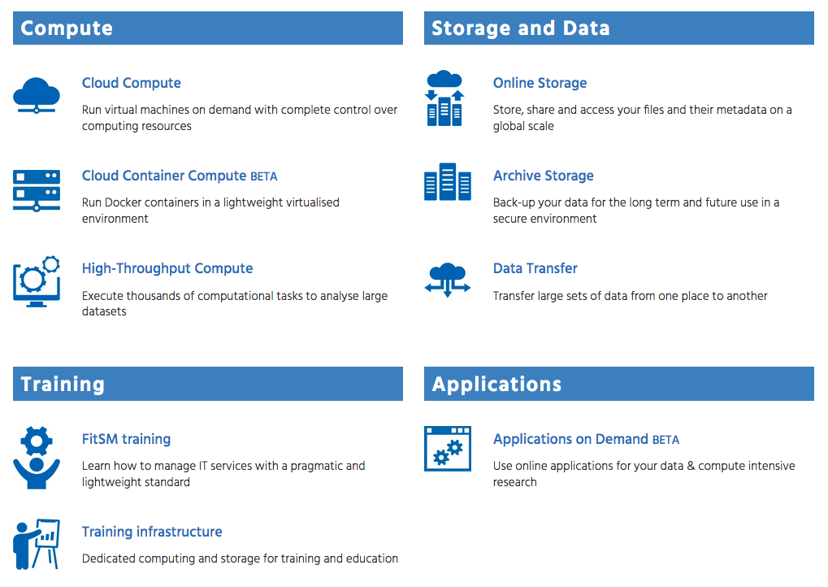
“integrated with EGI’s e-Infrastructure services”
www.egi.eu/services
‘Traditional’ combination

Slide 8
“integrated with EGI’s e-Infrastructure services”
www.egi.eu/services
Emerging combinations

Slide 9
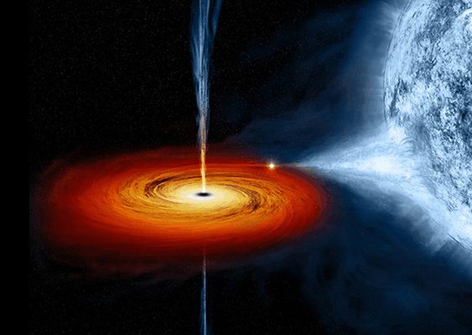
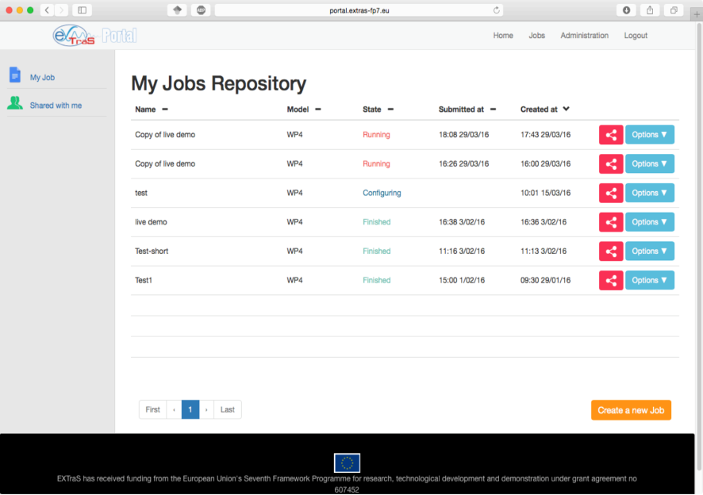
An example: EXTraS thematic service Portal for X-ray Transient and Variable Sources (astrophysics)
Harvesting data from the European Photon Imaging Camera (EPIC)
Carried by the XMM-Newton observatory spacecraft
Largest and most sensitive compilation of X-ray sources ever produced: 500,000+ detections over about 800 square degrees
In operation for 16 years
Portal with 4 lines of analysis pipelines
Underpinned by EGI cloud providers (SLA)
CYFRONET (PL); RECAS-BARI (IT)
16,000 CPU hours used so far
D. D'Agostino et al: A microservice-based portal for X-ray transient and variable sources. Proc. of the 8th International Workshop on Science Gateways (IWSG 2016), 8-10 June 2016, Rome, Italy.
Notes:
Background: The EXTraS project[1] (Exploring the X-ray Transient and variable Sky) is harvesting the hitherto unexplored temporal domain information buried in the serendipitous data collected by the European Photon Imaging Camera (EPIC) instrument on board the ESA XMM-Newton, in 13 years of observations. The main result will be a public catalogue that will become the reference for time domain astrophysics in the soft X-ray band, until a future, dedicated mission is deployed. The project plans to perform part of this analysis by exploiting Cloud resources through a dedicated science gateway. This will allow extending the analysis to recent EPIC data, not included in the public catalogue that will be released at the end of 2016, and will also allow users from the community to analyse their own data using EXTraS pipelines. The project was receiving EC funding between 2014-2017 (3 years).
Status and achievements: ExTras integrated its web portal[2], designed following the science gateway paradigm, with the EGI Federated Cloud. This is allowing users from the community to analyse their own data using EXTraS pipelines. The ExTras portal submits jobs that are processed on VMs created on the fly within the EGI Federated Cloud. A cloud resource pool with 3 sites from Italy (2) and Poland was setup and secured with SLA and OLAs[3]. 21 users instantiated 234 VMs that consumed around 16,000 CPU-hours until July 2017[4].
Partners involved from EGI: EGI Foundation, RECAS-BARI, CYFRONET-CLOUD, INFN-CATANIA-STACK

Slide 10
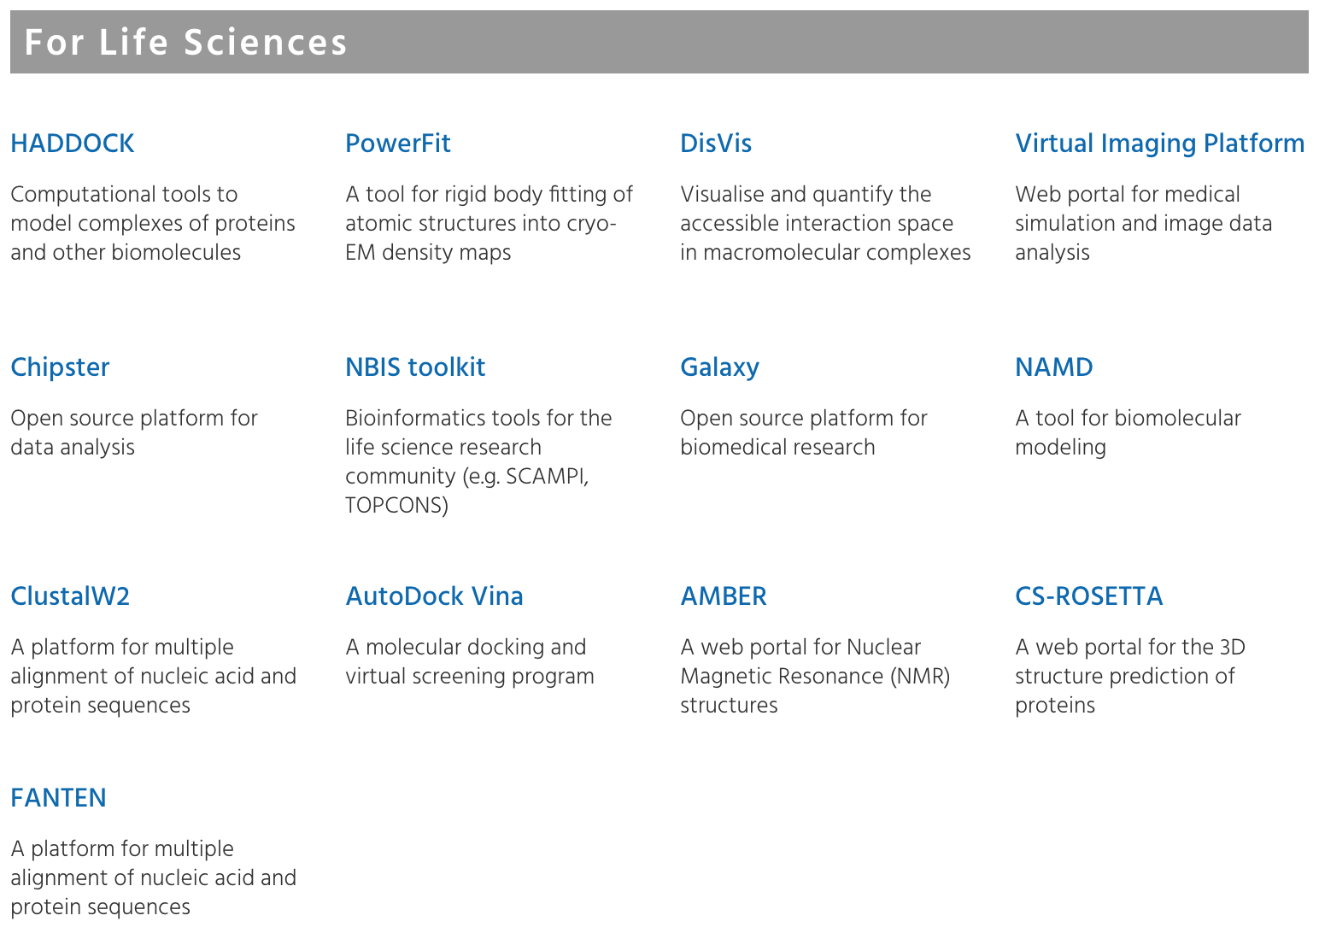
On the website
Life Sciences
Arts and Humanities
Computer Science and Mathematics
Earth Sciences
Multi-disciplinary
https://www.egi.eu/use-cases/scientific-applications-tools/
Thematic services, Applications on demand

Slide 11
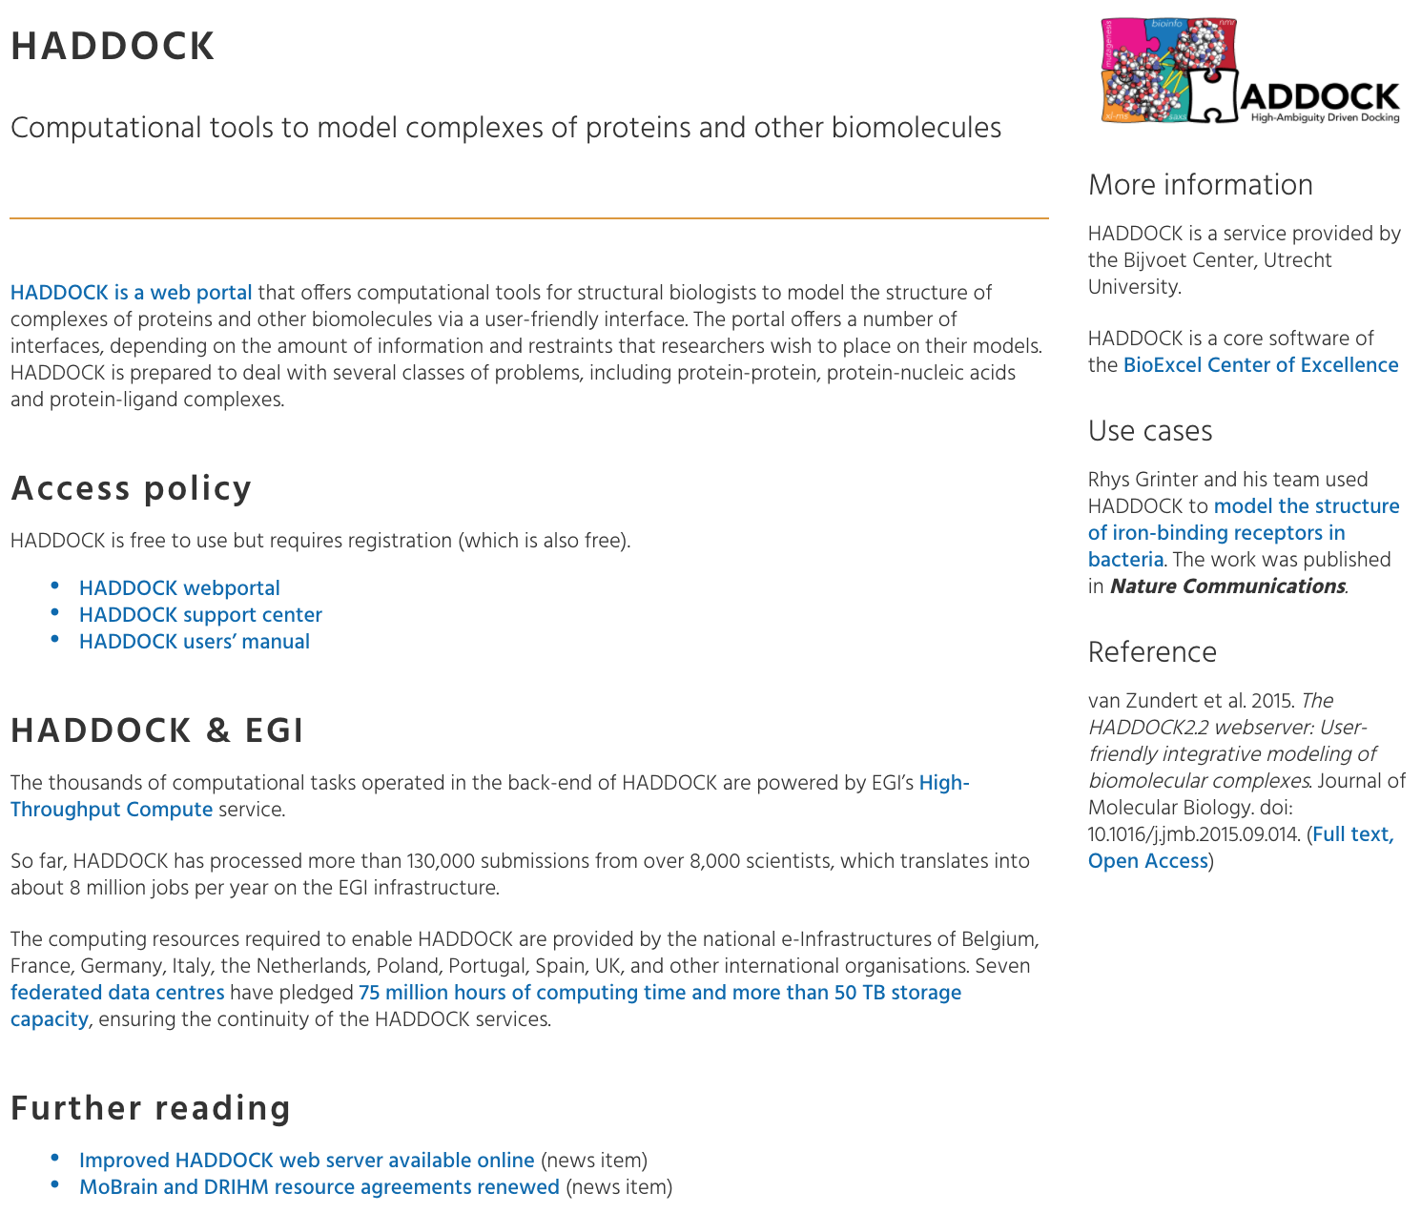
On the website
Life Sciences
Arts and Humanities
Computer Science and Mathematics
Earth Sciences
Multi-disciplinary
https://www.egi.eu/use-cases/scientific-applications-tools/
Thematic services, Applications on demand

Slide 12
Who can exploit the result? for what?
End users:
Researchers
Structured communities (e.g. EISCAT_3D Portal)
Communities of practice (e.g. WeNMR)
‘Long tail of science’ (e.g. NBIS bioinformatics Web Services)
Policy makers (e.g. ICOS portal)
Disciplinary professionals (e.g. Composers → Peachnote)
Citizen scientists (e.g. LifeWatch’s plant classification service)
Service providers:
Develop and operate Thematic Services → Research Performing Organisations (individual institutes or members of Virtual Research Communities)
Provide e-infra services → EGI Resource Centres

Slide 13
What is new or improved?
Similar services existed before EGI-Engage
During the project
Formalised relationships with the use of the SLA framework (11 SLAs)
Established new services based on cloud, container, GPGPU services
Worked with and supported 30 Thematic services during the project
Increased communication and dissemination (Website, brochures, newsletters)

Slide 14
Description and innovation Applications on Demand Service

Slide 15
Applications on Demand Service (AODS)
A scalable platform to offer scientific applications ‘as elastic services’
Applications that are not offered as Thematic Service
User-friendly registration and access interfaces
Tools to port and share new applications
Distributed support for end-users and application integrators
Included in the EGI Service Portfolio
Ownership responsibilities on EGI Foundation

Slide 16
AoDS: Integrating diverse services into a single framework
Cloud, HTC sites - 5
Application frameworks - 3
Applications - 15
Support experts
App. App.
1 … K
Application hosting framework
App. App.
1 … L
Application hosting framework
1
2
Cloud, HTC, storage sites
Usage stats
EGI
Accounting system
Marketplace
Users
Application hosting framework 3
Scientific publications
Identity vetting
suspend users
App. 1
…
App. M
National support teams
Usage stats
Thematic services, Applications on demand

Slide 17
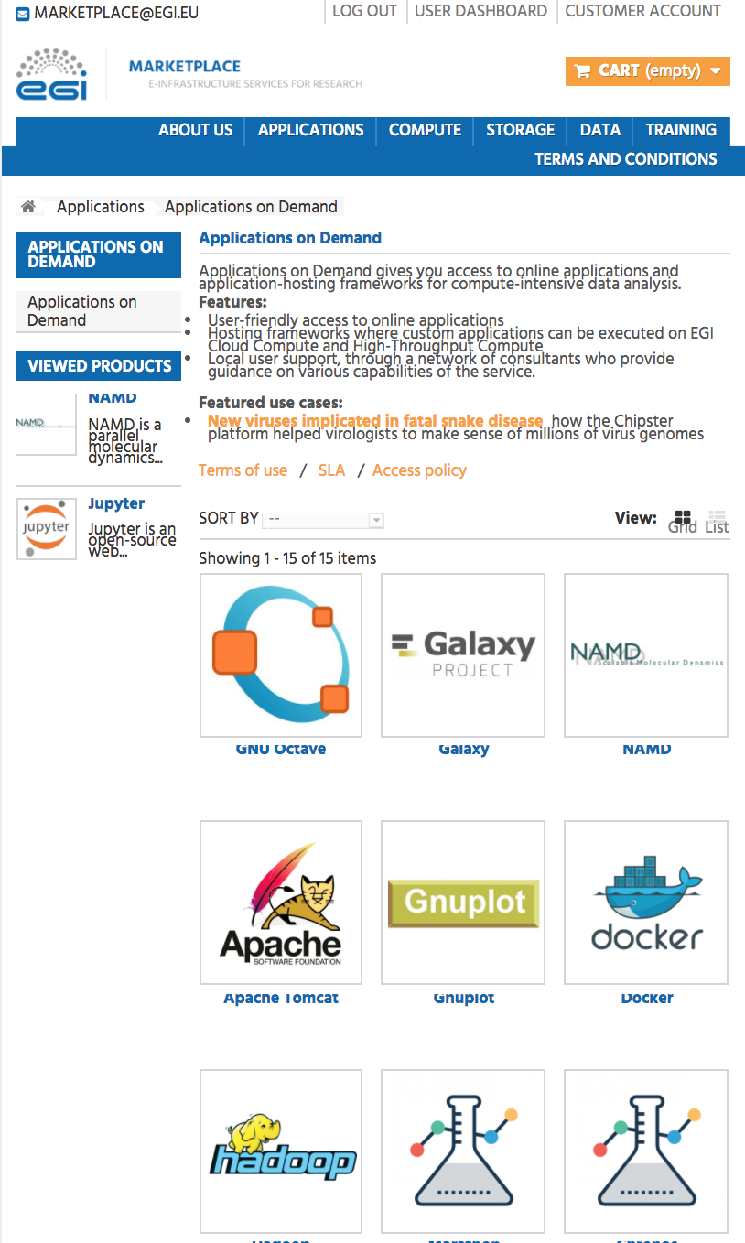
How to access the AoD service
http://marketplace.egi.eu
Approval by distributed Support Team
Thematic services, Applications on demand

Slide 18
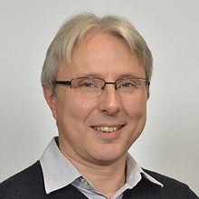
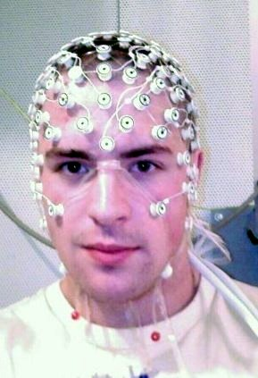
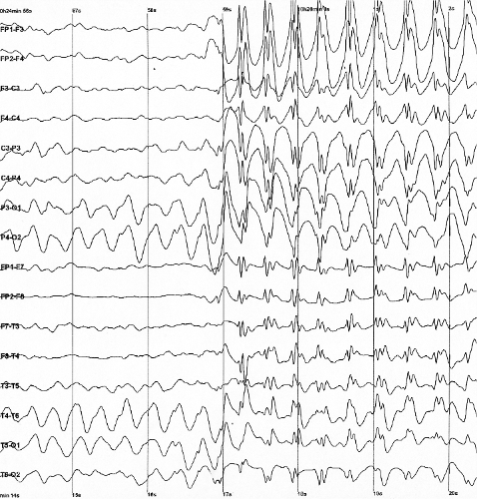
AoDS exploitation example: Epilepsy research
Massimo Rizzi from the Mario Negri Institute for Pharmacological Research
Understand the mechanisms leading to epilepsy as well as new therapeutic approaches
Emergence of nonlinear dynamics in the electrical activity of the brain of epileptic subjects
Mathematical approach: Recurrence Quantification Analysis (RQA) to nonlinear time-series analysis.
Potential journals: Brain; J. of Neuroscience
Computational aspect:
Custom C code, run in batch mode
Typical study: 70k-100k EEG epochs
Each epoch takes 3-5 min on a PC
Output is small (80-100 Byte/epoch)
Using EC3 gateway in AoDS
Source: Wikipedia

Slide 19
Who can exploit the result? for what?
End users:
Researchers → Application reuse
‘Long tail of science’ (e.g. Jupyter)
Representatives or early phase Research Infrastructures
Application and tool developers → Application integration
Scientific applications, workflows, pipelines, …
Service providers:
HTC, cloud, storage providers
Framework providers (gateways, virtual research environments, …)
Consultants

Slide 20
What is new or improved?
Before EGI-Engage
National services for the long tail of science
During the project
Integrated national tools and support groups into a single platform (3 gateways, HTC, Cloud, Storage resources, registration interface)
Populated the framework with applications (17 applications)
Put a simplified access layer on top (Marketplace, easy-to-follow process, no X.509)

Slide 21
Communication and exploitation Thematic services Applications on Demand service

Slide 22
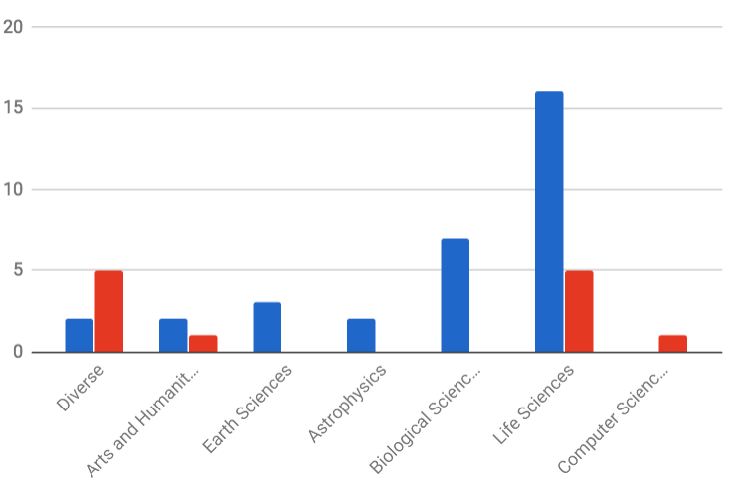
Science discipline distribution of the thematic services and applications
Supported by EGI-Engage:
30 thematic services
17 applications in AODS
Legend:
THEMATIC SERVICE
APPLICATIONS ON DEMAND
Notes:
Demonstrate the diversity of disciplines
Demonstrate that we turn the generic EGI service catalogue into disciplinary ‘subcatalogues’ with this approach

Slide 23
Benefits and exploitation
Benefits
Represent the ‘researcher facing tier’ → Diversify EGI capabilities for a much wider user base
Helps EGI scale up to, and reach the ‘long-tail of science’
Level out the difference between NGIs
Publicise ‘excellent services’ from the NGIs
Directly enabling scientific outcomes
Publications; conference talks; posters; etc.
Exploitation areas
Thematic services built in partnership with other projects → Direct uptake
Broadly applicable domain-specific toolsets. E.g. CHIPSTER – NGS
Several generic tools and services. E.g. Jupyter
AODS: An approach to form a Community Service Federation
Exploring this in EOSCpilot project Fusion demonstrator

Slide 24
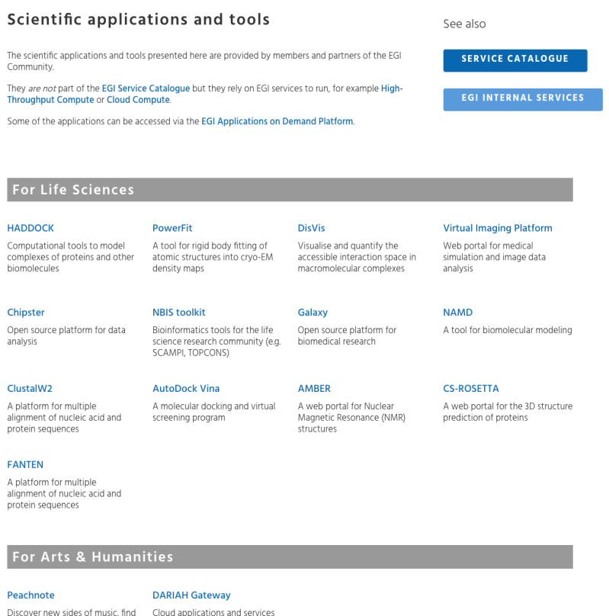
Dissemination, communication
Integrated into the EGI website & marketplace
Area dedicated to community-lead scientific applications and tools with individual pages for each service.
Selected Virtual Imaging Platform (VIP) activities
New biomarkers for multiple sclerosis (reprinted in ScienceNode)
Featured in EGI Use Cases
VIP: medical imaging (April 2015)

Slide 25
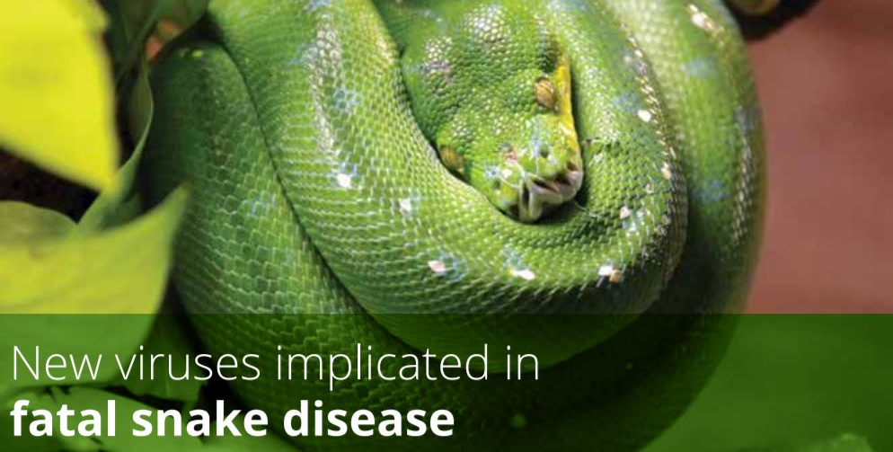
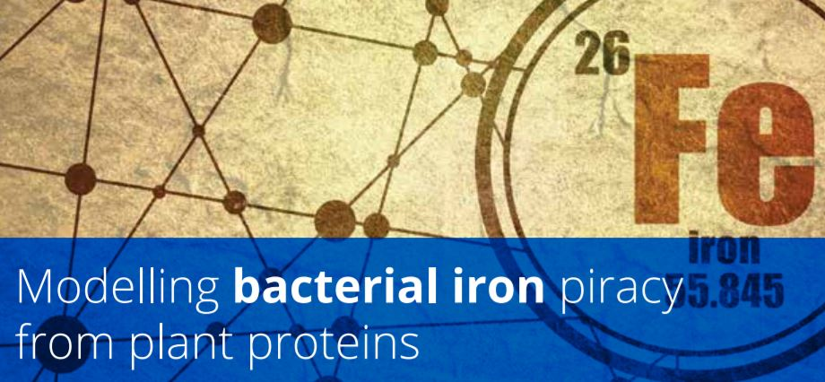
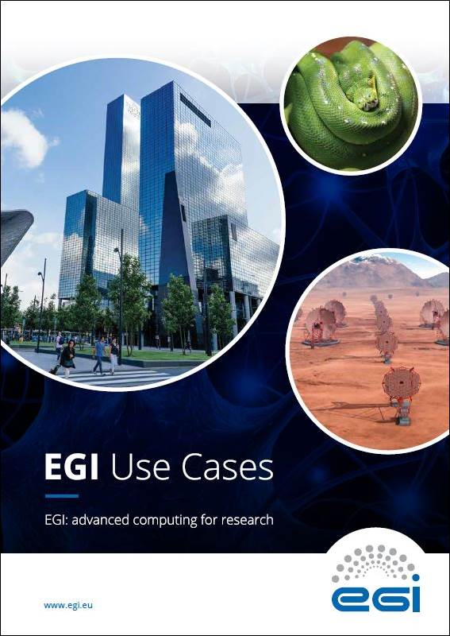
Dissemination, communication
Selected Chipster activities
New viruses implicated in fatal snake disease
(reprinted in ScienceNode)
Featured in EGI Use Cases
New Chipster paper published in EMBnet.journal (February 2017)
Selected HADDOCK activities
Modelling bacterial iron piracy from plant proteins (reprinted in ScienceNode)
Featured in EGI Use Cases
Improved HADDOCK web server available online (March 2016)

Slide 26
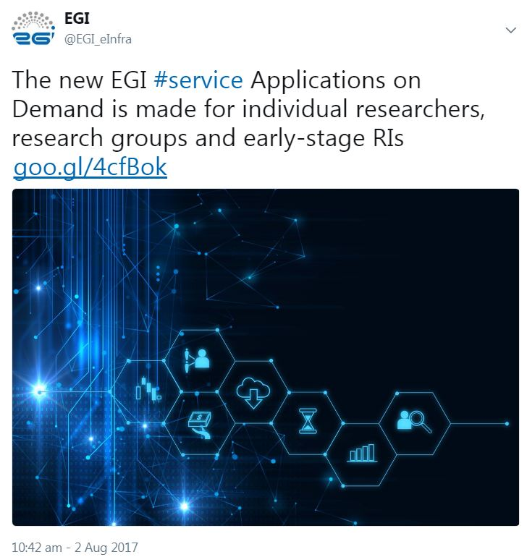
Dissemination, communication
Applications on demand
EGI website:
Applications on Demand service page
Paper and presentations:
EGI Applications on Demand Service (IWSG 2017)
Newsletter:
EGI: Services for open science (#27)
EGI-Engage: a list of key exploitable results (#28)
News item:
Webinar: EGI Applications-On-Demand Service
Webinar:
EGI Applications-On-Demand Service

Slide 27
The use of results
End-users served: past 12 months
Approx. 20,000 scientific users
Peachnote alone served 1.6 million users (!)
50% spent between 3-30 minutes on the service (typically composers who find occurrences of melodies in score sheets)
On average:
Thousands of users: e.g. MoBrain, VIP
Dozens of users: e.g. DARIAH, EISCAT_3D
Use in various external initiatives
E.g. EMSOdev, ENVRIplus, EXTraS, INSTRUCT, AGINFRA+
Notes:
Outside the project
Also commercial?

Slide 28
The use of results
19 Thematic services by 5 Competence Centres:
DARIAH → Establishing a community of practice in A&H → Continue in EOSC-hub
Disaster Mitigation → Re-simulating disaster events from the region → Expand in EOSC-hub
EISCAT_3D → Data access and online processing portal → Finalise in EOSC-hub
LifeWatch → Online services for biodiversity research → Exploitation in EOSC-hub
MoBrain → Online portals for structural biology → Exploitation in EGI-Engage & EOSC-hub
50+ scientific publications; 135 events
Notes:
Outside the project
Also commercial?

