Slide 1
Strategy, Governance, Procurement
Yannick Legré
Managing Director, EGI Foundation
Administrative & Financial Coordinator, EGI-Engage Project

Slide 2











EGI-Engage: Key Exploitable Results
Improved EGI Service portfolio
IMS & Certification
Security policies
Marketplace
Tools for federated service management
Check-in
Federated Cloud Computing
Open Data
Platform
Strategy, governance & procurement
Integrated thematic services
Applications on Demand
Policy papers
on the EOSC

Slide 3
Description of the KER
Evolution of the EGI Governance
Development of the EGI Strategy
Draft framework on cross-border procurement

Slide 4
Updates on the EGI Governance
EGI Foundation statutes
First version: 8 Feb 2010
Second version: 20 Jul 2015
Main changes:
  Open to the world
  Open to user representation
    ERIC/EIRO can be full participants
  EGI, NGI
    A name (not an acronym anymore)
  Name:
    Stichting EGI
    EGI.eu
    EGI Foundation
Fee model
Simplified to 6 levels
Linked to GDP for national reps
  Or organisation turnover for EIROs
Linked to number of votes
Associated participants pay 50% with no voting rights
Affiliation program
To try out participation in EGI
12 months x2
Fixed fee: 1.5K€/year
Notes:
Open to the world: initially only European NGIs could join; now all NGIs

Slide 5
EGI governance bodies
SIB
EGI Council
EGI.eu Executive Board
Terms of
Reference
(ToR)
Common
Process
(PDP)
Common
Glossary
(GCG)
Technology
TCB
Security
OMB
Users
UCB
SPG
SCG
Operations
Services & Solutions
SSB
URT
SVG/RAT
CSIRT
OTAG
Primary group
http://www.egi.eu/about/policy/groups/
Supporting group

Slide 6
Strategy and Innovation Board (SIB)
Advisory board set up to provide advice and guidance to the EGI Council and to EGI Foundation leadership about the strategy in terms of:
  Relationship and service provision to user communities
  Relationship to other e-infrastructures
  Relationship to industry
  Technology and innovation
  e-infrastructure organisation and management
Composition Objective
  Public research: 3
  Computing/Data: 2
  Big industry: 1
  SMEs: 1
Terms of reference: https://documents.egi.eu/document/2131

Slide 7
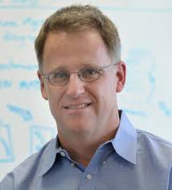

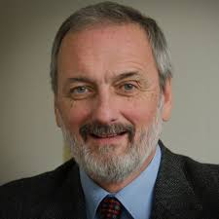
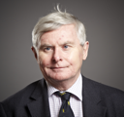
Strategy and Innovation Board (SIB)
Current members
Prof. Ian Foster: Distinguished fellow and senior scientist in the Mathematics and Computer Science division at Argonne National Laboratory; Professor in the department of Computer Science at the University of Chicago
Michela Magas: Director, Stromatolite Innovation Lab; EU Woman Innovator of the Year 2017; Advisor, Innovator’s Strategic Advisory Board on People-Centred Innovation to G7 Leaders; Advisor, Innovation, Advisor, Open Innovation Strategy and Policy Group, European Commission (OISPG)
  Prof. Giorgio Rossi: Professor of Physics at the Università degli Studi di Milano; ESFRI Chair since July 1st, 2016; Chair of the GSO-G8+5 group on Global Research Infrastructures in 2017
  Prof. John Wood: Chair of the ATTRACT advisory board based at CERN in Geneva. He was a founder member of the European Strategy Forum for Research Infrastructures and became chair in 2004 where he was responsible for producing the first European Roadmap. He became the first chair of the European Research Area Board in 2008-11.

Slide 8
What is new or improved? Benefits?
Who can exploit the result? For what?
What is new or improved?
  More open participation
  Two new boards established (SSB, SIB)
  Simpler, clearer fee scheme
What are the benefits?
  EGI Participants consider the fee scheme more fair
  All associate participants became full participants
Who can exploit the result?
  EGI Federation
For what?
  Attract more organisations to become Council participants
  Source strategic recommendations from key experts
  Better decision making on service strategy

Slide 9
Description of the KER
Evolution of the EGI Governance
Development of the EGI Strategy
Draft framework on cross-border procurement

Slide 10
Strategy development
EGI Federation strategy for 2020

Slide 11
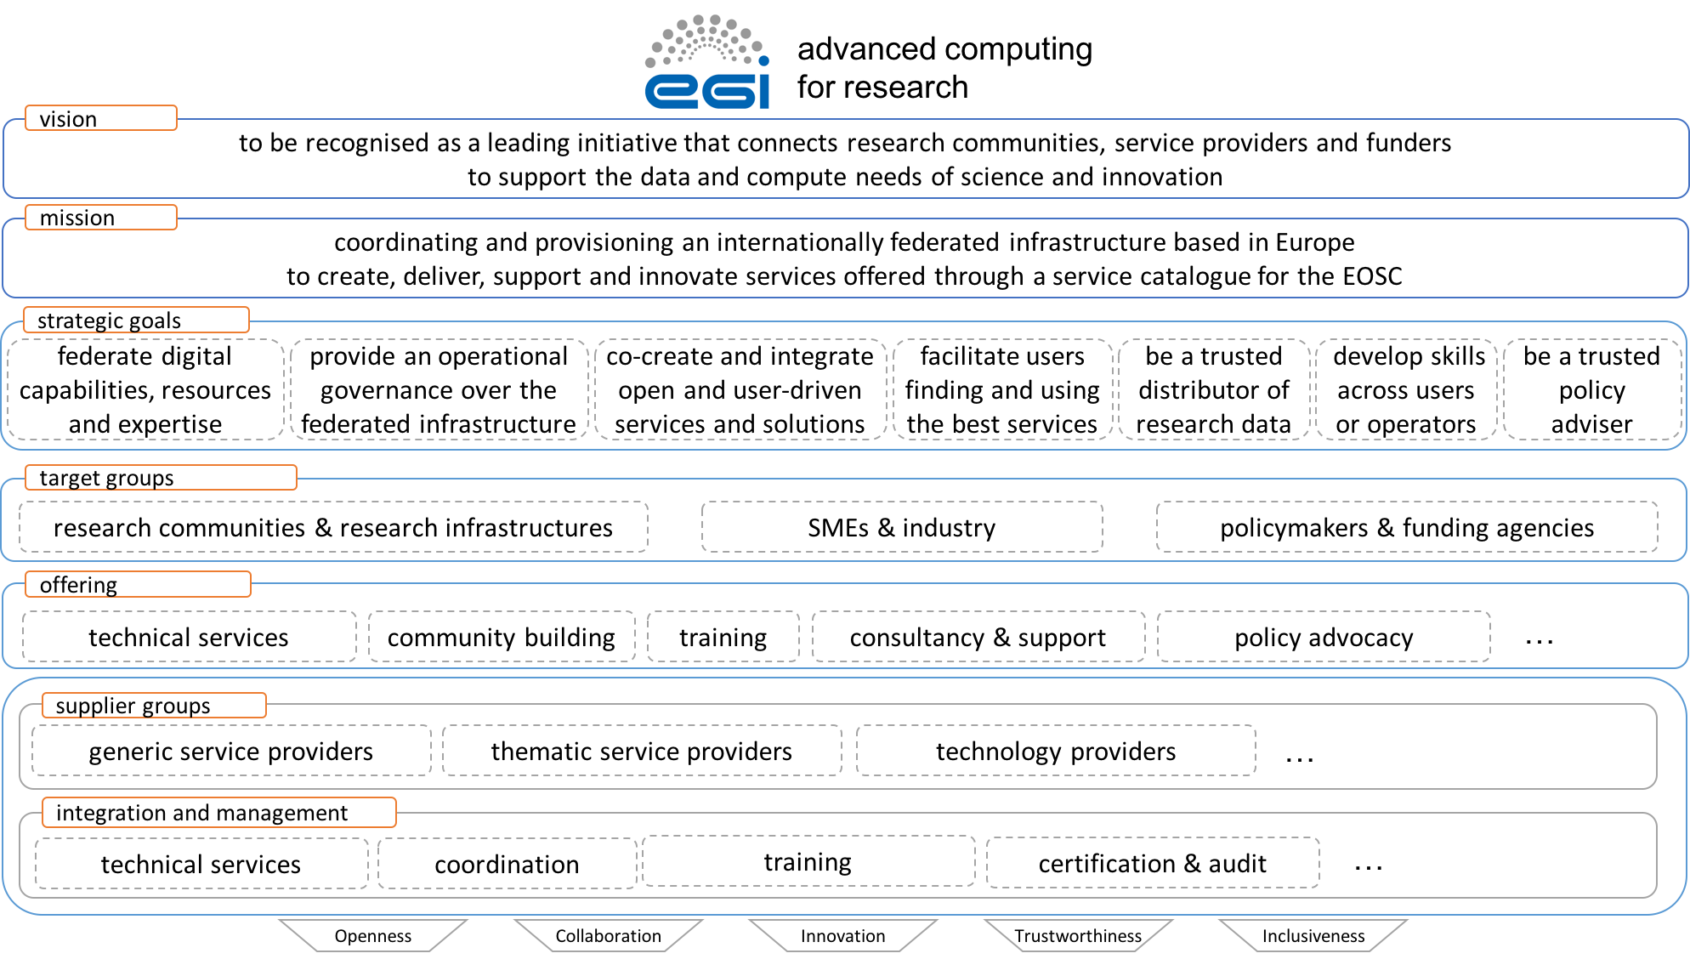
Strategy development
EGI Federation strategy for 2025

Slide 12
What is new or improved? Benefits?
Who can exploit the result? For what?
What is new or improved?
  Monitoring the implementation of the current strategy
  New strategy drafted in the context of the EOSC
What are the benefits?
  Position the EGI Federation with a more coherent set of actions towards the EOSC
Who can exploit the result? For what?
  EGI Federation: align set of actions towards common goals
  Funding agencies, policymakers: develop implementation roadmap for the EOSC

Slide 13
Description of the KER
Evolution of the EGI Governance
Development of the EGI Strategy
Draft framework on cross-border procurement

Slide 14
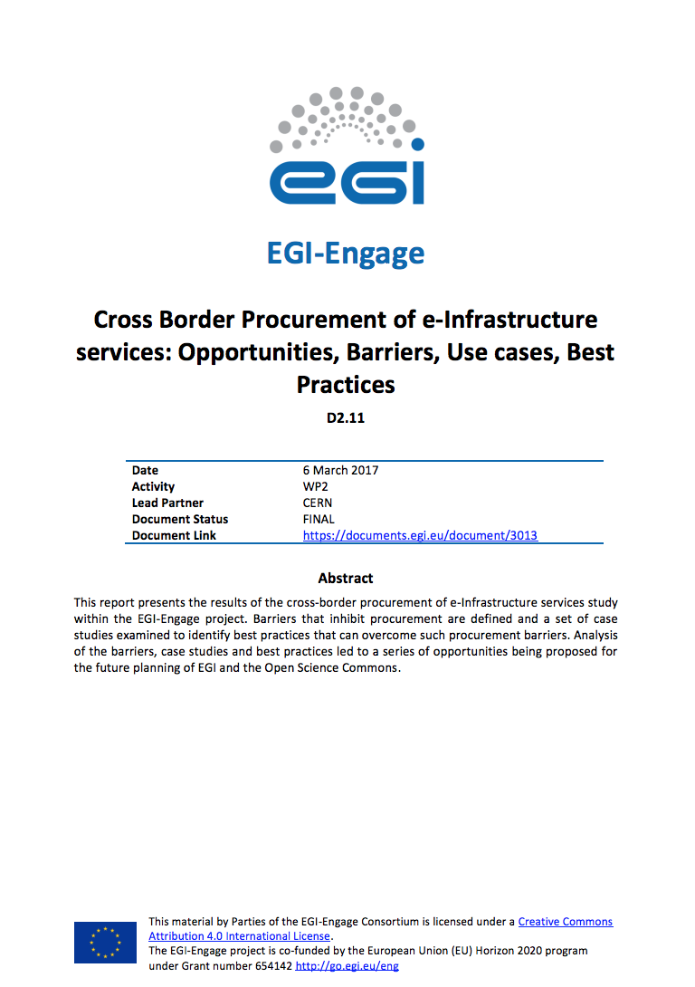
Procurement
Procurement study
Direct charging to users requires public procurement for non-trivial capacity
Performed study on opportunities, barriers, use cases and best practices for cross-border procurement
Four Research Infrastructures participated in the study
Exploitation as part of wider activity in the EOSC-hub project proposal
Notes:
Explain the value of cross-border procurement focus
This study is the involvement of the RIs, and the fact that it complements ESFRI activities on national investments on national infrastructures

Slide 15
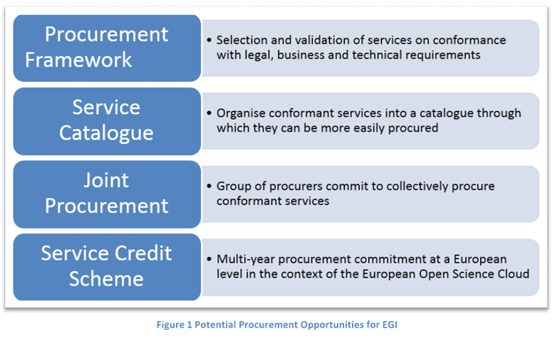

Procurement
Identified opportunities
Identified a set of potential opportunities for cross-border procurement:
Each successive opportunity represents increasing added value for the stakeholders with the key questions being:
Who pays? What risks are the participating parties ready to accept?

Slide 16
What is new or improved? Benefits?
Who can exploit the result? For what?
What is new or improved?
  Identified opportunities in the area of cross-border procurement for RIs
What are the benefits?
    Bring clarity about how to move forward
Who can exploit the result?
  EGI Federation
For what?
  Update strategy and define a project activity to exploit the identified opportunities
How the result was used?
  To define a partnership and an implementation project activity in the EOSC-hub project

Slide 17
Dissemination and Communication

Slide 18
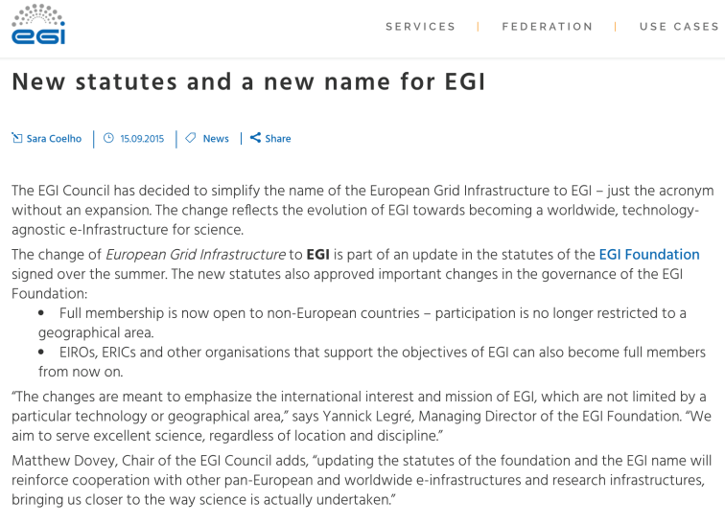
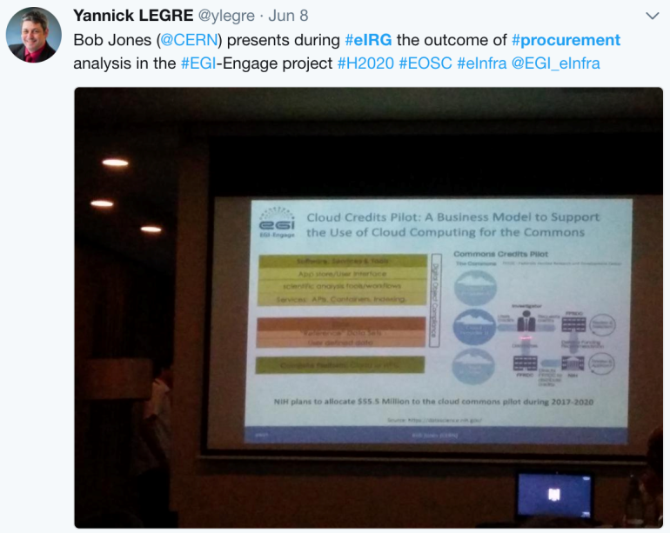
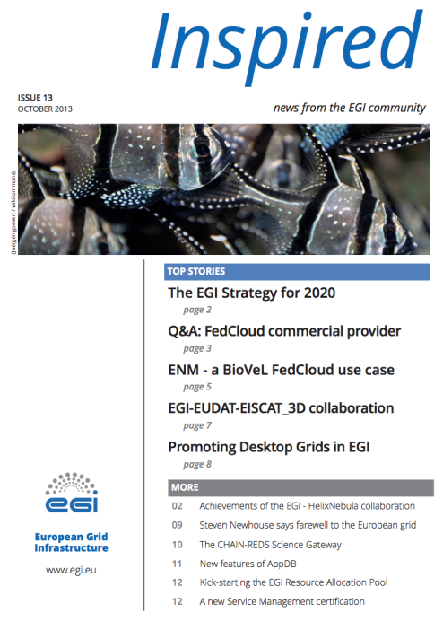
      Dissemination and Communication Activities
Strategy
Publication: EGI Strategy 2015-2020
Newsletter article
Governance
News item: New statutes and a new name for EGI
Presentations at EGI Council
Procurement
Workshops at EGI Conferences
e-IRG workshop: Session on Procurement and financial schemes of digital services for research (Malta, Jun 2017)
Twitter: @ylegre: Bob Jones (@CERN) presents during #eIRG the outcome of #procurement analysis in the #EGI-Engage project

