Slide 1
WP2 Strategy, Policy and Communications
Sergio Andreozzi
Strategy and Policy Manager, EGI Foundation
WP2 Activity Leader, EGI-Engage Project

Slide 2
Outline
WP Overview
Objectives, tasks, partners and effort
Achievements
Communications and events
Dissemination and exploitation of project results
Service portfolio management
Strategic planning and evaluation
Policy advocacy
Collaborations
Business models and procurement
Engaging with the private sector
Use of resources, issues
Summary

Slide 3
WP Overview

Slide 4
NA2 (WP2) objectives
Task # | Task Objectives
NA2.1 Communication and Dissemination | Keep the EGI community informed of the project activities Disseminate the success stories
NA2.2 Strategy, Business Development and Exploitation | Identify and analyse project results for dissemination and exploitation Develop the EGI strategy and governance and assess progress Evolve the services and solutions portfolio and related business models Establish collaboration agreements with strategic partners
NA2.3 SME/Industry Engagement and Big Data Value Chain | Facilitate the engagement with SMEs Explore the creation of pilot projects, especially those based on Open Data in selected industry sectors

Slide 5
Activities and Achievements
Notes:
Main achievements of the work package

Slide 6
Communications and events
Dissemination and exploitation of project results
Service portfolio management
Strategic planning and evaluation
Policy advocacy
Collaborations
Business models and procurement
Engaging with the private sector

Slide 7
Communications & Events
Communications
Website
Newsletter
Newsfeed
Blog
Publications
Social media
Events
EGI Conference 2016
DI4R 2016
EGI Conference 2017
DI4R 2017 (in prep)
The actual communication activities that were conducted through the channels were described in the KER presentations and in D2.14
Notes:
Main goals of NA2.1 were: 1) support the dissemination of the project results; 2) community building through events
For 1. the communication team developed and maintained 6 communication channels
This presentation will describe these channels and provide factual information;
The actual communication activities that were conducted with these channels were described in the KER presentation and in D2.14

Slide 8
Communications EGI website
purpose
Shop window to the EGI services Give visibility to EGI's resource providers and users
Website redevelopment (M2.3)
Simpler, flatter structure
Focused on the service offer and service providers
New workflow to request access to services
Notes:
Realign the main shop window of the EGI website towards a strategy focused on the service offer
Simplified/streamlined content on two pillars: EGI services + resources providers
The old website was not optimised to promote the services and lacked a clear “call to action”; this website brought to as 40+ requests (add screenshot of call to action); to link in the future to the marketplace
(Check D2.14 related section)

Slide 9
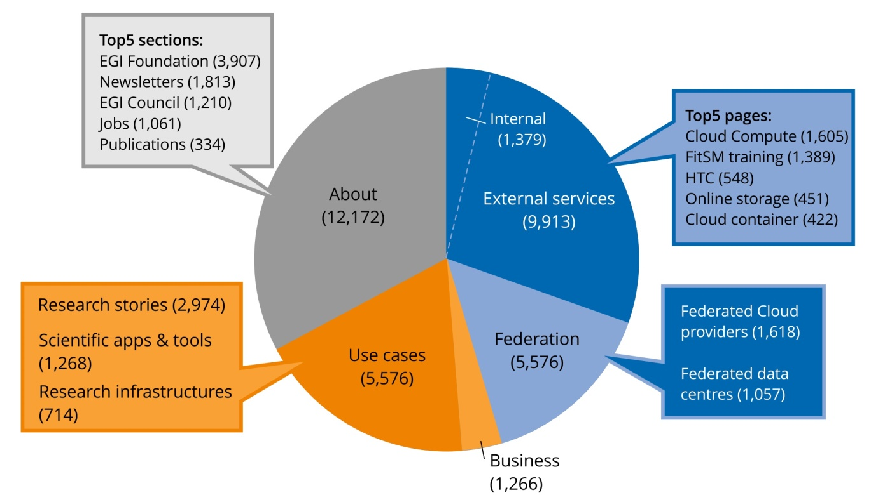
Communications EGI website
Unique website views per top menu section (Oct 2016 – July 2017)
Notes:
Say: this is to quickly show you the most viewed sections of the website

Slide 10
Communications Newsletter
purpose
For the EGI Community, with in depth stories,
opinion, future trends, reflections
8 issues – 74 articles (2015-2017)
Sent via MailChimp to EGI SSO accounts + subscribers
Most popular articles:
About project milestones and technical developments

Slide 11
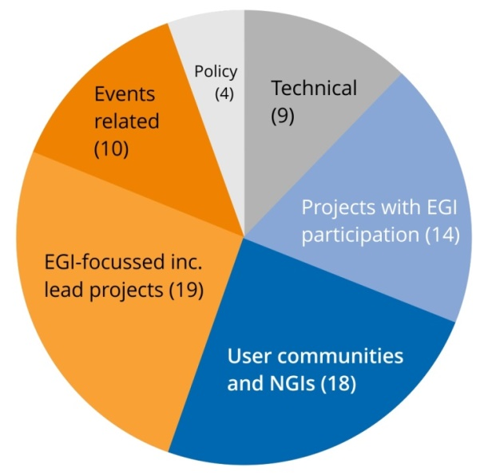
Communications Newsletter
Number of articles per category
Summary of readership stats
(details in D2.14):
On average, each issue:
Sent to ∼4,000 subscribers
Reached 2,107 readers
Included 9 articles

Slide 12
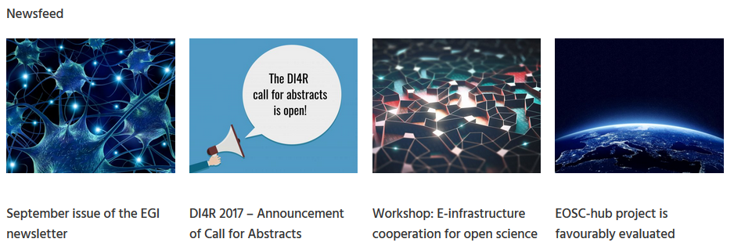
Communications Newsfeed
purpose
For all audiences, to report updates, milestones, EGI Federation announcements
103 news stories
Quoted by external sites at least 500 times
Syndicated by NGIs
Notes:
Conservative estimate: number of results of the Google search ["egi.eu/news" AND NOT site:egi.eu ].
Excludes all sites that do not publish 'naked' links, i.e. that embed links in text.

Slide 13
Communications Publications
purpose
To convey the added value of or to stimulate interest in EGI services and key results
Keeping EGI Secure
Report about the EGI security team
go.egi.eu/csirt
EGI Check-in
Benefits and main features of the service
go.egi.eu/cin
Notes:
These are two examples on how publications support the dissemination of EGI services

Slide 14
Communications Publications
EGI Use Cases
Collection of the research use cases
Shows the scale & diversity of EGI-supported research
go.egi.eu/usec
EGI Service Catalogue
Overview of EGI’s services
Distributed at conferences and meetings with partners
go.egi.eu/SCpdf

Slide 15
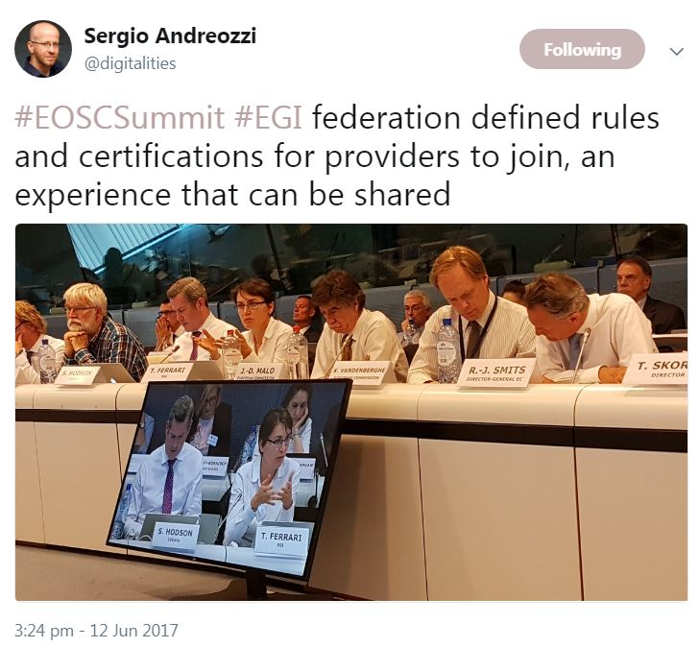
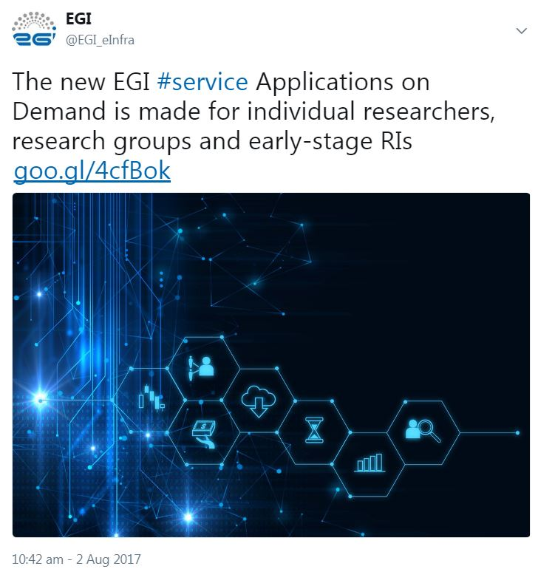
Communications Social media
purpose
To amplify EGI’s communication channels
Twitter
@EGI_eInfra
2,201 followers (+3x)
Facebook
/EGIeInfrastructure
452 followers
LinkedIn
Group
570 members
Notes:
Social media exist to support communication activities, especially twitter (3x grow in followers)

Slide 16
Events: 2016
EGI Conference 2016
6-8 April, Amsterdam
188 participants
EGI-focused event
DI4R 2016
28-30 September, Krakow
407 participants
Jointly organised with EUDAT, GÉANT, OpenAIRE & RDA Europe
Notes:
EGI conference is focused on EGI community topics (e.g. procurement, operations, NGIs sharing experience on engagement)
Reflecting EGI strategy to work closely with other e-infrastructures, we replaced one of our yearly conferences with an event co-organised and co-developed with other e-infras;
DI4R was born following an EGI initiative, US is doing the same from 2017

Slide 17
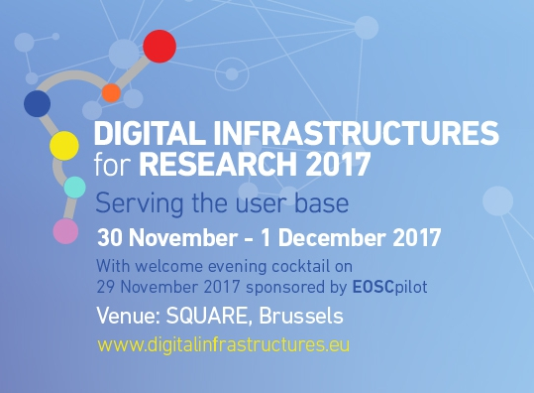
Events: 2017
EGI Conference 2017
9-12 May, Catania
238 participants
In partnership with the INDIGO-DataCloud project
DI4R 2017
30 Nov-1 December, Brussels
In preparation
Jointly organised with EUDAT, GÉANT, OpenAIRE, PRACE & RDA Europe

Slide 18
Communications and events
Dissemination and exploitation of project results
Service portfolio management
Strategic planning and evaluation
Policy advocacy
Collaborations
Business models and procurement
Engaging with the private sector

Slide 19
Identification and management of project results
Review with Activity Management Board
Characterization & update of catalogue
Aggregation & prioritization
KER
& supporting results
Catalogue of Project Results
Deliverables
Review with WP leaders

Slide 20
Service Portfolio Management
EGI Council
EGI website
Services and Solutions Board
EGI marketplace
Requirements
Service catalogue
Service Portfolio Mgmt.
Service Level Mgmt.
EGI service catalogue brochure
Other external representations
e.g. eInfraCentral
Service portfolio
*Simplified view

Slide 21
Strategic Planning and Evaluation
Strategy for 2020 approved in May 2015
Strategy implementation evaluated at
M12 (D2.9) and M30 (D2.13)
Live document updated on a 6-month basis
Strategy for 2025 in advanced development
Discussion started in May 2017 with the EGI Council
Mature draft available as part of D2.13
Approval expected by the end of 2017

Slide 22
Policy papers

Slide 23
MoUs agreed during EGI-Engage
Partner name | Partner type | Main goal | Date
GÉANT | e-Infrastructure | Strengthen collaborations in specific areas such as AAI | 06.2017
ComputeCanada | e-Infrastructure | Integrate in the EGI infrastructure | 10.2015
TUW/EODC | e-Infrastructure | Create national e-infra in Austria to link with EGI and EOSC | 11.2017
PRACE-4IP | e-Infrastructure related project | Interoperability and integration between PRACE and EGI | 06.2016
UberCloud | SME (multiplier) | Promote EGI services in UberCloud SME network | 12.2015
CloudSME | SME (multiplier) | Integrate EGI services in CloudSME platform and support SME engagement | 10.2016
Terradue | SME | Integrate ESA TEPs with EGI services via Terradue platform | 09.2016
Notes:
Explain the relevance of each MoU: - GEANT: cooperation on AAI mainly
PRACE: reinforce cooperation
Add a column on value

Slide 24
Communications and events
Dissemination and exploitation of project results
Service portfolio management
Strategic planning and evaluation
Policy advocacy
Collaborations
Business models and procurement
Engaging with the private sector

Slide 25
Business models and procurement Main Model: Sponsored use
Funding Agency
Funding Agency
Resource Provider
Service provision:
a complex network of players interacting for providing products, services and solutions for excellent research
Funding Agency
Resource Provider
Funding Agency
Resource Provider
Funding Agency
EGI.eu
Service

Slide 26
Business models and procurement Pay-for-Use Motivations
Increase awareness of economic value for service delivered
Incentivize resource providers to serve users outside their own remit
Adapt to the shift of funding from CAPEX to OPEX

Slide 27
Business models and procurement Additional Model: Pay-for-use
Funding Agency
Funding Agency
Resource Provider
Service provision:
a complex network of players interacting for providing products, services and solutions for excellent research
Funding Agency
Resource Provider
Funding Agency
Resource Provider
Funding Agency
EGI.eu
Service

Slide 28
Business models and procurement Pay-for-Use: from concept to production
2013
2014
2015
2016
2017
Exploratory document
Kick-off of proof of concept
Adapted tools to support price setting/negotiation/reporting (GOCDB, e-GRANT, Accounting Portal)
Established agreement framework: - services, prices, processes
- Letter of Intent from EGI providers
In production: https://wiki.egi.eu/wiki/Pay-for-use
- Transition from e-GRANT to the EGI Marketplace as front-end and order management

Slide 29
Business models and procurement Pay-for-Use: EGI-Engage PY2 contribution
~30
7
# involved providers
# signed Letter of Intent (+4 in PY2)
3
2
Financial transactions in discussion
Financial transactions completed
Notes:
LoI: 100% IT, CESGA, CSC, IFCA, IISAS, INFN, PSNC
Financial completed:
- IBM->PSNC
- NextGeoss->INFN-Bari
Financial transaction in discussion:
- Terradue -> INFN-Bari
Numeca -> All
FAO through D4Science -> All

Slide 30
Business models and procurement Business & Service Delivery Model: BlueBridge & Marine Fisheries
Customer
Service mediator
Infrastructure mediator
(Inter)national Datacenter
BlueBridge project serves various SMEs
Integration of D4Science platform in EGI infrastructure part of EGI-Engage WP4
Developed service delivery model to serve SMEs after the end of BlueBridge
BlueBridge SMEs
Terms of Use + Privacy Policy + SLA
BlueBridge project (sponsored access) CNR/Engineering (paid access)
(platform based on D4Science)
Contract + UA
EGI Foundation
Contract + OLA
EGI Resource providers
Full report: https://documents.egi.eu/document/2699
Notes:
the Community are the users of the FAO services, either in FAO (as data managers) or beyond (the consumers of FAO data).
In the Deliverable 2.6 we talked to representatives of the community of data managers, but mainly from legal and data policy perspective in FAO.
in the SDM case we added a perspective from 'external' service providers (D4S) and service consumers ('GRSF').

Slide 31
Business models and procurement Business & Service Delivery Model: FAO & Marine Fisheries
Customer
Service mediator
Infrastructure mediator
(Inter)national Datacenter
FAO Community needs both technical and legal interoperability on marine fisheries data
FAO reviewed two agreements
SLA between D4Science and the EGI Foundation
MoU between FAO and CNR
FAO provided a gap analysis in the legal framework
Plan to support FAO under a paid scheme
FAO Community
Terms of Use + Privacy Policy + SLA
CNR (platform based on D4Science)
Contract + UA
EGI Foundation
Contract + OLA
EGI Resource providers
Full report: https://documents.egi.eu/document/2699
Notes:
the Community are the users of the FAO services, either in FAO (as data managers) or beyong (the consumers of FAO data).
In the Deliverable 2.6 we talked to representatives of the community of data managers, but mainly from legal and data policy perspective in FAO.
in the SDM case we added a perspective from 'external' service providers (D4S) and service consumers ('GRSF').

Slide 32
Business models and procurement Business & Service Delivery Model: NextGEOSS
Partner:
3-year EC H2020 project (2017-2020)
Challenge:
Developing the next generation hub for Earth Observation (EO)
Run 10 formal pilots (6 scientific, 4 business) with specific needs for cloud services
EGI Federation offered
Broker role via the EGI Foundation with a central allocated budget
Cloud services
Success story:
EGI Foundation acts as neutral broker and expert advisor on provider selection
Selected EGI service providers provided services and recovered costs via pay-for-use framework
Participation possible thanks to pay-for-use + business engagement
Notes:
Explain how the results of EGI-Engage contributed to the success stories

Slide 33
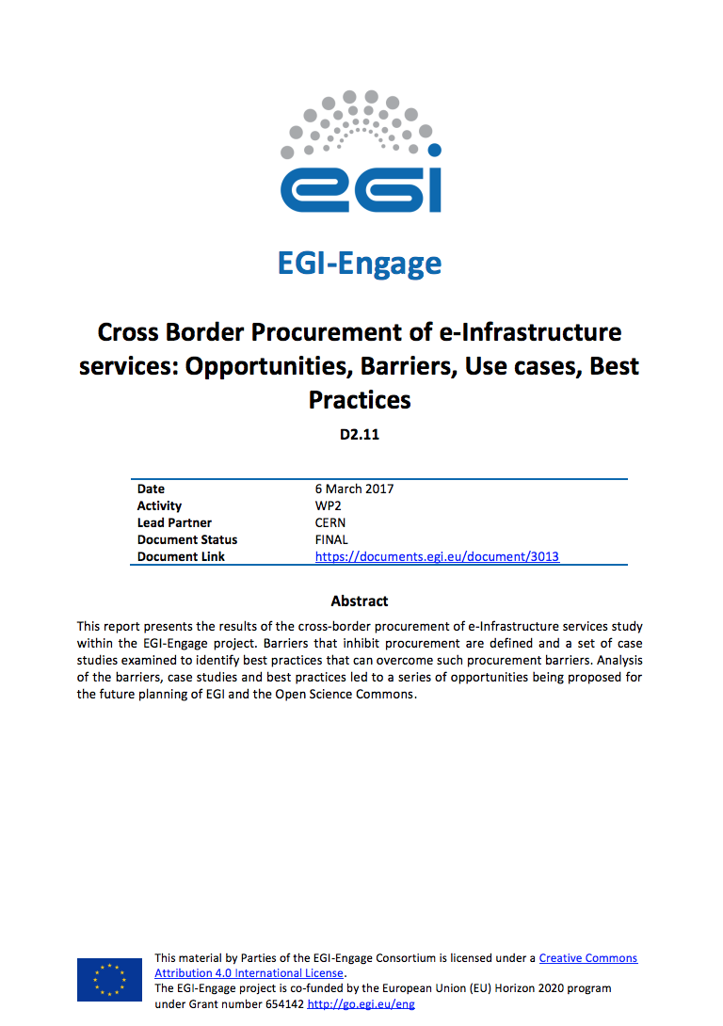
Business models and procurement Procurement study
Direct charging to users requires public procurement for non-trivial capacity
Performed study on opportunities, barriers, use cases and best practices for cross-border procurement
Four Research Infrastructures participated in the study
Exploitation as part of wider activity in the EOSC-hub project proposal
Notes:
Explain the value of cross-border procurement focus
This study is the involvement of the RIs, and the fact that it complements ESFRI activities on national investments on national infrastructures

Slide 34
Communications and events
Dissemination and exploitation of project results
Service portfolio management
Strategic planning and evaluation
Policy advocacy
Collaborations
Business models and procurement
Engaging with the private sector

Slide 35
Engaging with the private sector Motivations
Enable the EGI Federation to serve SMEs and industry for research and innovation activities
EGI Foundation operates as the coordinator for the framework
EGI service providers engage with SMEs
Privilege multipliers (e.g. BVDA, EARSC, clusters, hubs)
Focus areas:
Marine fisheries
Earth Observation
Agri-food

Slide 36
Engaging with the private sector Main achievements
+150
8
~20
# business contacts
# use cases completed
# ongoing use cases
13
3
# SMEs who filled the intake questionnaire
# MoUs with private sector organisations
Notes:
150+ business related contacts (100+ of which are SMEs)
8 concrete use cases (https://www.egi.eu/business/business-use-cases/)
~20 actively ongoing (~90 added since the end of PY1); further details in D2.14
Initial questionnaire for private organisations was prepared during PY2
13 companies reached out via this form
Webinars
“How SMEs Can Use EGI’s Cloud for CAE – Intro & Demo Using OpenFOAM (Oct 2016) (https://www.egi.eu/blog/egi-and-ubercloud-webinar-for-smes-cae-openfoam-demo-20oct2016)
“How to engage SMEs for national e-Infrastructures” (May 2017) (https://www.egi.eu/news/egi-webinar-how-to-engage-smes-for-national-e-Infrastructure-providers)
Market Analysis
Marine Fisheries (D2.7 https://documents.egi.eu/document/2700)
Agri-food (D2.10 https://documents.egi.eu/document/2843)
Proposal for a service delivery model from data centre to community
Follow-up to D2.6 - Report on data sharing policies and legal framework in fishery and marine sciences data sector (https://documents.egi.eu/document/2699)
Uses EGI, CNR (D4Science) and FAO as a concrete test case
3 new MoUs with industry (Terradue; CloudSME and TUW/EODC (4 total including UberCloud from PY1)

Slide 37
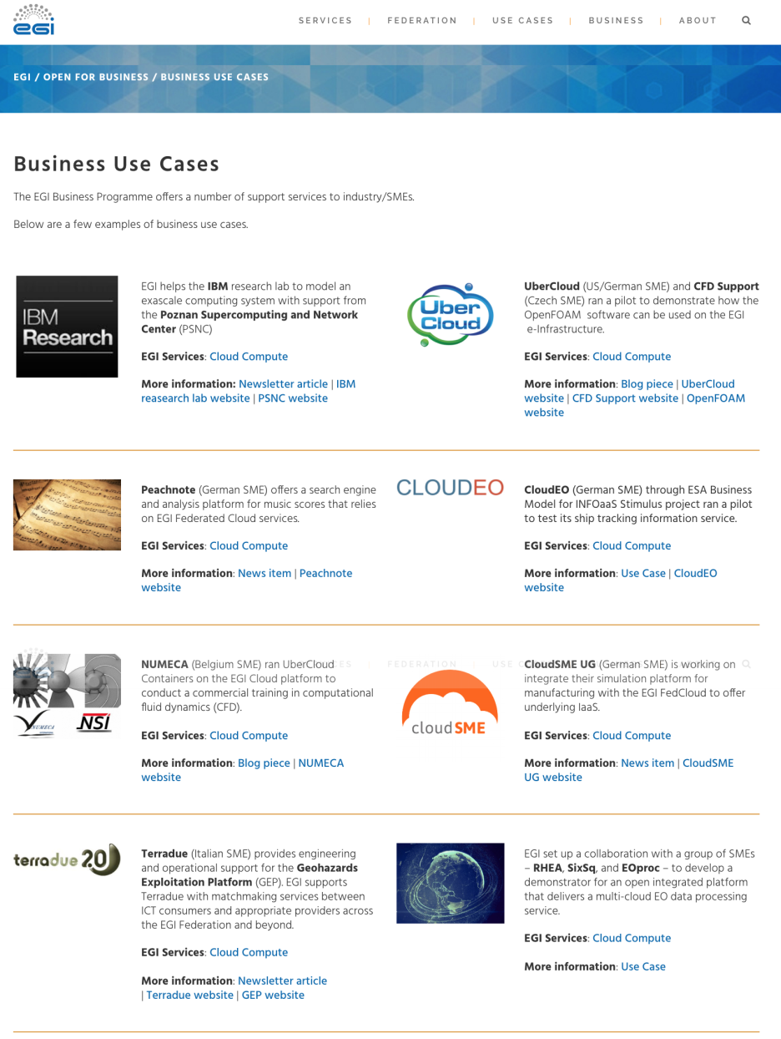
Engaging with the private sector Business Use Cases
8 business use cases
Main service used:
EGI Cloud Compute
Sectors:
Computer-aided design
Computational fluid dynamics
Earth Observation
Manufacturing/Engineering
Music
Radio-astronomy
Industry representatives
9 SMEs, 2 large enterprises
9 countries: Belgium, Czech Republic, France, Germany, Italy, Netherlands, Spain, Switzerland, UK
https://www.egi.eu/business/business-use-cases/
Notes:
CloudSME = MoU
Terradue = MoU
UberCloud = MoU
TEISS + SixSq + (CloudEO as Pilot) = ESA Stimulus
AgroKnow, Engineering, FAO = EGI-Engage Partner
BDVA = EGI is a paying member
Helix Nebula = Partnership Agreement as members of the HNI
100%IT = OLA
ITEMO = Member
TUV = Registered Training Organisation
mITSM = Partnership Agreement
Ecohydros = Commercial contract with IFCA
CWA = ??
Singerise = ??

Slide 38
Engaging with the private sector Success stories: IBM Research
Partner:
IBM Research team in Zurich
Challenge:
Developing a new exascale model to support Square Kilometer Array
Need systems with different network topologies
EGI Federation offered:
PSNC partner: 1.4 Petaflops computing power and a fat-tree network interconnect fabric under a paid scheme
Success:
First success story under paid scheme
Published article/linked business case
Notes:
Explain how the results of EGI-Engage contributed to the success stories

Slide 39
Engaging with the private sector Success stories: Earth Observation pilot
AdviceGEO
Partners:
RHEA, SixSq, CYFRONET, EOProc, AdviceGEO
Challenge:
Develop an open platform for multi-cloud EO data processing services with the objective to
Prevent cloud vendor lock-in
Allow for end-to-end processing of EO data in multiple cloud environments
Success stories - two use cases implemented:
Sentinel-1 data retrieved and processed to produce change detection maps of a glacier in Greenland and of shipping activity in the Panama canal
Sentinel-2 data processor to generate true colour 10m resolution images
Notes:
Our vision is to offer a generic and open service, intended to work with any EO data located anywhere and with any EO processor, that can be rapidly deployed with flexibility, scalability, at low cost, and which provides services accessed via public and standardised APIs.

Slide 40
Engaging with the private sector Engaging with the Big Data Value
EGI Foundation Managing Director now part of the Board of Directors of BDVA
EGI contributed to the revision of the Strategic Research and Innovation agenda
EGI contributed to several task forces (e.g. Earth Observation and i-Spaces)
White Paper on Big Data from Space
Member of i-Space review committee
Part of SRIA Contribution Group
Actively defining the Strategic goals of BDVA
EGI was awarded the label of i-Space in Oct 2017
An i-Space is a trusted data incubator targeted to accelerate take up of data driven innovation in commercial as well as in the not-for-profit sector

Slide 41
Use of Resources and Issues
Notes:
Numbers will be provided by PO, work package leaders must provide explanation

Slide 42
Use of resources
Use of resources:
No major deviations in resource consumption or issues
CERN: requested 1PM + 1KE (travel) to support more dissemination actions for their work on procurement
Issues:
Pay-for-Use
Shift from e-GRANT to Marketplace delayed implementation of front-end interface
Notes:
Open with a main message about alignment/deviation

Slide 43
Summary
Notes:
Freedom on way to present

Slide 44
Summary
Objective 1 (O1): The continued coordination of the EGI Community
Consolidated the service portfolio management process
Four community conferences (two jointly organised with other e-Infrastructures)
Objective 2 (O2): EGI Solutions, related business models and access policies
Improved EGI service portfolio
Pay for use in production
Procurement study identified opportunities that have been reused for follow-up activities (EOSC-hub project)
Objective 4 (O4): Open data platform and the European Big Data Value
Developed pilot for supporting the exploitation of EO data using EGI services
EGI Federation represented in the BDVA BoD and awarded the label of i-Space
Objective 5 (O5): Promotion of the adoption and extension of the current EGI services
New website launched
Research stories and news items to promote results
Notes:
Achievements grouped by objectives

Slide 45
Key exploitable results
KER name | Description
Policies, Processes and Procedures
Update of the Strategy, Governance evolution and Procurement | Developed the EGI strategy and governance towards the Open Science Commons vision. Analysis of opportunities and barriers for cross-border procurement of e-Infrastructure services
Policy papers on the EOSC | Co-authored papers providing a shared vision for the European Open Science Cloud for Research, input on its governance and financial schemes
Software and services
Improved EGI service Portfolio | Improved service definitions, creation of two portfolios and publication of service catalogues. Brochures and publication of EGI services in the EGI Website
Marketplace | Establishment of a marketplace where researchers can discover and exchange services relevant to their research, applying the one-stop-shop concept for data and services.

