Slide 1
WP3
E-Infrastructure Commons
Diego Scardaci
Senior User Community Support and Outreach Officer EGI Foundation

Slide 2
Outline
WP Overview
  Objectives
Achievements
  AAI (JRA1.1)
  Marketplace & e-Grant (JRA1.2 & JRA1.5)
  Accounting (JRA1.3)
  Operational Tools (JRA1.4)
Use of resources
Summary

Slide 3
WP Overview

Slide 4
JRA1 (WP3) objectives
Tasks | Project Objectives
TJRA1.1 | Provide viable methods for AAI
TJRA1.1 TJRA1.2 TJRA1.5 | Simplify the access to the infrastructure services through a Marketplace
TJRA1.3 | Evolve the EGI accounting system: Optimised architecture new types of accounting metric (e.g. data accounting) New portal
TJRA1.3 TJRA1.4 | Enhance the operations to satisfy new requirements
All tasks | Standard interfaces towards other e-/R infrastructures

Slide 5
Activities and Achievements
Notes:
Main achievements of the work package

Slide 6

The new EGI AAI infrastructure
TJRA1.1

Slide 7
AAI
Core requirements for the AAI
Credentials/Tokens
  Users access EGI services with credentials released by his/her home organisation (eduGAIN support)
  Take into account the so-called homeless users
  Level Of Assurance (LoA) for each credential type
Open architecture
  Support the most common technologies to manage federated identities: SAML, OpenID Connect, X.509, etc.
  Support several attributes sources
  Community managed authorisation
  Easily extensible and interoperable with other infrastructures
Hide the complexity to the Service providers
  SPs receive harmonised user attributes aggregated from IdPs/AAs
  Token Translator Services (TTSs)
    Convert a credential to be recognised by the service

Slide 8
AAI
Achievements for AAI
Planned
Partially Done
Done

Slide 9
AAI
Achievements for AAI
Planned
Partially Done
Done

Slide 10
AAI
Achievements for AAI
Planned
Partially Done
Done

Slide 11






AAI
Functional view of the EGI AAI
SAML
X.509
X.509
X.509
OIDC
OIDC
X.509
SAML
OIDC
X.509
X.509
X.509
Check-in
SAML
X.509
OIDC
Social media IdP
Notes:
EGI – big history with X509 – HTC/Grid and WLCG
while X.509 remains the main authentication and authorization mechanism for most of the HTC services,
the EGI AAI strategy is to support both X.509 and federated identity standards such as SAML and OIDC.
There are services, like cloud computing, that now are enabled for both X.509 and OIDC or SAML authentication, and there will very likely be services that will not support X.509 in the near future.
The existing users will continue to use, if they choose so, X.509 credentials and be able to continue to work with EGI as they always did.
New users holding eduGAIN credentials or other federated identity credentials will access EGI services through CheckIN, which will also bridge to the X.509 only services – if needed – translating federated identity credentials to X.509.
This slide is simplified, it does not show all the use cases supported by the EGI AAI platform, which will be presented in the slides that follow

Slide 12







AAI
Check-in
Architecture based on
blueprint
Supported IdPs:
  SAML2.0: eduGAIN
  OIDC/OAuth2: Google, Facebook, LinkedIn, ORCID
  X509: IGTF
Supported RPs:
  SAML2.0 & OIDC
Attribute Authorties
  SAML2.0 Attr. Query, REST, LDAP, SQL
Token Translation Services
  SAML2.0-to-X.509: Master Portal RCauth.eu Online CA
Support for LoA
SAML 2.0
OpenID Connect
EGI Services
IdP
User Enrollment
IdP Discovery
Check-in
IdP/SP Proxy
User
User Consent
SAML 2.0
SP
SAML 2.0 REST
LDAP
SQL
Social IDs
Attribute Authorities
OpenID Connect
ELIXIR AAI

Slide 13

The EGI Marketplace & e-GRANT
TJRA1.2 and TJRA1.5

Slide 14
Marketplace
Concepts
Ensure the discoverability of the services delivered by EGI
Facilitate service discovery and reuse
Facilitate service access
Facilitate access to existing expertise
Increase the visibility of providers
Facilitate inter-disciplinary research
Collaborative improvements of products and services
Supported IMS processes
Service Level mgmt
Customer relationship mgmt
Concepts defined in collaboration with NA2
Notes:
Relate marketplace to processes of IMS

Slide 15
Marketplace
Main Achievements (1/2)
Assessment of the technologies
Definition of the data model
  Three-level hierarchy: Service areas/Services/Service Options
  Metadata defined for each level
Definition of the customer workflows
  Authentication & Registration, Discover and request services, Check-out
Development of two prototypes based on PrestaShop and Open IRIS
  PrestaShop selected

Slide 16
Marketplace
Main Achievements (2/2)
Marketplace as tool to automate service order management
  Relationship with EGI Integrated Management System (IMS) processes
  Relationship with the other EGI tools
  Application on Demand service (AoDs) integration
PrestaShop Marketplace in pre-production (beta)
Analysis on publishing thematic community services in the Marketplace

Slide 17
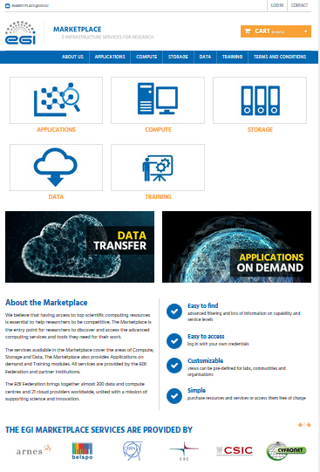
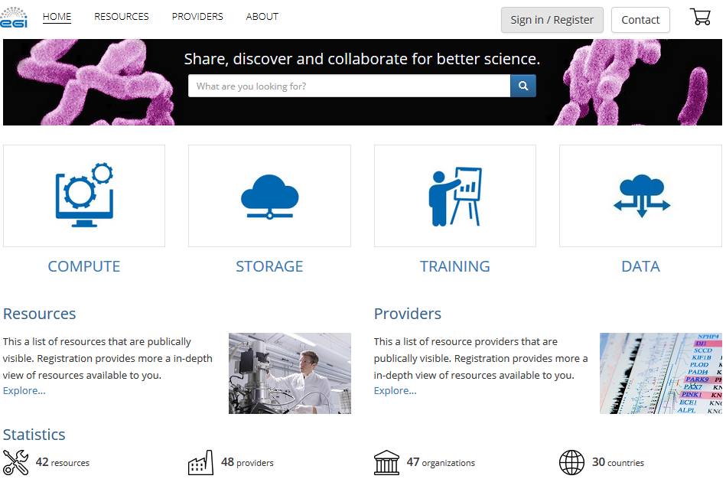
Marketplace
PrestaShop and Open IRIS Marketplaces
Base Prestashop + plugins + ad-hoc customisations
http://marketplace.egi.eu
Enhanced Open IRIS according to the EGI requirements
http://egi.science-it.ch

Slide 18
Marketplace
A tool to automate service order management
The Marketplace partially automates the service order procedures
  handle the customers’ request
Marketplace as an orchestrator of the several EGI tools involved in the processes
  trigger related IMS processes and procedures exploiting the customer and service order profile information collected

Slide 19
Marketplace
Relationship and impact on the EGI tools
Impacts on other tools
  remove redundancies:
    AODS - service discovery and a user profiling
    e-GRANT – dismissed
  implement new features:
    Service order pre-processing: orders grouped according to type
    Service order management
    SLA/OLA management: future work
Service order pre-processing performed by the MP
New Service Order Management tool (MP plugin)
  keeps trace and enables the mgmt of the service orders

Slide 20
Marketplace
Service order management – Tools and Processes
Customer Relationship Management
2. CRM handles the new order
4. CRM is notified when SLA is finalised
Future works
Marketplace
1. New order
Service Order mgmt tool
SLA/OLA mgmt tool
3. SLM is notified when SLA needs to be setup
5. SLM monitors SLA and related OLAs
Service Level Management

Slide 21
Marketplace
Service order mgmt – Tool interactions
Check-in
Operation Portal
Accounting
User authentication
Enabling VOs
Usage information
Marketplace
Service Order mgmt tool
SLA/OLA mgmt tool
Service providers
Enabling AoDs users
Data for service report
Config. Database
Applications on Demand
Monitoring (ARGO)
Already implemented
Future work
Notes:
Clarify what was implemented by EGI-Engage
Do not refer to EOSC-hub explicitly
Just mention “future work”

Slide 22
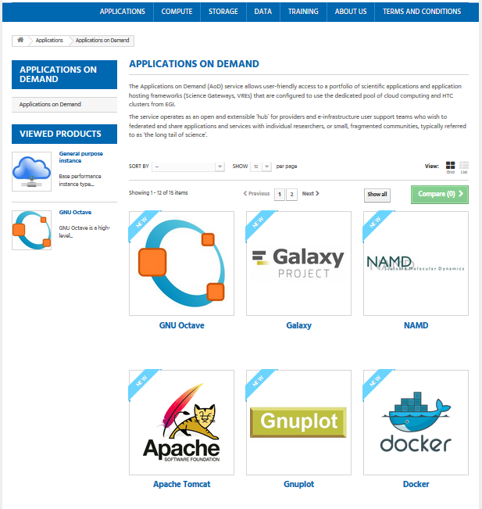

Marketplace
Integration with the Applications on Demand
Marketplace replaced the AoDs User Registration Portal
  Service discovery and a user profiling features
  Frontend

Slide 23


Marketplace
Integration with the Applications on Demand
8. Customer access AoDS after logged in in Check-in
Check-in
Applications on demand
AoDs users
Applications
1. A customer submit an order
7. The customer is notified that the order is approved
6. Ticket mgmt asks Check-in to add the customer to the AoDs user list
Marketplace
Service Order mgmt tool
2. A new order for AoDs is detected
Ticket mgmt
Service Orders
5. Ticket mgmt is notified
RT queue
ADMIN
3. The order is stored in the queue
4. The admin approve the order

Slide 24
Marketplace
Publishing of thematic community services
Services of the EGI service catalogue are now in the Marketplace
Thematic community services → Planned
  Will be included in the Applications service areas
  Semi-automatic workflows to enable users (like AoDs)
Criteria to publish services in the Marketplace:
  First draft defined
  Guarantee a certain level of quality, being compliant to generic security policies and EC regulations etc.

Slide 25

The EGI Accounting System
TJRA1.3

Slide 26
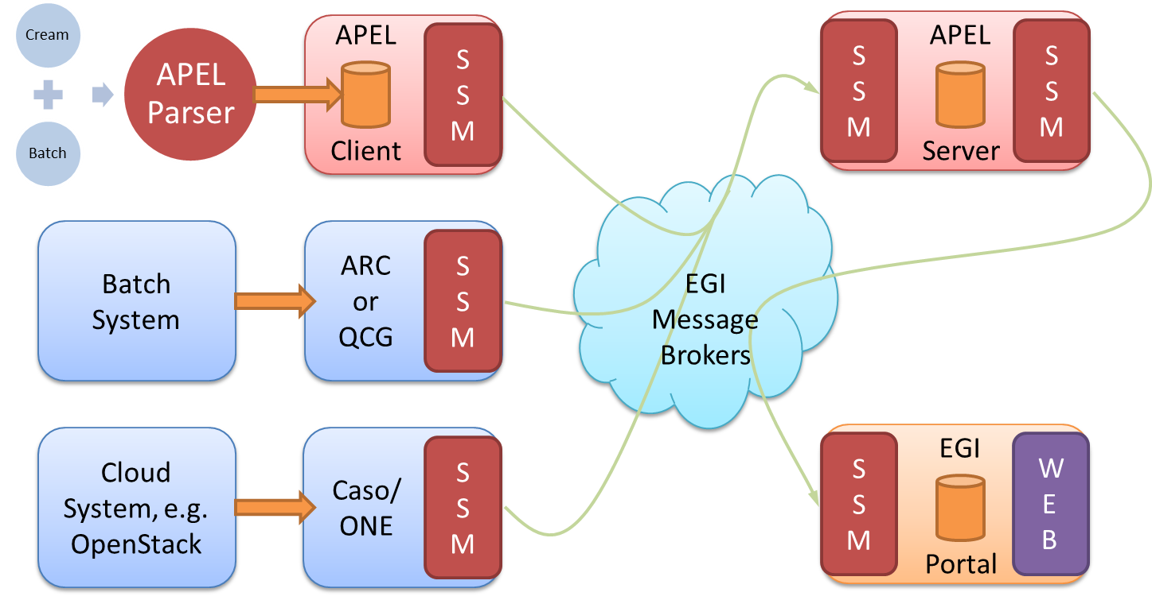
Accounting
The EGI Accounting system
Supported IMS processes
Service Level mgmt
Customer relationship mgmt
Capacity mgmt
Supplier, Federation Member Relationship Management
Accounting Repository
Service
Probe
Probe
Accounting Portal

Slide 27
Accounting
Evolution of the Accounting Repository architecture
3 Broad categories investigated
Message Broker
  Optimised use of the MySQL database
  Replacement with Apache Hadoop and the Hadoop Distributed File System
  Replacement with a time series databases
Ingest
Data Store
Export
Export
Ad-hoc queries
Aggregator
Outcome of the tests
  Optimise MySQL DB usage via parallel batch processing most promising solution
    Improvement of the performance without requiring big changes on the repository
Notes:
The central processing stage for the CPU accounting data takes many hours to complete and operates in a single processor thread. Although the data is backed up regularly, the data is not distributed across multiple hosts to provide greater resilience and processing power. Recent advances in Big Data tools provide an opportunity to address these limitations: improving the performance and resilience of the central repository.

Slide 28
Accounting
Improvements on the accounting measures
Cloud accounting
  New usage record in production
    N. of CPU cores, n. public IPs, benchmark type and benchmark value
  Long running VMs
    Data of virtual machines properly distributed over the time
  Exploratory activity to include GPGPU support
Storage accounting
  Improvement of storage scripts and updates on the central repository
  Campaign to on-board resource providers
    Around 30 RPs already sending records to the central repository
CPU accounting
  Support for recent versions of Torque and LSF batch systems

Slide 29
Accounting
Data Accounting
Data Accounting: record how much data is used, by whom and from where
  Data set as a logical set of files uniquely identified (PID)
  More efficient use of the infrastructure
  Assist scientists in assessing the impact of their work
Data Accounting usage record (OGF UR-2.0)
First prototype in 10/16
EGI Open Data platform as exp. source
New DB to store dataset URs
Support for loading dataset URs in APEL
Second prototype in 06/17
More metrics extracted
Data:
  parsed on a OGF message
  loaded into the DB
  aggregated into summaries
Notes:
We just have two reporting periods : PY1 PM01-PM12 and PY2 PM13-PM30 please replace PMs and PYs with respective months/years

Slide 30
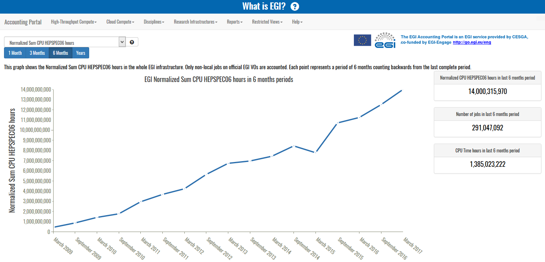
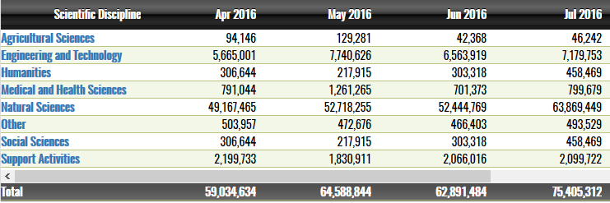
Accounting
The new Accounting Portal
Home page
  Global view of the e-infra
Contextualised help
Menu in line with the EGI service catalogue
REST API
New reports
Improved report granularity
Creation of community views:
  New WLCG dedicated menu
Better look & feel
  Improved table visualisation

Slide 31

Operational Tools
TJRA1.4

Slide 32
Operational Tools
The EGI Operations Portal
Portal for operations: broadcast tool, VO management facilities, operation and security dashboards, metrics, etc.
VO Administration and operations PORtal (VAPOR)
  Resource browser (OGF GLUE2)
  New views and geographical maps with provider distribution
  Summary of the CPU and storage capacities by countries, resource or operations centres
Integration with Check-in
Integration with ARGO UI
Extended VO ID Card
New metric view for VOs
Evolution of the background technologies
  Better maintainability
  Improved performance
Continuous Integration
  integration platform: PHPUnit, GitlabCI , Docker, SonarQBE
Supported IMS processes
Incident and service response mgmt
Capacity mgmt
Configuration mgmt
Customer relationship mgmt
Notes:
Use different slide to provide overview of graphical user interface (screen shot)

Slide 33
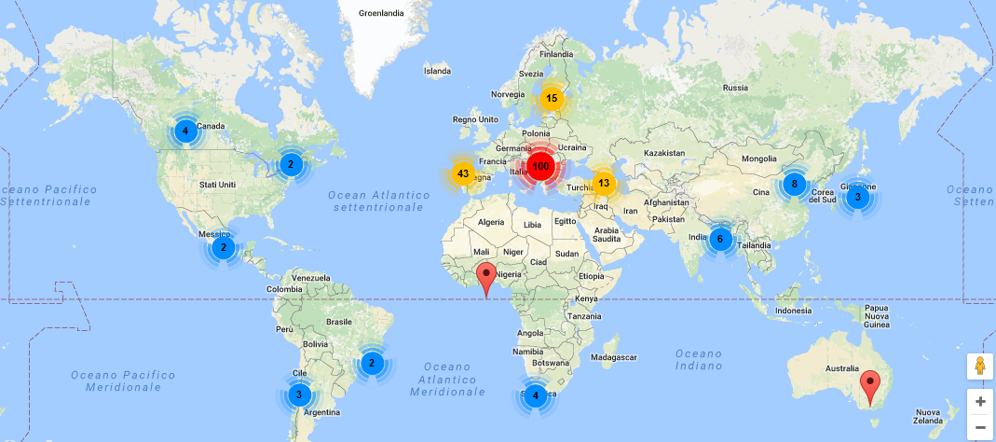
Operational Tools
The EGI Operations Portal
  Geographical maps with provider distribution

Slide 34
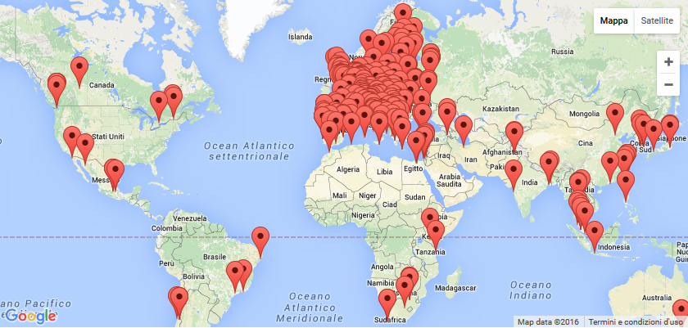
Operational Tools
The EGI Configuration DB – GOCDB
Catalogue to record information about resource providers, services, service-endpoint of a digital infrastructure
Write API
  Ease extension of the data model (custom properties)
  programmatic service endpoints mgmt and updates to the details of services
Integration with Check-in
  As service and attribute provider
Paging on select PI queries
Supported IMS processes
Configuration mgmt
Supplier, Federation Member Relationship Management
Notes:
Too crowded

Slide 35
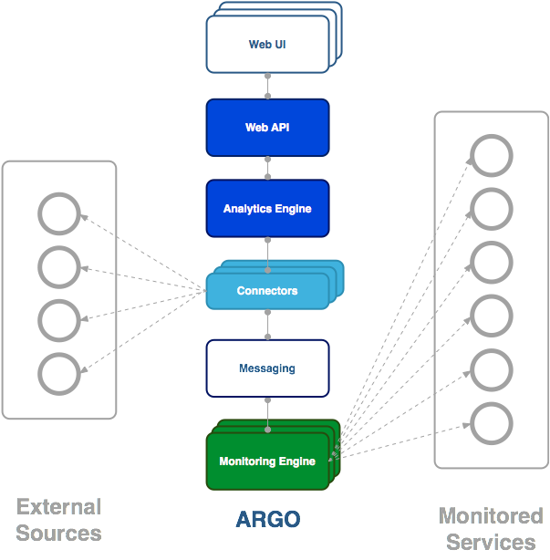
Operational Tools
The EGI Monitoring System – ARGO
Framework for monitoring status, availability and reliability
Support for multiple monitoring engines
Centralised Monitoring Engine
Stream processing in real time (Alerting system)
GOCDB as a single source of topology
VAPOR replaced GSTAT
Support for probe management
New probes (Check-in, FedCloud)
Integration with Check-in
Supported IMS processes
Service Level mgmt
Supplier, Federation Member Relationship Management
Service Availability & Continuity Management
Notes:
Too crowded

Slide 36
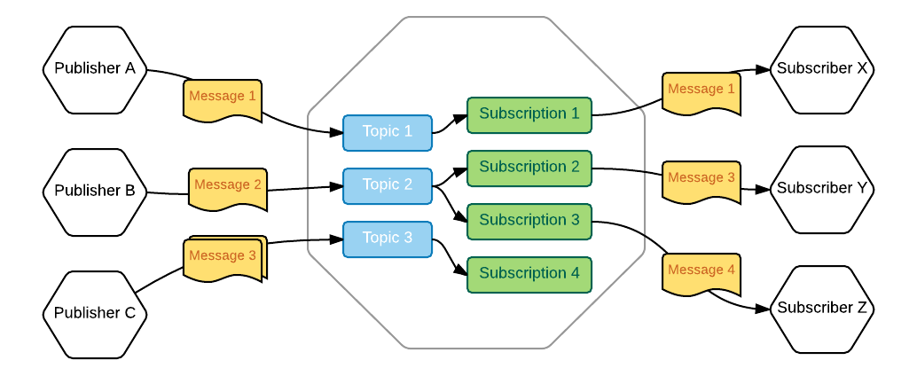
Operational Tools
The EGI Messaging Service
Enables reliable asynchronous messaging for the EGI infrastructure
New ΗTTP Messaging as a Service
  HTTP API for client access
  Implement the Google PubSub protocol
  Transparent scalability & high availability for clients
  Push & Pull models supported
  Multi-tenant support and easy updates
  Going to be adopted by ARGO, Ops Portal and Accounting

Slide 37
Operational Tools
Secant
Framework to detect security vulnerabilities in images of virtual machines
Perform security assessment of new VM images in the Cloud Marketplace
Workflow:
  Instantiate the new virtual appliance
  Launches a series of external scans to detect vulnerabilities
  run a series of internal probes
    checks security properties of the installed software
Secant integrated with the Messaging Service
Integration with AppDB in progress
  Support the assessment of the virtual appliances

Slide 38
Use of resources and issues
Notes:
Numbers will be provided by PO, work package leaders must provide explanation

Slide 39
Use of Resources
Nikhef: AAI - Token Translation
CESNET: AAI - Authorisation authority
CNRS: Ops Portal - Vapor and continuous integration

Slide 40
Summary
Notes:
Freedom on way to present

Slide 41
Summary
Objective 1 (O1): The continued coordination of the EGI Community.
  WP3: coordination of the development of the EGI tools
Objective 2 (O2): EGI Solutions, related business models and access policies.
  WP3.2: EGI Marketplace
Objective 3 (O3): Offer and expand an e-Infrastructure Commons solution
  WP3.1: Check-in service
  WP3.3: enhancement of the EGI Accounting System
    Cloud, HTC, storage, dataset and GPGPU
    New repository architecture
    New portal
  WP3.4: enhancement of the Operational Portal, ARGO and GOCDB.
  WP3.4: new messaging infrastructure
Notes:
Achievements grouped by objectives
➔ Use table format for a more compact and visual layout?

Slide 42
Summary
Objective 4 (O4): Open data platform and the European Big Data Value.
  WP3.3: Dataset accounting
Objective 5 (O5): Promotion the adoption and extension of the current EGI services
  WP3.2: Marketplace
  WP3: User communities requirements
Notes:
Achievements grouped by objectives

Slide 43
Key exploitable results
KER name | Description
Software and services
Federated Authentication & Authorization (Check-in) | Tools for authentication and authorisation (AA) in the EGI ecosystem
Tools for federated service management | Technological innovation and new services in the area of Service Registry and Marketplace and resource allocation. Evolved EGI accounting system. Adapted operations tools to new technologies and to satisfy new requirements from service providers and user communities.
Marketplace | Establishment of a marketplace where researchers can discover and exchange services relevant to their research, applying the one-stop-shop concept for data and services.

