Slide 1
WP6 Knowledge Commons
Gergely Sipos
Customer and Technical Outreach Manager, EGI Foundation
SA2 Activity Manager, EGI-Engage

Slide 2
Outline
WP Overview
Objectives, tasks, partners and effort
Activities and achievements
Training (SA2.1)
Engagement and support for new communities (SA2.2)
Competence Centres (SA2.3-10)
Use of resources
Summary

Slide 3
WP Overview

Slide 4
SA2 (WP6) objectives
Objective
1. Identify and support communities and users from EGI and its partners
2. Facilitate the integration of scientific applications with EGI’s e-Infrastructure services
3. Co-design and co-develop services for sustainable, structured scientific communities
4. Promote and support the uptake of new services within scientific communities
5. Provide a training framework, foundational training services and domain specific training events for scientific communities, EGI members and partners

Slide 5
From opportunities to operational setups
Opportunity
Customer support case
Operation
User story (business case)
Community national footprint
Potential EGI services
NGI support
Cost-Value-Support analysis
Technical requirements
Soft. devel. &integration
SLA – OLAs
Service satisfaction reviews (3/6/12 months)
Improvement suggestions
Publications, users
Helpdesk requests
Complaints
Customer relationship management
Business development
Service Level Management
9001:2015
2000-1:2011

Slide 6
SA2 Partners and effort
SA2 | Task | Leader / Partner
SA2.1 | Training | Gergely Sipos / EGI.eu
SA2.2 | Technical User Support | Enol Fernandez / EGI.eu
SA2.3 | ELIXIR | Kimmo Mattila / CSC
SA2.4 | BBMRI | Petr Holub / BBMRI-Eric
SA2.5 | MoBrain | Alexandre Bonvin / BCBR – SURFsara
SA2.6 | DARIAH | Davor Davidovic / RBI – SRCE
SA2.7 | LifeWatch | Jesus Marco de Lucas / CSIC
SA2.8 | EISCAT_3D | Ingemar Häggström / EISCAT
SA2.9 | EPOS | Daniele Bailo / INGV – INFN
SA2.10 | Disaster Mitigation | Simon Lin / AS
47 Participants (incl. Asia Pacific and US)
WP Total effort
455 PMs
Competence Centres (CCs)

Slide 7
Activities and Achievements

Slide 8
Training Task 6.1
Established and operated a cloud-based training infrastructure
For cloud trainings AND for application trainings
4 sites, ~150 vCPUs
Used by ~300 students in 13 courses (incl. 2 event with Numeca)
Reference courses: 17 topics. Recurring: Cloud, Security, Data Management, Containers. Delivered for
CCs (as webinars)
Research Infrastructure (RI) representatives (RI and EGI conferences)
Research students and researchers (1/2 day tutorials and Summer Schools)
NGIs (Webinars, EGI Conferences)
Event delivery and support
42 tutorials at 33 events (19 f2f, 12 webinar-type) – 20 EGI events, 13 external events
Approx. 800 participants in total
Contributed to 2 summer schools in 2017: CODATA-RDA
Joint activities with EUDAT, GEANT, OpenAire, RDA
‘Design your e-infrastructure’ workshops (2x in 2016; planning for 2017)
Introduction to European E-infrastructures (DI4R, September 2016)

Slide 9
Task 6.2: Serving researchers and innovators
Competence Centres (task 6.3-10)
Direct engagement (task 6.2)
Size of individual groups
ELIXIR
BBMRI
INSTRUCT
DARIAH
LifeWatch
EISCAT_3D
EPOS
Disaster Mitigation
WLCG
ELI
CTA
CLARIN
LOFAR
ICOS
EMSO
CORBEL
ENVRIplus
…
Tools and support for the NGIs
(task 2.3)
(task 6.2)
100% IT
Amazon
CFD Support
CloudEO
CloudSME
Ecohydros
EOproc
IBM Research
mITSM
Numeca
Peachnote
RHEA
SixSq
Terradue
UberCloud
PeachNote
CEBA Galaxy eLab
Semiconductor design
Main-belt comets
Quantum pysics studies
Virtual imaging (LS)
Bovine tuberculosis spread
Convergent evol. in genomes
Geography evolution
Seafloor seismic waves
3D liver maps with MRI
Metabolic rate modelling
Genome alignment
Tapeworms infection on fish
…
OpenDreamKit
WeNMR
DRIHM
VERCE
PhenoMeNal
BioExcel
Multiscale Genomics
AgINFRA
LSGC
…
ESFRIs
Multinational communities, (e.g. H2020 projects)
Industry, SMEs
‘Long tail of science’
WP6 Knowledge Commons

Slide 10
From opportunities to active customers
Outreach and training
Opportunity identification → Opportunity DB
Or service orders from Website, Marketplace
Opportunity analysis → Customer DB
Technical onboarding
SLA-OLA negotiation
Operation
Service reports
Regular satisfaction reviews (incl. publications)
Complaints
1
2
3
4
5
6
Training (SA2.1)
New communities (SA2.2)
ELIXIR (SA2.3)
BBMRI (SA2.4)
MoBrain (SA2.5)
. . .

Slide 11
Technical user support Task 6.2 Highlights
Support network and support tools
Integrated engagement and Customer Relationship Management with FitSM
Coordination meetings with the NGI International Liaisons → For national support
Engagement and support for new communities
32 communities: 19 RIs; 13 project/platform developer communities
'Design your e-infrastructure' events
5 use case / event (ICOS, EuroArgo, CLL, ELI, …);
Co-organised with EUDAT, GEANT, OpenAIRE
The workshop format was adopted by the Dutch NGI at national events
Services for the long-tail of science
Thematic Services & Applications On Demand (KER presentation earlier today)
Operational setup with 45 applications and 3 application porting gateways

Slide 12
Achieved maturity (Described in details in D2.14)
1
2
3
4
Early engagement
Co-development.
Prototype setup
Operations
Opportunity DB:
ACTRIS
AnaEE
Blue Cloud institutes
CESSDA
DANUBIUS
EBMRC
ELI (ELItrans)
EMPHASIS
Human Brain Project
KM3Net
LTER
SKA (AENEAS)
Multi Scale Genomics VRE
BigDataEurope
BioImaging-ES
CLL research initiative
BioExcel
AGINFRA+
EODC
New communities:
ENES
Euro-Argo
ICOS
OpenDreamKit VRE
PhenoMeNal
ELI-NP
4 CCs:
BBMRI
ELIXIR
EPOS
EISCAT_3D
9 New communities:
D4Science (SLA)
ExTRAS (SLA)
NBIS (SLA)
PeachNote (SLA)
VIP (SLA)
EMSO (SLA)
ESA TEPs (SLA)
BioISI (SLA)
DRIHM (SLA)
4 CCs:
DARIAH (SLA)
Disaster Mit.
LifeWatch
MoBrain (SLA)
→ CC in EOSC-hub
→ CC in EOSC-hub
→ TS in EOSC-hub
TS in
EOSC-hub
11 SLAs signed. 36 providers pledge
>152 Million of CPU hours
>170TB of storage
>3926 GB of RAM
>1410 vCPU cores

Slide 13
Support for new communities – Examples
AQUAEXCEL H2020 project
Identified on the CORDIS website in2017: “a dedicated e-infrastructure which will support both actual and virtual research experiments'”
Discussions are ongoing (using EGI external vs. internal services)
NBIS (National Bioinformatics Infrastructure Sweden)
Contacted EGI via the support channel
PconsC2, Pcons, TOPCONS2 servers on Federated Cloud – With SLA
TOPCONS2 alone predicted more than 2 million protein sequences by 5000 users from 69 countries
1
2
3
4
Early engagement
Co-development.
Prototype setup
Operations
European Research Initiative on chronic lymphocytic leukemia
Applied to 2nd Design Workshop
Moved to stage 2 in PY2
Portal with data repository and applications (Galaxy workflows with Perl, R, JavaScript)
Limited demonstrator achieved
Scale-up ongoing, aiming for community demo
Euro-Argo (ocean climate)
Contact established at ENVRIplus Week 2015
Participated in 1st Design Workshop
Data subscription and delivery service
Combining EGI Federated Cloud and B2SAFE
Demo at ENVRIplus Week 2017; Conf. Paper
Development continues in EOSC-hub

Slide 14
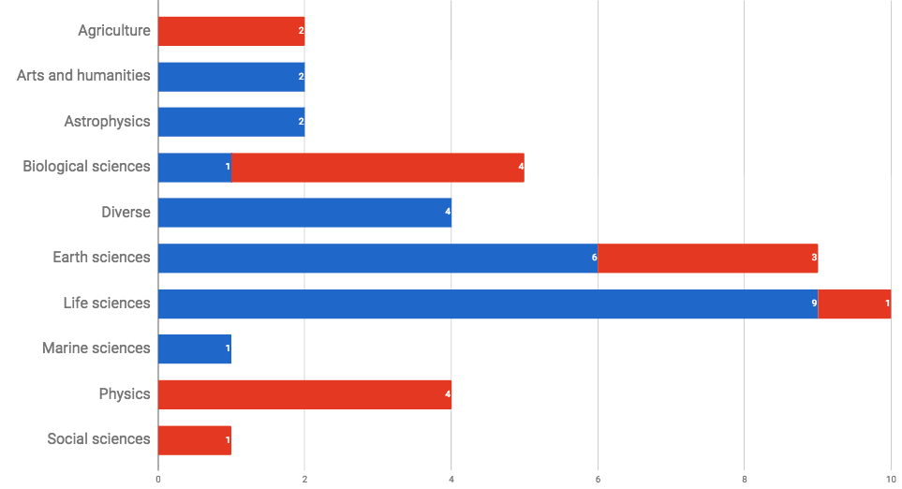
Working with new communities: per discipline
Legend:
ACTIVE COLLABORATION
EARLY ENGAGEMENT
Notes:
Life science (incl. Biological scineces) dominate → Because there are so many projects/Ris in this; Because they pro-actively look for capacity. (Note that several of these relate to biodiversity research)
In the second period we broadened our reach: Agriculture; Social sciences; Physics
Still underrepresented: Arts and humanities

Slide 15
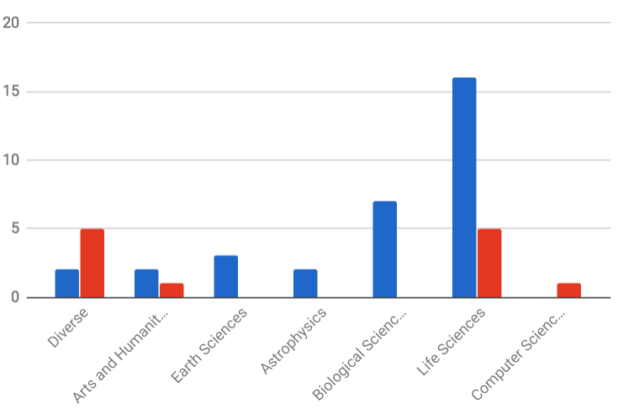
Support for the long-tail of science
Applications On Demand Platform: 15 apps.
Roll-out through the NGIs (Jan-May 2017)
Webinar; Conference paper; Newsletter articles; Demos
First NGI event based on this tool: Croatia, October 2017
Thematic services: 30
Legend: THEMATIC SERVICE
APPS ON DEMAND

Slide 16
Competence Centres: SA2.3-10
Distributed Competence Centre
BBMRI
ELIXIR
EPOS
MoBrain/ INSTRUCT
EISCAT-3D
DARIAH
LifeWatch
Environment (disaster mitigation)
EMSO
ICOS
NEW!
Notes:
ESFRI Projects:
The ESFRI Projects have been selected for scientific excellence and maturity and are included in the Roadmap in order to underline their strategic importance for the European Research Infrastructure system and support their timely implementation. The ESFRI Projects can be at different stages of their preparation according to the date of inclusion in the ESFRI Roadmap.
ESFRI Landmarks:
The ESFRI Landmarks are the RIs that were implemented or started implementation under the ESFRI Roadmap and are now established as major elements of competitiveness of the European Research Area. The ESFRI Landmarks need continuous support for successful completion, operation and upgrade in line with the optimal management and maximum return on investment.

Slide 17
PY1 → PY2 → PY3 → EOSC-Hub
Requirement collection & system design
Tests, evaluation
Dissemin./
Exploitation
ELIXIR | Compute Platform with AAI 5 use cases are defined | Operates in 3 nodes | Application demos | ELIXIR AHM ’17, AHM ’18 | CC in EOSC-hub
BBMRI | Private clouds | Deployed at biobank-SE Under setup in biobank-CZ | Workflows and PIDs | BioBanking annual event
MoBrain | Community portal | Done | Done | 75+ events | SLA in place TS in EINFRA12
 | Cryo-EM in the cloud (SCIPION) | Done | Done
 | GPGPU application gateways | Completed | Completed
DARIAH | Data repository | Done | Completed | 20 events | SLA in place TS in EOSC-hub
 | Real-time search | Done
 | Application gateway | Completed
LifeWatch | Cloud infra. Services & VREs | Marine VRE, GBIF | Cloud site in Seville | Approx 10k users | TS in EOSC-hub
 | Apps. for citizen science | Done | Done
EISCAT_3D | Data Portal | Done–Proof-of-concept | Done (For Proof of Concept) | EISCAT Symposium ’16 | CC in EOSC-hub
 | Data & Compute Portal | Completed | Ext. portal | EISCAT Symp’17
EPOS | 3 use cases are defined | Completed | Completed- AAI, Compute, Data |  | CC in EOSC-hub
Disaster Mitigat. | 2 simulation gateways | gWRF and iCOMCOT gateways | Completed | 3 cases: Typhoon Haiyan MY flood ‘14-15 Forest fire dust | CC in EOSC-hub
 |  |  |  | Climate change cases
Co-development
Operation
Cloud certification work in EOSC-hub

Slide 18
CC achievements in 30 months
Thematic services from 4 CCs:
MoBrain-8 service, LifeWatch-2, DARIAH-1, Disaster Mitigation-2
Serving more than 10,000 users
50+ scientific papers
Consumed 6,000,000 cloud CPUh (LifeWatch, MoBrain, ELIXIR, DARIAH)
Consumed 76,000,000 HTC CPUh (MoBrain)
Setup of demonstrators/pilots from 5 CCs:
ELIXIR-6 demo, BBMRI-3, EISCAT_3D-1, EPOS-3, EMSO-1
Services integrated: Cloud; AAI; GPGPUs; Containers; Online Storage; Check-in; Operation tools
More than 130 events in 30 months
To share experiences
To promote Thematic Services
To demonstrate capabilities & make recommendations to Ris

Slide 19
Increase in cloud usage in second project period
Biological sciences
Structural biology: WeNMR (existing, +43%)
Marine and Freshwater Biology: EMSO - European Multidisciplinary Seafloor and water-column Observatory (starting, +44.6%)
Earth sciences
Earth Geohazards ESA exploitation platform (starting, +6,100%)
Agricultural Sciences
Agriculture, Forestry and Fisheries (starting, +826%) – EGI-Engage infrastructure integration action
Humanities
Arts/Musicology: Peachnote (active, constant usage)
Humanities: DARIAH Research Infrastructure (starting, +607%) – EGI-Engage Competence Centre
Multi-disciplinary support
D4Science (starting, +288%)

Slide 20
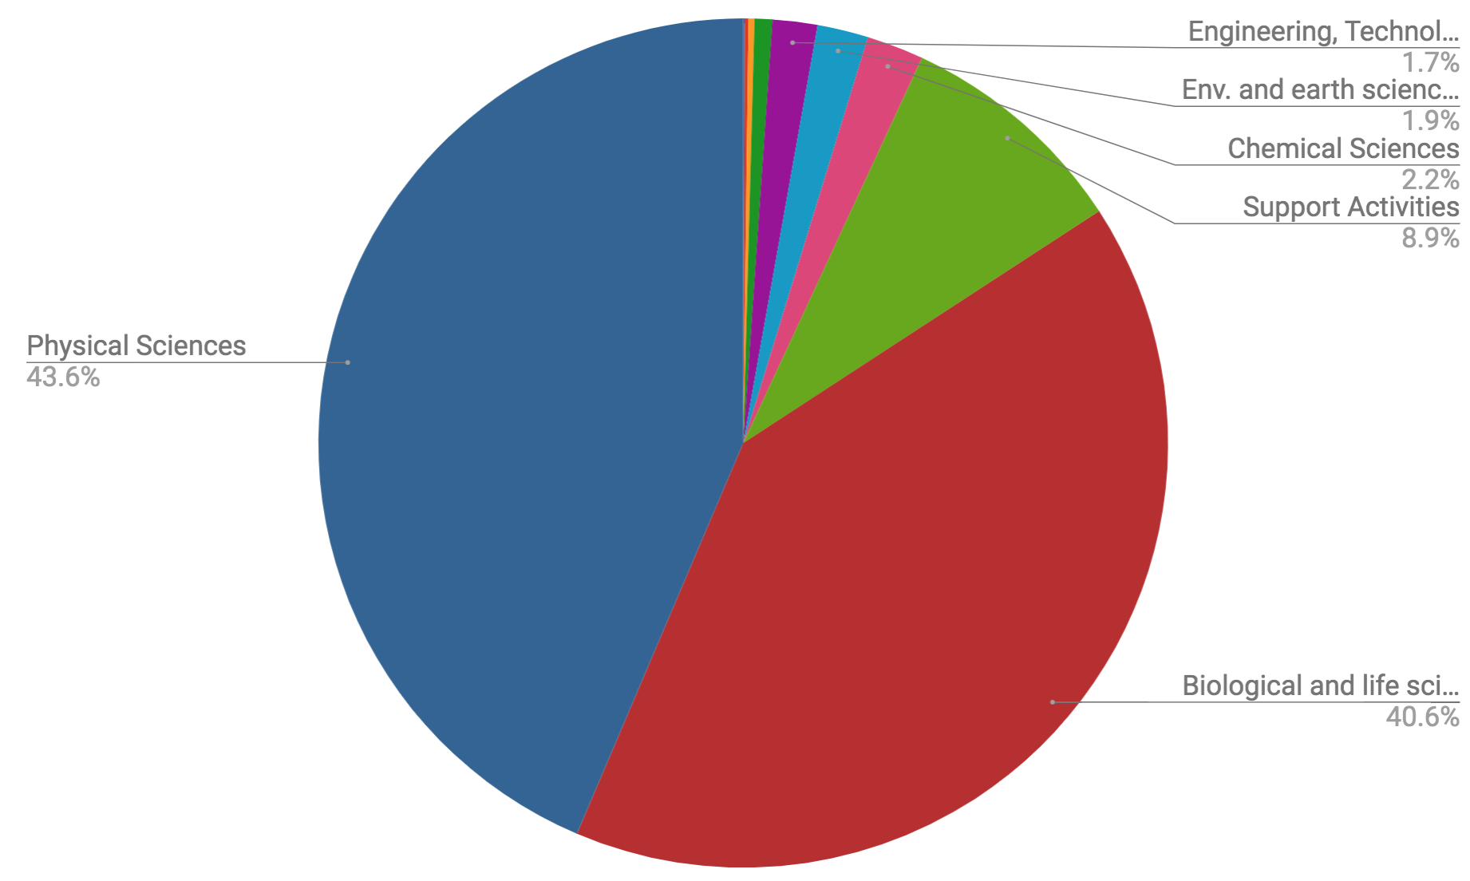
EGI user distribution ~60,000 in total, 1% = 600
Mathematics, Humanities, Agriculture
~5,500
~26,500
~24,000

Slide 21
Community flash presentations
Mathematics, Humanities, Agriculture
3. ICOS (new comm.):
EGI-EUDAT integration
4. LHC:
Established user of EGI federation services
2. ELIXIR CC: Prospective user of federation services
1. WeNMR/MoBRAIN CC: Community of practice, in production before EGI-Engage
~24,000
~24,000

Slide 22
Use of Resources

Slide 23
Effort analysis
 | Period 2 (M13-30) |  |  | Grand Total
Task | Plan | Report |  | Plan | Report
T6.1 Training | 35.3 | 36.5 | 103% | 43 | 42.1 | 98%
T6.2 Technical support | 26.4 | 24.7 | 94% | 49.5 | 49.5 | 100%
T6.3 ELIXIR | 28.3 | 31.6 | 112% | 34.5 | 36.4 | 105%
T6.4 BBMRI | 20 | 25.3 | 127% | 25 | 32.4 | 130%
T6.5 MoBrain | 36.2 | 26.9 | 74% | 65.5 | 64.5 | 99%
T6.6 DARIAH | 28.9 | 35.9 | 125% | 62.5 | 68 | 109%
T6.7 LifeWatch | 38.5 | 52 | 135% | 60 | 68.3 | 114%
T6.8 EISCAT_3D | 20.3 | 11.8 | 58% | 28 | 19.2 | 69%
T6.9 EPOS | 23.8 | 23.6 | 99% | 30.5 | 29.7 | 97%
T6.10 Disaster Mitigation | 34.2 | 11 | 32% | 57 | 18.3 | 32%
WP6 total | 291.7 | 279.3 | 96% | 455.5 | 428.5 | 94%
KTH, BBMRI-NL, BBMRI-CZ
CNRS data is still to come
Data is still to come

Slide 24
Summary

Slide 25
Summary
Objective 1 (O1): The continued coordination of the EGI Community.
CRM process that spans from opportunity identification to operational support
Support 40 communities – 8 CCs and 32 new communities
Established a new workshop format (Design Your E-infrastructure)
Objective 5 (O5): Promotion the adoption and extension of the current EGI services
42 training events; 130+ CC events
Uptake of cloud (by 24 communities); HTC (by 3 communities); Online storage (by 4 communities); AAI and operation tools (by 4 communities)
Services are secured with SLAs to 11 communities
Established and opened the Applications On Demand service
A biggest achievement was bringing together 100+ domain experts from 50 institutes to establish
Knowledge commons

