Slide 1
Lightning talk: MoBrain Competence Centre
Alexandre BONVIN
Professor of Computational Structural Biology
Utrecht University, the Netherlands

Slide 2
Introducing the community
Main Goals:
Brings the micro (WeNMR) and macro (N4U) worlds together into one competence center under EGI Engage
Bringing data to the cloud (cryo-EM)
Exploiting GPGPU resources
Dissemination and training
Members:
Utrecht University, NL
CIRMMP, IT
CSIC and Spanish NGI, ES
STFC, UK
Ospedaliero di San Giovanni di Dio - Fatebenefratelli (IRCCS FBF), IT
GNUBILA, FR
INFN, IT
SURFsara (Dutch NGI), NL
Cyfronet AGH (Polish NGI), PL
CESNET (Czech NGI), CZ
Open Science Grid (US)
Notes:
“MoBrain builds on grid- and cloud-based infrastructures and on the existing expertise available within WeNMR (www.wenmr.eu), N4U (neugrid4you.eu), and technology providers (NGIs and other institutions, OSG). This initiative aims to serve its user communities, related ESFRI projects (e.g. INSTRUCT) and in the long term the Human Brain Project (FET Flagship), and strengthen the EGI services offering.”
Introduce these communities here to put the CC into the bigger context. (1-2 slides)

Slide 3
Introducing the community
EGI-Engage Final Review: Lightning talk WeNMR/MoBRAIN

Slide 4
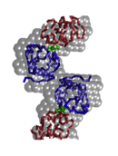
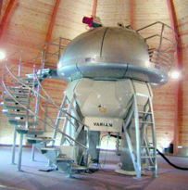
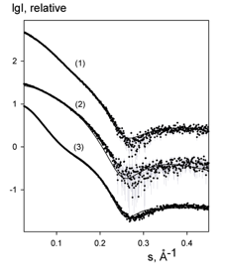
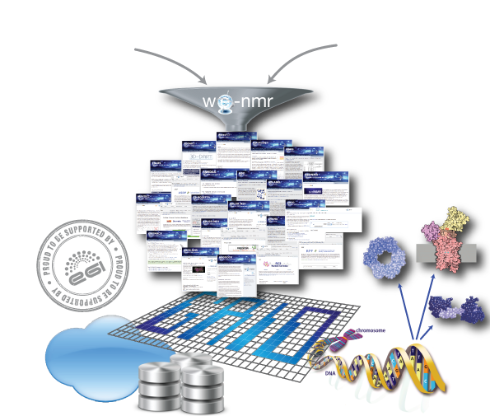
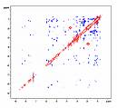
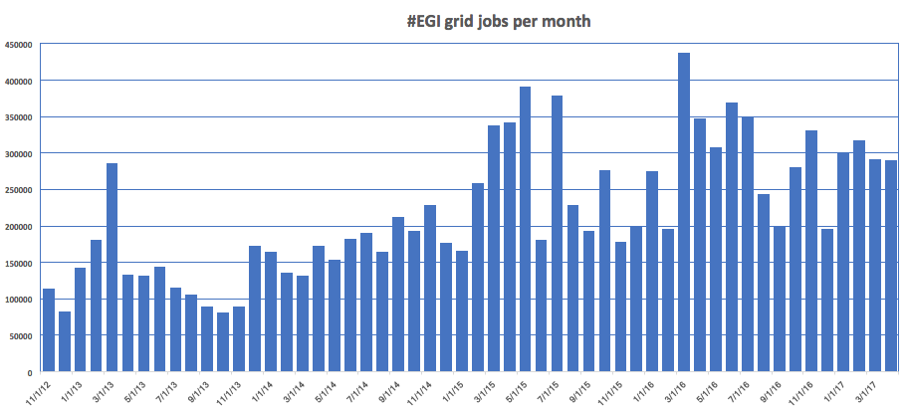
Operational from day 1
Building on the strong legacy of the WeNMR project (FP7) we have been offering services from day 1
enmr.eu: One of the largest (#users) VO in life sciences
>830 users have registered so far(36% outside EU)
Support from >40 sites for >200’000 CPU cores via EGI infrastructure (SLA)
User-friendly access to Grid via web portals
Supported by an SLA (2016, updated in 2017) with EGI and NGIs
NMR SAXS
Start of EGI-Engage
End of WeNMR funding
www.wenmr.eu

Slide 5
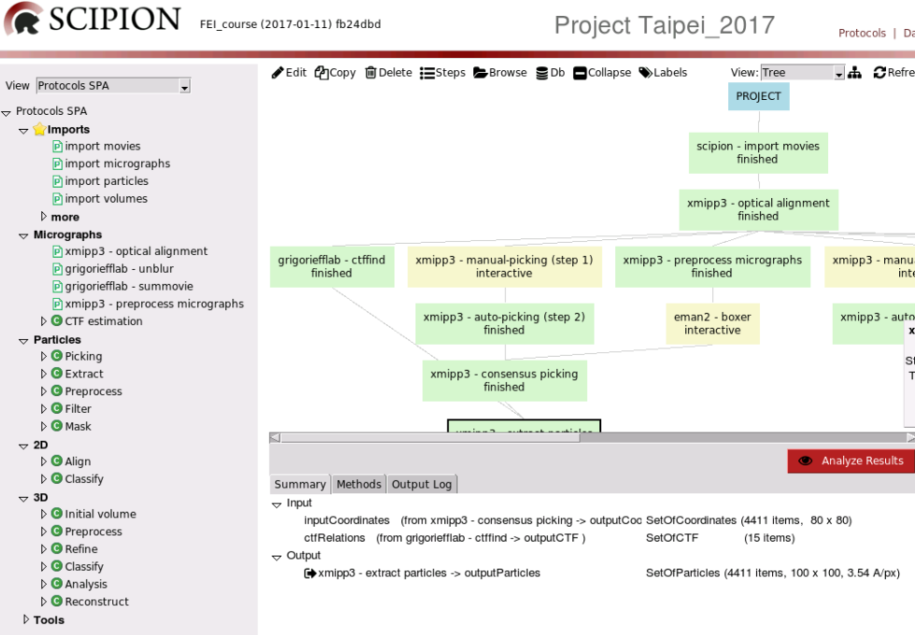
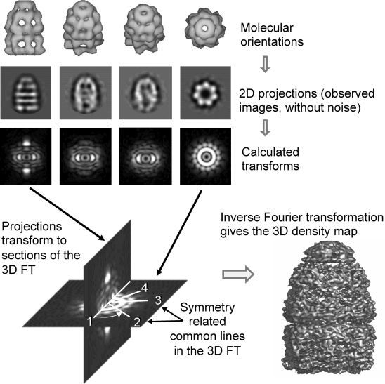
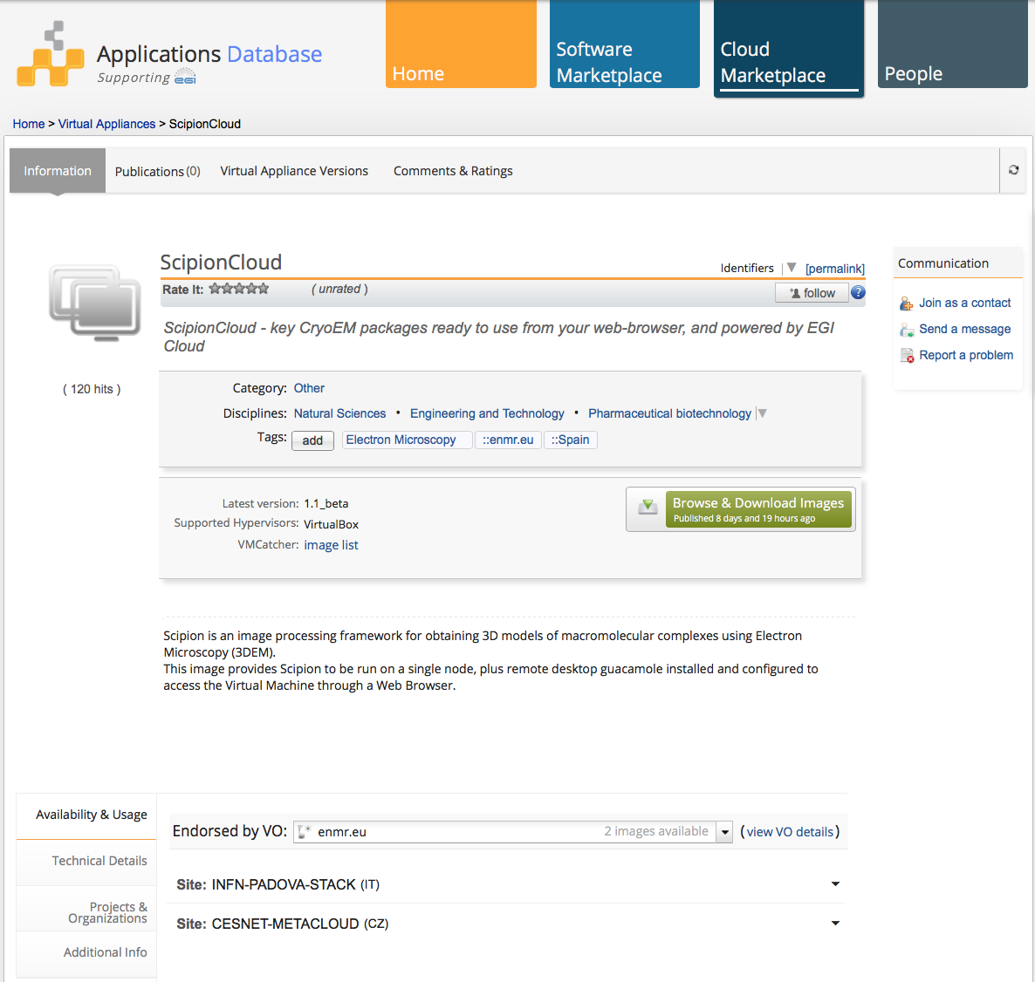
CC highlights: Cryo-EM in the clouds
SCIPION developed in Madrid (I2PC) and deployed at CesNet European Federated Cloud and Amazon
Available for download from the EGI AppDB
In production for iNEXT, INSTRUCT and various international courses (e.g. INSTRUCT Utrecht, ISGC Taipei, Cryo-EM course at NESCEN center NL)
De la Rosa, J.M. et al., Scipion: A software framework toward integration, reproducibility and validation in 3D electron microscopy. J.Struct.Biol. (2016), 195:93

Slide 6
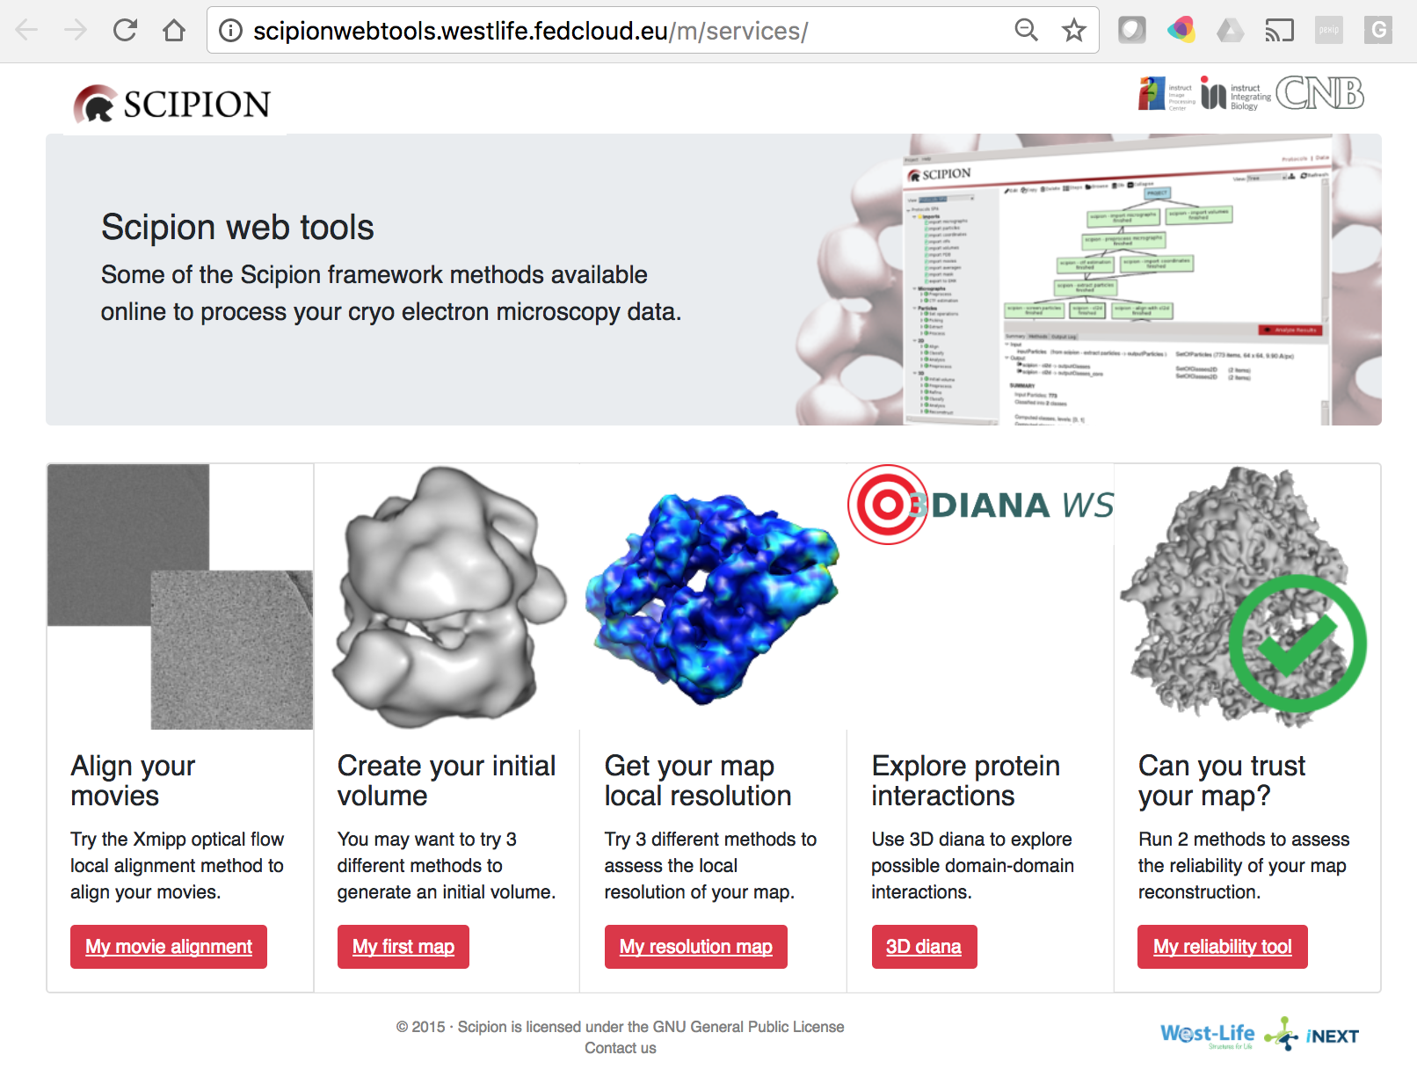
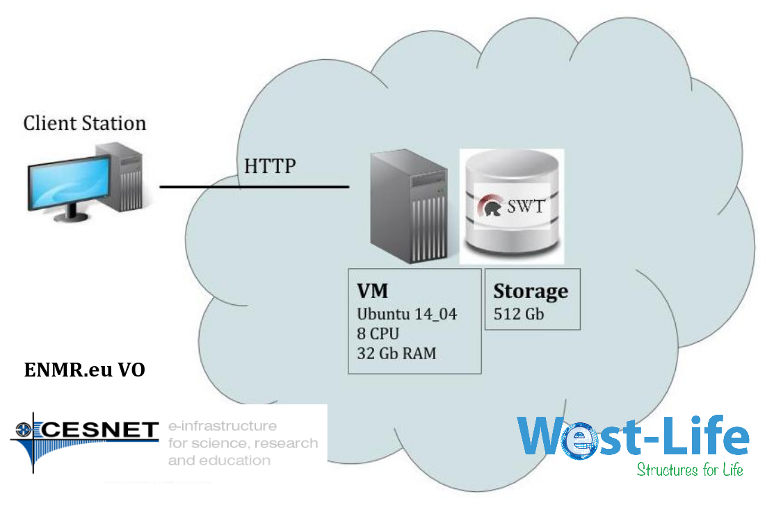
CC highlights: Cryo-EM in the clouds
SCIPION cloud server now in production

Slide 7
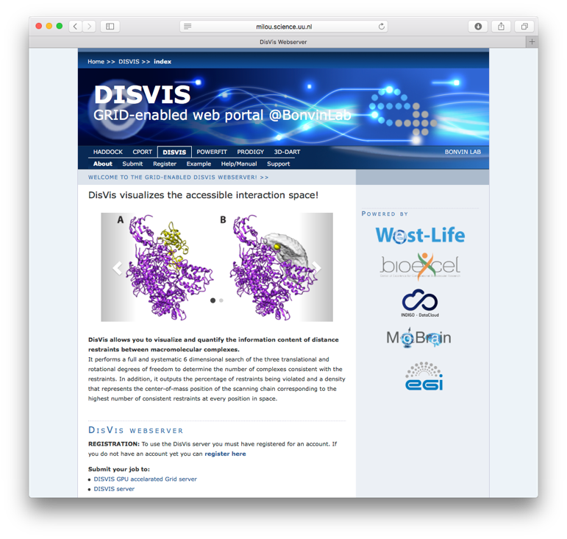
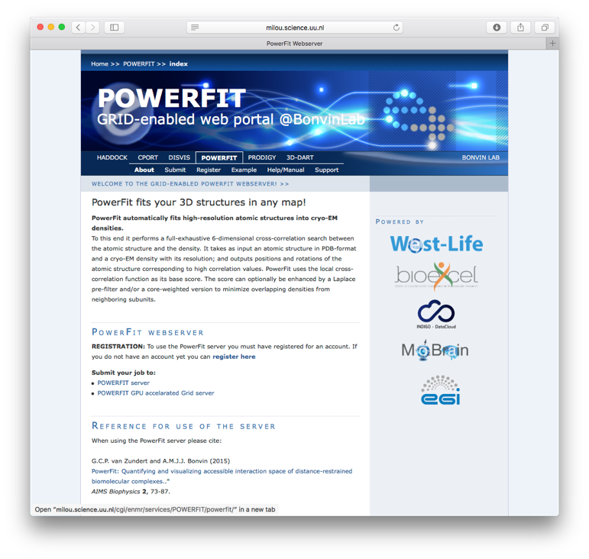
CC highlights: Harvesting EGI GPGPU resources for integrative modelling
Because of complex software dependencies we use docker containers
Python2.7
NumPy 1.8+
SciPy
FFTW3
pyFFTW 0.10+
OpenCL1.1+
pyopencl
clFFT
gpyfft
And to avoid security issues on the grid side, udocker from INDIGO
indigodatacloudapps/disvis
indigodatacloudapps/powerfit
http://milou.science.uu.nl/enmr/services/DISVIS
http://milou.science.uu.nl/enmr/services/POWERFIT
G.C.P. van Zundert, M. Trellet, J. Schaarschmidt, Z. Kurkcuoglu, M. David, M. Verlato, A. Rosato and A.M.J.J. Bonvin.
The DisVis and PowerFit web servers: Explorative and Integrative Modeling of Biomolecular Complexes.
J. Mol. Biol., 429, 399-407 (2017).
Notes:
Introduce the CC here
Approx 1 slide

Slide 8
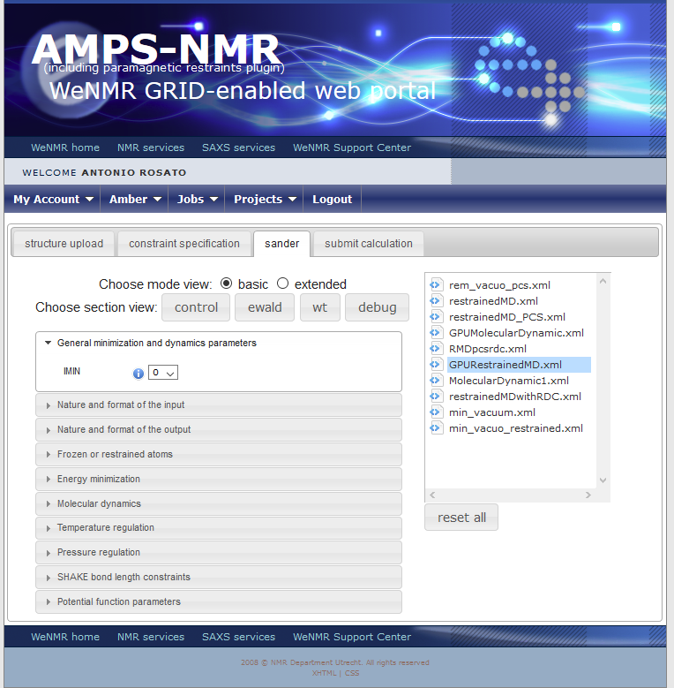
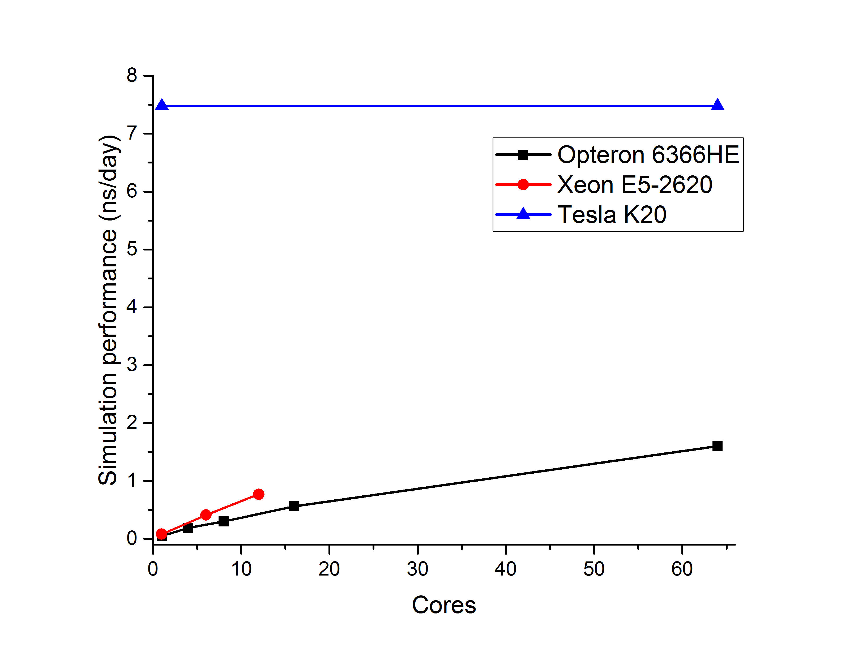
CC highlights: Harvesting EGI GPGPU resources for MD simulations
We benchmarked calculations run on a very large protein system via the portal using different hardware configurations
A single GPGPU card computes longer simulations (ns) per day (wall time)
Energy consumption (dynamic power) per one ns of simulated time is about 8% of the 64 core Opteron system
Notes:
Introduce the CC here
Approx 1 slide

Slide 9
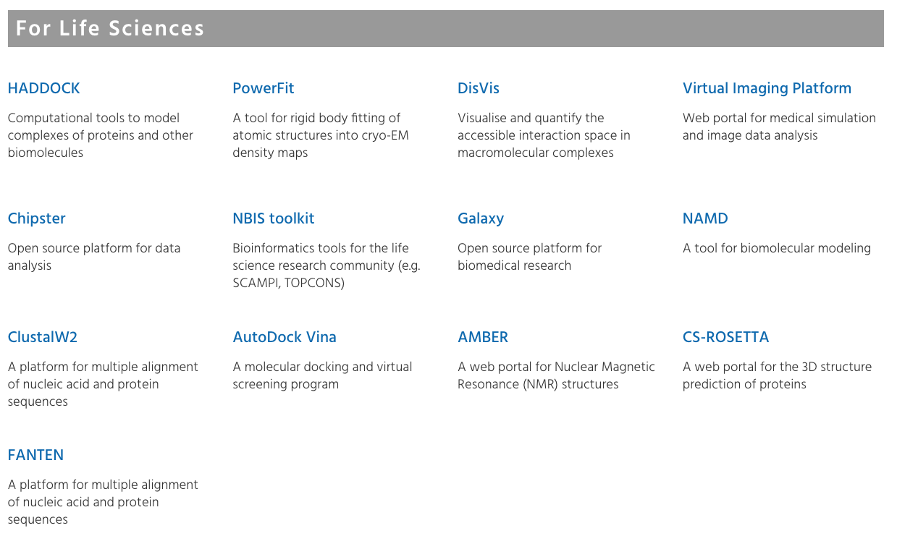
EGI thematic services
https://www.egi.eu/use-cases/scientific-applications-tools/

Slide 10
Some Usage statistics
MoBrain/WeNMR/WestLife portals statistics
 | Stats 2015 |  |  | Stats 2016 |  |  | Stats 2017 |  |  | User increase
 | Users total | User jobs | Grid jobs | Users total | User jobs | Grid jobs | Users total | User jobs | Grid jobs
AMBER | 300 | 0 | 8k | 390 | 185 | 3.6k | 488 | 571 | 1.7k | 25%
CS-ROSETTA3 | 219 | 67 | 189k | 228 | 33 | 264k | 228 | 20 | 817 | 0%
DISVIS | n.a. | n.a. | n.a. | 39 | 172 | 64 | 160 | 553 | 218 | 310%
FANTEN | n.a. | n.a. | n.a. | n.a. | n.a. | n.a. | n.a. | 1246 | n.a. | n.a.
HADDOCK | 6699 | 24.8k | 7490k | 8320 | 27.3k | 8948k | 10190 | 33.3k | 8893k | 22%
POWERFIT | n.a. | n.a. | n.a. | 21 | 34 | 13 | 99 | 150 | 96 | 371%
TOTAL | 7218 | 24.9k | 7597k | 8998 | 27.7k | 9270k | 11165 | 41.2k | 10025k | 24%
DISVIS and POWERFIT grid jobs run on GPGPU resources
75% of AMBER grid jobs are on GPGPU resources

Slide 11
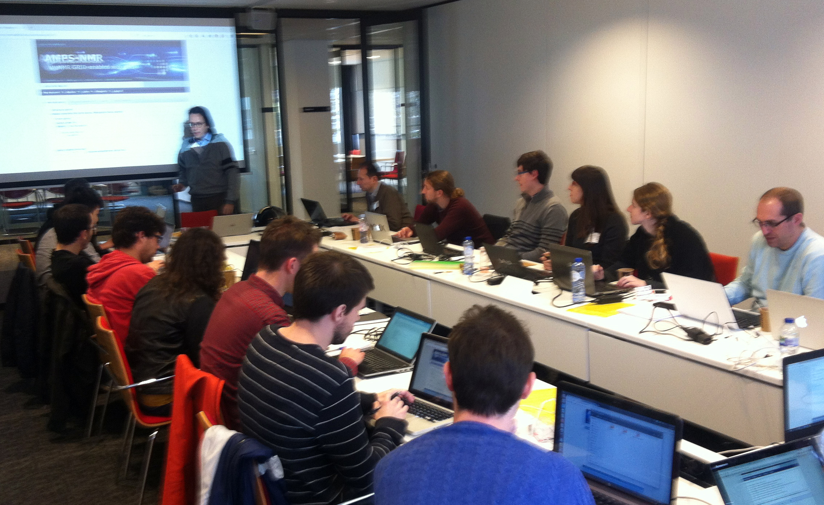
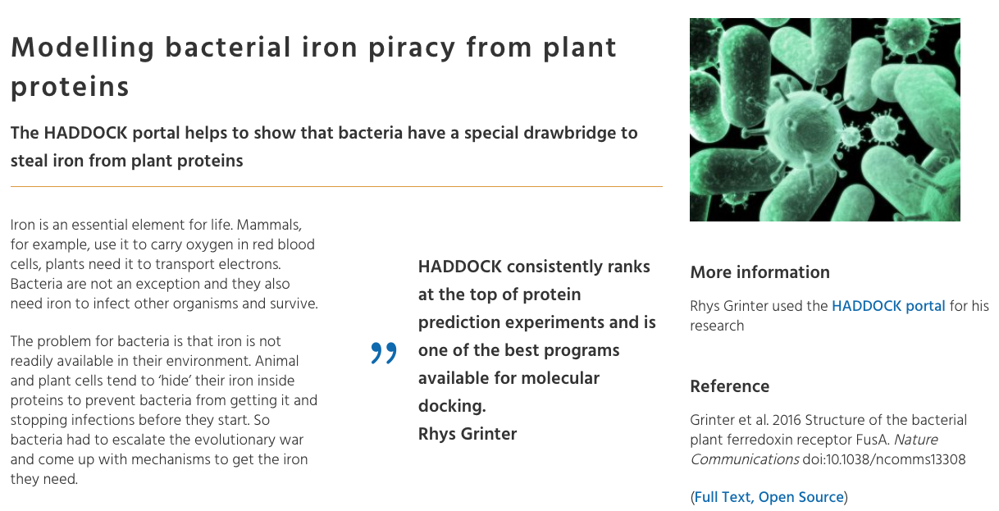
CC highlights
INSTRUCT / MoBrain course Utrecht 2016
Outreach
45 Publications (34 in peer-reviewed scientific journals)
75 events (presentations at conferences, workshops, training events…)
Infrastructure use (from accounting system):
Cloud VMs: 1,080
Cloud CPUh: 1,135,739
HTC CPUh: 73,262,983
Cryo-EM workshop,
ISGC 2017, Taipei
https://www.egi.eu/use-cases/research-stories/

Slide 12
Future Plans
Mature and in production services will be operated and further improved within the EOSC-Hub project
Transnational access
Consolidation of submission machinery (DIRAC4EGI)
Intergration with EGI CheckIn and DataHub
Connection to ONEDATA and EUDAT data repositories
Dissemination, training and support
EOSC-Pilot demonstrator for cryo-EM use case

