Slide 1
WP4/JRA2 Development of EGI Technical Platforms
Matthew Viljoen
WP4 Leader

Slide 2
Outline
WP Overview
Objectives, tasks, partners and effort
Activities and Achievements
Task JRA 2.1 Federated Open Data (Lead: Cyfronet)
Task JRA 2.2 Federated Cloud (Lead: IFCA-CSIC)
Task JRA 2.3 e-Infrastructure Integration (Lead: EGI)
Task JRA 2.4 Accelerated Computing (Lead: SAVBA)
Resources and Issues
Summary

Slide 3
JRA2 (WP4) objectives
Tasks | Project Objectives
TJRA2.1 Federated Open Data | Analysis of open data use cases and requirements Design and develop the Open Data platform prototype Open Data platform demonstrator
TJRA2.2 Federated Cloud | Evolve the federated IaaS Cloud platform with functionalities required by the CCs Extend ‘open standards’-based interfaces exposing new capabilities Maintain interface support for future versions of popular Cloud Management Frameworks (CMFs)
TJRA2.3 e-Infrastructure Integration | Integration for gCube and the D4Science infrastructure EGI-EUDAT Harmonisation for Virtual Research Environments Canadian Advanced Network for Astronomical Research
TJRA2.4 Accelerated Computing | Enabling accelerated computing support in the Information System Enabling accelerated computing support in the HTC and Cloud middleware frameworks

Slide 4
Compute
Storage and Data
Training
Applications
Cloud Container Compute BETA
Archive Storage
FitSM training
Applications
on Demand
Cloud Compute
Data Transfer
Training
infrastructure
High-Throughput
Compute
Online Storage
Alpha services
Attribute Management
Check-in
Configuration Database
Content Distribution
Data Hub
Federated Data Manager
Service Monitoring
Workload Manager
JRA2.4
JRA2.2
JRA2.1
Notes:
The bigger picture
JRA 2.1 – federated open data
JRA 2.2 – federated cloud
JRA 2.4 – HTC + Cloud accelerated computing
(no JRA 2.3 – e-Infrastructure Interoperatibility)
Addressing technological gaps – meeting user needs that isn’t met by EGI at present, mainly because technology isn’t there

Slide 5
Activities and Achievements
Notes:
Main achievements of the work package

Slide 6
Task JRA2.1
Federated Open Data

Slide 7
JRA2.1 Federated Open Data Aim
A new prototype platform (and services)
to enable the easy discovery, access and usage of reference open data and user data
Notes:
=

Slide 8
Community Requirements
REQ1. Publication of open research data based on policies
REQ2. Make large data sets available without transferring them completely
REQ3. Enabling complex metadata queries
REQ4. Integration of the open data access data management with community portals
REQ5. Data identification, linking and citation
REQ6. Enabling sharing of data between researchers under certain conditions
REQ7. Sharing and accessing data across federations
REQ8. Long term data preservation
Use of external services (e.g. EUDAT)
REQ9. Data provenance
Notes:
at the beginning of the project, custom questionnaires were created and distributed to: Biological and Medical Sciences
(Human Brain Project, MoBRAIN, BBMRI) Environmental and Earth Sciences(EMSO, LifeWatch)
Agriculture(Agrodat.hu, agINFRA)Astronomy & Astrophysics (A&A)(CTA, LoFAR, CANFAR) – for results, see M4.1
requirements summarized here.
9 originally, we’ve concentrated on only 8 – no Long Term Preservation

Slide 9
EGI Open Data Platform architecture
DOI Registrar (e.g. DataCite)
Community Portal
EGI User 1 (VO x)
Anonymous
User 1
EGI User 2
(Onedata space)
Anonymous
User 2
REST
Web GUI
POSIX
HTTP
OAI-PMH
CDMI
REST
Space Manager
Space Manager
Open Data Manager
Metadata Registry
OAI-PMH Data
Provider
Authentication and Authorization
Long Term Retention
Open Data Platform
EGI Site 1
EGI Site 2
EGI Site 3
Cloud storage
EUDAT
Notes:
ODP is a solution for a a gateway to storage – it’s not duplicating anything.
Federated approach of accessing data. Complexity completely hidden from users, who only need to chose 1) the data they want and 2) how they want to access it
Top – users accessing the way they chose Say each in turn.
Openaire – service for discovering journals, datasets. Fed by a metadata protocol called OAIPMH Open Archives Initiative Protocol for Metadata Harvesting)
DOIs – Digital Object Identifiers. Allow citation of datasets
Bottom – disparate storage with plugins installed making them work with ODP.
Its implementation in this project is based on Onedata, developed by Cyfronet

Slide 10
EGI Open Data Platform Interactions
Public Services
For Data Discovery
2: opendata publish
collection Data-set-1.1
-> DOI.1
3: discover data
-> DOI.1
Snapshot
Data-set-1.1
4: Visit Collection
Web Page (HTTP)
5: opendata mount remote
DOI.1 /localdir/
Data-set-1.1
Mounted to
/localdir/
1: opendata create
snapshot Data-set-1
6: opendata fork DOI.1
Data–set-1
Cloned
Data-set-1.1
Private Resources
Private Resources
Notes:
An example of how users formation interact with the ODP
User has a dataset on a private resource
Snapshots the data (Makes the the data readonly) & publishes it. Gets a DOI
Another user discovers it, visits the collection via ODP and mounts it.
User may forks the collection by copying to own space & continues to work on it privately.

Slide 11
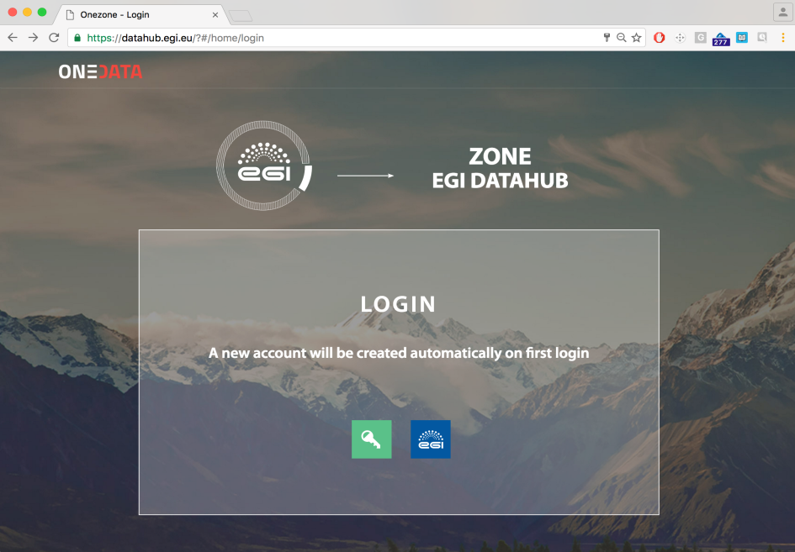
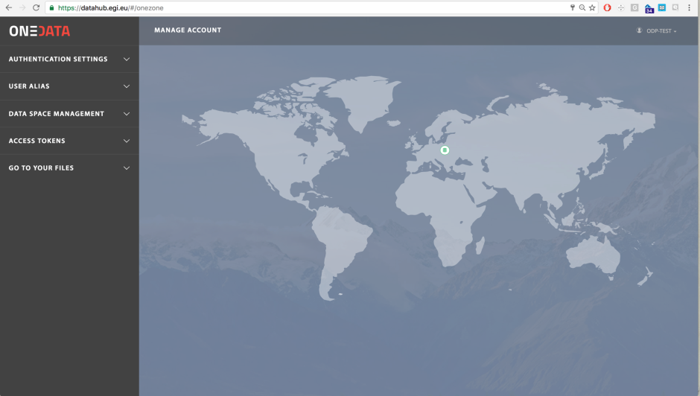
EGI DataHub (https://datahub.egi.eu)
A single point of entry for Open Data sets managed on FedCloud
EGI DataHub provides access to reference scientific data of public interest
Provides integration with EGI AppDB service for automatic open data set computation
Notes:
Not in the orig. DoA, but we decided it would be a useful output of this task.
A prototype EGI Data as a Service – EGI DataHub for federating open data

Slide 12
EGI Federated Data Gateway
Means for exposing user data to computing
Enabling technology for storage to be exposed to users
Means for storage providers to easily expose storage to users/VOs
Notes:
Also same tech allows fed data managing of user data and brining it to computing.

Slide 13
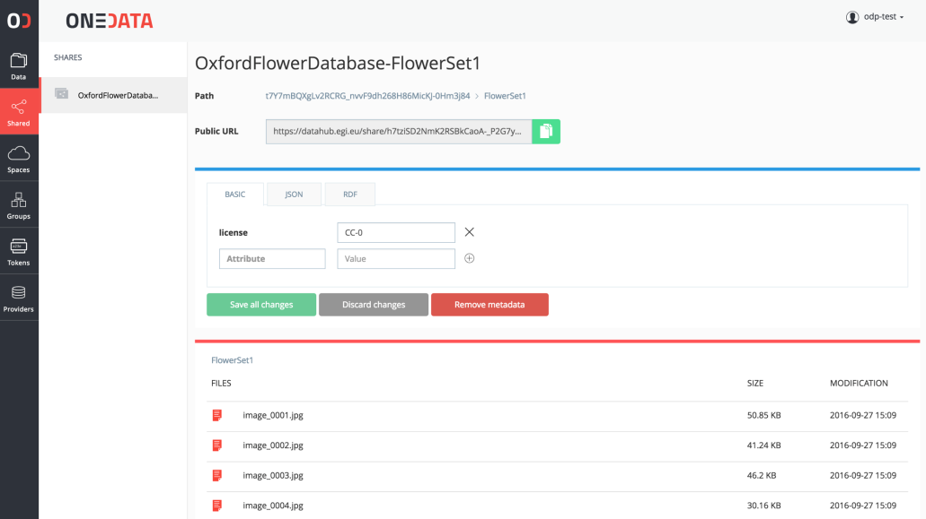
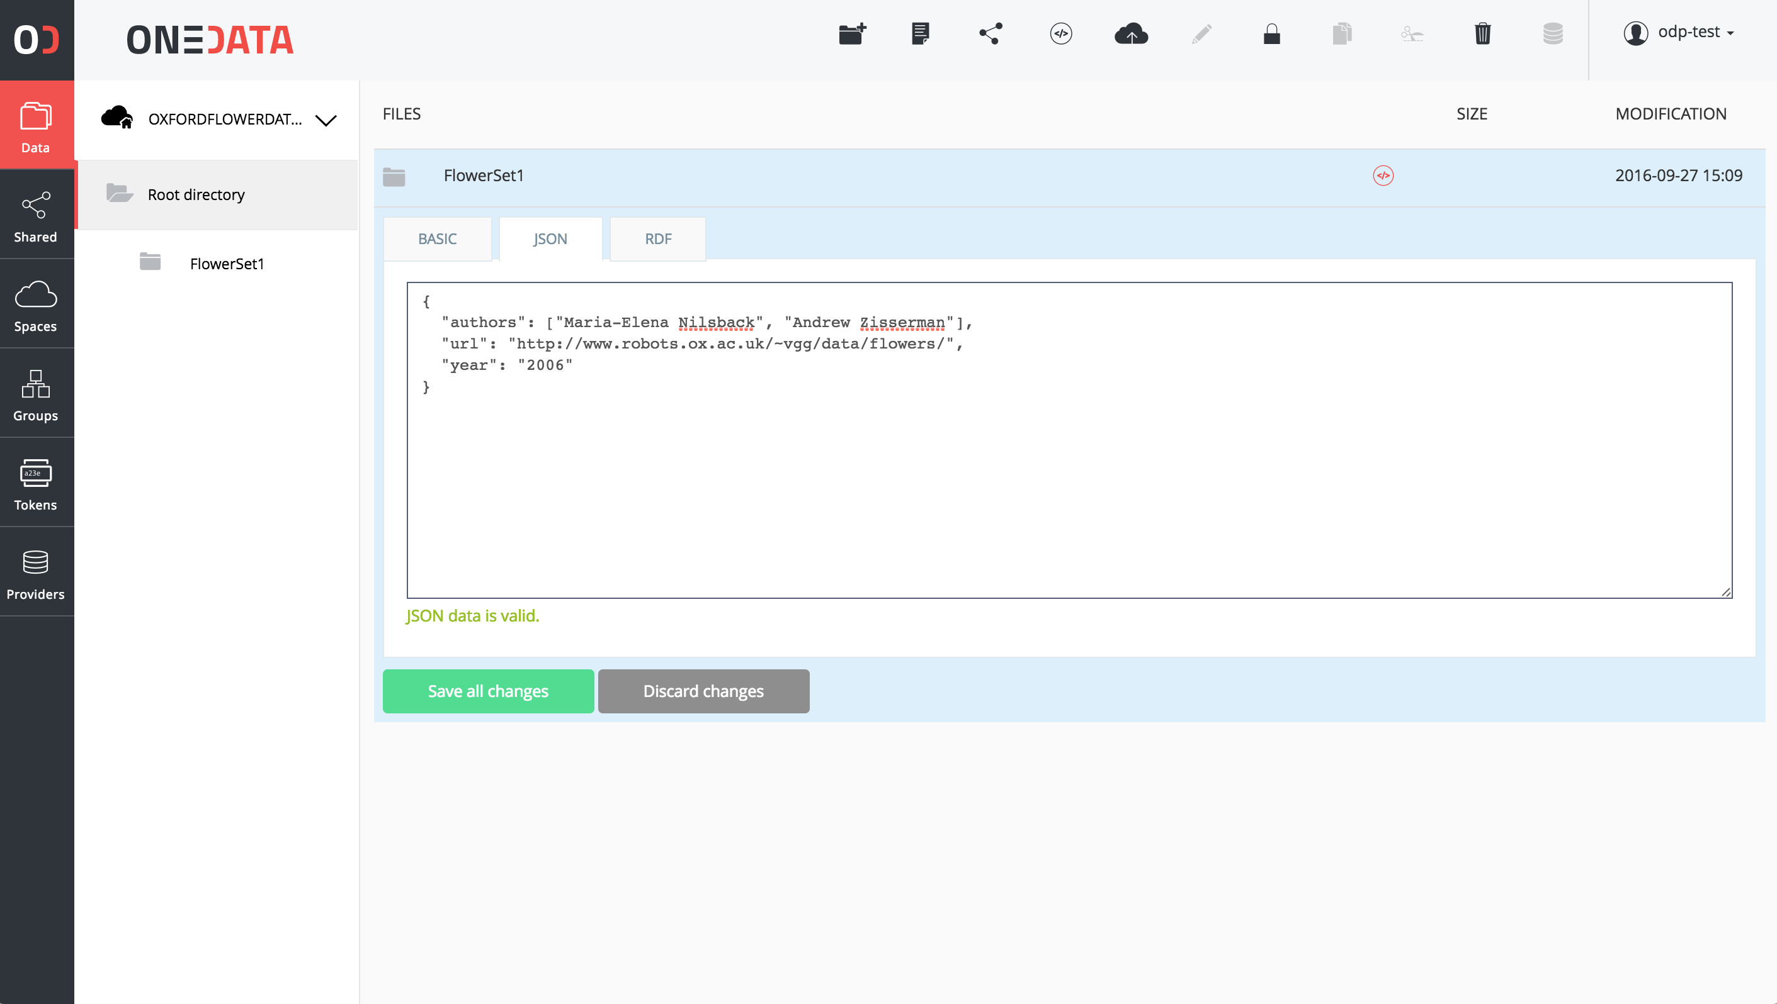
Advanced metadata support
Metadata can be attached to resources (files, folders) in simple key-value form, JSON or RDF
Users can define custom indexes over the metadata in order to filter their data collections
Metadata can be used for Open Data collections when published
Notes:
conforming to ANY schema deemed useful to users.
Annotations. Provenance. etc.
maybe Dublin Core schema.

Slide 14
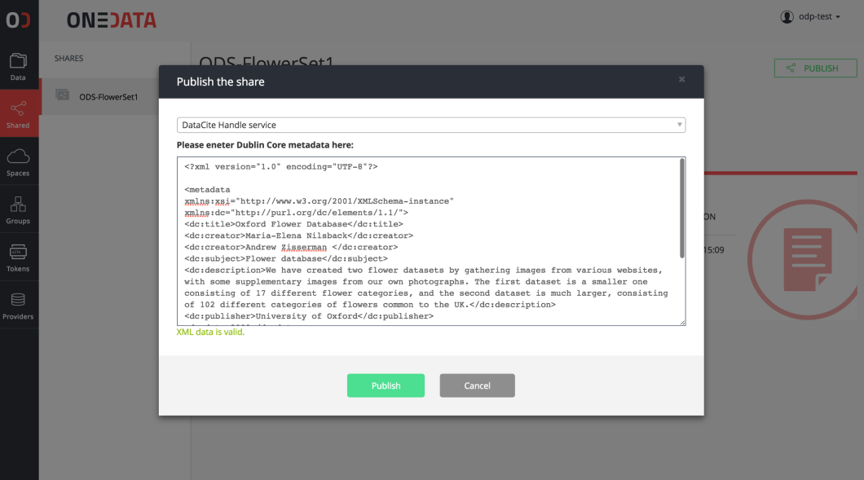
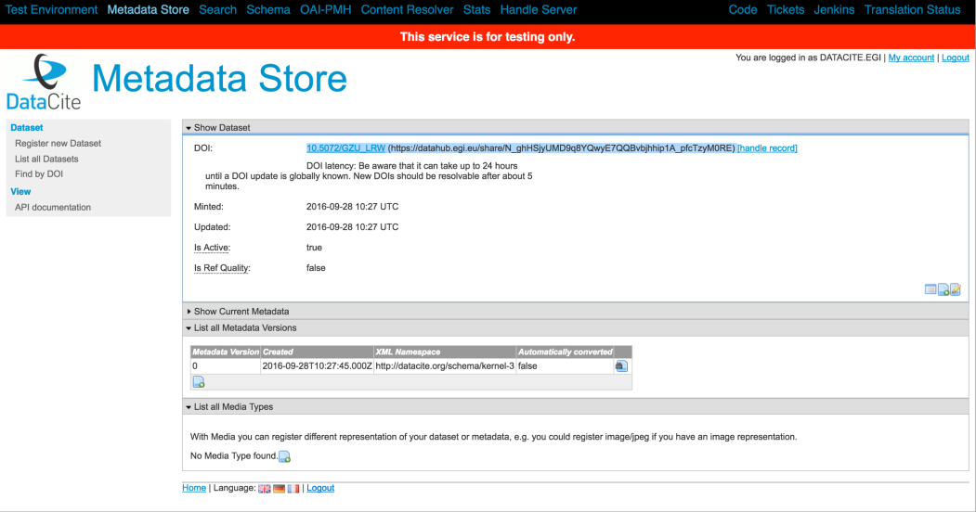
DOI registration
ODP supports Handle system-based identifier services (e.g. DOI and PID)
Any user can register such service, provided they have a valid account with the registrar
Each file or collection can be accessed directly using DOI identifier
Notes:
Tested with the testing instance of DataCite, provider of DOIs.
Update layout (use different one to make sure you have no overlapping EGI logo

Slide 15
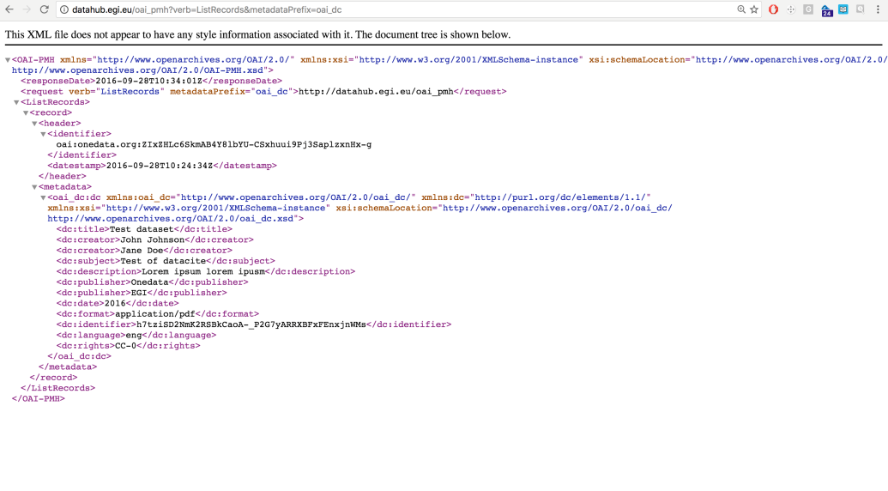
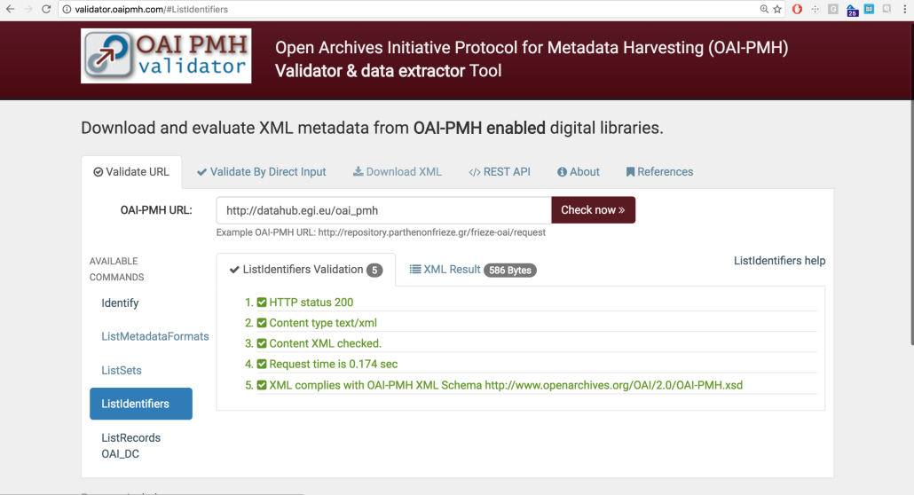
OAI-PMH interface
ODP supports full OAI-PMH Data Provider protocol
By default ODP will expose all metadata of shares which have been made publicly available
Currently Dublin Core is supported for record metadata but can be extended in the future
Notes:
OAI PMH (Open Archives Initiative Protocol for Metadata Harvesting) was developed as part of this task.
low level mechanism for exposing the records and content of a repository. Can be used for repo interoperability
demoed at DI4R – dataset created with metadata. Assigned DOI & metadata explosed through OAI-PMH

Slide 16
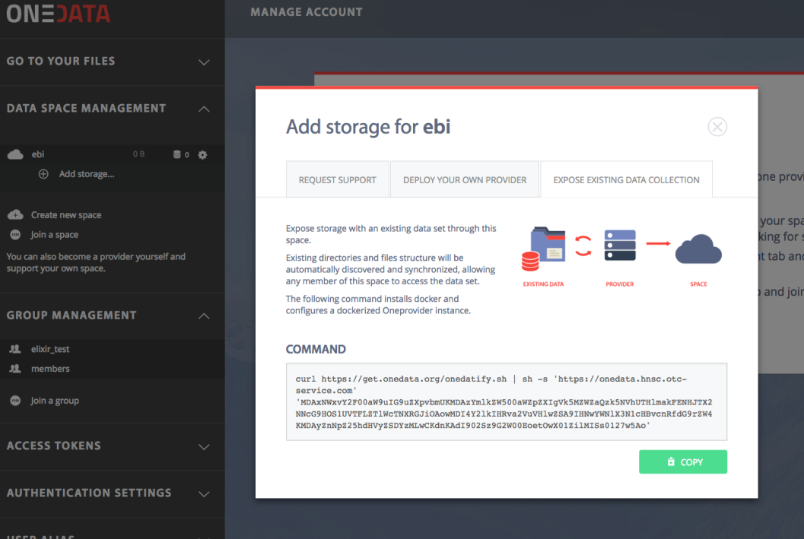
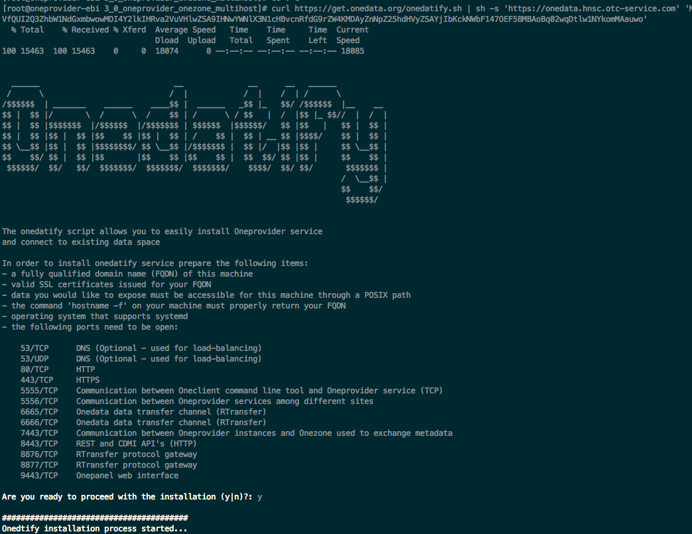
Onedatify – legacy data access
Open Data Platform enables seamless exposing of existing datasets directly from legacy storage
Easy to use script automatically installs and configures Oneprovider service, and connects it to EGI DataHub
Notes:
e.g. for PanCancer 60TB indexed and made available for EGI DataHub
Developed as part of Engage

Slide 17
Preparation for production and the future
Integration with EGI monitoring infrastructure
Usecases successfully completed advanced testing of Onedata (Earth Observation PoC)
Independent audit of documentation and security within INDIGO-DataCloud
Completed INDIGO Staged Rollout, will be added to the EGI repositories
EGI ODP/Onedata will be further developed as part of:
XDC, Xtreme Data Cloud (from Nov ’17)
EOSC-hub (from Jan ‘18)

Slide 18
Task JRA2.2
Federated Cloud

Slide 19
JRA2.2 Federated Cloud Aim
Improve user experience
Develop new required functionality
Develop improved tools
Promoting EGI Federated Cloud adoption
Notes:
Improve user experience
AppDB VMops Dashboard
Develop new required functionality
VM snapshotting, resource modification
Develop improved tools
Cloudkeeper, cloud-info-provider, AAI in OpenStack

Slide 20
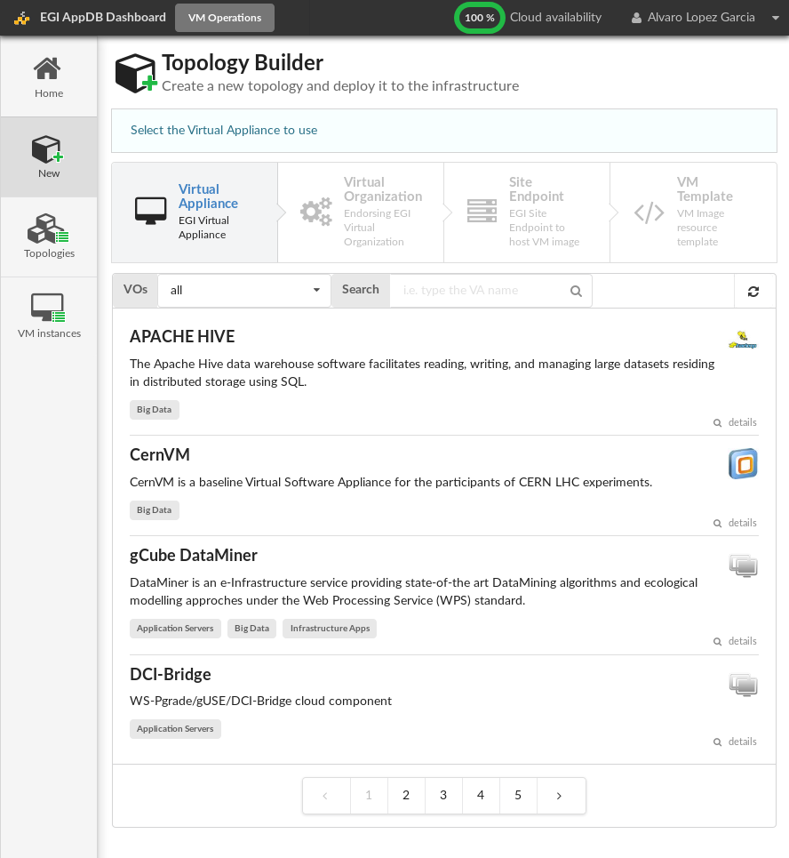
AppDB VMOps Dashboard
Web interface to deploy different topologies in the EGI Federated Cloud
Based on the VMIs registered in the AppDB
Control of the complete topology life-cycle
Infrastructure Manager (IM) as a backend
http://go.egi.eu/indigodemo - for a demo from EGI/INDIGO-DataCloud, from 1:32 to 3:39
Notes:
Very significant output of this task – completely new way of GUI-only way of interacting with the FedCloud
been used in FedCloud trainings
and from new users (e.g. from EOSCpilot) – good feedback

Slide 21
OCCI Improvements
Development and inclusion of VM snapshotting and VM resize support into new OCCI 1.2 standard
Requested by EGI user communities
New implementation: OOI
Initially targeted to OpenStack
New architecture to ensure compatibility across CMF releases
Now adopted by Synnefo (same codebase)
OCCI 1.2 support implemented in OOI and rOCCI
Notes:
HIGHLIGHTS of development…
OCCI is the Open Cloud Computing Interface
a low level protocol and API for VM management tasks, independent of cloud management implementations (e.g. OS, ON)
enables interop. of tools: e.g. for deployment, scaling, monitoring

Slide 22
VM Image synchronization tools
VM Image synchronization
availability, propagation of updates/bugfixes
New product developed: CloudKeeper
New design and architecture
Decoupled different actions in separated components: VMI download, transformation, upload
One single tool performing CMF-agnostic actions, per-CMF plugins to upload images
Agreement on new metadata published at the AppDB and propagated via CloudKeeper

Slide 23
Information System
Refactored to use a template language and engine
Same tool with different renderings
e.g. JSON rendering for INDIGO-DataCloud
Complete GLUE 2.1 draft into cloud-info-provider
Comments sent to OGF GLUE-WG
Approval of standard by end of year (expected)

Slide 24
Task JRA2.3
e-Infrastructures Integration

Slide 25
JRA2.3 e-Infrastructures Integration Aim
Improved service to users, regardless of their e-Infrastructure
Enabling of cross e-Infrastructure technical interoperability
Future proofing via alignment of standards
In scope: EGI-EUDAT, iMarine/D4Science, CANFAR

Slide 26
EGI-EUDAT integration use cases
First use case ‘universal’ use case:
VM instantiated on the EGI cloud federation for the interacting with EUDAT resources (B2STAGE, B2SAFE)
Requirement driven use cases:
Call for cross-infrastructure case-studies in PM15 for driving developments selected ICOS and EPOS use cases
ENES use case started on May 2017 after contacts during EGI Conference
Building on the universal use

Slide 27
gCube/D4Science integration
D4Science FedCloud Connector
Relies on jOCCI SDK
Using EGI VOMS authentication
VA on AppDB
Able to spawn VMs on demand to execute computational models
Notes:
d4science is a generic virtual research environment providing common services to ranges of earth scientists: computing, data
Bult on gCube open source sw

Slide 28
gCube/D4Science exploitation
SLA establishment (Nov 2016)
5 resource providers (CESGA, GeoGrid, IISAS, INFN-BARI, UPV-GRyCAP)
Testing of the integration (Nov 2016 – Apr 2017)
Solved issues with networking configuration
Tested reliability and availability of sites
Production (since May 2017)
Users of the VREs now using EGI Federated Cloud as a platform for the execution of their models
Notes:
now requesting more resources that we are in discussions about

Slide 29
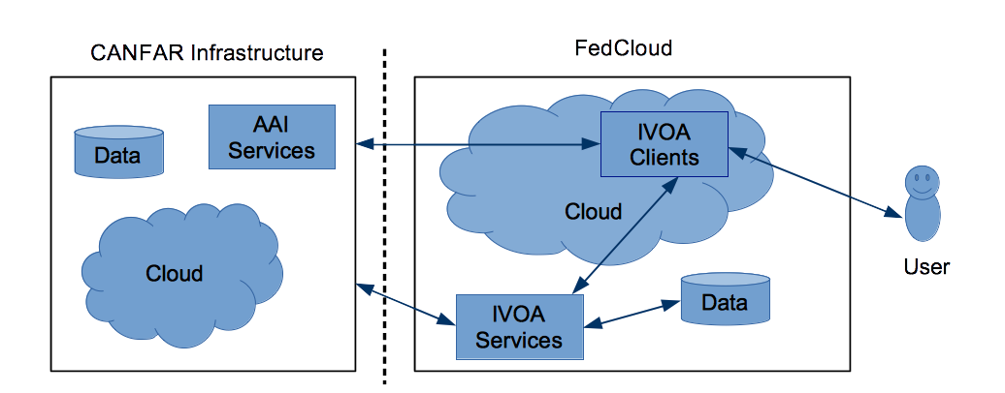
CANFAR interoperability
CANFAR – Canadian Advanced Network for Astronomy Research
Work to enable European astronomers to access and exploit CANFAR data via the EGI FedCloud
CANFAR software stack modified and deployed at INAF-OAT, usable by FedCloud users
Notes:
CANFAR is the Canadian Advanced Network for Astronomy Research, a community platform for astronomy based on IVOA standards running on Compute Canada resources
Offers data access to astronomical data (archives and catalogues), Access control (GMS), user storage (VOSpace), cloud processing integrated with telescope data collections (OpenStack)
In 2014, > 7,000 users, > 1 PiB of data handled

Slide 30
CANFAR interoperability - ongoing work
Full EGI Check-in - CADC Access Control components (X509 currently used)
Improving data movement between infrastructures
Better user and developer guides

Slide 31
Task JRA2.4
Accelerated Computing

Slide 32
JRA2.4 Accelerated Computing Aim
Making GPGPUs available through EGI services and facilitating their use
Notes:
Accelerated Computing – a way to utilize energy efficient and powerful High Performance Computing capabilities
GPGPU – General Purpose Graphics Processing Unit, originally developed for better graphics rendering (by offloading processing from the CPU to the graphics card) thanks to the demands of the gaming industry
Now very prevalent and a cost effective means of increasing processing power in hardware.
2 parts to this work – enabling GPGPUs for High Through Computing, HTC and GPGPUs for Cloud, we’ll deal with them separately here.

Slide 33
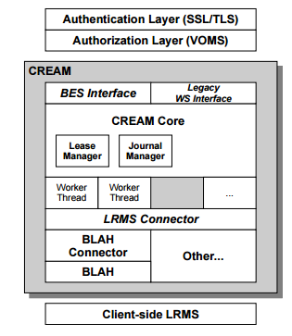
Accelerated computing in HTC
Starting from previous work of EGI Virtual Team (2012) and GPGPU Working Group (2013-2014)
CREAM-CE is the most popular grid interface (Computing Element) to a number of LRMSes (Torque, LSF, Slurm, SGE, HTCondor)
Most recent versions of these LRMSes do support natively GPUs (and MIC cards), i.e. servers hosting these cards can be selected by specifying LRMS directives
CREAM must be enabled to publish this information and support these
Notes:
Local Resource Mgmnt Systems (LRMS)

Slide 34
Work done
Identified the relevant GPU related parameters supported by the different LRMSes, and abstracted them to significant JDL attributes
Implemented the needed changes in CREAM Core and BLAH components
Extended the GLUE 2.1 schema draft with accelerator information
Wrote the info-providers according to extended GLUE 2.1 draft specifications
Testing and certification of the prototype
Releasing a CREAM update with full GPU/MIC support
Notes:
MICs – Many Integrated Cores, a new arch from Intel
BLAH (Batch Local Ascii Helper) – protocol to manage jobs on different Local Resource Mgmnt Systems (LRMS)
a minimal interface for job submission

Slide 35
Summary
The CREAM GPU-enabled prototype was tested at 5 sites
LRMSes: Torque, LSF, HTCondor, Slurm, and SGE LRMSes
3 new JDL attributes defined: GPUNumber, GPUModel, MICNumber
At 3 sites the prototype is run in “production”: QMUL and ARNES (Slurm) and CIRMMP (Torque/Maui)
New classes and attributes describing accelerators proposed and included in GLUE2.1 draft after discussion with the OGF WG
A major release of CREAM is ready
with GPU/MIC support for most LRMSes
with the GLUE2.1 draft prototype as information system
future official approval of GLUE 2.1 would occur after the specification is revised based on prototype lessons learned
with new Puppet module for the CE site with support for GPU/MIC and GLUE 2.1
its CentOS7 version will be included in the next UMD 4.6.0 scheduled at mid November 2017
Notes:
CIRMMP is fully dedicated to MoBrain/WeNMR/West-Life community (i.e. structural biology) via the enmr.eu VO, see also the full reports in EGI_Engage deliverables D6.7 (CIRMMP - metalloproteins and metalloenzymes research)
At QMUL their main user is icecube, they do simulations. (IceCube Neutrino Observatory, Antarctica)

Slide 36
Accelerated computing in Cloud
For using GPGPU in clouds, the GPGPU must be supported in all layers including virtualization, CMF and higher tools
Virtualization technologies used:
KVM with PCI passthrough
Widely used but with limitations
Container-based technologies
LXD with GPU is promising
But limited support in cloud middleware
Notes:
Rather than software development, this task is mainly:
advanced config of Cloud Mgmnt Frameworks
testing/benhmarking
documentation & ease of deployment
has led to GGPU enabled FedCloud sites in prod.
LXD - pure-container hypervisor – an advanced system container manager that uses containers rather than VMs. LOWER OVERHEAD

Slide 37
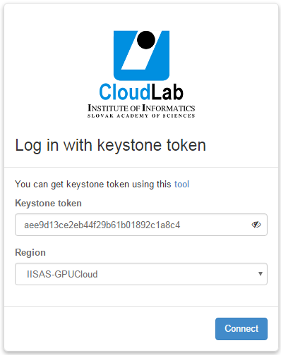
IISAS-GPUCloud site
Openstack GPGPU site at IISAS
Site is integrated into EGI Federated Cloud and in production
Access via command line or via the Openstack Horizon portal

Slide 38
Information system
GLUE 2.1 as starting point for Accelerator-aware info provider
For HTC:
New GLUE object, the Accelerator Environment, representing a set of homogeneous accelerator devices.
New attributes and associations for existing objects such as Computing Manager, Computing Share and Execution Environment.
For Cloud: Cloud Compute Virtual Accelerator
New entity, the Cloud Compute Virtual Accelerator
New attributes and associations for existing objects such as Cloud Compute Service
Notes:
other work related to GPGPU includes other services req for integration into the eInfra:
INFO SYSTEM – included in automatic discovery of resources

Slide 39
Accounting
For clouds, extended accounting records with new items for describing accelerators:
AcceleratorCount,
AcceleratorProcessors,
AcceleratorDuration,
AcceleratorWallDuration,
AcceleratorBenchmarkType,
AcceleratorBenchmark,
AcceleratorType
Modification of accounting tools for supporting new accelerator-related items

Slide 40
Docker support
For easy exploitation of accelerated computing
Chose a site with GPGPUs
Bring up a VM with a GPGPU-enabled flavour
Run docker
$>docker run --name=XXXXXX \
--device=/dev/nvidia0:/dev/nvidia0 \
--device=/dev/nvidia1:/dev/nvidia1 \
--device=/dev/nvidiactl:/dev/nvidiactl \
--device=/dev/nvidia-uvm:/dev/nvidia-uvm.
Works with udocker from INDIGO-Datacloud (used in production by MoBrain CC)
Notes:
for ease of usage.

Slide 41
Use of Resources and Issues
Notes:
Numbers will be provided by PO, work package leaders must provide explanation

Slide 42
Resource usage across WP
Task | Planned PM | Reported PM | Deviation
JRA2.1 | 45 | 56 | 125%
JRA2.2 | 63 | 77 | 122%
JRA2.3 | 35 | 38 | 108%
JRA2.4 | 19 | 19 | 100%
JRA2 | 162 | 190 | 117%
Moderate overspend in 3 tasks
Reasons:
Software development unforseen in DoA
Extra work unforseen in DoA (ODP services)

Slide 43
Primary overspending partners
Task | Partner | Planned | Reported |  | % | Reason
JRA2.1 | Agro-Know | 3 | 10.8 | +7.8 | 360% | Additional work done validating their testcase at the beginning of the project.
JRA2.2 | CSIC | 5.5 | 10.1 | +4.6 | 183% | Mistaken reporting of work that was actually done in WP6 and JRA2.3
JRA2.2 | CESNET | 25 | 28.3 | +3.3 | 113% | Cloudkeeper work that was unforseen
JRA2.2 | CESGA | 5 | 8 | +3.3 | 160% | VM image maintenance for local storage management
JRA2.1 | UPVLC | 1 | 3.5 | +2.5 | 349% | Additional work done validating their testcase at the beginning of the project.
JRA2.1 | CYFRONET | 36 | 38.5 | +2.5 | 107% | EGI DataHub setup and maintenance. Testing and supporting EOPoC. Not in DoA
JRA2.2 | UPVLC | 6 | 8.1 | +2.1 | 134% | Unforseen work done with the IM in the context of the AppDB VMOps dashboard

Slide 44
Summary
Notes:
Freedom on way to present

Slide 45
Summary
Objective 3 (O3): Offer and expand an e-Infrastructure Commons solution
Introduction of an Open Data Platform
Improve integration of FedCloud by developing improvements of different Cloud Middleware Frameworks
Integration with partner e-Infrastructures in Europe and worldwide
Objective 4 (O4): Open data platform and the European Big Data Value.
Prototype of EGI DataHub for sharing open data
Prototype of EGI Federated Data Gateway for federating user data
Tools for data publishing and importing of existing data
Objective 5 (O5): Promotion the adoption and extension of the current EGI services
Enhancement of OCCI with new extensions (snapshots of running VM and changing resources of running VMs)
Development of the AppDB VMOps Dashboard
Accelerated computing capability brought to production on the Fedcloud and a production ready prototype CREAM now ready for HTC
Notes:
Achievements grouped by objectives

Slide 46
Key exploitable results
KER name | Description
Software and services
Tools for federated service management | Technological innovation and new services in the area of Service Registry and Marketplace and resource allocation. Evolved EGI accounting system. Adapted operations tools to new technologies and to satisfy new requirements from service providers and user communities.
Open Data Platform | A platform designed to make data discoverable and available in an easy way across all EGI federated resources
Improved Federated Cloud Computing | Improved EGI federated Cloud platform with new IaaS capabilities; Integrated existing commercial and public IaaS Cloud deployments and e-Infrastructures with the current EGI production infrastructures
Notes:
All KERs have been met.
Adapted operations tools to new technologies and to satisfy new requirements from service providers and user communities. – ODP, cloudkeeper, appdb vmops dashboard, occi (but isn’t this already covered by WP3???)

