Slide 1
Introduction to D4Science
Massimiliano Assante
ISTI - CNR
Massimiliano.assante@cnr.it

Slide 2
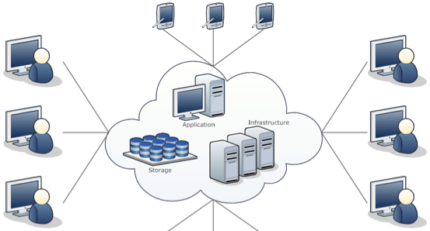
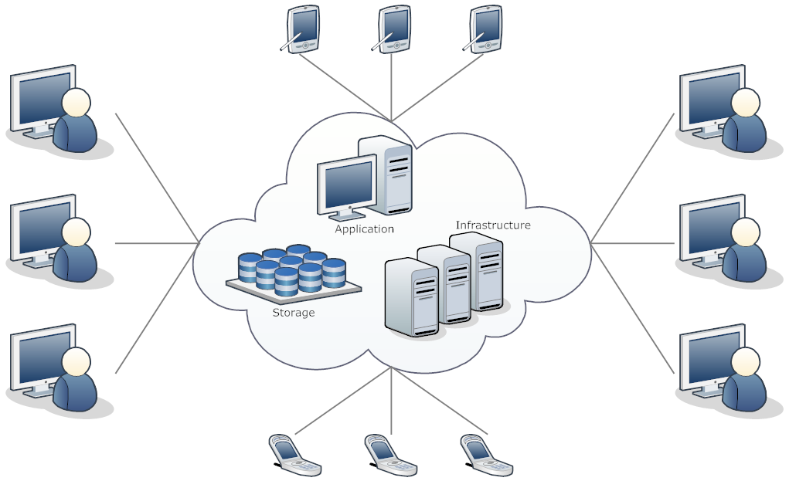
The D4Science infrastructure
Data Infrastructure combining over 500 software components into a coherent and centrally managed system of hardware, software, and data resources

Slide 3
D4Science Identity
D4Science is
connecting +3900 scientists in 44 countries
integrating data from +50 heterogeneous providers
executing +50,000 models & algorithms/month
providing access to over a billion quality records in repositories worldwide
operating with 99,7% service availability
D4Science hosts 95 Virtual Research Environments to serve the biological, ecological, environmental, social mining, culture heritage, and statistical communities world-wide.

Slide 4
D4Science for Geeks
uses cloud-computing technologies to manage +300 servers (more than 5 TB Ram, +1700 CPUs, 400 TB storage)
is monitored via Nagios and Ganglia
is maintained via Ansible (Application Deployment + Configuration Management + Continuous Delivery)
is governed by deployment and operation policies
has established SLA
is operated according to defined Terms of Use

Slide 5
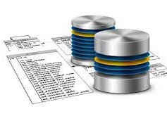
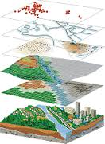
Storage as Service
to host and maintain data
Database
High-availability
Standard
Ready-to-use
Cloud Storage
Scalable
Reliable
Secure
Geographical DB
Scalable
OGC Standard
Privacy and Attribution

Slide 6
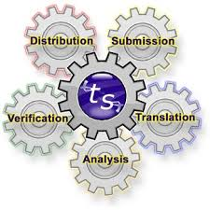
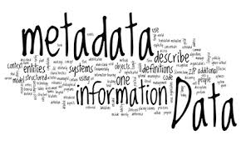
Applications as a Service
to curate and manage data
Metadata Generation
Geospatial Data
Biodiversity Data
Statistical Data
Textual Data
Harmonization
Disambiguate
Validate
Integrate and Consistency Check
Data Exchange
OGC protocols
DarwinCore
SDMX
DublinCore

Slide 7
Computing as Service
to process and extract knowledge
Scalable
Easy to Manage
Across Boundaries
Tailored
Elastic
Assignment of Computing
Assignment of Processors
Virtual Research Environment
Rich and Heterogeneous
High Throughput
Map-Reduce
Parallel R

Slide 8
Born from the user needs
to host applications in a secure and scalable environment
to maintain and preserve data
to securely delivery data to known users
Capacities
to analyze datasets
to manage the full data life-cycle from import to validation, curation, harmonization and publication
to reduce the costs of data maintenance
Applications
to access authoritative datasets
to mash-up data
to analyse big datasets
to validate datasets and provide a standard access to them
Data

Slide 9
Virtual Research Environment
to access, share and collaborate
Share
Database Tables
Workflow
Files
Communicate
Post
Favourite
Connection
Organize
Dynamic VRE Creation
Secure
Policy Control

Slide 10
Virtual Research Environment
a distributed and dynamically created environment
where subset of resources (data, services, computational, and storage resources)
regulated by tailored policies
are assigned to a subset of users via interfaces
for a limited timeframe
at little or no cost for the providers of the participatory data e-infrastructures
L. Candela, D. Castelli, P. Pagano (2013) Virtual Research Environments: An Overview and a Research Agenda. Data Science Journal, Vol. 12

Slide 11
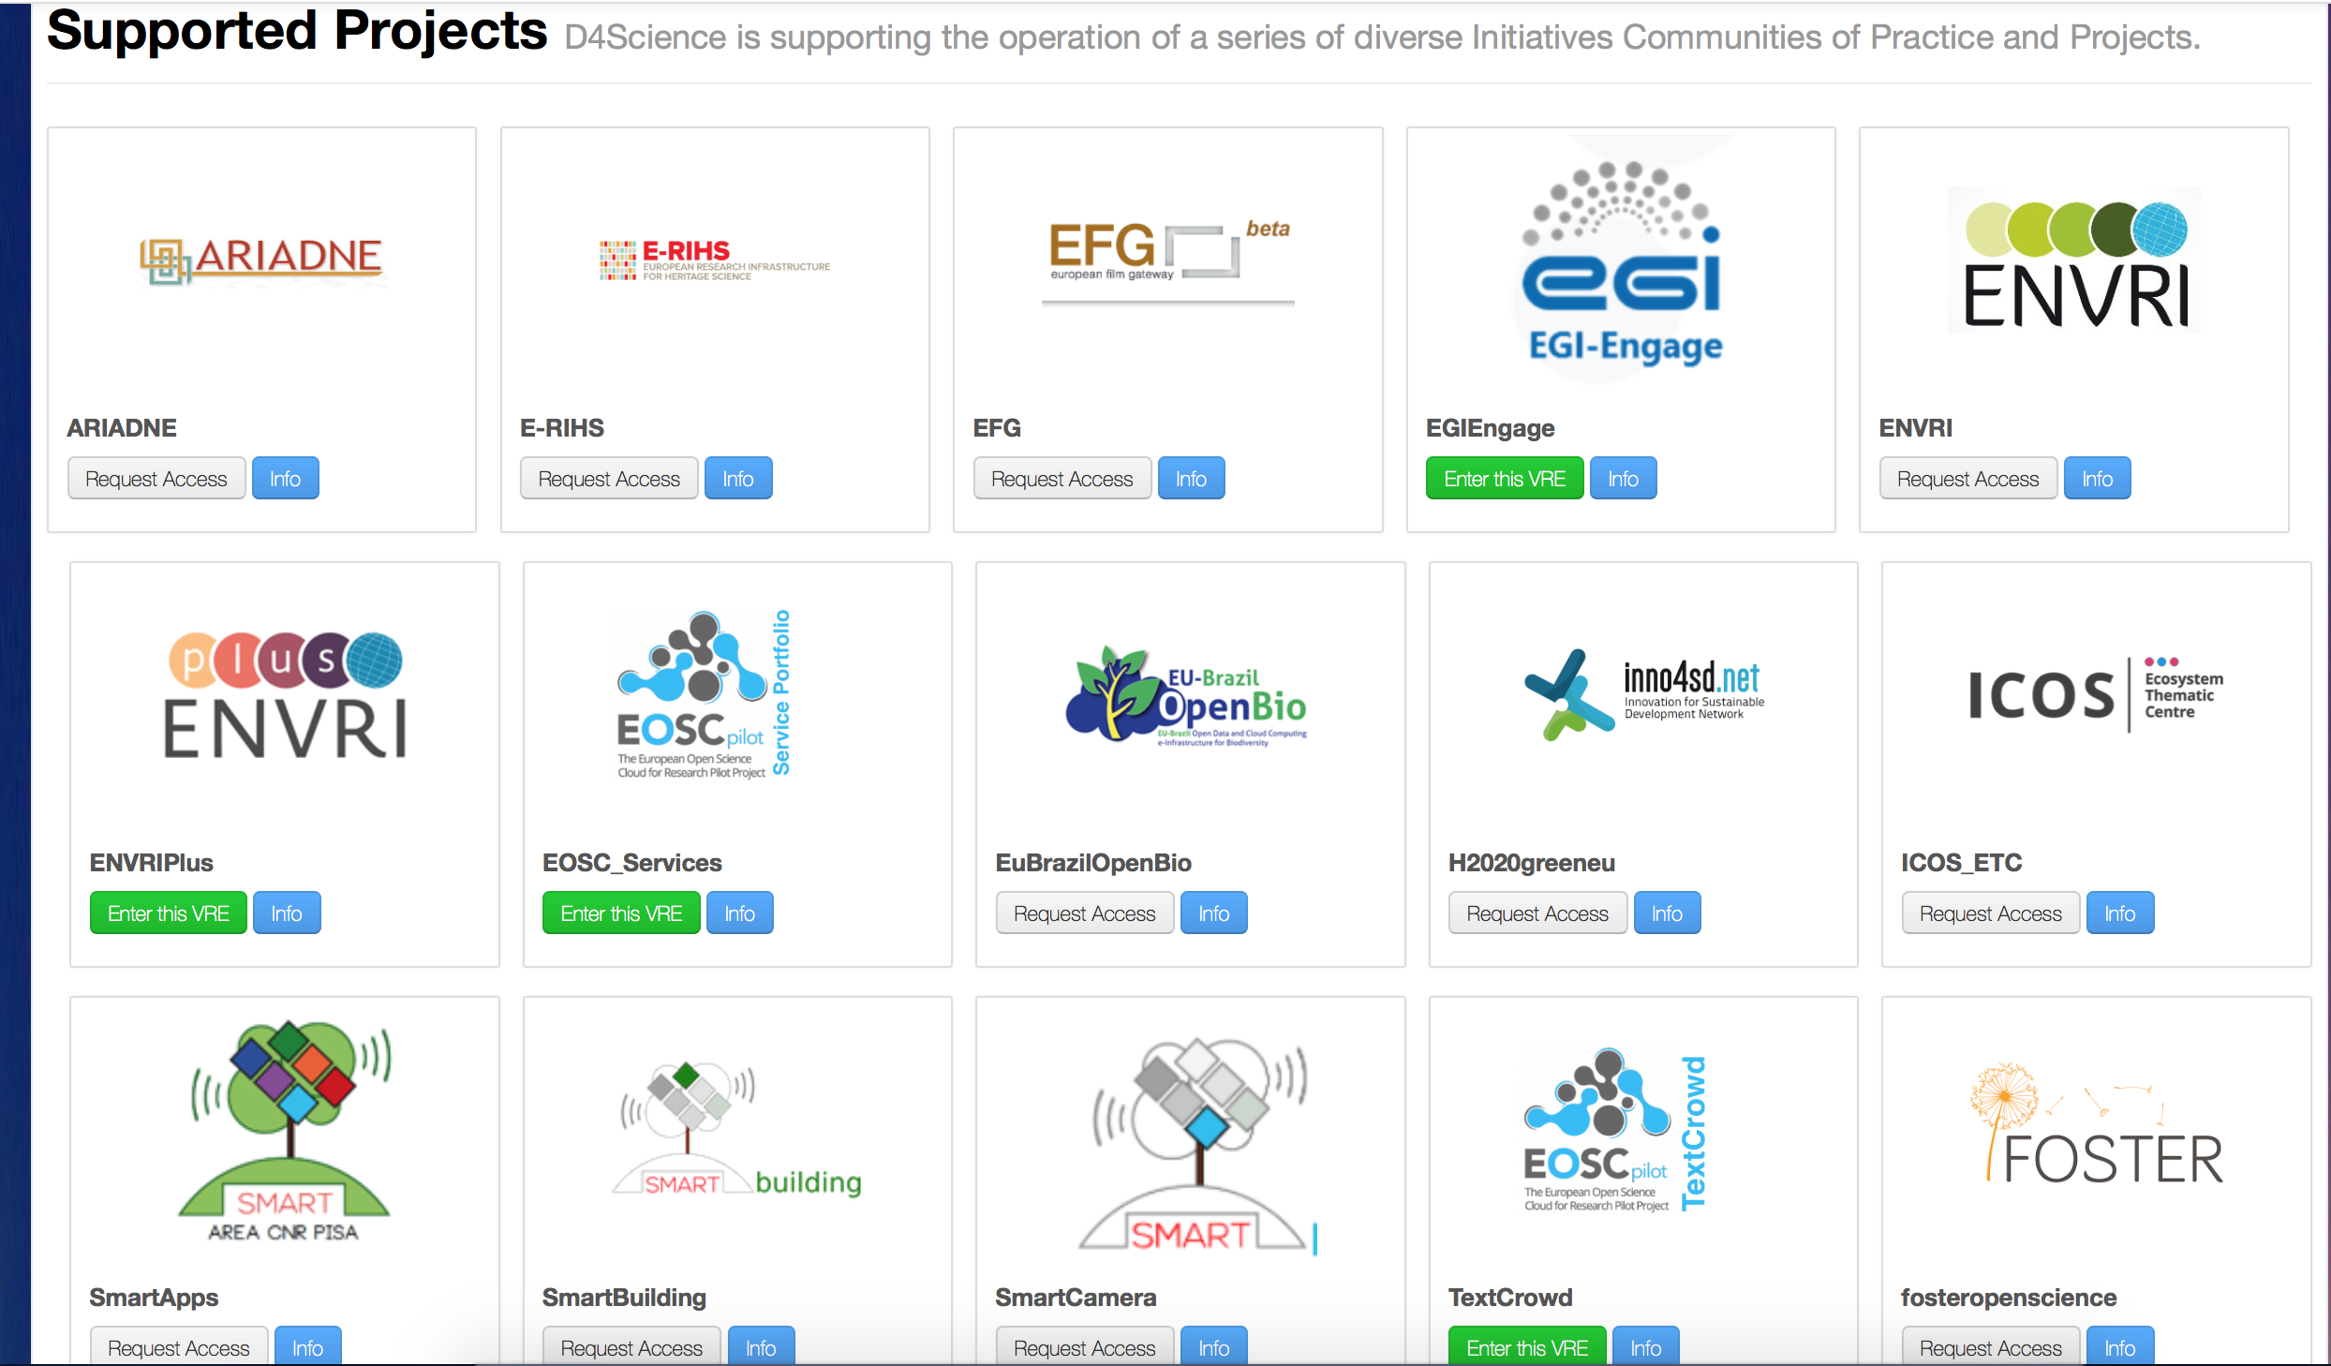
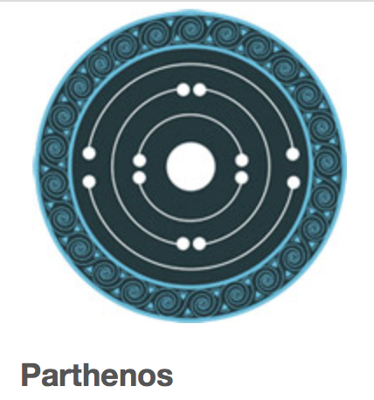
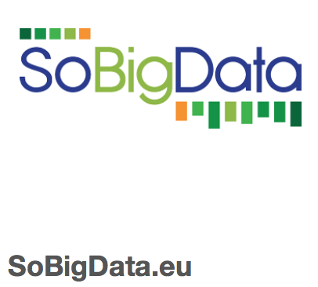
Supported projects – full list at https://services.d4science.org/explore

Slide 12
References / Links
D4Science Web Site: http://www.d4science.org
D4Science for developers: http://dev.d4science.org
Catalogue of Applications
https://www.gcube-system.org/catalogue-of-applications
Software Key Features
https://wiki.gcube-system.org/GCube_Features
Developer Guide
https://wiki.gcube-system.org/Developer%27s_Guide
FeatherWeightStack
https://wiki.gcube-system.org/Featherweight_Stack
SmartGears
https://wiki.gcube-system.org/SmartGears
gCube APIs
https://wiki.gcube-system.org/GCube_Application_Programming_Interface
Administration Guide
https://wiki.gcube-system.org/Administrator%27s_Guide

