Slide 1
Open Research Cloud
Identity Working GROUP
Nicolas Liampotis / GRNET, AARC
Second International Open Research Cloud Congress
September 27-29, 2017
Science Park, Amsterdam, NL

Slide 2
Outline
ORC-IWG – What is it?
Common requirements
Remaining challenges (technical and policy-releated)
Cloud-specific challenges
Why and how to federate

Slide 3
Identity Working Group for the Open Research Cloud (ORC-IWG) - Introduction
Established to discuss the challenges for federating a distributed open cloud for researchers and scientists internationally, focusing on:
Identity Provisioning
Authentication
Authorisation
Ultimate goal: Reach consensus on the principles that the community is prepared to follow and support for enabling international scientific research computing, leveraging both academic and commercial cloud infrastructure
Notes:
The Identity Working Group for the Open Research Cloud (ORC-IWG) was established in order to discuss the challenges for federating a distributed open cloud for researchers and scientists internationally, focusing on the areas of Identity Provisioning, Authentication and Authorisation. Ultimately, the goal is to reach consensus on the principles that the community is prepared to follow and support for enabling international scientific research computing, leveraging both academic and commercial cloud infrastructure.

Slide 4
Requirements for federated identity and access management – Related work
TERENA AAA Study → https://www.terena.org/publications/files/2012-AAA-Study-report-final.pdf
FIMR4 paper → https://cdsweb.cern.ch/record/1442597/files/CERN-OPEN-2012-006.pdf
AARC Analysis of user community and service provider requirements → https://aarc-project.eu/wp-content/uploads/2015/10/AARC-DJRA1.1.pdf
FIM4R v2.0 → coming soon in a theater near you…
Notes:
Several initiatives, including the AARC project, have explored the requirements for federated identity and access management. The set of common requirements that follows is based on the requirements analysis by AARC which collected input from a multitude of external sources, including previous activities such as the “TERENA AAA Study” and the documents produced by FIM4R (which will soon produce a v2.0 of the requirements)

Slide 5
Common requirements for federated identity and access management
Open and standards-based technologies
End-user & Service Provider friendliness
Guest/homeless users
Social media & eGov identities
Levels of Assurance
Community-­based authorisation
Attribute aggregation
Notes:
Open and standards-based technologies - build on open and standards-­based AAI technologies to allow for interoperability (by means of appropriate translation services when necessary) and deployment on existing identity inter-federation efforts such as eduGAIN
End-user & Service Provider friendliness - provide simple and intuitive tools that are able to address the needs of users with different levels of ICT literacy and enable more Service Providers (commercial and non-­commercial) to connect
Guest/homeless users - support users without a federated institutional IdP, such as citizen scientists and researchers without formal association to research laboratories or universities
Social media & eGov identities - support common social media identity providers (e.g. Google, Facebook), but also researcher ID providers, such as ORCID, to act as authentication providers and/or attribute authorities & support broader cross-domain collaboration including e-Government infrastructures
Levels of Assurance - support different levels of assurance for credentials issued under different policies and procedures
Community-­based authorisation - enable communities to manage the assignment of attributes to their members for authorisation purposes
Attribute aggregation - support the aggregation of identity attributes originating from different sources of authority, including federated IdPs and community-based attribute authorities

Slide 6
Common requirements for federated identity and access management (II)
Persistent unique user identifiers
User-managed identity information
Step-up & Multi-Factor Authentication
Non-web-browser based access
Credential delegation
Attribute release (see REFEDS R&S)
Federated incident report handling (see REFEDS Sirtfi)
Notes:
Persistent unique user identifiers - reference the digital identities of users through long-­lasting unique identifiers
User-managed identity information - enable users to self-­manage some of their attributes; depending on the attribute type, update restrictions should be imposed; support right to erasure
Step-up & Multi-Factor Authentication - provide an additional factor or procedure that validates a user’s identity for high-risk transactions or according to policy rules
Non-web-browser based access - provide federated access to both web-browser-based and non-web-browser-based services, such as CLI tools and APIs
Credential delegation - allow users to delegate third parties, mostly computational tasks or services, to act on their behalf, without the need for interactive access
Attribute release - Support flexible negotiation mechanisms for governing the release of identity attributes; define a set of commonly supported and consumed attributes, which allow for effective use of services and represent a privacy baseline such that further minimisation achieves no particular benefit (see REFEDS Research and Scholarship Entity Category - R&S)
Federated incident report handling - adopt common procedure for reporting and handling security incidents that involve federations spreading across multiple administrative domains (see REFEDS Security Incident Response Trust Framework for Federated Identity - Sirtfi)

Slide 7
Remaining technical challenges
Authorisation in multi-provider environments
Access to non-­web-browser-based services
Delegation capabilities
User friendliness
Integration with cross-sector AAIs (social & eGov)
Notes:
There are functional aspects that have yet to be addressed, such as:
authorisation in multi-provider environments
access to non-­web-browser-based services
delegation capabilities
user friendliness
integration with cross-sector AAIs (social & eGov)

Slide 8
Remaining policy challenges
Data privacy and protection
Incident response handling
Acceptable use policy alignment
Notes:
In addition to addressing technical aspects, integration of AAIs requires significant efforts to define a common policy framework covering the necessary legal and operational practices for all entities involved in the AAI ecosystem in areas such as the following:
Data Privacy and Protection
Incident Response handling
Acceptable use policy harmonisation

Slide 9
Specific challenges for enabling federated access to cloud services
Authorisation:
common model for collecting and aggregating attributes from multiple sources/authorities and exchanging attributes across communities and cloud providers
two dimensions of authorisation: access to data & compute resources
Proportion of users federated through identity federations / eduGAIN inter-federation
Proportion of cloud providers federated through identity federations / eduGAIN inter-federation
Commercial providers are treated inconsistently across federations (financially & policy wise)
Eligibility of commercial cloud providers for the R&S entity category ?
End-to-end (de)provisioning of users across security domains
Management/revocation mechanisms for tokens enabling access to CLI tools and APIs
Notes:
Authorisation aspects are particularly challenging:
common model for collecting and aggregating attributes from multiple sources/authorities and exchanging attributes across communities and cloud providers
two dimensions of authorisation:
access to data
access to compute resources
Proportion of users federated through identity federations / eduGAIN inter-federation
Proportion of cloud providers federated through identity federations / eduGAIN inter-federation
Commercial providers are treated inconsistently across federations (financially & policy wise)
The idea of a commonly supported set of attributes (R&S) seems to be largely accepted; however, are commercial cloud providers eligible for the R&S entity category which applies to Service Providers “that are operated for the purpose of supporting research and scholarship interaction, collaboration or management, at least in part”?
(De)Provisioning of users
Management/revocation mechanisms for tokens enabling access to CLI tools ans APIs

Slide 10
Why federated identity management?
Separate authentication from authorisation
Home institute handles identification
Community manages authorisation
Ease of use
Users don’t need to maintain multiple username/password credentials for accessing different resource provider; they need just one password, and they have to type it only once (single sign-on)
Collaboration
Allows distributed communities of users to access resources across infrastructures/resource providers

Slide 11
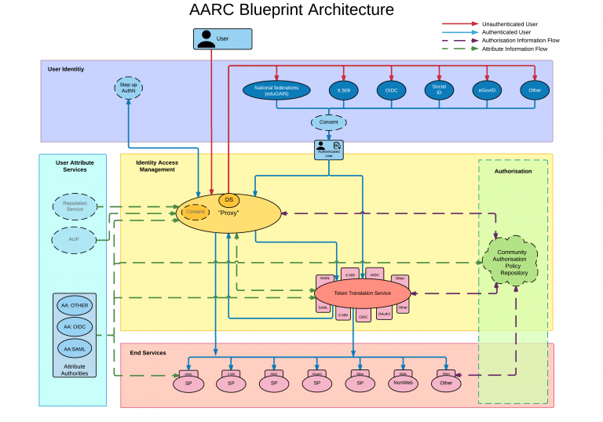
How to federate identity management?
Join eduGAIN as a service provider through a national federation
Use AARC Blueprint Architecture patterns
Credit to Hannah Short – CERN for this slide
Credit to Lukas Hämmerle – SWITCH/GÉANT for this graphic

Slide 12
Thank you
Any Questions?

