Slide 1
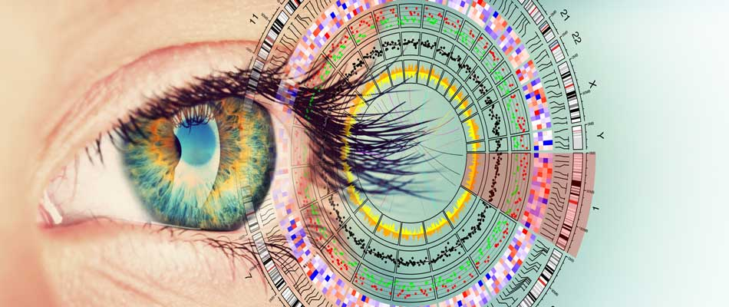

ELIXIR & Pan Cancer Use Case for Open Clouds
Steven Newhouse &Sergei Iakhnin
European Molecular Biology Laboratory (EMBL)

Slide 2
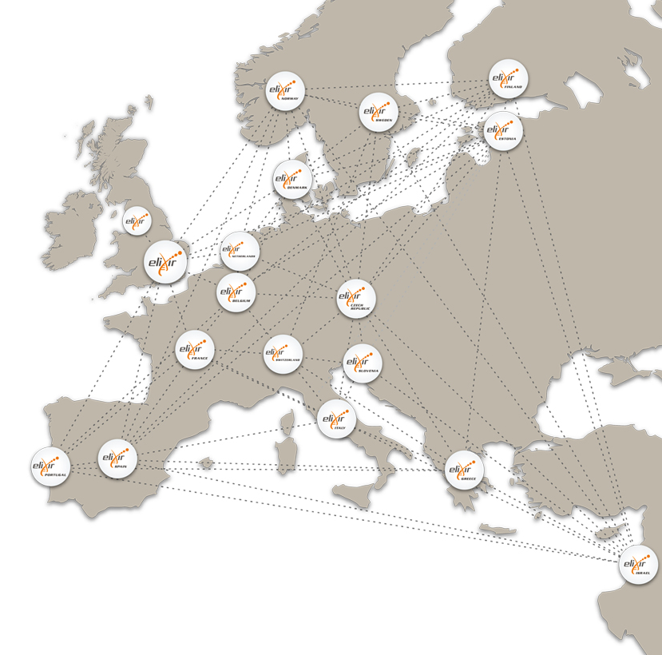
ELIXIR – Research Infrastructure for Life Science
Compute
  Access, Exchange & Compute on sensitive data
Data
  Sustain core data resources
Tools
  Services & connectors to drive access and exploitation
Standards
  Integration and interoperability of data and services.
Training
  Professional skills for managing and exploiting data
Notes:
Creating a robust infrastructure for biological information is a bigger task than any individual organisation or nation can take on alone
These are issues of such complexity that no single institution or country can tackle alone

Slide 3
AAI Architecture
Relying services
EGA
wiki
…
…
…
Cloud
Intranet
Data archive
ELIXIR AAI
Credential translation
Dataset authorisation management
ELIXIR Directory
Group/role management
ELIXIR Proxy IdP
Bona fide management
Attribute self-management
External authentication
(e-infrastructures)
eduGAIN IdPs
Common IdPs

Slide 4
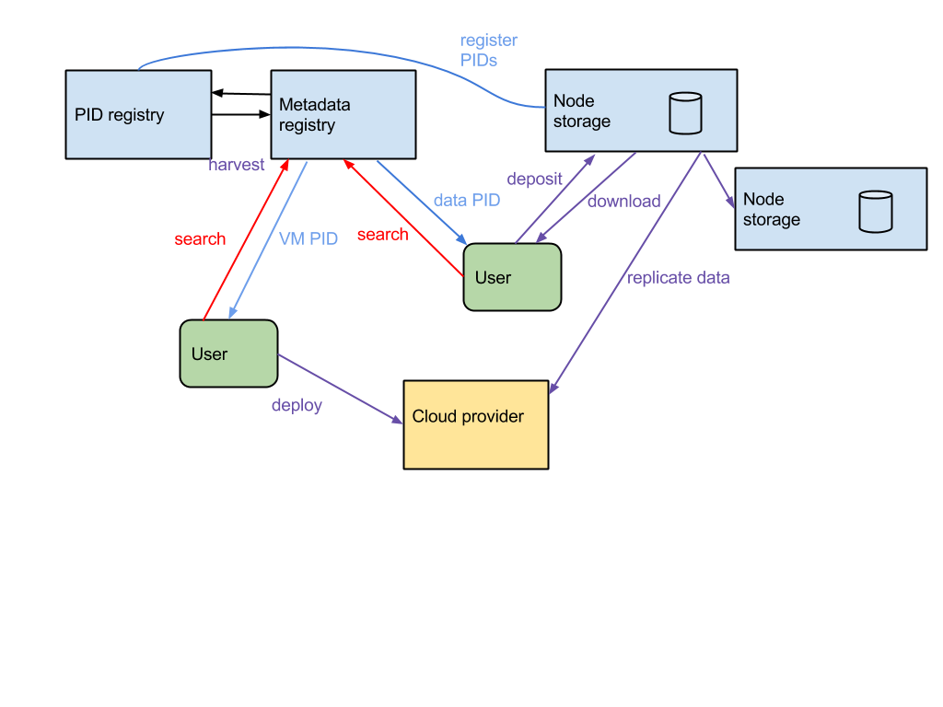
Storage Architecture

Slide 5
Cloud & Storage Architecture
Relying services
Portals
Workflow
Engines
ELIXIR
Metrics
Cloud IaaS
Cores
Storage
Service Registry
Authentication & Authorization
Storage
External (e-infrastructures)
Cloud IaaS
Cores
Storage
Storage
Data Transfer
Service Directory
Accounting
Software Library

Slide 6
ELIXIR Cloud Resources
Cloud Name | Country (Node) | # Users | # Compute Cores | # TB Storage | # TB RAM
COMPUTEROME | Denmark | 1200 | 16048 | 4000 | 92
EMBL-EBI Embassy Cloud | EMBL-EBI | 28 groups | 10000 | 4151 = Local Disk - 251, Cinder - 300TB, Object Store - 2500TB, NFS - 1100 | 43.5
ePouta + cPouta | Finland | 639 | 6384 | 2902 | 38,3
IFB-core Cloud | France |  | 200 (+HT) | 50
IFB-PRABI Cloud | France |  | 140 (+HT) | 200
DE.NBI CLOUD | Germany |  | 15000 | 5000
SCICORE | Switzerland | 500 | 7624 | 2800 | 37
VITAL-IT | Switzerland | 820 | 8600 | 5000

Slide 7
What we expect from Clouds
User: Discovery
  Understanding what is available and how to access
User: Consistency of interaction
  Ansible/Terraform/…
User: Integration
  Same experience across local, national, international, commercial
User: Expectation of scale
  We do big data & compute
Provider: Control as to who uses my resources
  A facilitator to collaboration, not an open door
Provider: Understanding how my community uses resources
  Accounting & usage control

Slide 8
Cloud Computing in bioinformatics
Increased data-set size
  1000 GP – 200 TB
  PCAWG – 750 TB
  ICGC – 1.2 PB
  HCA – ~50 PB
Availability of cloud computing environments
  AWS/GCP/Azure - global
  EMBL-EBI Embassy Cloud - UK
  Open Science Data Cloud - US
  de.NBI - Germany
  European Open Science Cloud – Europe
  DNANexus, Seven Bridges Genomics, etc.
Global community collaborating on analysis and methods
  Global Alliance for Genomics and Health
  Sharing best-practices and establishing standards (e.g. Docker)

Slide 9
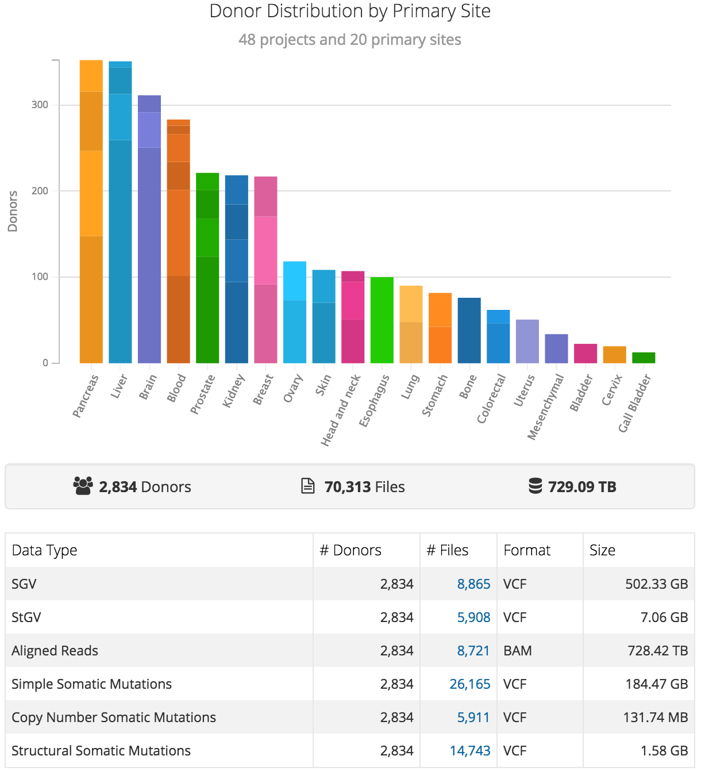

The Pan-Cancer Analysis of Whole Genomes Project (PCAWG)
The International Cancer Genome Consortium (ICGC)
Stein, Knoppers, Campbell, Getz & Korbel, Nature 2015
https://dcc.icgc.org/pcawg

Slide 10
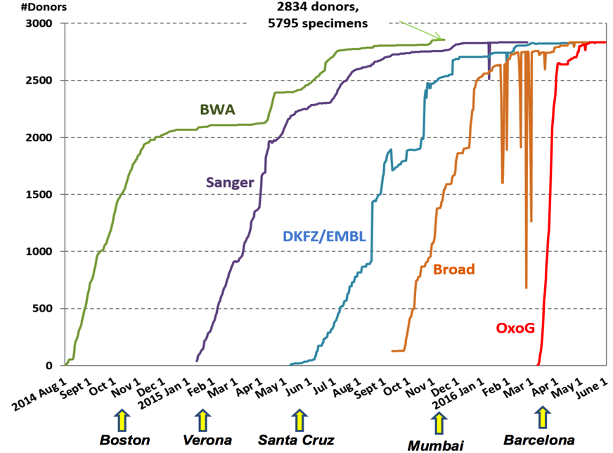
PCAWG Data Processing Timeline
Pipeline | Potential Time Savings
BWA | 10 months
Sanger | 8 months
DKFZ/EMBL | 5 months
Broad | 5 months
OxoG | 2 months
Large-Scale Uniform Analysis of Cancer Whole Genomes in Multiple Computing Environments, C. Yung et al, 2017

Slide 11
Requirements for scientific computing on the cloud
Provisioning
Configuration Management
Workflow
Operations Management
Manage infrastructure
Cloud-agnostic
Health metrics
Troubleshooting
Highly distributed
System-of-record

Slide 12


https://github.com/llevar/butler
Butler
Enabling rapid cloud-based analysis of thousands of human genomes via Butler, S. Yakneen et al, 2017 - https://doi.org/10.1101/185736

Slide 13
Butler Framework

Slide 14
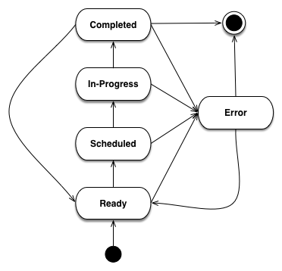
Analysis State Tracking

Slide 15
Configuration Management

Slide 16
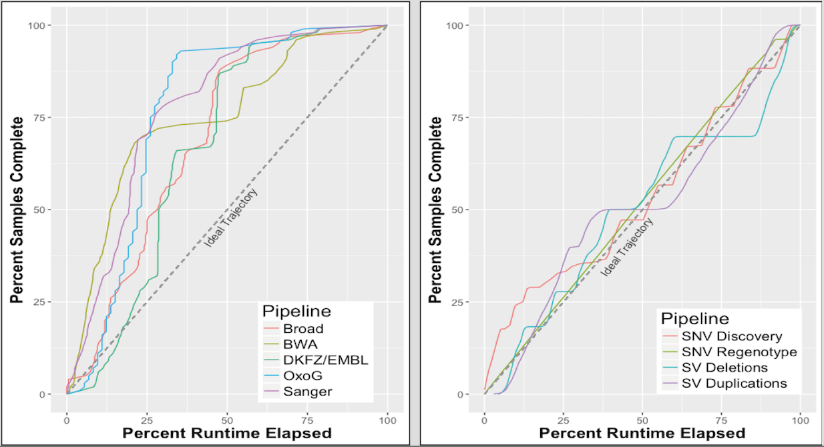
Butler usage in PCAWG on Embassy Cloud – 2015-2016
  1500 cores, 5.5 TB RAM, 750 TB primary NFS storage, 50 TB scratch storage.
  Germline variant detection and genotyping of 100M variants across PCAWG cohort of 2834 whole-genome-sequence T/N sample pairs – 6 passes through 750 TB.

Slide 17
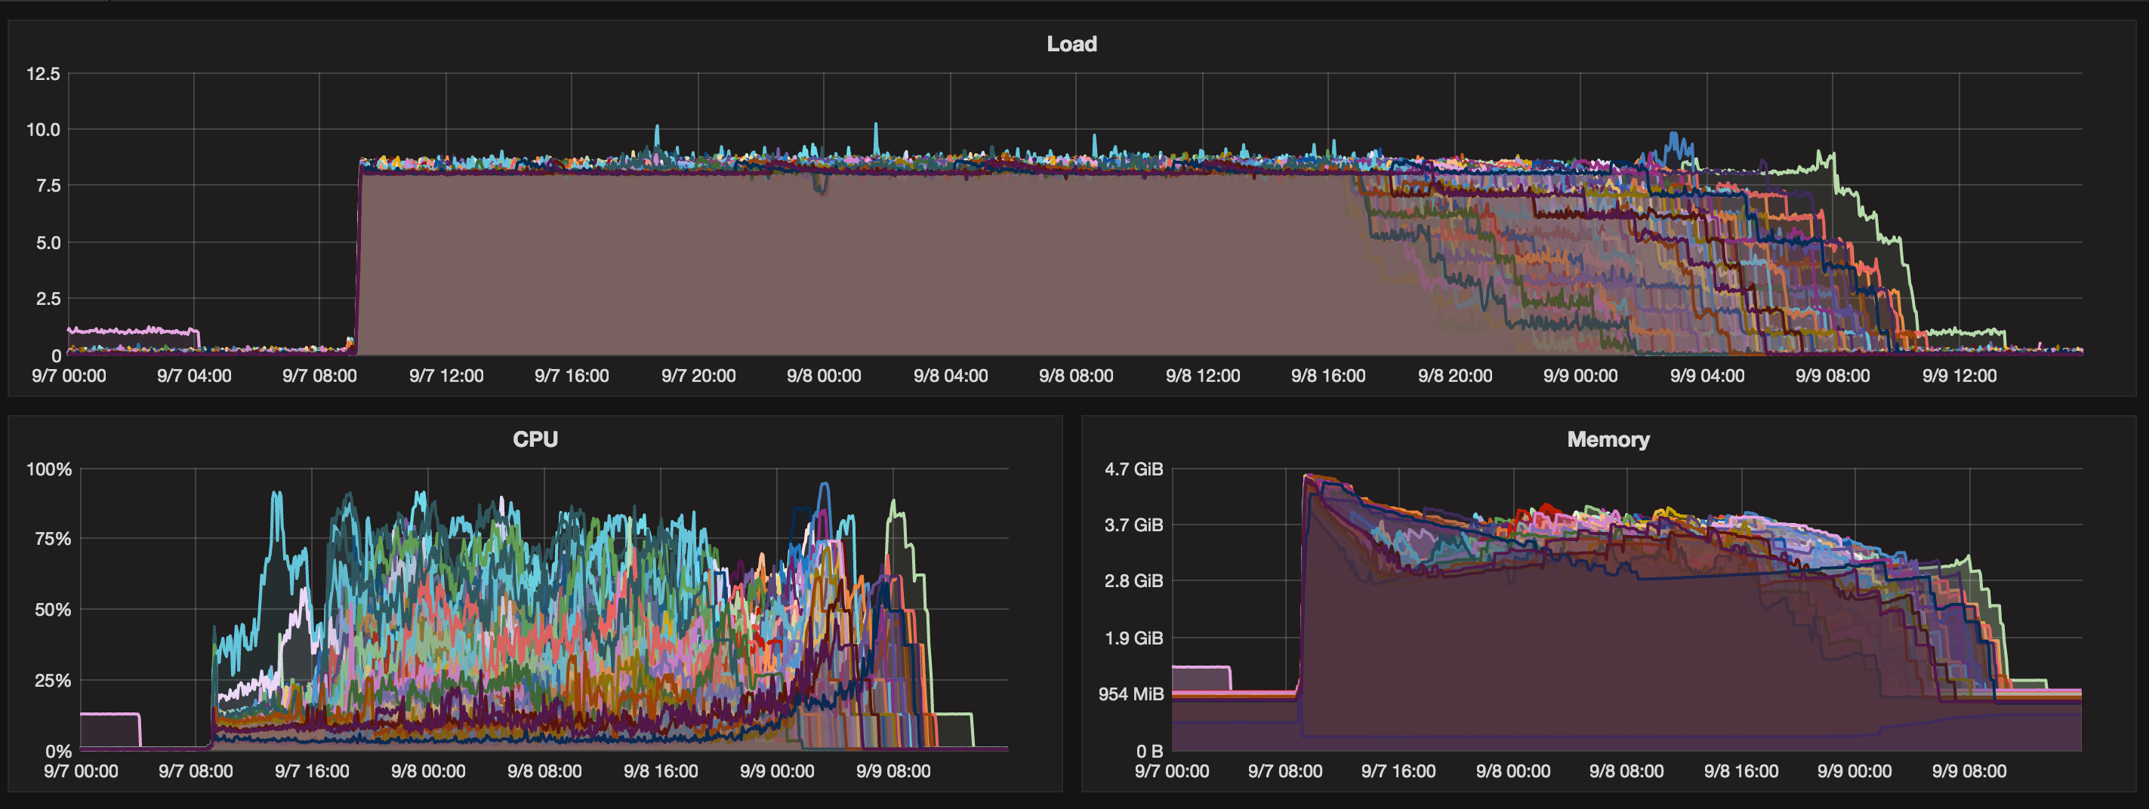
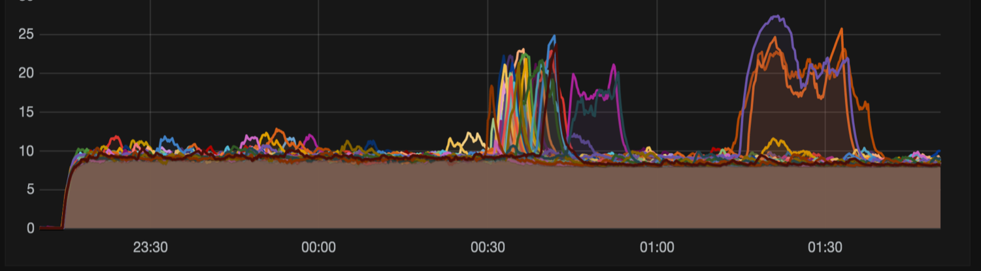
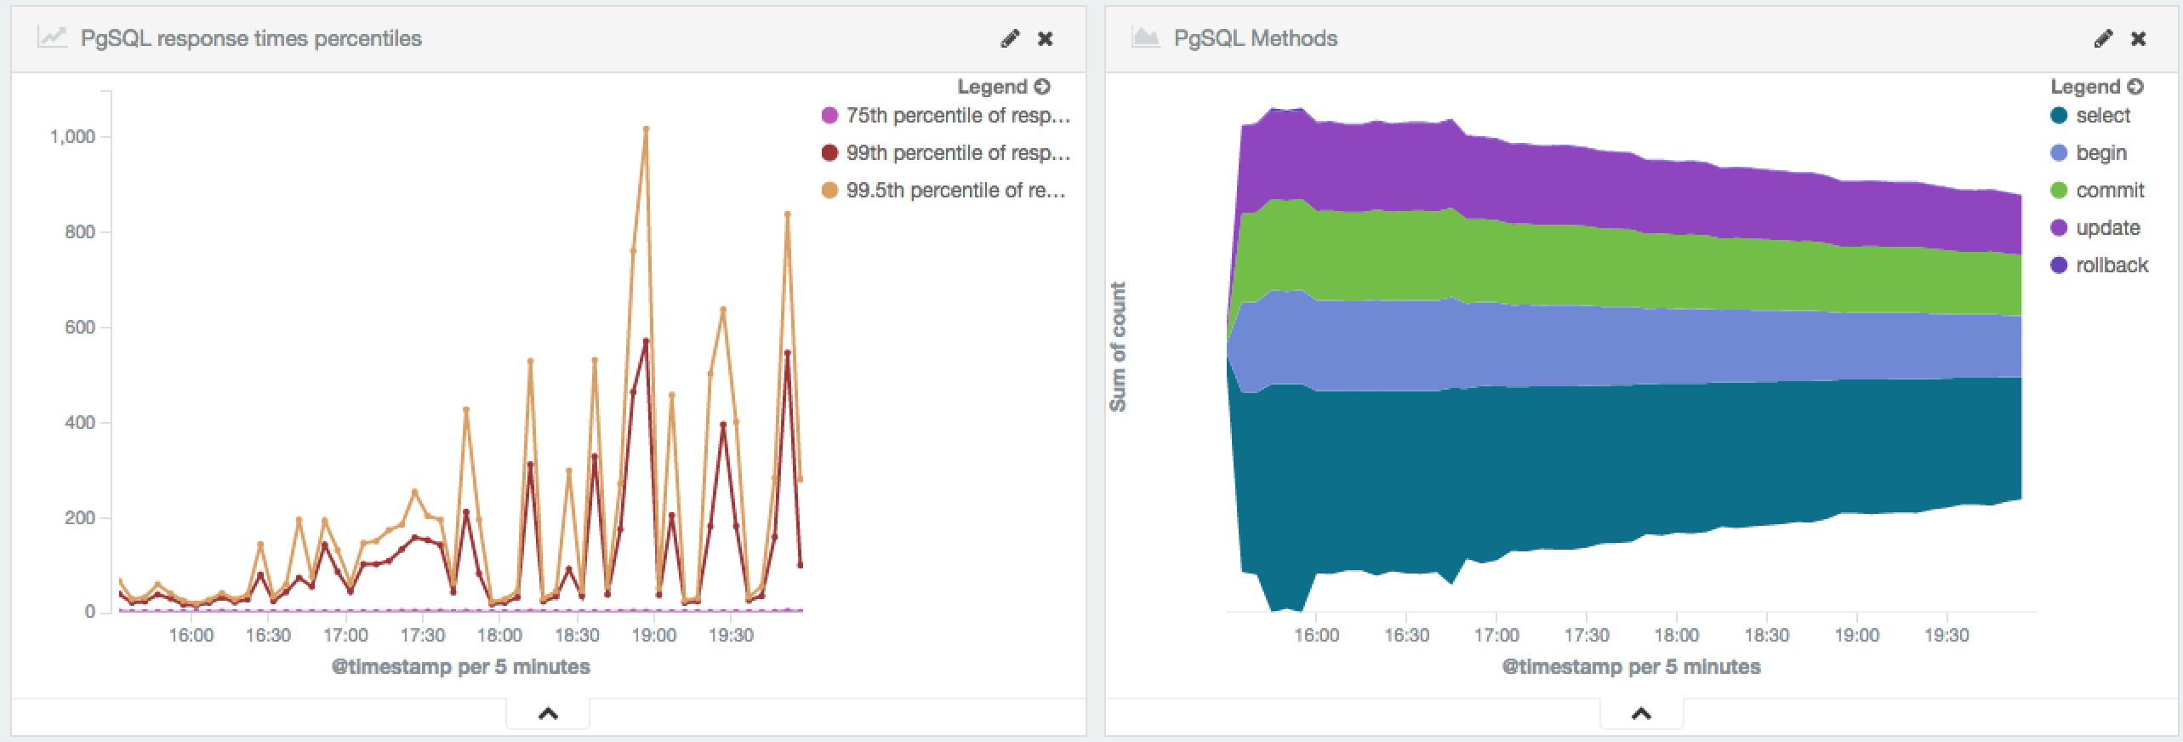
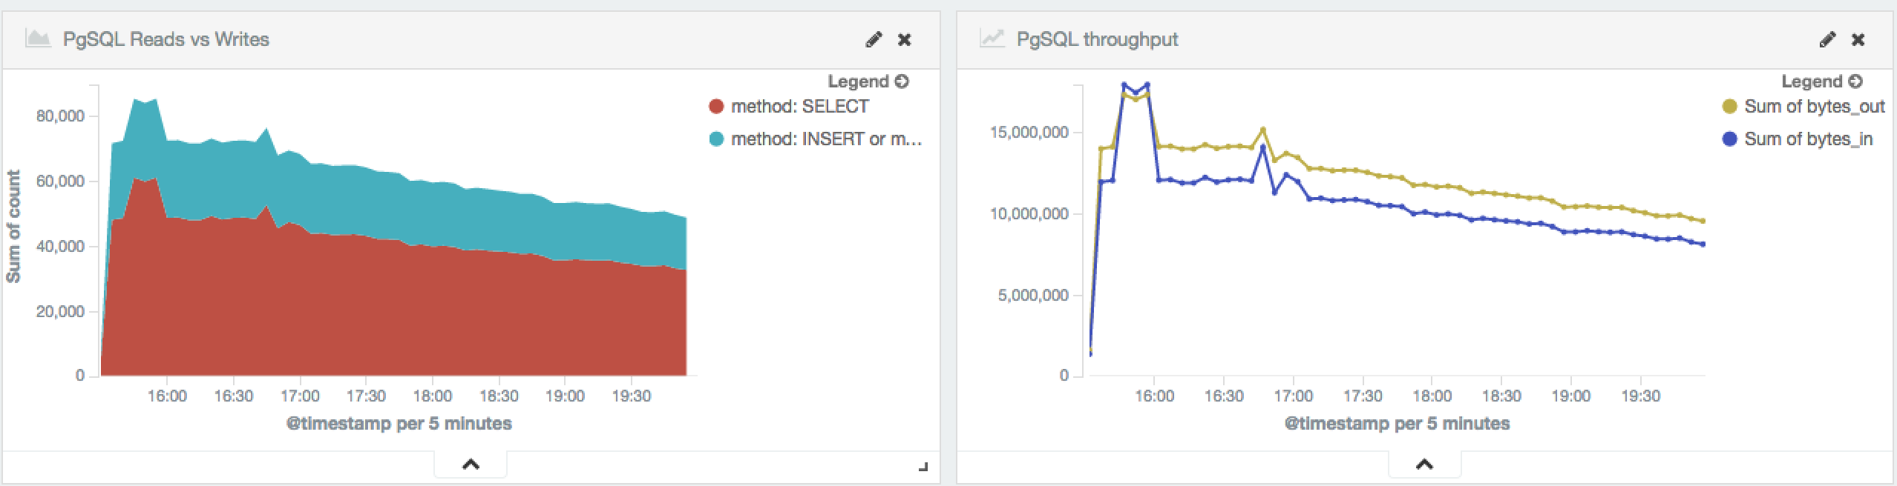
Normal Operation
Infrastructure “event”
Database metrics harvested from logs

Slide 18
Acknowledgements
EMBL
Jan Korbel
Sebastian Waszak
Tobias Rausch
Rupert Lueck
PCAWG
PCAWG-TECH
PCAWG-QC
PCAWG-8
EMBL/EBI
Andy Cafferkey
David Ocana
Charles Short
Steven Newhouse
Ewan Birney
Dario Vianello
Erik van den Bergh
Sanger Institute
Peter Campbell
Adam Butler
Keiran Raine
OICR
Lincoln Stein
Vincent Feretti
Brian O’Connor
Christina Yung
Dennis Yuen
George Mihaiescu
Broad Institute
Gad Getz
DKFZ
Chris Lawerenz
Rolf Kabbe
Manuel Prinz
EGI
Gergely Sipos
Matthew Viljoen
Enol Fernández

Slide 19
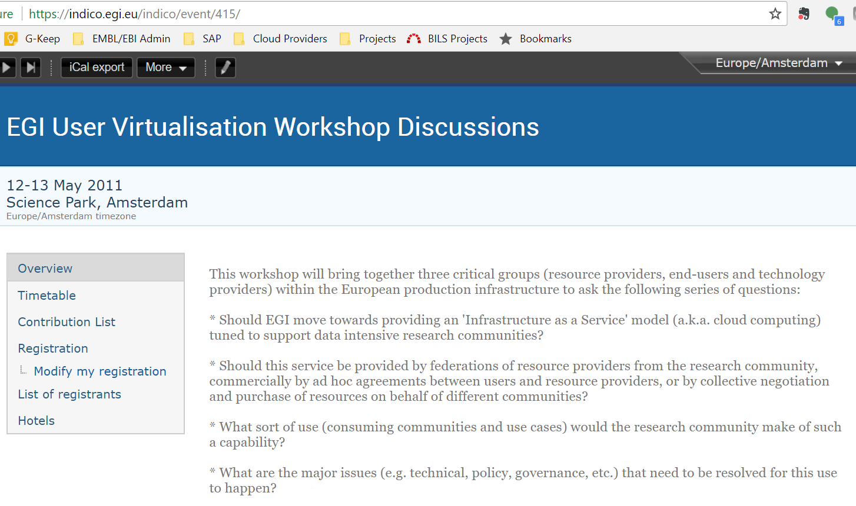

Slide 20
Future Plans & Needs
European Open Science Cloud
  User: PanCancer deployment & use across multiple clouds
  Provider: Integrate ELIXIR Compute Platform
Define simple, mainstream & minimal ‘neck’ of the hour glass
  From a user perspective
  From a cloud provider perspective
Provide a platform for P2P collaboration
  Portability vs. interoperability
  Federate through PaaS not through IaaS

