Slide 1

SeaDataCloud – further developing the pan-European SeaDataNet infrastructure for marine and ocean data management
Dick M.A. Schaap (MARIS - Netherlands)
Technical Coordinator SeaDataCloud project
Second International Open Research Cloud Congress
Amsterdam – Netherlands – 28th September 2017

Slide 2
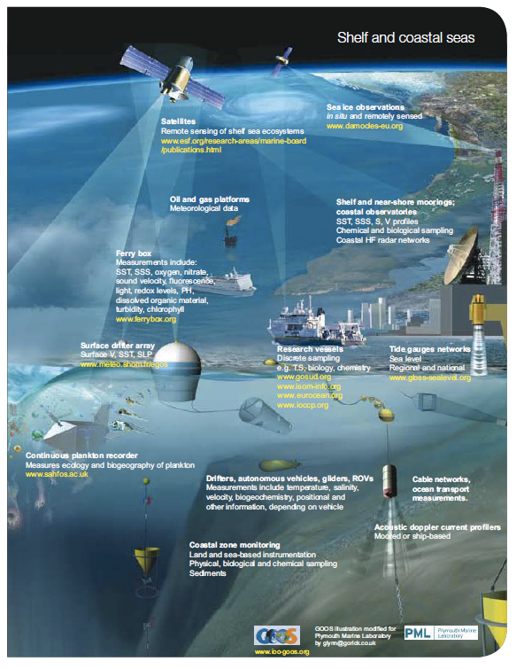
Acquisition of ocean and marine data in many ways

Slide 3
Ocean and Marine Data acquisition
Data are collected by governments, research institutes, and private industry (in Europe more than 1.000 organisations)
Data are gathered for physics, geophysics, chemistry, biology, geology, and bathymetry
Acquisition of oceanographic and marine data is expensive; annual costs in Europe estimated at 1.4 Billion Euro (1.0 = in-situ; 0.4 = satellites)
Professional data management is required with agreements on standardisation, quality control protocols, archiving, catalogues, and access.
Collect once; use many times!

Slide 4
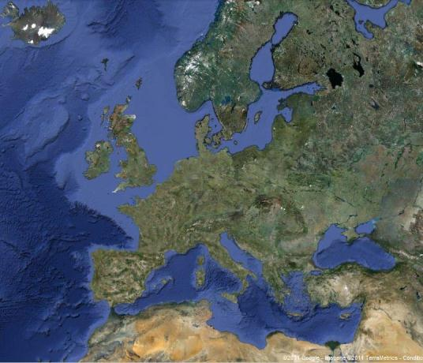





What is SeaDataNet?
A pan-European infrastructure set up and operated for managing marine and ocean data in cooperation with the NODCs and data focal points of 35 countries bordering the European seas

Slide 5
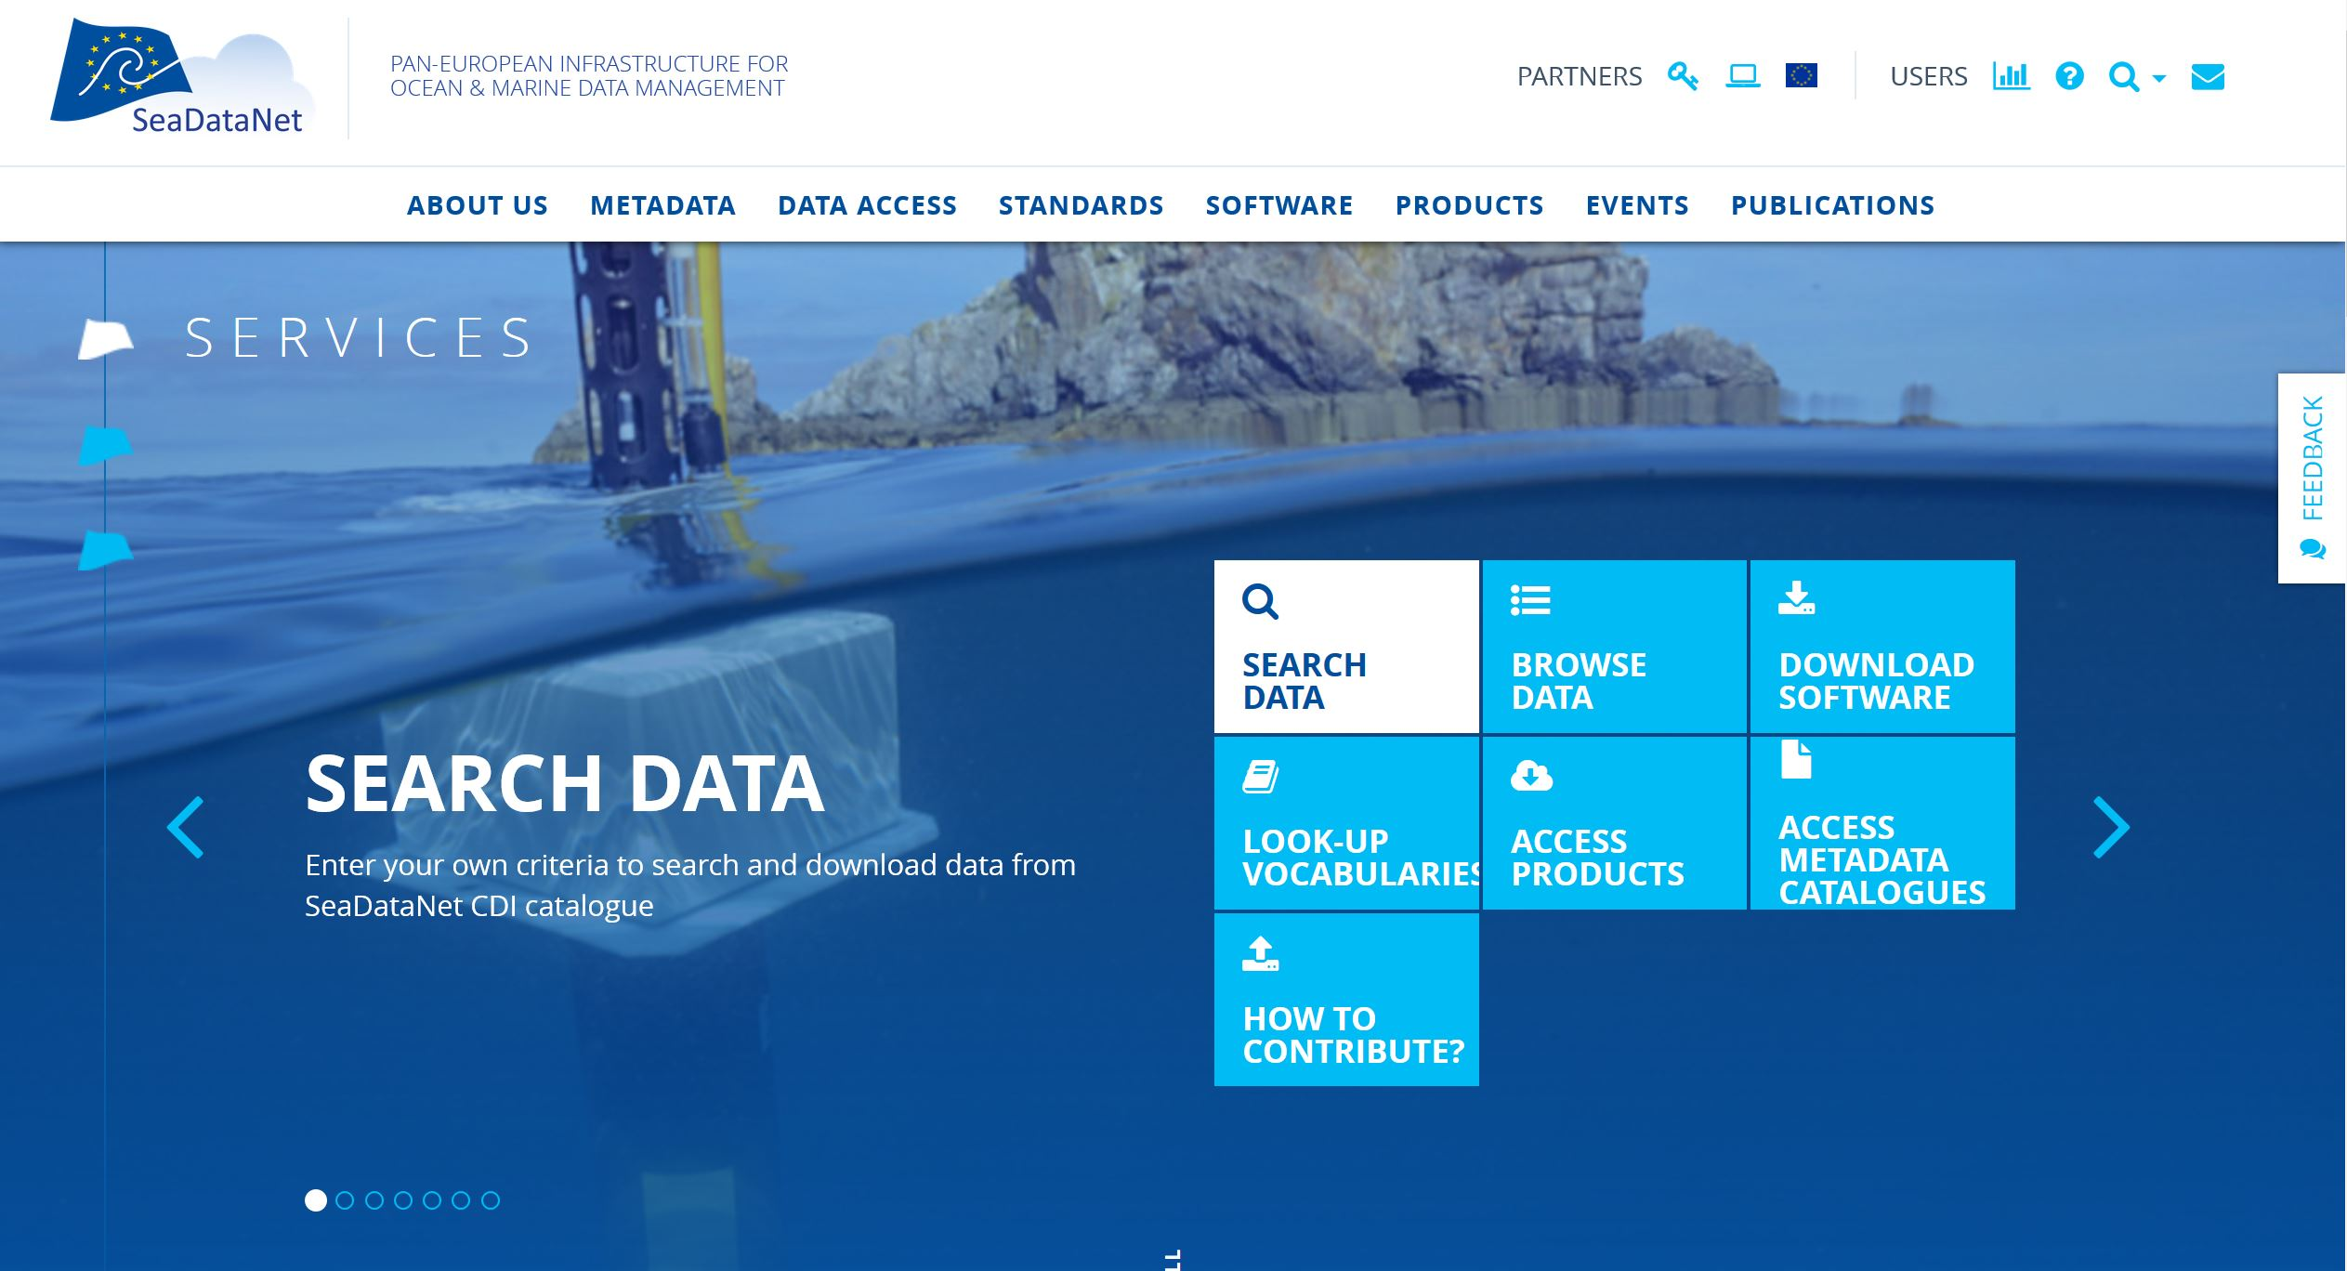
Portal with standards, tools, and services, both for users and data centres
www.seadatanet.org

Slide 6



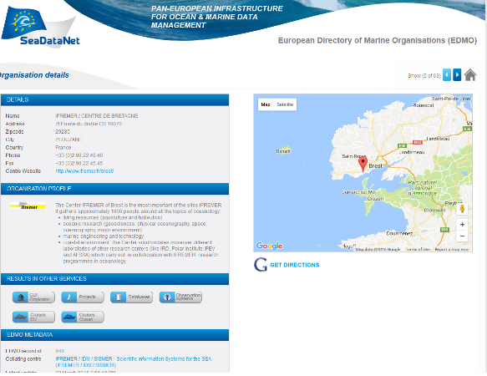
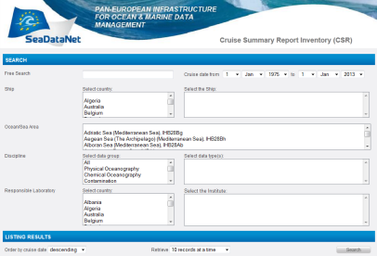
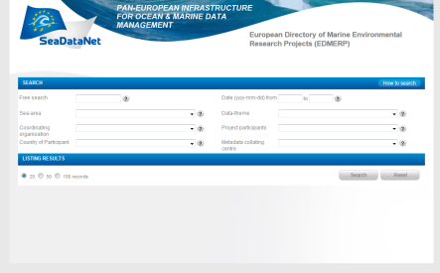
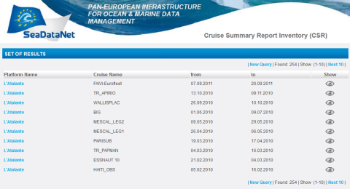
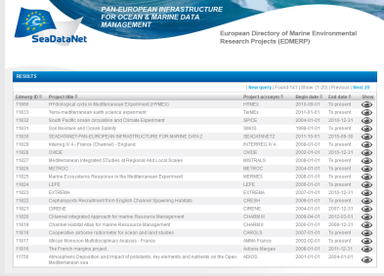
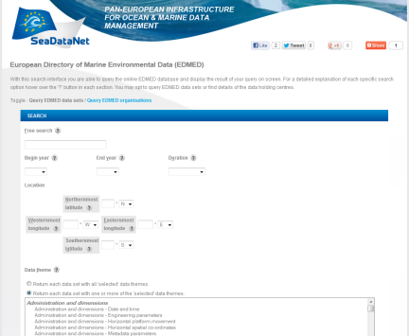
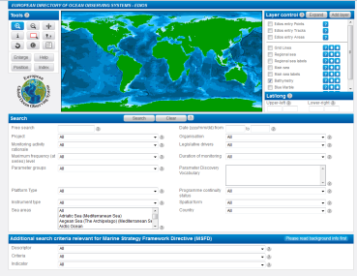
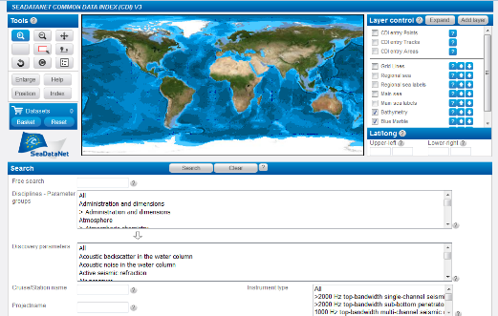
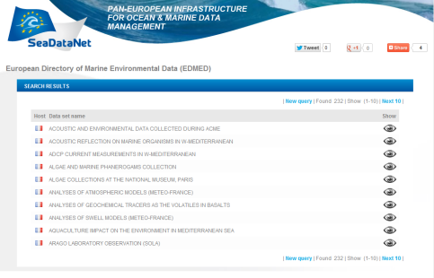
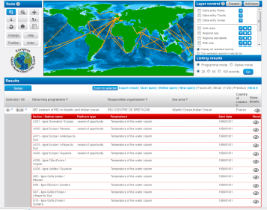
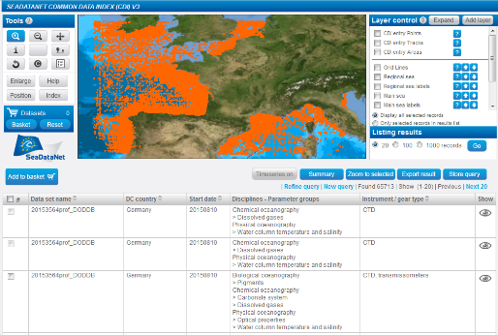
SeaDataNet metadata directories
EDMO
Organisations
CSR
EDMERP
Research cruises
Projects
EDIOS
EDMED
Observing programmes
CDI
Data sets
Data index

Slide 7



CDI service for discovery and unified data access
SeaDataNet portal
Search and Shop
Data download
Already 102 data centres connected and more underway
Data centres
Metadata
+ transaction data
European data sources
data centres > 600 originators

Slide 8
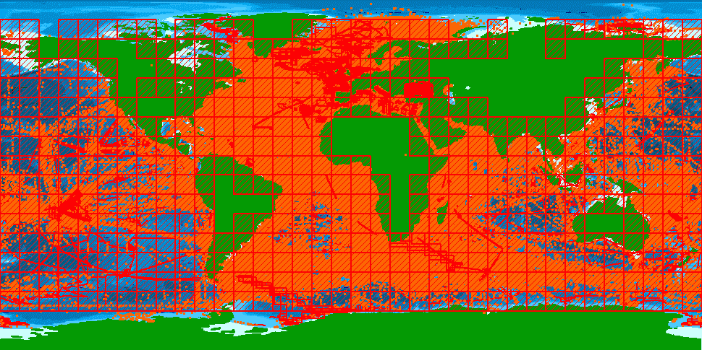
1.95 million CDI entries from 34 countries, 102 data centres and 612 originators for physics, chemistry, geology, geophysics, bathymetry and biology; from 1805 to 2017; 87.6% unrestricted or under SDN License

Slide 9
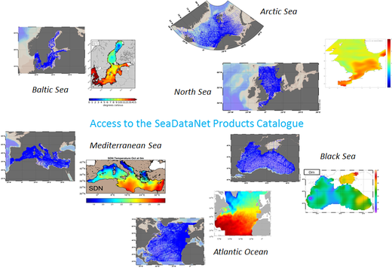

SeaDataNet products
CENTRAL CDI
File and parameter aggregation
Analysis of data anomalies
QC analysis
Data harvesting
SeaDataNet Quality Checks Strategy (QCS)
Regional products
Aggregated datasets and climatologies
Improvement of the data quality

Slide 10
SeaDataNet cooperation and involvement
Copernicus Marine Environmental Monitoring Services (CMEMS): providing long-term archives and standards
Marine Strategy Framework Directive (MSFD): providing infrastructure, standards and data collections for several indicators
Large ocean monitoring systems (EuroGOOS, AtlantOS, Euro-ARGO, JERICO-Next, ..): providing standards and validation + long-term archiving services
Ocean Data Interoperability Platform (ODIP): exploring and demonstrating common standards and interoperability with leading data management infrastructures in USA and Australia
GEOSS - EuroGEOSS: Maintaining the GEOSS portal with SeaDataNet in-situ data collections from large community of European data holders (> 100 data centres; >600 data originators)
European Open Science Cloud (EOSC): shaping the pilot Blue Cloud

Slide 11

SeaDataNet and EMODNet
EU initiative for an overarching European Marine Observation and Data Network (EMODNet) driven by Marine Knowledge 2020 and Blue Growth
SeaDataNet qualified as a leading infrastructure for the EMODnet data management component and is driving several thematic portals from the start in 2008
This synergy has resulted in many more data centres adopting SeaDataNet standards and connecting to the CDI Data Discovery and Access service while it gave a flying start to EMODnet

Slide 12
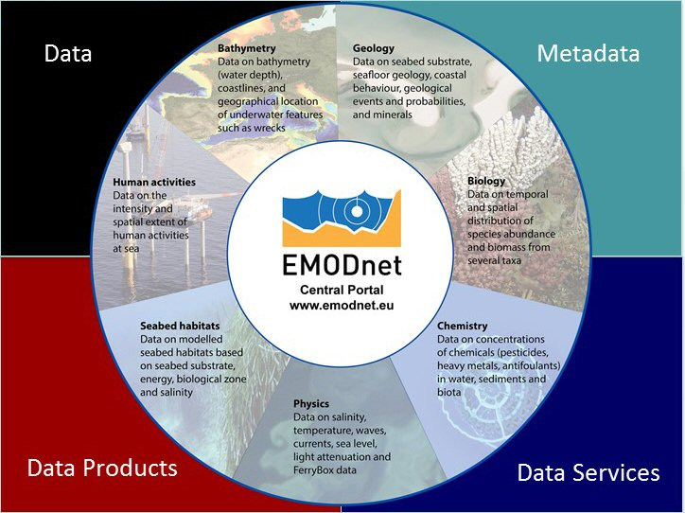

Slide 13
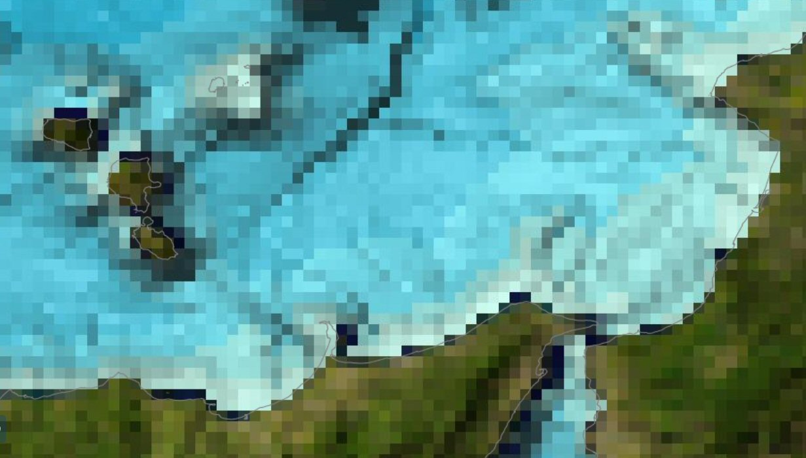
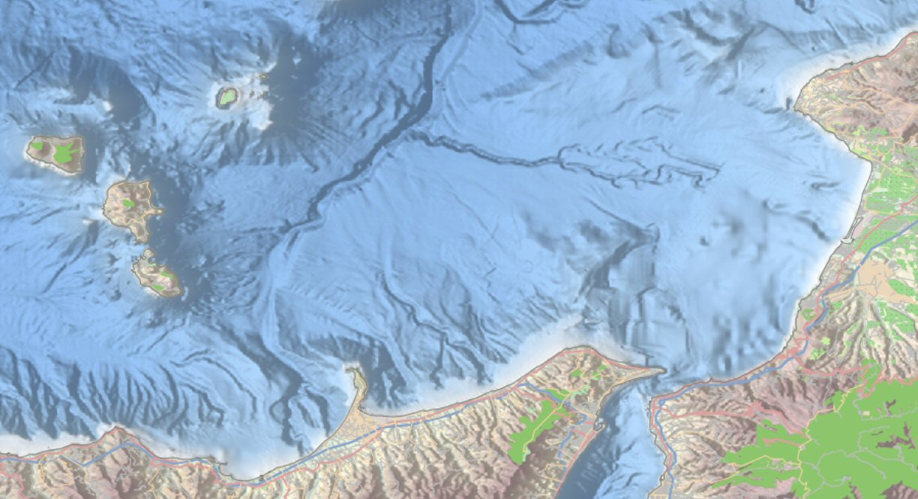
Example of EMODnet Bathymetry
Example of EMODnet Bathymetry – using > 7000 survey data sets to generate and provide a harmonized and higher resolution digital terrain model for all European seas – comparison with GEBCO

Slide 14
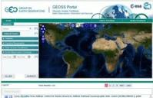
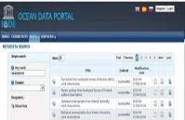

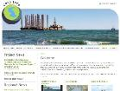
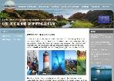


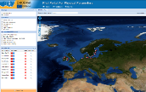
Total collection
GEOSS portal
IODE ODP portal
Aggregated collection
Data discovery
and access
Black Sea portal
Caspian portal
Geo-Seas portal
Regional subsets
> 100 data centres
Bathymetry
Thematic portals
NODCs; HOs; GEOs; BIOs; ICES; PANGAEA
Physics
Chemistry
≈ 600 European data originators
CDI Data Discovery and Access service
Geology
Biology

Slide 15
SeaDataCloud – general challenges
It is about updating and further developing standards
It is about improving and innovating services & products
It is about adopting and elaborating new technologies
It is about giving more attention to users and putting the user experience in a central position
Moreover, it is about implementing a strategic and operational cooperation between the SeaDataNet consortium of marine and ocean data centres and the EUDAT consortium of e-infrastructure service providers

Slide 16
SeaDataCloud – cooperation with EUDAT
European Computing Infrastructure

Slide 17
SeaDataCloud topics
Standards:
  Vocabularies
  Data Formats
  INSPIRE compliance
  Sensor Web Enablement (SWE)
  Data Management for new data types
Services:
  Implementing Linked Data for SeaDataNet directories for M-to-M services
  Upgrading the CDI Data Discovery and Access service making use of the cloud
  Integrating data offering from international programmes and organisations
  Integrating INSPIRE Transformation services
  Data publishing

Slide 18
Upgrading of CDI Data Discovery and Access service
Introducing central data cache
  Extra QA-QC
  More efficient delivery
  Higher performance
  Transformations
Replication for synchronisation

Slide 19

Added-value services and applications
WP10
Downstream
Services
NEW FOCUS:
ACHIEVING
MORE USER
ENGAGEMENT
WP8
Standards &
Vocabularies
make it work!
WP9
Upstream
Services
Discovery and access
to more datasets and information

Slide 20
SeaDataCloud topics
Developing and deploying a Virtual Research Environment (VRE):
  Collaborative environment
  Cloud computing
  Big data
  Advanced e-services to facilitate research for handling, curating, quality controlling, transforming and processing marine and ocean data into value-added analyses, harmonised data collections, and data products which can be integrated, visualised and published using OGC and high level visualisation services.
Products:
  Improved T&S Climatology – cooperation with Copernicus Marine Environmental Monitoring Service

