Slide 1



Second International Open Research Cloud Congress
Science Park, Amsterdam
September 27-29, 2017

Slide 2
Welcome
Khalil Yazdi
Enol Fernandez, EGI

Slide 3
Objectives for Amsterdam Congress
In addition to our continuing work on the drafting of the ORC Declaration, our ambitions for this Congress include:
Collecting new insights on the challenges facing research clouds -- benefiting from the perspectives, insights and experience of our European colleagues;
Validating scope of coverage – through use-case presentations where increased interoperability and federation are a concern and hearing from our technical colleagues on the development side; and
Exploring solution pathways that would support interoperability and allow for the implementation of the Declaration objectives.

Slide 4
Agenda Day 1 (September 27th):
13.00 to 13.30: Arrival and Refreshments
13.30 to 13.40: Welcome
13.40 to 14.00: Objectives and Agenda Overview
14.00 to 14.20: Boston Congress Recap
14.20 to 15.30: Participant Introductions
15.30 to 15.45: Break
15.45 to 17.00: Working Group Updates and Open Discussion
17.00: Adjournment and Dinner

Slide 5
Agenda Day 2 (September 28th)
08.30 to 09.00: Arrival and Coffee
09:00 to 09.15: Welcome and Overview of Purposes
09.15 to 10:30: Current and Ongoing Initiatives (European Perspectives)
10:45 to Noon: Why Research Cloud Interoperability is Important: Use Cases
12:30 to 13:15: Use Cases (Continued)
13:15 to 14:15 Technical Perspectives from the Scientific Working Groups
14.30 to 16.00: Solution Approaches to Enabling Interoperability of Research Clouds
16.00 to 17.30: Open Discussion
17.30 to 17.45: Recap and Next Steps
17.45: Adjournment and Dinner

Slide 6
Agenda Day 3 (September 29th)
08.00 to 08.15: Arrival and Coffee
08.15 to 08.45: Recap from Day 2
08.45 to 09.15 Drafting Breakouts
09.15 to 12.30: Declaration Review and Discussion
12.00 to 13.00: Next Steps, Planning for Sydney
13.00: Adjournment and Departure

Slide 7
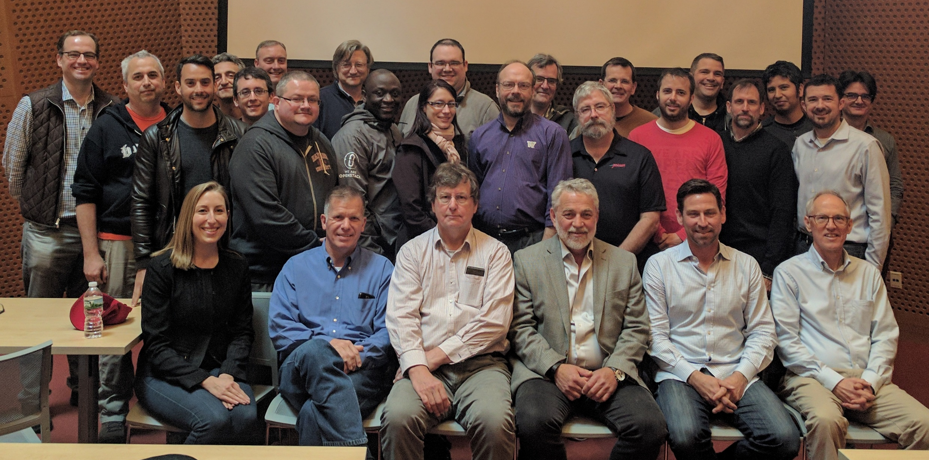
Inaugural Congress
Boston
May 11-12, 2017
80+ Participants
Dozen Countries
Identified Policy and Technical Challenges
Agreement to Continue the Dialogue

Slide 8
What we learned at the Boston Congress
Areas of concern:
  Data Access and Management
  Identity Federation
  Security and Data Privacy
  Sharing of Resources
  Hybrid Cloud Architecture (multi-public-private)
  Business Facilitation
  Governance, Coordination and Representation
    what should this group be?

Slide 9
What we learned at the Boston Congress
What do we need for the Declaration?
  Articulation of shared policies
  Defined structure for coordination between research clouds (public-private)
  Technical development direction (GitHub)
  Agreement on access protocols
  Repository for documentation

Slide 10
Participant Introductions
Who are you and why are you here?

Slide 11
Agenda Day 1 (September 27th):
13.00 to 13.30: Arrival and Refreshments
13.30 to 13.40: Welcome
13.40 to 14.00: Objectives and Agenda Overview
14.00 to 14.20: Boston Congress Recap
14.20 to 15.30: Participant Introductions
15.30 to 15.45: Break
15.45 to 17.00: Working Group Updates and Open Discussion
17.00: Adjournment and Dinner

