Slide 1
Integrating EODC into the EGI Federated Cloud
Enol Fernández
Cloud Technologist @ EGI Foundation
enol.fernandez@egi.eu

Slide 2
EGI Federated Cloud
Grid of clouds
Harmonised operational behaviour
Clouds and their interconnections are based on open standards, open technologies
EGI Service → Access online AND Technology → Build your own federation

Slide 3
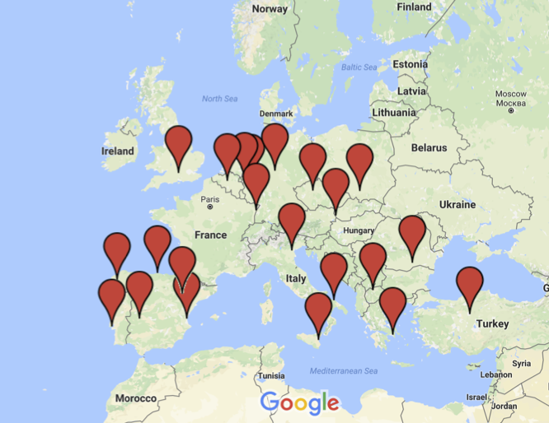
EGI Federated Cloud Infrastructure

Slide 4
Platforms on top of fedcloud
PeachNote | NBIS | GeoHazards TP | AoD | D4Science
7K registered users +64M page views | 8 different services 8K users from 73 countrues | +500 registered users 50% resources on EGI | Beta open for NILs Easy to access applications | VREs on a Hybrid Data Infrastructure Entering production this month
104 vCPUs 162 GB RAM 8TiB Storage | 172 vCPUs 400 GB RAM 9TiB Storage | 360 vCPUs 800 GB RAM 10TiB Storage | 167 vCPUs 244 GB RAM 4TiB Storage | 210 vCPUs 584 GB RAM 12,5 TiB
CESNET, FZJ | RECAS-BARI, IN2P3, ULAKBIM | RECAS-BARI, 100IT, GRNET, GWDG, CYFRONET, BELSPO, CESGA | CESGA, BIFI, RECAS-BARI, INFN-CATANIA | IISAS, CESGA, UPV-GRYCAP, RECAS-BARI, GWDG

Slide 5
Architecture: IaaS Federation
EGI AAI
Community Platforms
AppDB VMOps
IaaS Federated Access Tools
IaaS API
IaaS API
IaaS API
Cloud Management Framework
Cloud Management Framework
Cloud Management Framework
EGI Federation services:
Accounting, Monitoring, Configuration Database, Information Discovery, VM Marketplace
Notes:
Provide access to the heterogeneous IaaS frameworks:
IaaS provisioning systems that allow to define infrastructure as code and manage and combine resources from different providers, thus enabling the portability of application deployments between them
Smart brokers providing matchmaking for workloads to available providers
Cloud Management Software that provides a unified console for accessing resources and deploy workloads following a set of user-defined established policies (e.g. Scalr or RightScale)

Slide 6
IaaS Cloud User
or Gateway
Browse
VAs
EGI AppDB
Registers
VAs
Cloud Developer
Manage IaaS resources
IaaS API
IaaS API
VM
VM
Automatic distribution of VAs
VM
EGI Cloud Providers
Platform/Service User

Slide 7
Integration with resource providers
Providers keep complete control on their resources
Enable access to a Virtual Organisation into local tenants with EGI credentials, SLA based
Set of components using OpenStack APIs to retrieve provider information and make it available to EGI services
No (major) changes in operational activities
Provide support through EGI channels
Comply with the operational and security requirements. These are based on best practices and common requirements
Most well-operated providers already have these activities in place, so the additional task for a site manager is to acknowledge to EGI that the task has been performed.

Slide 8
Resource allocation to Virtual Organisations (VOs)
Type, number, size, cost, availability, etc.
Applic. provider
Service requirements
Conditions
Storage provider
Cloud provider
Project/Community representing the VO
Negotiator
Grid provider
Service Level Agreement
Operation Level Agreement
Training
Support
Satisfaction review (every 3/6/12 months)
Performance reports
Notes:
SLA is an agreement on intentions to collaborate and support research.
OLA captures conditions, such as: What type of service? How much capacity? Location of service? Free or pay-for-use? How much availability and reliability? Response time for user/operational requests? ‘Human services’, such as consultancy and training? Etc.

Slide 9
EGI – OpenStack integration
OpenStack resource center
Apache+mod_auth_oidc
ceilometer
Keystone
Keystone-VOMS
Publish accounting records
Get access token
Extract usage information
cASO + SSM
EGI accounting repository
IaaS Operations
OpenStack clients
nova-api
cloud-bdii-provider
Publish information
EGI BDII
Extract information
OCCI clients
ooi
Cloud Keeper
Subscribe to
image lists
AppDB (vmcaster)
EGI monitoring
glance
Register/update images

Slide 10
EGI AAI
Users identified with X.509 certificates (IGTF Federation) with VOMS extensions
VOMS (Virtual Organization Management System) provides attributes on membership to VOs, groups and roles on the VO
Now in transition to new EGI AAI (EGI CheckIn)
Federated identity standards (SAML, OpenID Connect)
Allows users to authenticate with their institutional accounts
Integration with Attribute Authorities beyond VOMS

Slide 11
Keystone-VOMS
WSGI filter for Keystone V2 API
Extracts information from VOMS proxies to perform AuthN/AuthZ
Can manage federation users
Add users to Keystone
Add roles to users in tenants
Mapping VOMS → Keystone defined on file
https://github.com/IFCA/Keystone-VOMS

Slide 12
EGI – OpenStack integration
EGI CheckIn
OpenStack resource center
Apache+mod_auth_oidc
ceilometer
Keystone
OS-FEDERATION
Publish accounting records
Get access token
Extract usage information
cASO + SSM
EGI accounting repository
IaaS Operations
OpenStack clients
nova-api
cloud-bdii-provider
Publish information
EGI BDII
Extract information
OCCI clients
ooi
Cloud Keeper
Subscribe to
image lists
AppDB (vmcaster)
EGI monitoring
glance
Register/update images

Slide 13
EGI AAI - CheckIn
Relies on Keystone OS-FEDERATION:
Available since Icehouse (EGI tests based on Mitaka)
Allows to configure external identity providers
Using federated identity technology
Relying on Apache modules
OpenID Connect supported
Pilot experience already working
Docs: https://wiki.egi.eu/wiki/AAI_guide_for_OpenStack
Working on completing monitoring to be production ready

Slide 14
OpenStack FedCloud Appliance
A single VM with all the components using the public OpenStack interfaces
Accounting, Information discovery, VMI replication
Packaged as Docker containers, available at docker hub https://hub.docker.com/u/egifedcloud/
Documentation:
https://wiki.egi.eu/wiki/MAN10#Integration_with_EGI_FedCloud_Appliance
Appliance at AppDB:
https://appdb.egi.eu/store/vappliance/fedcloud.integration.appliance.openstack

Slide 15
EGI – OpenStack integration with Appliance
EGI CheckIn
OpenStack resource center
Apache+mod_auth_oidc
ceilometer
Keystone
OS-FEDERATION
Publish accounting records
Get access token
FC Appliance
Extract usage information
cASO + SSM
EGI accounting repository
IaaS Operations
OpenStack clients
nova-api
cloud-bdii-provider
Publish information
EGI BDII
Extract information
OCCI clients
ooi
Cloud Keeper
Subscribe to
image lists
AppDB (vmcaster)
EGI monitoring
glance
Register/update images

Slide 16
OpenStack OCCI interface (ooi)
OCCI (Open Cloud Computing Interface, OGF)
RESTFul protocol and API focusing on cloud interoperability
Primarily for IaaS (manage VMs and Block Storage), extensible to other areas
ooi (OpenStack OCCI interface)
Completely written from scratch OCCI implementation
Uses only public OpenStack APIs
Support for VM, volumes and network operations
Can be installed along an existing nova-api endpoint or as a separate WSGI application
https://launchpad.net/ooi

Slide 17
AppDB: VM Image Marketplace
Open Library of Virtual Appliances
Use on providers or for personal download
EGI VM images, securely configured and tested
Community curated sets of images
Automatic distribution to cloud providers

Slide 18
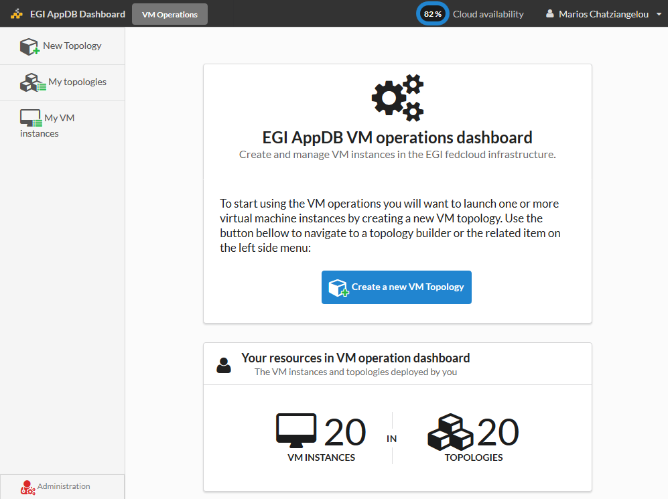
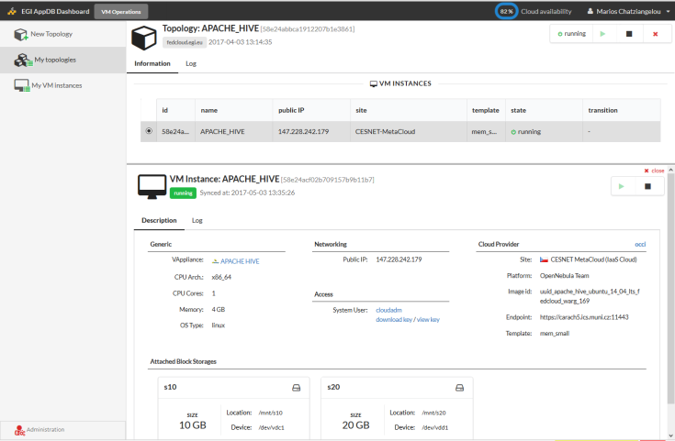
AppDB: VMOps Dashboard
https://dashboard.appdb.egi.eu/vmops
Unified resource management on the Federated Cloud
Complete EGI CheckIn integration (Federated AAI)
Personalized, wizard-like, topology builder:
Manage multiple-VM topologies with associated storage and contextualization
Fine grained control of VMs within topologies
Notes:
Feature list from Marios original slide:
Create a new topology with one (or more) instances of a specific VM
Attach additional storage to the VM instances
Deploy/Un-deploy a topology
Start/Stop a topology (= all the VM instances of a topology)
Start/Stop a single VM instance
Execute bash script on deployment time

Slide 19
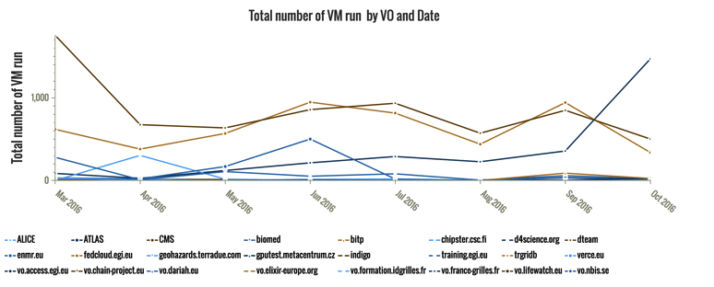
Accounting
Collect, aggregate and display usage information across the whole federation.
OGF Usage Record extended for Cloud
cASO produces accounting records using nova (and optionally ceilometer) APIs
https://github.com/IFCA/caso

Slide 20
Monitoring
Health monitoring of services
A/R metrics for SLA/OLAs
Powered by EGI ARGO
https://argoeu.github.io/

Slide 21
User Support
https://wiki.egi.eu/wiki/Federated_Cloud_user_support

Slide 22
Documentation
EGI Federated Cloud
https://wiki.egi.eu/wiki/EGI_Federated_Cloud
Resource providers documentation
https://wiki.egi.eu/wiki/Federated_Cloud_resource_providers_support
OpenStack integration (Mitaka):
https://wiki.egi.eu/wiki/Federated_Cloud_Mitaka_guide
Federated Cloud User Support
https://wiki.egi.eu/wiki/Federated_Cloud_user_support
AppDB Cloud Marketplace FAQ:
https://wiki.appdb.egi.eu/main:faq#cloud_marketplace

