Slide 1
Harnessing text-mining for biophysically-detailed brain modeling
Christian O’Reilly, École Polytechnique Fédérale de Lausanne
DI4R 2017

Slide 2
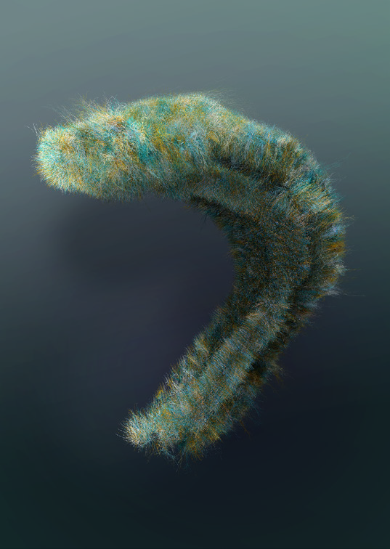
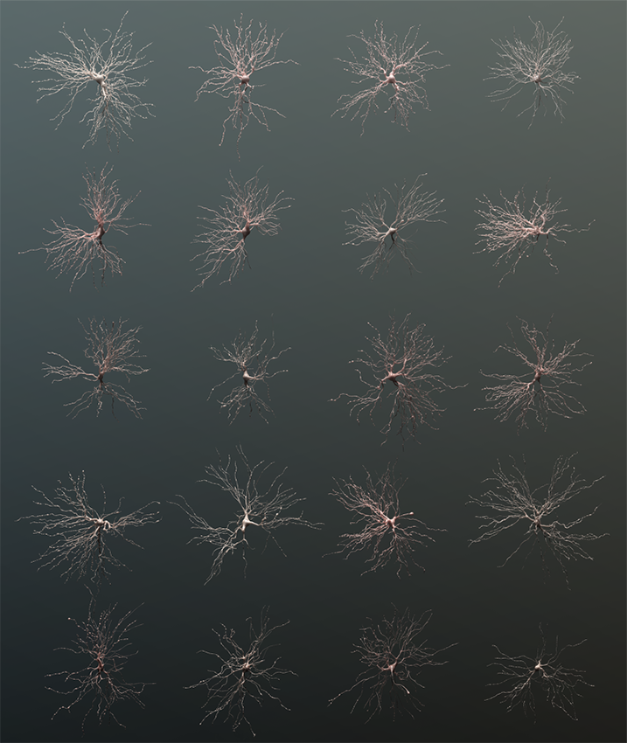
Biophysically-detailed modeling at the Blue Brain Project (EPFL)
A cortical microcircuit (a “cortical column”).
A hippocampus.
Example of thalamo-cortical relay cell morphologies used for circuit building.
In silico retrograde projection of a pyramidal cell.
Courtesy of the Blue Brain Project.

Slide 3

Biophysically-detailed modeling at the Blue Brain Project (EPFL)
[…]
Cell types
Cell densities
Connectivity
Ion channel conductance
Ion channel kinetic properties
Brain region volume
Synaptic release probability
Post-synaptic potential amplitude
Synaptic bouton counts
Number of synapse per connection
Calcium-binding protein expression
Axon axial resistivity
Cell membrane capacitance
Cell resting membrane potential
Inter-spike interval
Extracellular calcium concentration
Cell input resistance
Cell rheobase
Action potential amplitude
Membrane time constant
[…]
Courtesy of the Blue Brain Project.

Slide 4
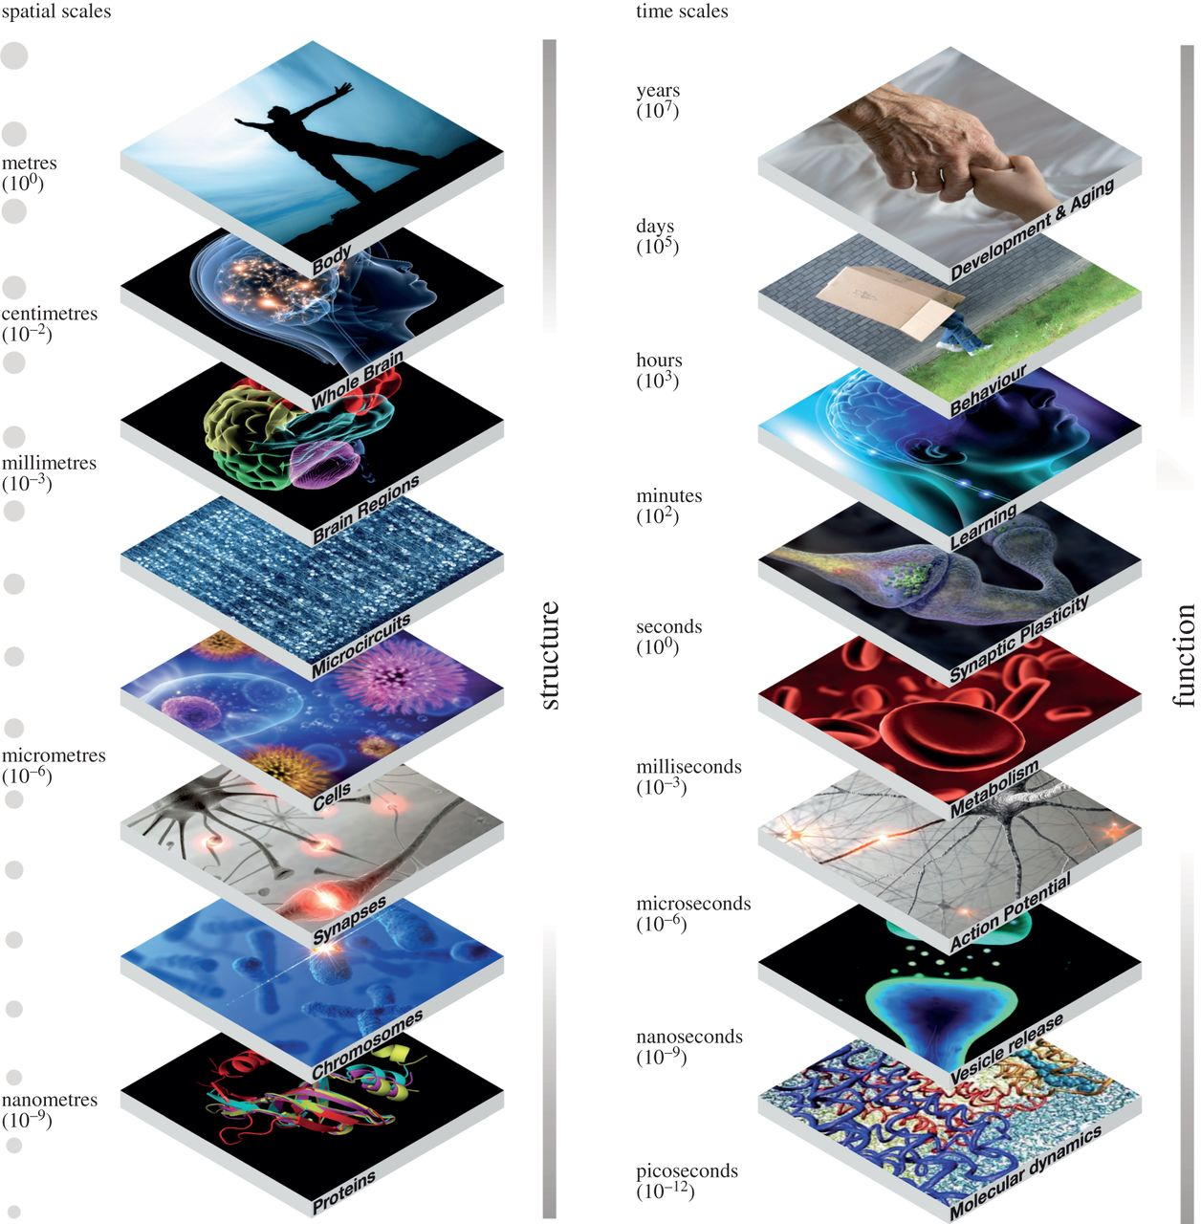
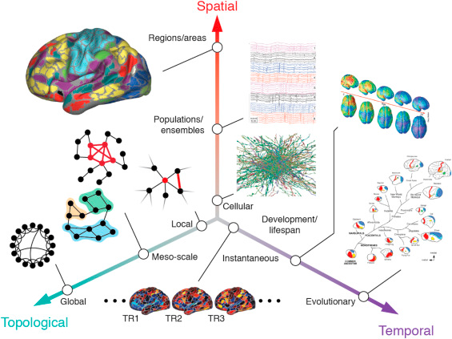
Complexity in understanding neuroscience
(Frackowiak & Markram, 2015, Phil. Tans. R. Soc. B.)
(Betzel & Basset, 2017, NeuroImage)

Slide 5
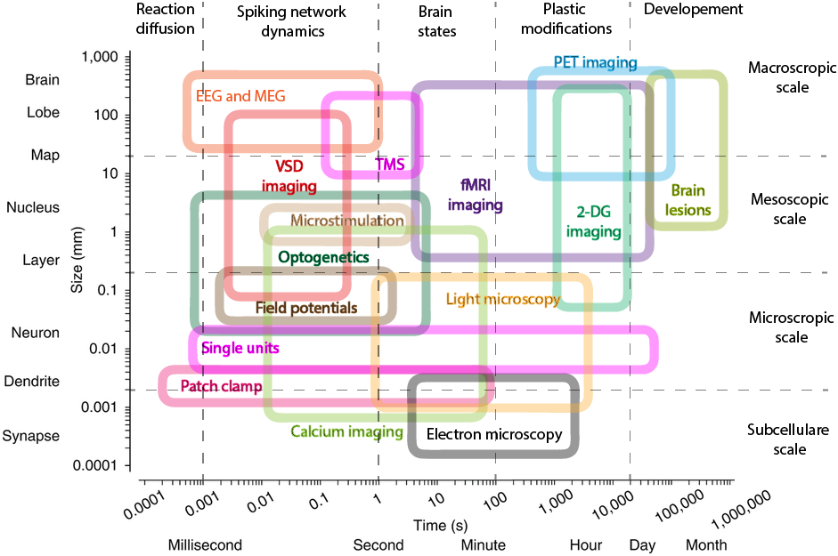
Complexity in understanding neuroscience
Clinical availability
Modified from (Sejnowski, Churchland and Movshon, 2014, Nat. Neurosci.)

Slide 6
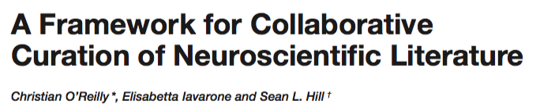
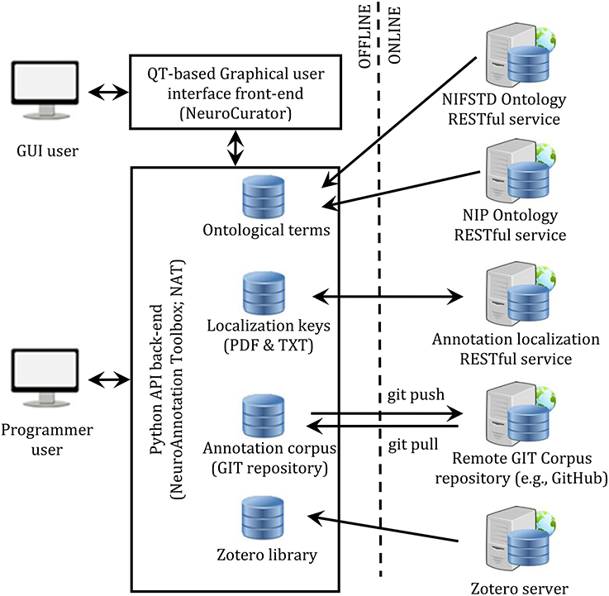
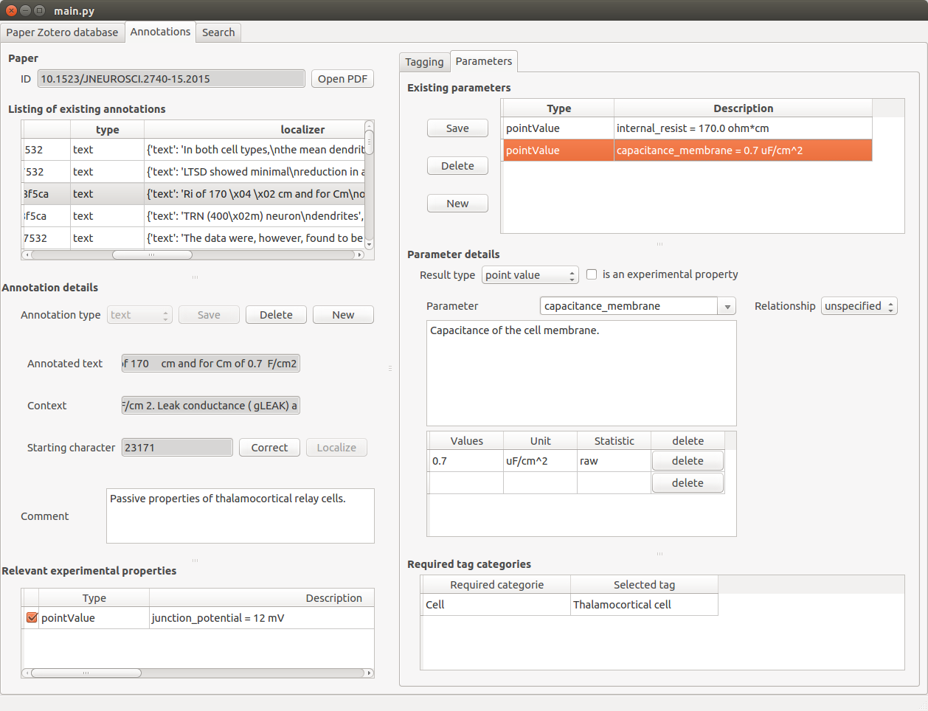
Design of a framework for literature curation

Slide 7
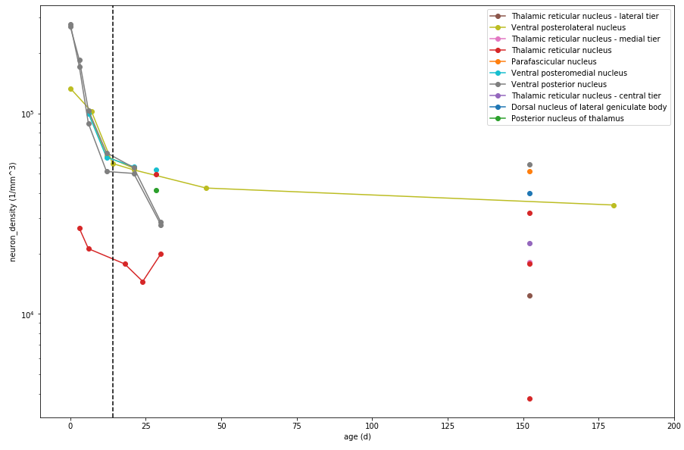
Example of curated parameter values (neuron density)

Slide 8
Exploiting text-mining for brain modelling
Automating the curation process through text-mining. NERs for neuroscience literature curation (by M. Shardlow et al.):
Entity | Manual annotations |  |  | Deep Learning NER
 | Number Double Annotated | Total | Agreement | Precision | Recall | F1
Brain Region | 480 | 1055 | 0.891 | 0.856 | 0.833 | 0.844
Neuron | 309 | 767 | 0.825 | 0.878 | 0.760 | 0.814
Model Organism | 150 | 299 | 0.846 | 0.860 | 0.878 | 0.869
Ionic Channel | 83 | 201 | 0.639 | 0.737 | 0.875 | 0.800
Ionic Current | 137 | 339 | 0.904 | 0.872 | 0.680 | 0.764
Ionic Conductance | 50 | 76 | 0.810 | 0.929 | 0.722 | 0.813
Value | 211 | 594 | 0.784 | 0.895 | 0.828 | 0.860
Unit | 151 | 507 | 0.902 | 0.904 | 0.957 | 0.930

Slide 9
Thank you
Any questions?
christian.oreilly@epfl.ch
Thanks to Matthew Shardlow, Meizhi Ju, Maolin Li, Elisabetta Iavarone, John McNaught, Sophia Ananiadou, and the OpenMinTeD and the Blue Brain teams for their involvement in this work.

