Slide 1
ELITRANS project
Computing part (WP3)
Jiri Chudoba on behalf of ELITRANS WP3
DI4R, 1.12.2017, Brussels

Slide 2
ELI = Extreme Light Infrastructure
Common
initiative
Parallel
Implementation
Common
operation
ELI-Beamlines
Czech Republic
ELI
ESFRI
ELI-PP
ELI-ALPS
Hungary
ELI-NP
Romania
2006
2007
2010
2011
2013
2017
2018
PF
MoU
ELI-DC AISBL
ELI- ERIC

Slide 3
ELI – 3 pillars
ELI Beamlines
ELI-ALPS

Slide 4
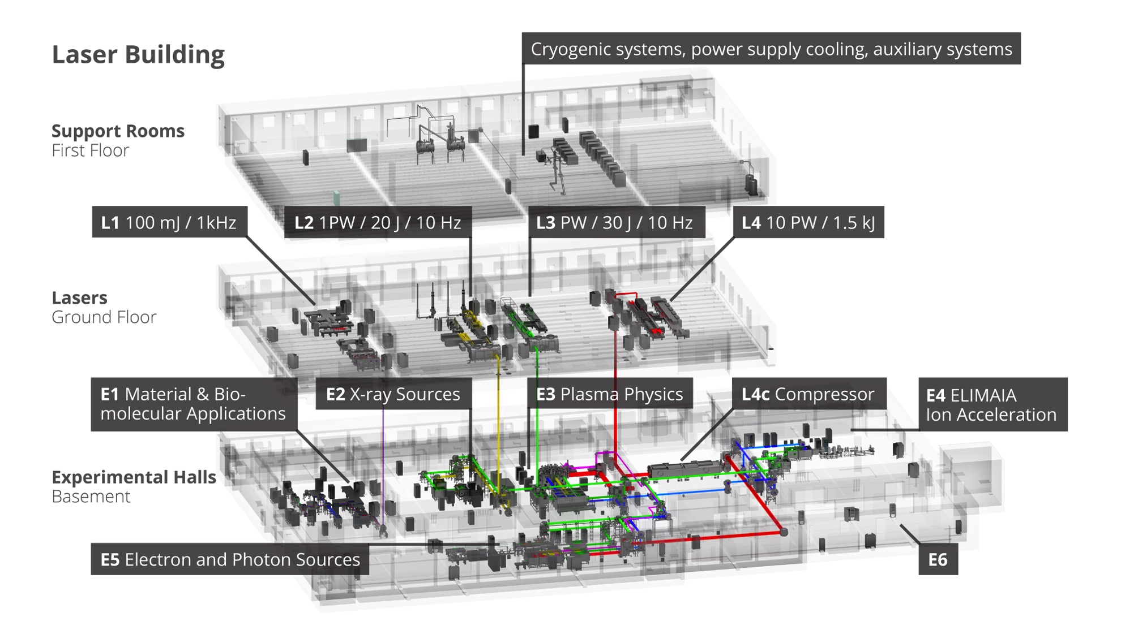
Laser building in ELI Beamlines

Slide 5
Computing challenges
One ERIC - Common Services
Standardized soft- and hardware tools necessary to implement common structure across the ELI facilities
User Management (800 staff, > 1000 users/year)
Back office (Document handling - distribution, archive, …)
Secure network environment
Teleconference solutions
Roadmap towards realization

Slide 6
Computing challenges
Scientific Data Management
Data volumes: up to tens of PB yearly
Common User Interfaces
Data access, data transfers tools
Data models
Archive
Open Access

Slide 7
Solutions
Solutions based on existing and emerging products
Partners (EGI, EUDAT, PRACE) – access to storage and computing resources
Virtual organizations
HPC Usage
Consultations with similar existing projects
Diamond Light Source
The European X-Ray Laser Project XFEL
ELETTRA
ESRF
ALBA
PSI

Slide 8
THANK YOU
FOR YOUR ATTENTION!

