Slide 1
Authentication and Authorisation Service for ELIXIR Research Infrastructure
Mikael Linden, Michal Prochazka, Ilkka Lappalainen
DI4R 30 Nov 2017

Slide 2
ELIXIR connects national bioinformatics centres and EMBL-EBI into a sustainable European infrastructure for biological research data
medicine
agriculture
bioindustries
ELIXIR underpins life science research – across academia and industry
environment

Slide 3
ELIXIR AAI design
Work item for 2017
Done
Relying services
EGA
eLearning
wiki
…
…
Cloud
Intranet
Data archive
ELIXIR AAI
Credential translation
Dataset authorisation management (REMS)
Step-up AuthN
ELIXIR Directory
Group/role mgmt (PERUN)
Bona fide management
ELIXIR Proxy IdP
Attribute self-management
External authentication (e-infrastructures)
eduGAIN IdPs
Common IdPs

Slide 4
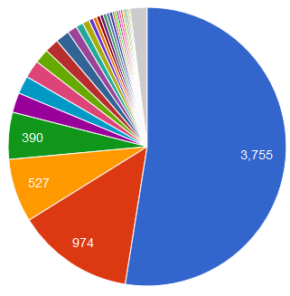
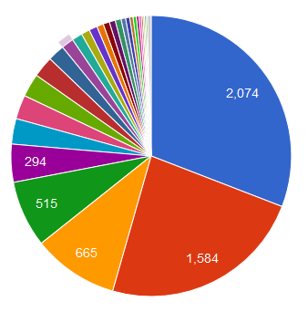
Statistics from ELIXIR AAI
ELIXIR AAI has:
1037 active users
75 Relying services
119 groups
381 eduGAIN IdPs enabled
During last month:
7195 logins
from 73 external IdPs
to 35 Relying services
https://login.elixir-czech.org/stats/

Slide 5
Use case: Sensitive human data
Relying services
Dataset access
VM
VM
VM
Dataset transfer
VM
VM
VM
Staging area
Cloud
Local EGA
Cloud
Staging area
EGA
Dataset permissions
ELIXIR AAI
Credential translation
Dataset authorisation management
Step-up AuthN
ELIXIR Directory
Group management (Perun)
Bona fide management
ELIXIR Proxy IdP
Attribute self-management
External authentication (e-infrastructures)
eduGAIN IdPs
Google

Slide 6
Towards a Life Science AAI
ELIXIR is one of the 13 ESFRI RIs for Health and Food
Many of the RIs have similar AAI needs
AAI is not a core competence for any of the RIs
Many researchers use services from multiple RIs
=> Let’s develop a Common AAI for Life Sciences
Requirements gathering done in CORBEL project
Pilot starting in the AARC2 project

