Slide 1
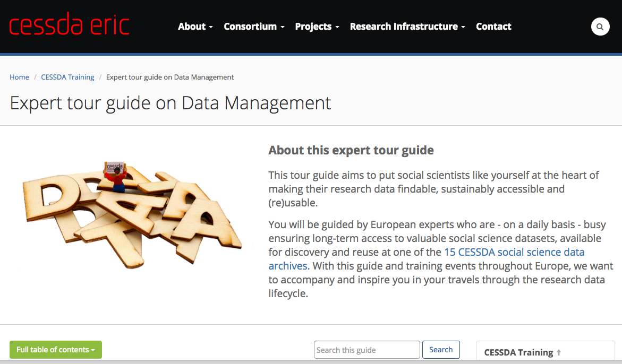
Researchers in need of RDM skills CESSDA Online expert tour guide on DM
Digital Infrastructures 4 Research, Brussels, 1 Dec 2017,
Ellen Leenarts, DANS, The Netherlands
Notes:
Researchers in need of research data management skills – The CESSDA Online expert tour guide on RDM
Many members of the Consortium of European Social Science Data Archives (CESSDA ERIC) host workshops on how to manage, store, organise, document and publish data for researchers in the social sciences. The forthcoming CESSDA online Research Data Management (RDM) expert tour guide is an online tutorial based on the archives’ experiences when engaging with researchers in their workshops. The guide is based on the research data life cycle and can be used by individual researchers as self-study but also as part of an online or face to face workshop on research data management or as part of a university offering.
When it comes to RDM, many sources of information exist, but researchers often need to comply with specific requirements, e.g. related to funders, national legislation and common practices within their particular domain. The tutorial describes the diversity that can be found in Europe with respect to the practical implementation of the research data life cycle. There is another storyline that describes what a researcher needs to do when creating and adapting a data management plan in the various stages of their research, taking into account discipline-specific context (e.g. privacy issues, data documentation). The guide also features practical examples and checklists.
The new guide will be promoted within the CESSDA ERIC, but will promote its use by universities and research institutes as well by organising train de trainer workshops and providing additional guidance materials for local trainers on various types of workshops.

Slide 2
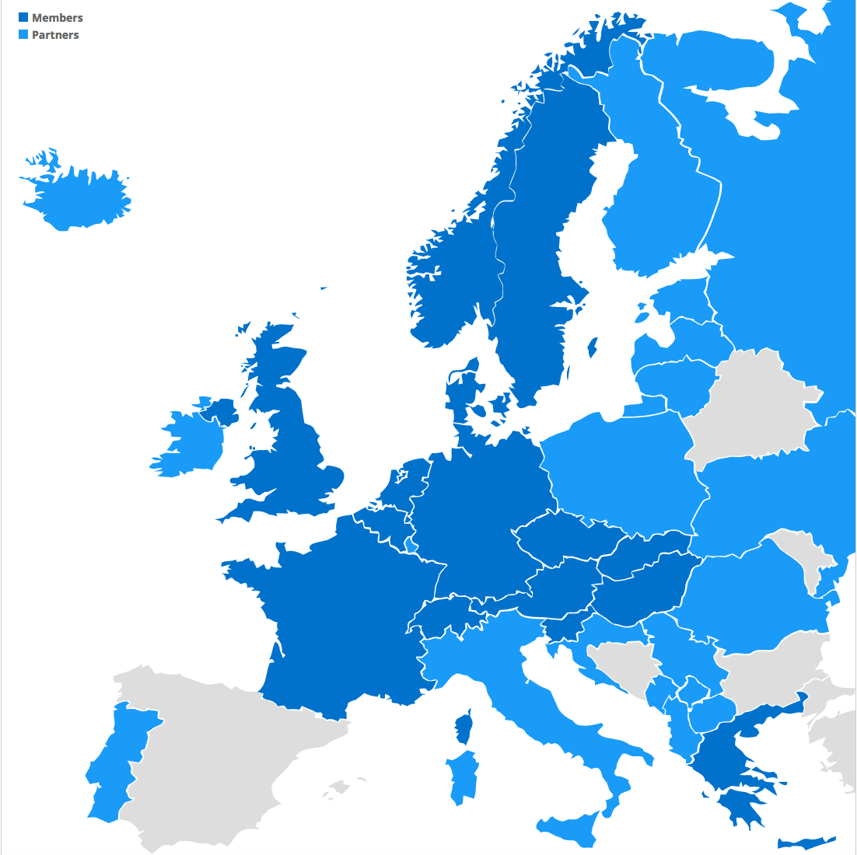
What is CESSDA?
Consortium of European Social Sciences Data Archives
Cross-European resource discovery
Improved quality of data and metadata
A wider selection of comparable data
Certification of data archiving organisations
Professional training for data archivists and scientific community
Improved mechanisms for data dissemination and analysis
Strong involvement of organisations outside Europe
CESSDA became an European Research Infrastructure Consortium (ERIC) owned by the European Ministries
15 (16) members:
Austria
Belgium
Czech Republic
Denmark
Finland
France
Germany
Greece
Netherlands
Norway
Portugal
Slovak Republic
Slovenia
Sweden
Switzerland (Observer)
UK
10 countries with activities aiming at membership:
Bulgaria
Croatia
Estonia
Hungary
Ireland
Italy
Macedonia
Romania
Serbia
Spain

Slide 3
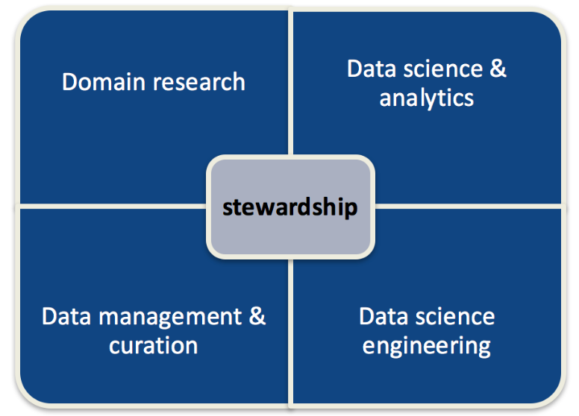
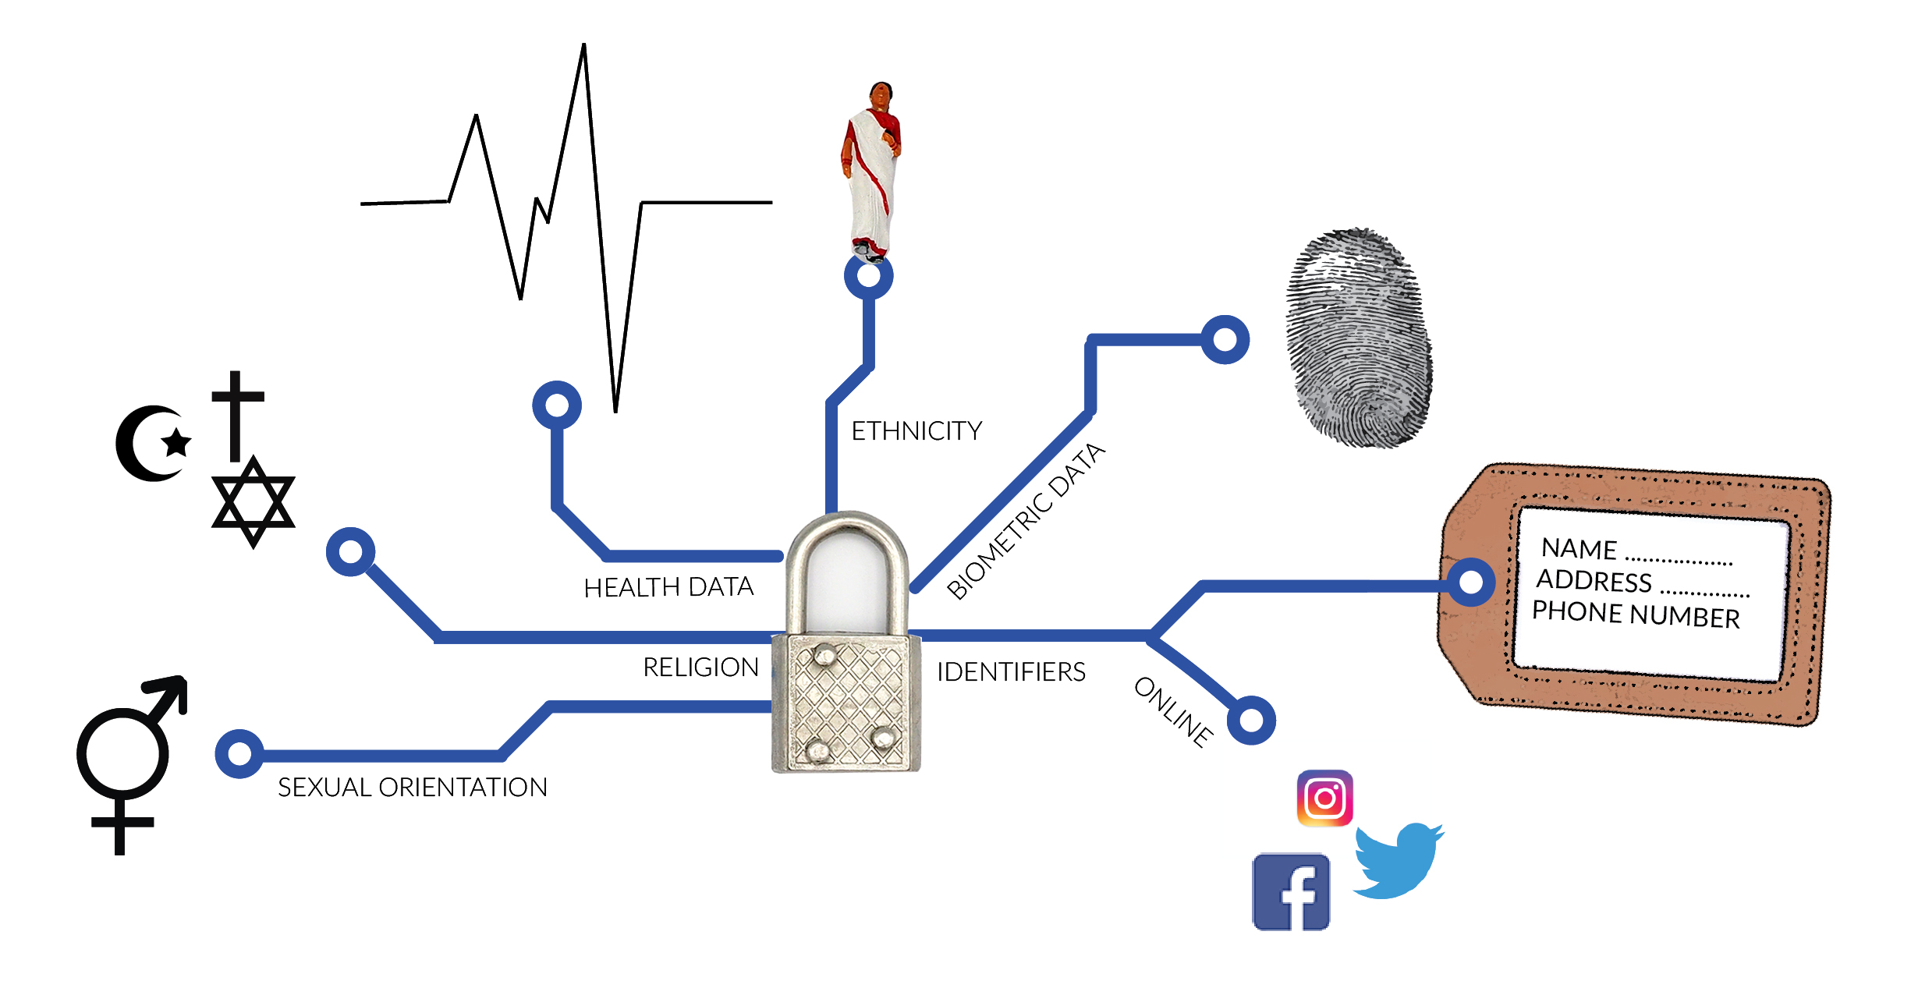
Why an online module on data management for social sciences researchers?
Many CESSDA partners organise face to face local RDM workshops for researchers and would like to combine their best practices, examples and insights
There is a need for guidance on DM: domain specific support particularly legal and privacy issues, and how to create a DMP that funders require (e.g. Horizon 2020)
Source: EOSCpilot D7.1 https://eoscpilot.eu/content/d71-skills-landscape-analysis-and-competence-model p. 41
Notes:
EOSC pilot: Data Stewardship skills areas:
Domain research skills to apply data science to research domain for innovative purposes
Data science & analytics skills: e.g. machine learning, data visualisation
Data science engineering skills to build, deploy and maintain data services; e.g. software engineering, DB management
Data mgt & curation

Slide 4
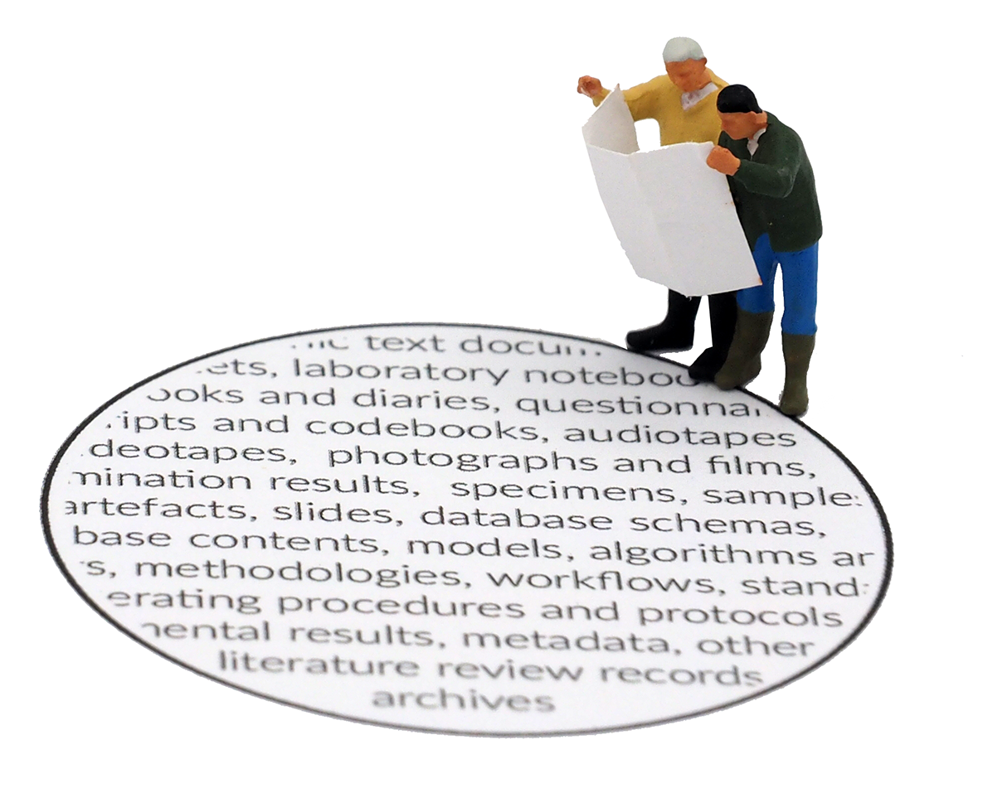
Activities engaging researchers
CESSDA Expert tour guide on DM – one year project
Kicked off in December 2016 – training managers brought in experiences from their local workshops
May 2017– Workshop content and structure – training managers and a group of researchers participated
Defining chapters, cycle, ideas on examples and product statement
October 2017 – Feedback period: researchers, DM specialists and trainers participated (30 in total)

Slide 5
Notes:
During the workshop in May the RDM group created a product statement on what the tour guide should provide and how it would distinguish from other RDM online materials such as MANTRA and Essentials4DataSupport. In this way we had a clearer idea on the target audience (early career social scientists)

Slide 6
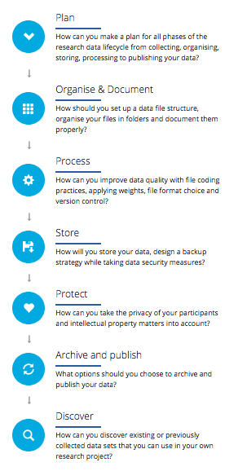
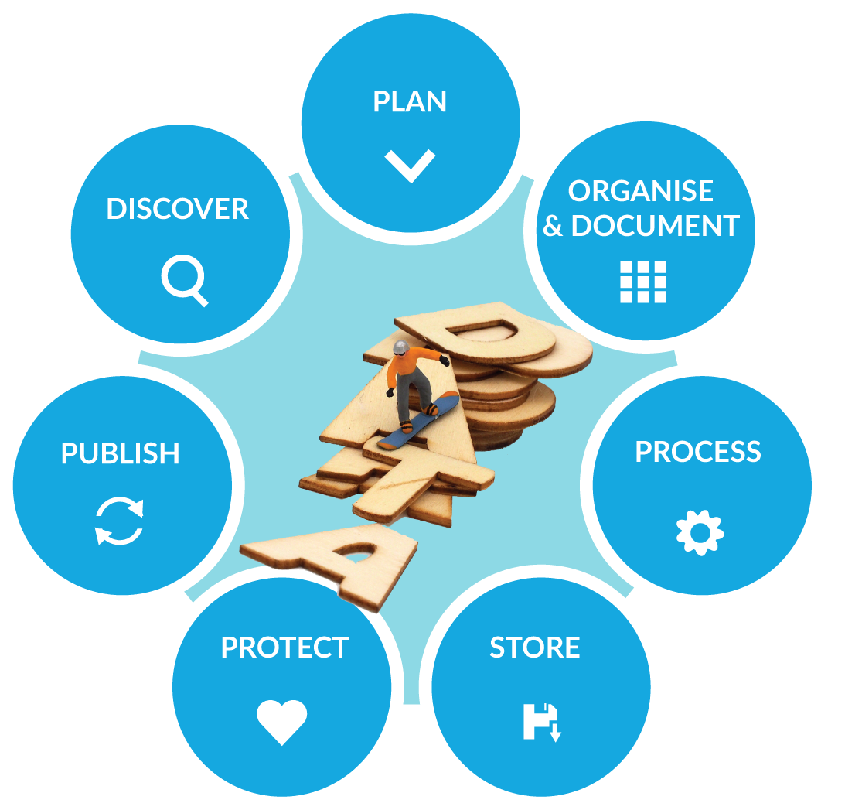
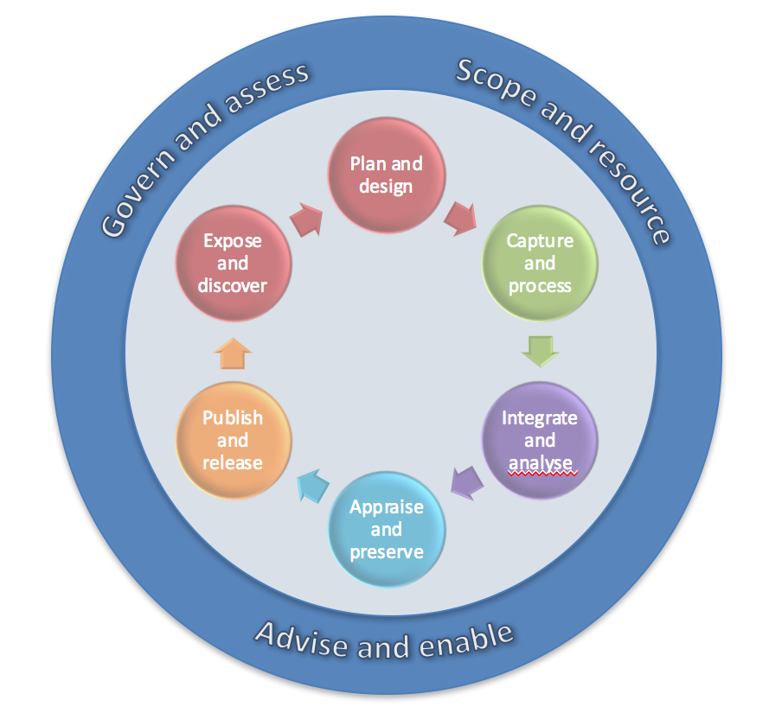
The online guide chapters are based on the research data life cycle
Source: EOSCpilot D7.1 https://eoscpilot.eu/content/d71-skills-landscape-analysis-and-competence-model p. 43
Notes:
In line with the EOSCpilot life-cycle based skills groups:
Inner ring: project-level data or software stewardship activities.
Outer ring: cross-project level.
Govern and assess: e.g. IPR management, service monitoring
Scope and resource: e.g. RDM costing, project management
Advise and enable: e.g. user support, education, consultancy

Slide 7
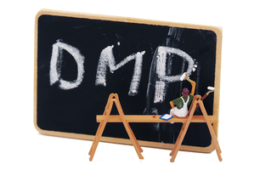
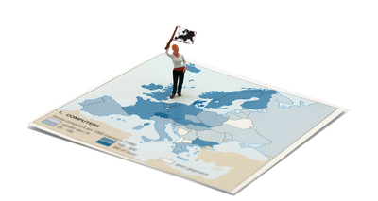
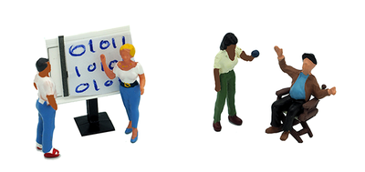
Recurring chapter sections
Adapt your DMP
Local diversity
Expert tips
Quantitative and Qualitative

Slide 8
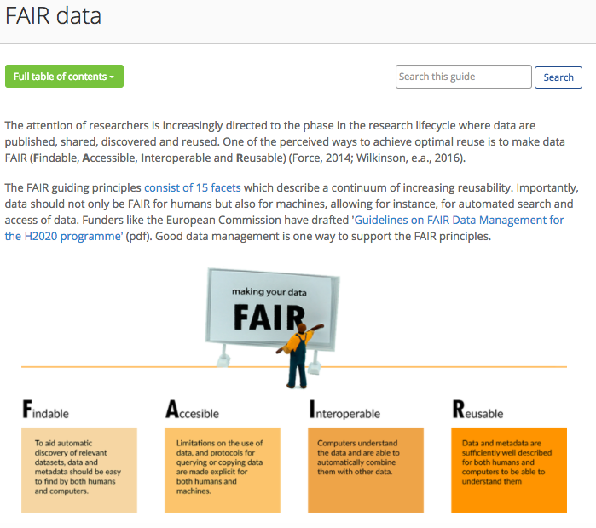
Sneak preview

Slide 9
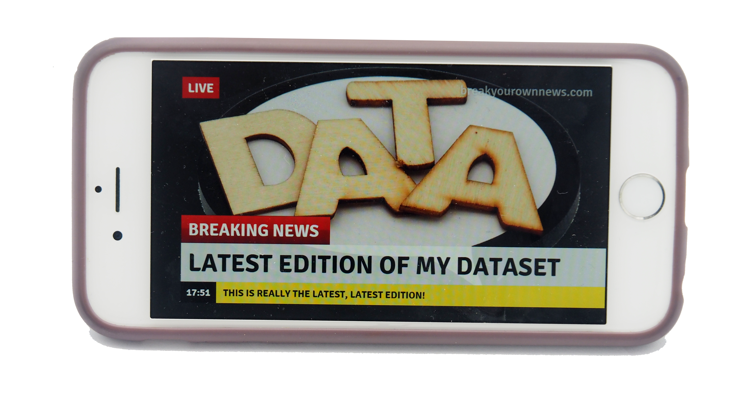
More information
Flyer (with url) available now
Training As A Service: available 15 December 2017 at www.cessda.eu/DMGuide
In 2018: Train de trainer workshop and local workshops using this online module – available for everyone
Contact for information, sneak preview, use in local workshops: Ellen.Leenarts@dans.knaw.nl, training@cessda.net
The Expert Tour Guide on Data Management has been developed for CESSDA ERIC by ADP, AUSSDA, CSDA, DANS, FORS, FSD, GESIS, NSD, SND, So.Da.Net and UK Data Service and is illustrated and edited by Verbeeldingskr8.
Notes:
CESSDA Expert tour guide is in line with the main conclusions of the EOSC pilot:
EOSC training materials and events should be FAIR
Standard metadata, open standard formats, license terms, …
Source: EOSCpilot D7.1 https://eoscpilot.eu/content/d71-skills-landscape-analysis-and-competence-model page 54-55
EOSC training materials and events should be managed like the services they describe: Training as a Service
EOSCpilot should highlight the relevance of the institutional role in enabling and rewarding data skills developments

