Slide 1
eduTEAMS
An AAI solution for collaborations at scale
Christos Kanellopoulos, GÉANT
DI4R17
30 November 2017
Brussels, Belgium

Slide 2
eduTEAMS A suite of services for using federated AAI for collaborations
Collaboration suite to enable use of federated identity in research communities
Partner for any e-Infra or Research Infra inc. “long tail”, informal groups
Components
eduTEAMS Membership Management service
eduTEAMS Identity Hub
Characteristics
Documentation, Cookbooks, Privacy Policy etc available
https://wiki.geant.org/display/ED
eduTEAMS Discovery Service
2 monthly release cycle
Supports AARC architecture
Single- and multi-tenant options
eduTEAMS Proxy

Slide 3
eduTEAMS - Pilots Engaging with communities, eInfras and NRENs
Research communities and e-Infrastructures
AARC2-as-VO (Pilot committed)
LifeScience AAI (Pilot)
Umbrella (Pilot committed)
HPC-Europe (Pilot interest)
EUDAT (Pilot committed)*
EGI *
* as part of AARC2 interoperability activity
NRENS
JISC (Pilot committed)
Moonshot Pathfinder project
SURFnet (Pilot committed)
Science Collaboration Zone project
GARR (Pilot interest)
SWITCH (Pilot interest)
SWITCH eduID
Swiss Personalised Health Network
Swiss Data Science Center
Swiss National Supercomputing Centre

Slide 4
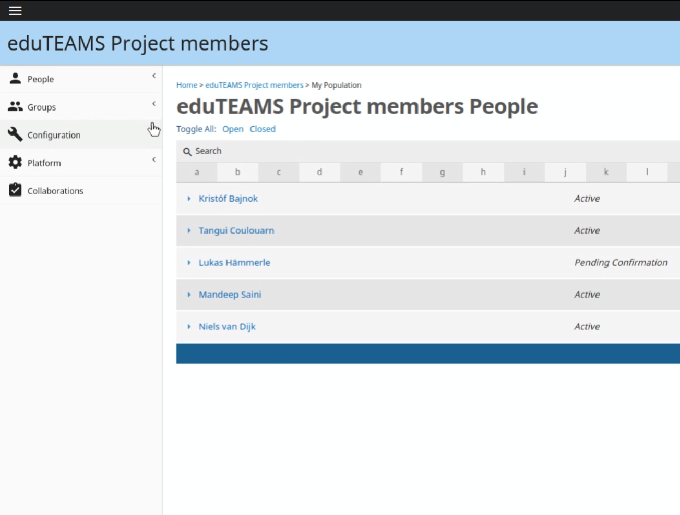
eduTEAMS Membership Management Service (MMS)
Manage Roles and Rights
Available trough eduGAIN
CoCo and R&S supported
Strong focus on privacy and GDPR
part of AARC2 interop activity
Technical and cookbooks: https://wiki.geant.org/display/ED/Membership+Management+Service
Service:
https://registry.eduTEAMS.org
NRENS
JISC (Pilot committed)
Moonshot Pathfinder project
SURFnet (Pilot committed)
Science Collaboration Zone project
GARR (Pilot interest)
SWITCH (Pilot interest)
SWITCH eduID
Swiss Personalised Health Network
Swiss Data Science Center
Swiss National Supercomputing Centre

Slide 5
eduTEAMS Membership Management Service (MMS) - ecosystem
IdP
Service Provider
COmanage
AuthN:
ID + attributes
REST AA
SAML AA
eduTEAMS
Membership
Management
eduTEAMS Identity Hub
External IdP

Slide 6
eduTEAMS Discovery Service
Component of eduTEAMS, but generically usable for eduGAIN SPs
Based on proven service from CESNET
Engaged in RA21 Pilot – Resource Access for the 21st Century (https://ra21.org)
Publishers, libraries and users
https://wiki.geant.org/display/ED/Discovery+Service

Slide 7
eduTEAMS Identity Hub
Implemented
eduTEAMS Identity Hub
Persistent ID
LOA
Account
Recovery
Future
https://wiki.geant.org/display/ED/Identity+Hub

Slide 8
eduTEAMS Proxy
eduTEAMS Identity Hub
COmanage
OIDC
SAML
LDAP AA
REST AA
eduTEAMS Proxy
eduTEAMS Discovery
SAML AA
eduTEAMS
Membership
Management
SAML
OIDC
SP
SP
SP

Slide 9
Service offerings available to pilot now.
Multi-tenant – long tail
Membership management, ID Hub, Discovery
Shared infra – every collab is a group
Free at point of use to groups (use sponsored by NRENs)
No contracts needed, no legal form required
Limitations on personal data etc.
Single tenant – complex community needs, dedicated instance
Membership management, ID Hub, Discovery, Proxy Dedicated instances on a VM
Greater control over data – contract needed.
Possibility on case by case basis to support interface with more complex systems
Lead time TBD depending on complexity of case – HEXXA/PERUN/Grouper/Other examples

Slide 10
eduTEAMS Component | Multi-tenant | Single-tenant
Membership Management Service | ✔ | ✔
Discovery | ✔ | ✔
Identity Hub | ✔ | ✔
Proxy |  | ✔

Slide 11
Thank you
Any questions?

