Slide 1
ResOps: Research DevOps across clouds
Erik van den Bergh Cloud Application architect
www.ebi.ac.uk

Slide 2
The case for a cloud course
Technical Services and Infrastructure @ EBI has developed a large body of knowledge
Researchers often ask the same questions
Even without asking, we see the same problems come up often
The core question:
How do I use the cloud effectively?

Slide 3
The people who stare at clouds

Slide 4
Creating a course: Considerations
Target audience:
Fellow (bioinformatics) researchers
Team leaders (decision makers)
Target level:
Familiar with command line environment
Basic script writing skills
Familiarity with virtual machines

Slide 5
Creating a course: Goals
Theory
Basic knowledge of cloud computing
Overview of providers, public and commercial
Explanation of cost models
Advantages and disadvantages vs. cluster
Running compute in the cloud
Overview of provisioners (Terraform)
Overview of configuration managers (Ansible, Puppet)
Practicals

Slide 6
Recruiting
Dissemination across relevant internal mailing lists
Response was overwhelming
Over 50 applications
Expectation was max 20
Further recruitment through word-of-mouth after the first iteration

Slide 7
Execution

Slide 8
ResOps course: implementation & iteration

Slide 9
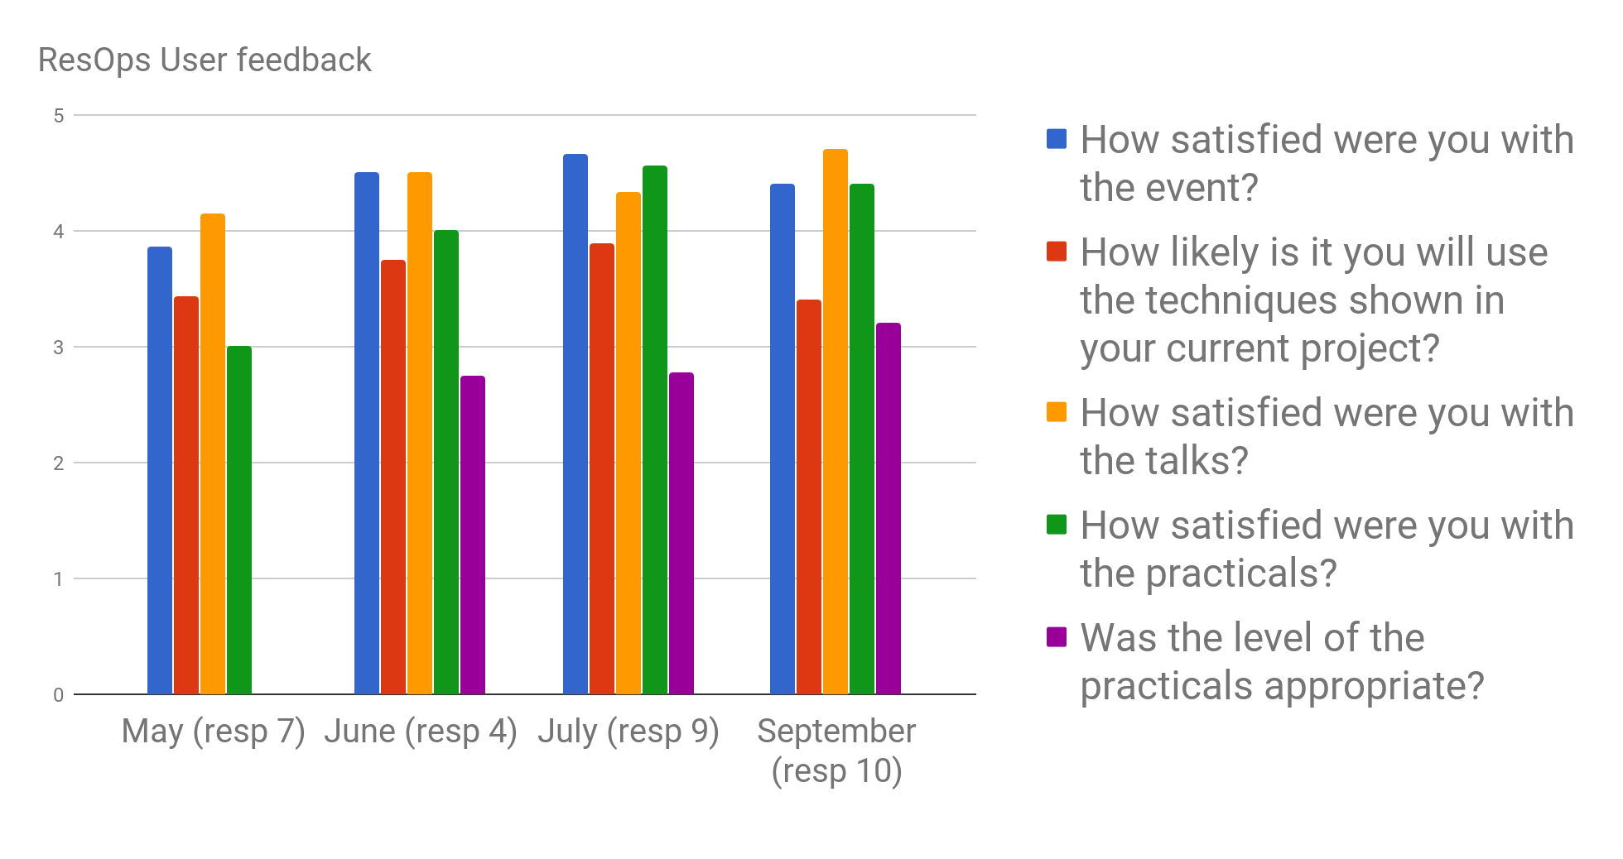
Feedback

Slide 10
Lessons learned
Test run your practicals!
...twice
Research audience is interested, but have little time to invest in new techniques
Evaluate and Iterate
Researcher backgrounds are heterogeneous
Especially with programming skills
Hard to cater to everyone
Perhaps a course split is in order

Slide 11
Future and Outlook
More courses lined up in January
Breakdown of components
Webinars
MOOC
Formalization of materials for standalone dissemination
As a published guide
As online tutorials
Happy to learn about options….

Slide 12
Acknowledgements
Dario Vianello
Pau Ruiz Safont
Amelie Cornelis
Gianni Della Torre
Ania Niewielska
Navis Mary Raj
Jose Dianes
Steven Newhouse
EMBL-EBI
TSI

Slide 13
Thank you!
Questions?

