Slide 1
Metrics for Open Access Digital Monographs
The HIRMEOS Project
Javier Arias, Open Book Publishers
DI4R 2017 Brussels – 01/12/2017
The project HIRMEOS has received funding from European Union’s Horizon 2020 research and innovation programme under grant agreement 731102
Notes:
1

Slide 2
HIRMEOS WP6: Metrics Services
Altmetrics and Citations Service
OAMetrics Service
Metrics API
Metrics Widget
2

Slide 3
OAMetrics Intricacies
Identification: what is a monograph?
Localisation: where are monographs hosted?
Usage: how should we measure it?
3

Slide 4
OAMetrics Intricacies: Identification
Most IDs do not identify a book (e.g. ISBN)
Digital Object Identifier (DOI)
Chapter DOIs are linked to book DOI
Any digital object, not just monographs (chapters, pictures, videos, etc.)
4

Slide 5
OAMetrics Intricacies: Localisation
Multiple repositories hosting the same book
We want metrics for a book, not a URL
5

Slide 6
OAMetrics Intricacies: Usage
OAMetrics Open Standard:
Book ID (DOI)
Country
Timestamp
Measure
Platform (e.g. Google Books, Open Edition, OBP PDF Reader)
Type (e.g. Session, Download, Page View)
Namespace (e.g. readership.operas.eu)
6

Slide 7
Statistics Collection Agent
Drivers
Run locally, within the publisher/platform environment
Independent, optional, modules – one per platform
Collect metrics from its platform and submits it to the metrics database via Reader Analytics API
They may be use by:
Publishers: to submit data from a third party platform
Platforms: to submit their own data
Drivers provided: Google Analytics, Google Books, Open Edition, OAPEN, Wikimedia, Unglue.it, The Classics Library, World Reader
Use the Translation Service for identifier resolution
7

Slide 8
Statistics Collection Agent
Identifier Translation Service:
Runs locally, within the publisher/platform environment
Translates book identifiers to DOIs
Uses a database with book metadata from:
Publisher
CrossRef (prior DOI submission by publisher required)
Web based client will be provided
API allows integration with existing system (e.g. OMP)
8

Slide 9
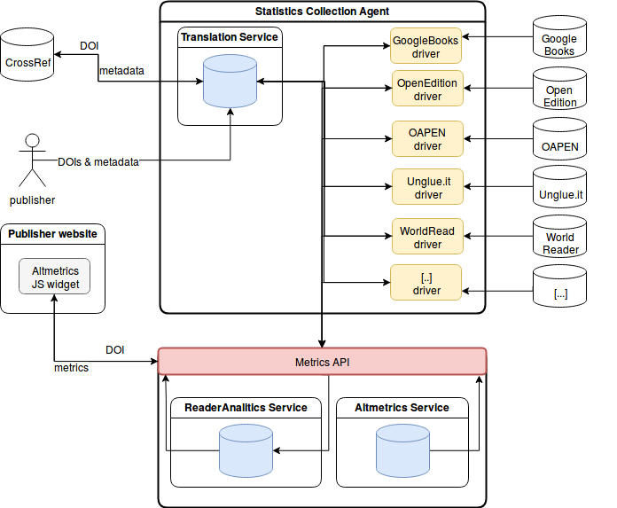
9

Slide 10
Thank you for your attention.
10

