Slide 1


GÉANT Services Roadmap
for EuroHPC
EDI - EuroHPC
Erik Huizer, GÉANT, Nov 2017
www.geant.org

Slide 2
Agenda
GÉANT Network evolution Overview
GÉANT Services evolution Overview
  eduGAIN
  Cloud Procurement
  GÉANT Testbed Service
What does it mean for EuroHPC?

Slide 3
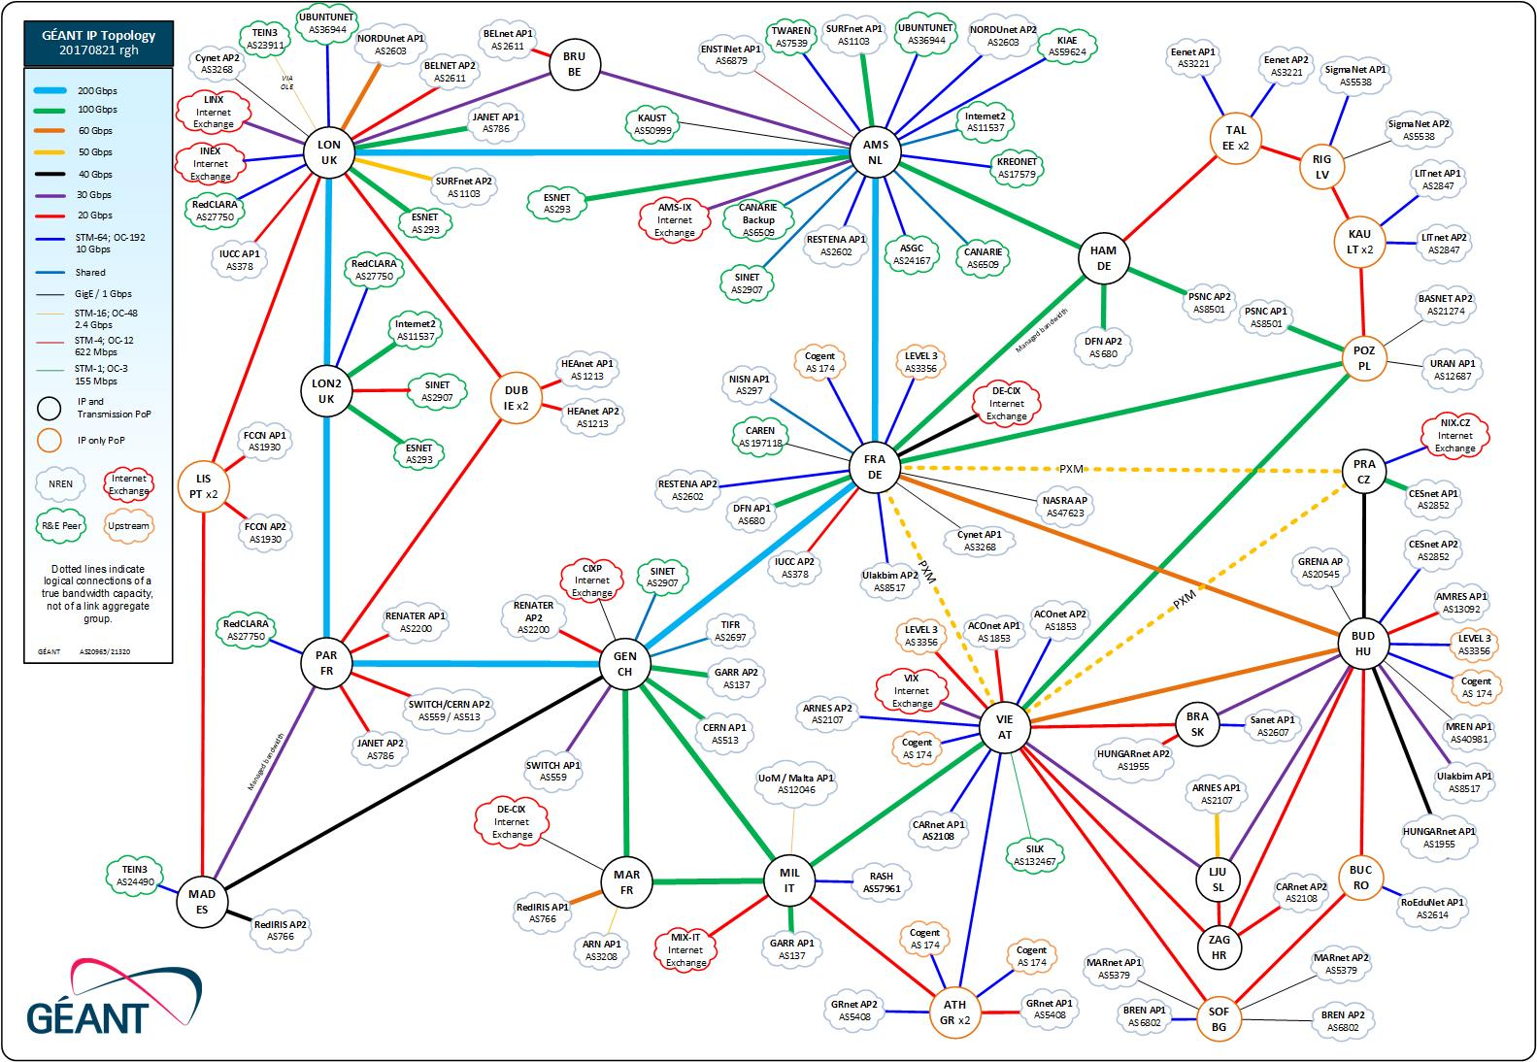
GÉANT Network – IP/MPLS Backbone
Global R&E IP – connects the NRENs and other regional R&E networks
LHCONE – connects NRENs and other regional networks for LHC related
data exchange
IAS – connects NREN
to ISP and CDN
networks
Over 500 Gbps
peak traffic

Slide 4
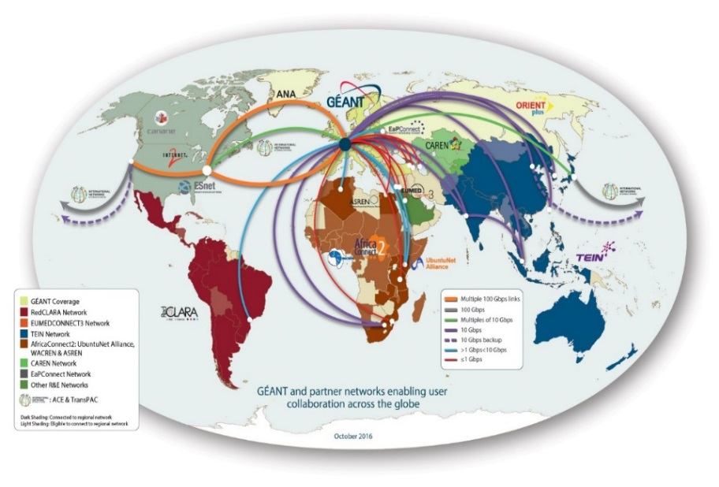
GÉANT Network – International Connectivity
Data transfer tests in Q1 2017 between 10G servers in GÉANT and AARNET achieved 9.73Gbps over 48h over R&E networks, whereas over commercial links this was only 1.77Gbps.
The GÉANT network connects at high speed directly to most of the world regions.
Worldwide connectivity achieved through partners R&E networks where direct links are not present.

Slide 5

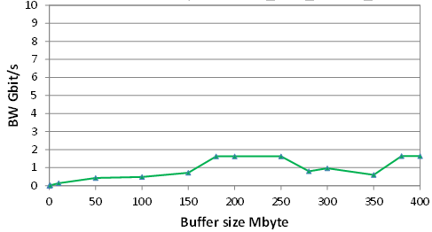
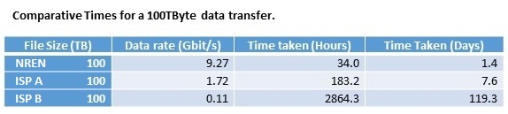
GÉANT Network – Optimised for research data transfers
Public Internet
GEANT and R&E partners
Geneva to Canberra
Geneva to Canberra GEANT + R&E networks US to Australia
R&E networks are designed for different goals than Internet
Geneva to Canberra

Slide 6
GÉANT Network – Challenges
Over 60% year on year growth on IP MPLS means 140 times in 10 years
In Q2 2017 GÉANT received about 4.6 Petabytes of traffic per day, that is 4.6 millions of Gigabytes.
Between 2015 and 2016 the IP/MPLS traffic on the GÉANT network grew by 64%. This has reduced to~50% in the last 4 quarters.
LHC and the high energy physics community has been one of the major drivers for growth.

Slide 7
Exascale requires more than a network of dumb pipes
It requires a set of smart end to end services across all the high performance infrastructures

Slide 8

Disaggregation
Service Management
User Services
Network Services
C&M Plane
Control & Management Plane
C&M Plane
Edge
Edge
Packet Core
Open Line system
Packet Core
Mux sponder
Mux sponder
Networks built from multiple specialised elements and vendors

Slide 9
GÉANT Next Gen Network
Networks will be intelligent and programmable; users can control and influence their behaviour
We can develop smarter end to end services between HPC and the network
GEANT, PRACE and our users need to work together, using these new capabilities to deliver Exascale

Slide 10
GÉANT Highlights - Services
In green: changes compared to March 2016
eduGAIN
  48 (+10) participating federations and 6 voting only members – up from 38 in 2016.
  9 candidates, 12 pilot federations (69 (+8) known federations).
eduroam
  89 (+13)territories are Roaming Operators.
  26 (+5) active pilots.
TCS
  30 (+1) NRENs are customers of the service.
  56842 (+25000) certificates issued in 2016.
  52317 certificates issued in 2017 to date.
Trusted Introducer
  321 (+55) listed, accredited and certified CSIRT teams in Trusted Introducer.
  In 2016, Trusted Introducer welcomed 34 new listed teams, 20 new accredited teams and 5 new certified teams.
  In 2017 so far we have welcomed 22 new listed teams and 9 new accredited teams.

Slide 11


Global Authentication Infrastructure…
edugain@geant.org

Slide 12
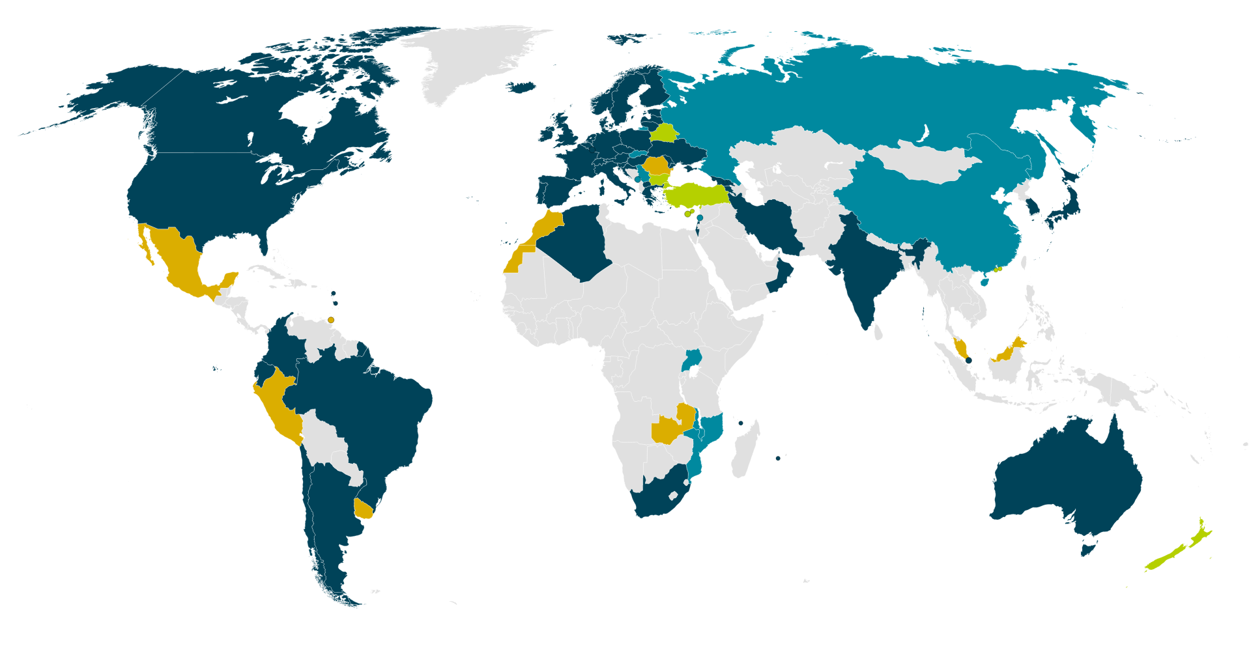
eduGAIN Membership
November 2017
48 eduGAIN Participants
6 eduGAIN Members
10 Candidate Federations
8 Known Federations
Notes:
Newest members are Hong Kong/Macau, Singapore, Iran, Cyprus, Algeria, South Africa, Korea.

Slide 13
Federations in eduGAIN
Members | 48
Voting-only Members | 6
Candidates | 10
Entities in eduGAIN
All | 4330
IdPs | 2573
SPs | 1762
eduGAIN Membership
November 2017
48 eduGAIN Participants
6 eduGAIN Members
10 Candidate Federations
8 Known Federations
Notes:
6 voting only members don’t contribute any services (SPs) or institutions (IdPs) to eduGAIN.

Slide 14
eduGAIN Roadmap
Adding security options
SIRTFI, GDPR etc
eduTEAMS
Identity as a service for Research collaborations
InAcademia
Privacy sensitive service to commercial service providers

Slide 15
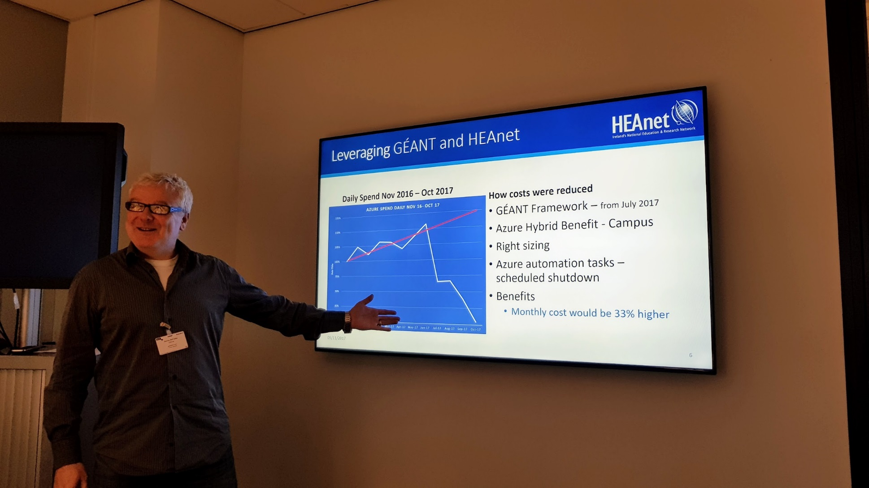
GÉANT IAAS Procurement

Slide 16
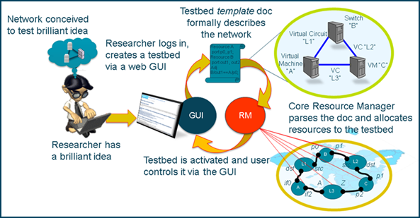
GÉANT Testbed Service (GTS)
Automatic provisioning of virtual infrastructures
Objective
  Create your own virtual infrastructure with GTS
  Use for network innovation and admin/operational testing
  Run European-wide and global experiments
  Choose your own topology and infrastructure resources
  Fully automated provisioning – set up within minutes
  No simulation – test in your own virtual environment over real hardware
Select
  Virtual machines
  Virtual circuits
  OpenFlow switches
  Bare Metal Servers
to build powerful and complex
infrastructures
16

Slide 17
This is how you can help us build better services in four easy steps
The more demanding you are the better we will be and become
Think of what services you need
Continue the collaboration
Send us or your NREN your thoughts
STEP 1
Be more demanding of your network operator / NREN
STEP 2
Think seriously about how R&E networks could help you do your job better
STEP 3
Engage with us to define the future GEANT network & services
STEP 4
Work together towards Exascale
Meet regularly with your NREN
We have an
opportunity
to build better network & services lets not miss that

Slide 18

Thank you
Erik.Huizer [at] GEANT.org
www.geant.org
© GEANT Limited on behalf of the GN4 Phase 2 project (GN4-2).
The research leading to these results has received funding from the European Union’s Horizon 2020 research and innovation programme under Grant Agreement No. 731122 (GN4-2).

