Slide 1
EUDAT training workflow DI4R 2017, 30 November 2017
Marjan Grootveld
DANS
marjan.grootveld@dans.knaw.nl
Visit us at Poster 9!
EUDAT Training Team

Slide 2
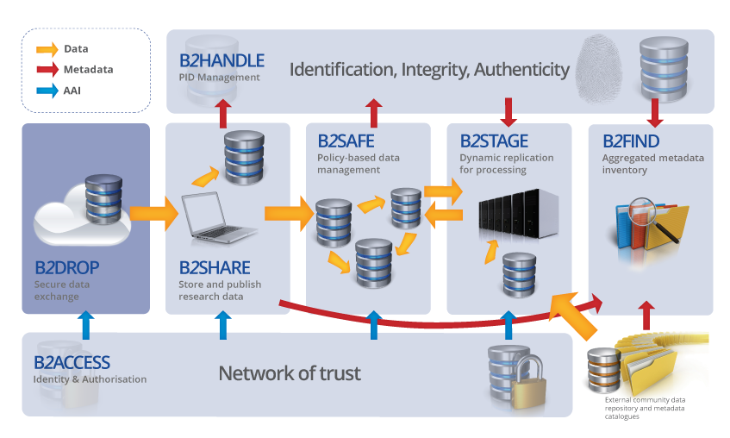
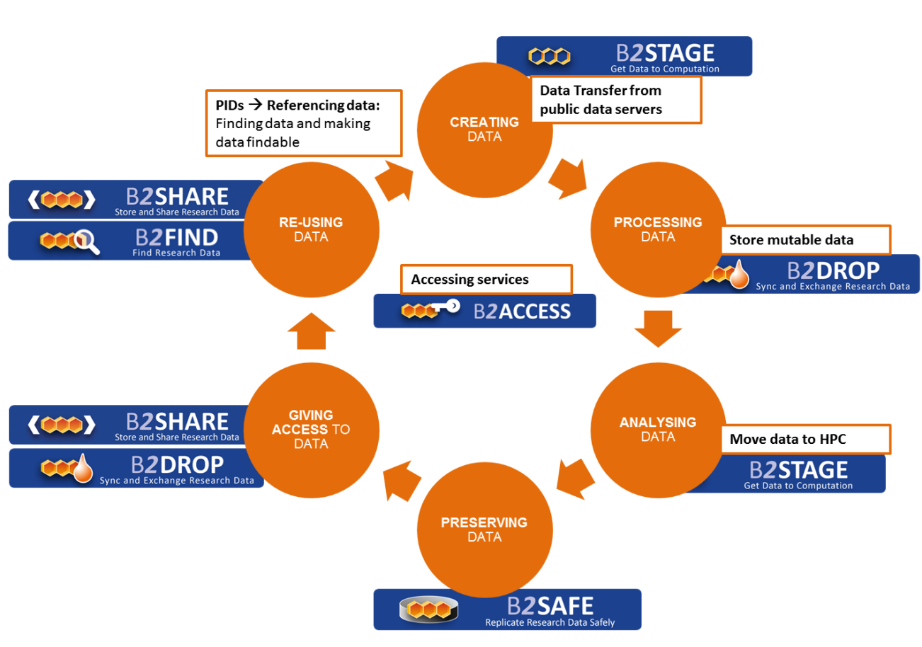
Our training content creation workflow
service development > user documentation > training > happy customers
Notes:
A coherent service suite as well as a portfolio that supports all stages of the data life cycle

Slide 3
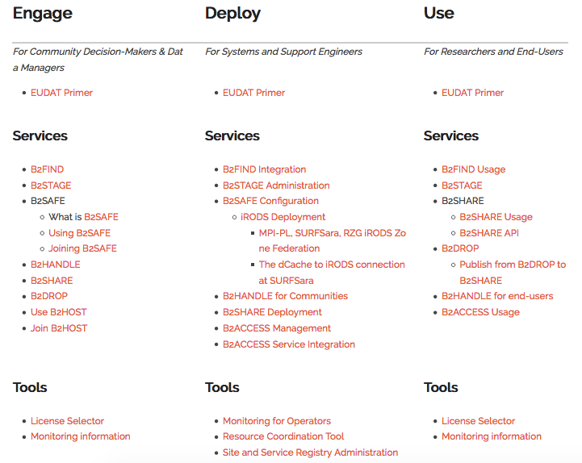
Our training content creation workflow
service development > user documentation > training > happy customers

Slide 4
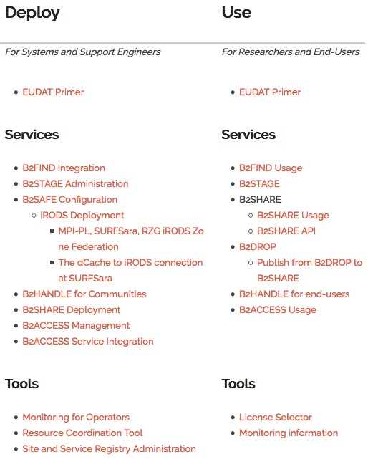
Our training content creation workflow
service development > user documentation > training > happy customers
Engage: community decision makers & data managers
Deploy: system and support engineers
Use: researchers and end-users
Face-to-face community events: ICOS, EGI forum, PRACE spring school…
Face-to-face conferences: RDA, Open Science Conference…
Face-to-face EUDAT events: EUDAT user forum, EUDAT summer school…
Webinars: on RDM, trust and services, also in collaboration with OpenAIRE
Audiences:
Researchers
Communities
Service providers/ infras
Various content types:
Annotated slides
Workflows on GitHub
Webinar recordings
And all publicly available

Slide 5
Our training content creation workflow
service development > user documentation > training > happy customers
Engage: community decision makers & data managers
Deploy: system and support engineers
Use: researchers and end-users
Events:
Face-to-face, community events e.g. ICOS, EGI forum, PRACE spring school
Face-to-face, conferences e.g. RDA, Open Science Conference
Face-to-face, EUDAT events e.g. EUDAT user forum and EUDAT summer school
Webinars, also in collaboration with OpenAIRE
Audiences:
Researchers
Communities
Service providers/ infras
Various content types:
Annotated slides
Workflows on GitHub
Webinar recordings
And all publicly available!
“I would like to thank all the trainers for their outstanding presentations and useful insights.”
EUDAT summer school student

Slide 6
Example: EUDAT summer school 2017
How to scale up for EOSC?
How to integrate training in the EUDAT CDI?
Business model for training?
Training as a Service?
Trainer Community of Practice?
To be continued at the EUDAT Conference 2018!

Slide 7
Let’s continue at
Join our “User engagement & training” session January 24th in Porto
Marjan Grootveld, DANS
Sara Garavelli, Trust-IT
Kostas Kavoussanakis, EPCC
Caterina Piagentini, Trust-IT
Christine Staiger, SURFsara
and EUDAT Training Team

